Slide 1
BDD with SlimJs
Presented
By
Ravichandran J V

Slide 2
BDD + TDD + UADD
BDD
TDD
UADD
User stories
Scenario Tests
Code
Unit Tests
UAC
Scenarios
Scenario Tests
UI
Functional
Code
Additional Scenarios
Defects
Refactor
Slim
fitnesse
Mocha
NodeJs
Slim
fitnesse
Tools

Slide 3
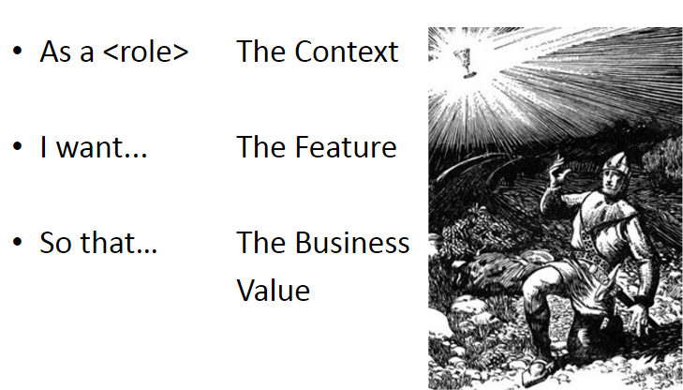
Given, when, then … the holy grail

Slide 4
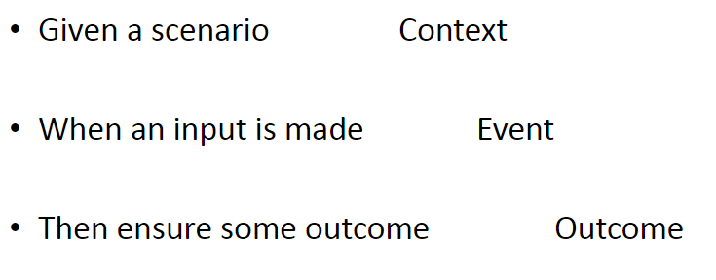
Given, when, then … the holy grail

Slide 5
Given, when, then … in action!
Requirement
User types some English sentence that must comply to a supplied drill line of text.
If user misses or adds any additional words from the drill text, then the words must be highlighted as errors for the user to correct.

Slide 6
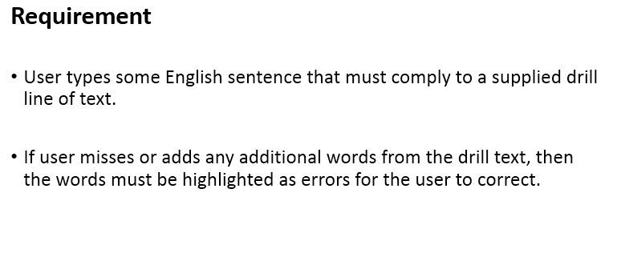
Given, when, then … in action!
Given
when
then

Slide 7
Identify Scenarios (Behavior)
Scenario 1 – if user misses words
Scenario 2 – if user adds words

Slide 8
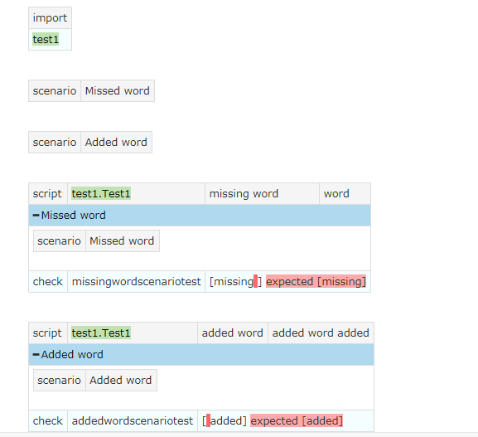
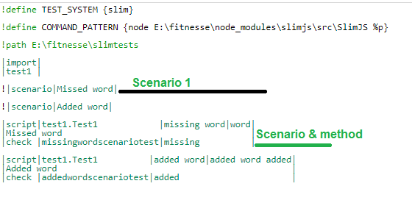
Scenario testing

Slide 9
Scenario testing
Remember, this is the first stage of development. The business rules and requirements are just in.
The code contains just that much logic to run the Scenario test.
The code will emerge once the next phase in the development lifecycle – TDD – begins.

Slide 10
Scenario testing
// Test
var app=require('./twoscenarios.js');
var assert=require('assert');
describe('#get missing word', function() {
it('should return missing word',function(){
var ob=new app.twoscenarios("missing word","word");
assert.equal("missing",ob.missingwordscenariotest());
});
});
describe('#get added word', function() {
it('should return added word',function(){
var ob=new app.twoscenarios("word","word added");
assert.equal("added",ob.addedwordscenariotest());
});
});
// Code – twoscenarios.js
function myApi(){};
myApi.prototype = {
twoscenarios:function(drill,user){
this.missingwordscenariotest=function(){
return "missing";
};
this.addedwordscenariotest=function(){
return "added";
};
}
}
module.exports=new myApi();

Slide 11
Thank you!

