Slide 1
TDD with Mocha
Presented
By
Ravichandran J V

Slide 2
BDD + TFD + UADD
BDD
TFD
UADD
User stories
Scenario Tests
Code
Unit Tests
UAC
Scenarios
Scenario Tests
UI
Functional
Code
Additional Scenarios
Defects
Refactor
Slim
fitnesse
Mocha
NodeJs
Slim
fitnesse
Tools

Slide 3
Given, when, then … in action!
Requirement
User types some English sentence that must comply to a supplied drill line of text.
If user misses or adds any additional words from the drill text, then the words must be highlighted as errors for the user to correct.

Slide 4
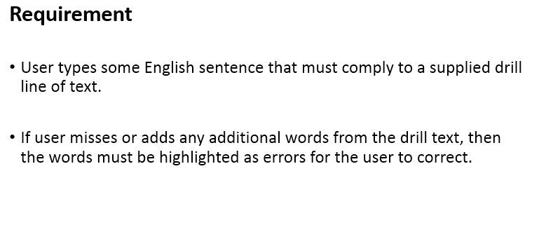
Given, when, then … in action!
Given
when
then

Slide 5
Identify Scenarios (Behavior)
Scenario 1 – if user misses words
Scenario 2 – if user adds words

Slide 6
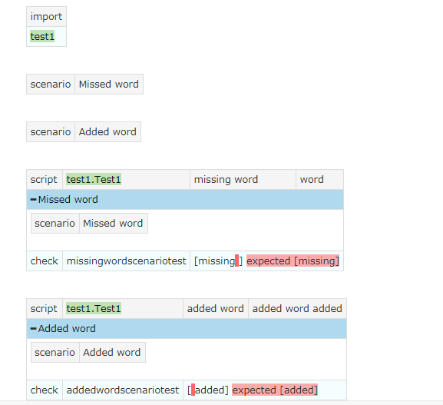
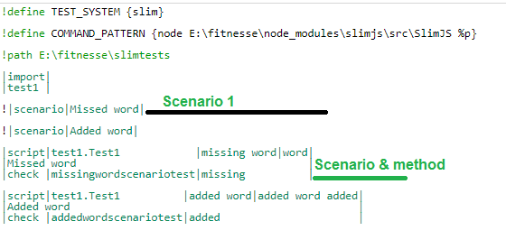
Scenario testing

Slide 7
Scenarios to Unit Tests
The need for scenario tests becomes clear when we derive unit tests out of the scenario tests.
Scenario tests enable an additional level of granularity to the unit tests apart from increasing traceability of business requirements/rules to implementation and back.
In the scenarios analyzed in the previous step, BDD, the space before or after the missing word and the added word would not have been apparent if we had simply done a unit test!

Slide 8
Test Driven Development
Test Driven Development (TDD) is done using unit testing
A Unit test isolates and verifies individual units of source code
A Unit Test is written first and if no code exists to satisfy the test, the unit test fails, always, in TDD
A Unit Test drives development thus enabling design to evolve through satisfying the unit tests

Slide 9
Mocha – Unit test
Scenario – get missing word
describe('#get missing word', function() {
it('should return missing word',function(){
assert.equal(missingwordscenario(),"missing ");
});
});
No code yet, so the test fails!
Add just the code to make the pass ie., add the method to run the assertion.

Slide 10
Mocha – Unit test
// twoscenarios.js
var jsDiff = require("diff");
function myApi(){};
myApi.prototype = {
twoScenarios : function(drill,user){
var str="";
var diff = jsDiff.diffWords(drill, user);
this.missingwordscenario=function(){
diff.forEach(function(part){
if(part.removed){
str+=part.value;
}
});
return str;
};
// test/Missingaddedwordtests.js
var app=require(‘.src/twoscenarios.js');
var assert=require('assert');
describe('#get missing word', function() {
it('should return missing word',function(){
var ob=new app.twoScenarios("missing word","word");
assert.equal(ob.missingwordscenario(),"missing ");
});
});

Slide 11
Mocha – Unit test
Scenario – get added word
describe('#get added word', function() {
it('should return added word',function(){
assert.equal(addedwordscenario(),"added");
});
});
No code yet, so the test fails!
Add just the code to make the pass ie., add the method to run the assertion.

Slide 12
Mocha – Unit test
var diff1 = jsDiff.diffWords(drill, user);
this.addedwordscenario=function(){
str="";
diff1.forEach(function(part){
if(part.added){
str+=part.value;
}
});
return str;
};
}
}
module.exports=new myApi();
// test/Missingaddedwordtests.js
describe('#get added word', function() {
it('should return added word',function(){
var ob=new app. twoScenarios("word","word added"); assert.equal("added",ob.addedwordscenariotest()); });
});

Slide 13
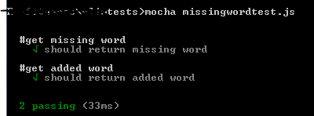
Run the Tests
Run the tests

Slide 14
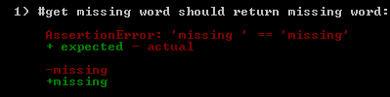
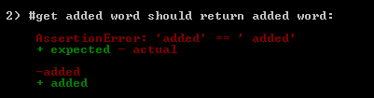
Check this
There is no space after “missing” and before “added” so the two tests fail:

Slide 15
Best practices
One assertion per test
Refactor after test passes and run test again
Add code only if the test result indicates the need
Don’t add domain code in the test file. To ensure this practice, keep test files in ‘test’ folder and .js files in ‘src’ folder.
Local variables like “str”, “diff”, “diff1” in this code need not be refactored!

Slide 16
TDD – Test, Code, Test Passes, Refactor Cycle
Test
Write Code to make test pass
Refactor
Run test again
Test passes

Slide 17
Thank you!

