Slide 1

Microsoft .NET

Slide 3














Your platform for building anything
WEB
CLOUD
IoT
.NET

Slide 4
Version | Release date | Released with | Latest update | Latest update date | Support ends^{[25]} | Support Lifetime
.NET Core 1.0 | June 27, 2016^{[26]} | Visual Studio 2015 Update 3 | 1.0.16 | May 14, 2019 | June 27, 2019 | 3 years
.NET Core 1.1 | November 16, 2016^{[27]} | Visual Studio 2017 Version 15.0 | 1.1.13 | May 14, 2019 | June 27, 2019 | 2.5 years
.NET Core 2.0 | August 14, 2017^{[16]} | Visual Studio 2017 Version 15.3 | 2.0.9 | July 10, 2018 | October 1, 2018 | 1.25 years
.NET Core 2.1 | May 30, 2018^{[17]} | Visual Studio 2017 Version 15.7 | 2.1.30 (LTS) | August 19, 2021 | August 21, 2021 | 3.25 years
.NET Core 2.2 | December 4, 2018^{[18]} | Visual Studio 2019 Version 16.0 | 2.2.8 | November 19, 2019 | December 23, 2019 | 0.9 years
.NET Core 3.0 | September 23, 2019^{[28]} | Visual Studio 2019 Version 16.3 | 3.0.3 | February 18, 2020 | March 3, 2020 | 0.5 years
.NET Core 3.1 | December 3, 2019^{[29]} | Visual Studio 2019 Version 16.4 | 3.1.32 (LTS) | December 13, 2022 | December 13, 2022 | 3 years
.NET 5 | November 10, 2020^{[30]} | Visual Studio 2019 Version 16.8 | 5.0.17 | May 10, 2022 | May 10, 2022 | 1.5 years
.NET 6 | November 8, 2021^{[22]} | Visual Studio 2022 Version 17.0 | 6.0.31 (LTS) | May 28, 2024 | November 12, 2024 | 3 years
.NET 7 | November 8, 2022^{[23]} | Visual Studio 2022 Version 17.4 | 7.0.19 | May 14, 2024 | May 14, 2024 | 1.5 years
.NET 8 | November 14, 2023^{[24]} | Visual Studio 2022 Version 17.8 | 8.0.6 (LTS) | May 28, 2024 | November 10, 2026 | 3 years
.NET 9 | November 2024 (projected) |  | 9.0.0-preview.4 | May 21, 2024 | May 2026 (projected) | 1.5 years (projected)
.NET 10 | November 2025 (projected) |  | (will be LTS) |  | November 2028 (projected) | 3 years (projected)
Legend: Old version Older version, still maintained Latest version Latest preview version Future release

Slide 5
Versions of .NET Framework available for download
Version | Release date | End of support
.NET Framework 4.8.1 | August 9, 2022
.NET Framework 4.8 | April 18, 2019
.NET Framework 4.7.2 | April 30, 2018
.NET Framework 4.7.1 | October 17, 2017
.NET Framework 4.7 | April 5, 2017
.NET Framework 4.6.2 | August 2, 2016
.NET Framework 3.5 SP1 | November 18, 2008 | January 9, 2029
Version | Release date | End of support
.NET Framework 4.6.1 | November 30, 2015 | April 26, 2022
.NET Framework 4.6 | July 20, 2015 | April 26, 2022
.NET Framework 4.5.2 | May 5, 2014 | April 26, 2022
.NET Framework 4.5.1 | October 17, 2013 | January 12, 2016
.NET Framework 4.5 | August 15, 2012 | January 12, 2016
.NET Framework 4.0 | April 12, 2010 | January 12, 2016

Slide 6
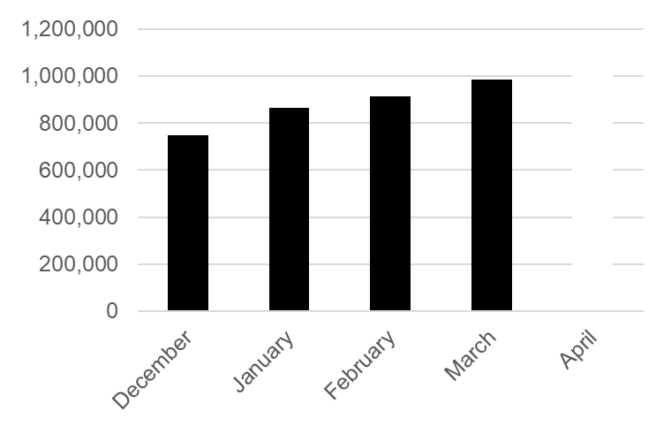
.NET Growth continues
>1 million .NET Core developers
Visual Studio, Visual Studio for Mac, Visual Studio Code
Visual Studio
+1 million new monthly active .NET developers in last year

Slide 7
Introduction to .NET Framework

Slide 8
.NET – What Is It?
Software platform
Language neutral
In other words:
  .NET is not a language (Runtime and a library for writing and executing written programs in any compliant language)

Slide 9
What Is .NET
.Net is a new framework for developing web-based and windows-based applications within the Microsoft environment.
The framework offers a fundamental shift in Microsoft strategy: it moves application development from client-centric to server-centric.

Slide 10
What is .NET?
Microsoft® .NET is a set of Microsoft software technologies for connecting information, people, systems, and devices
It is a device and platform independent distributed computing model based on Web Services (which are in turn based on open XML communication technology), and consists of
  a software platform for building .NET experiences
  a programming model and tools to build and integrate XML Web services
  a set of programmable XML Web services
  a way to enable users to interact with a broad range of smart devices via the Web, while ensuring that the user, rather than the application, controls the interaction
  a way to provide a user with applications, services, and devices that are personalized, simple, consistent, and secure
.NET is all about creation, consumption and delivery of Web Services
Notes:
.NET incorporates a software platform for building the .NET experiences, which means servers running databases, Web servers, and other systems. This isn't that different from the way we run our enterprises today; the differences are in the capabilities of these products. Today we have messaging systems like Exchange and databases like SQL Server, and these will be fundamental components of .NET. But products like BizTalk Server for orchestrating information through the enterprise, Application Center for managing these servers running .NET, and Mobile Information Server for providing the services for the mobile users, also will be part of .NET.
The .NET product will include a programming model with tools. This will allow developers to create the Web services that .NET is based on. The model is the .NET Framework, which will be described later on in this document.
The final component of .NET is the end result of the programming model, tools, and platform. Web services provide the services and information users will require of Phase 3 of the Internet. Because these Web services are programmable, they allow a user to use any device to access this information and to share this information with other sites and services.

Slide 11
.NET – What Is It?
.NET Application
.NET Framework
Operating System + Hardware

Slide 12
Framework, Languages, And Tools
VB
VC++
VC#
JScript
…
Visual Studio.NET
Common Language Specification
ASP.NET: Web Services
and Web Forms
Windows
Forms
ADO.NET: Data and XML
Base Class Library
Common Language Runtime
Notes:
The .NET framework exposes numerous classes to the developer. These classes allow the development of rich client applications and Web based applications alike. In the above slide these classes have been divided into 4 areas.
ASP.NET provides the core Web infrastructure such as Web Forms for UI based development and Web Services for programmatic interface development,
User interface development on the Windows platform can be done using Windows Forms
ADO.NET and XML provide the functionality for data access.
Finally, the core base classes provide infrastructure services such as security, transaction management etc.

Slide 13
The .NET Framework
.NET Framework Services
Common Language Runtime
Windows® Forms
ASP.NET
  Web Forms
  Web Services
ADO.NET, evolution of ADO
Visual Studio.NET
Notes:
Common Language Runtime
Common, secure execution environment.
We’ll drill into this in some detail in the first parts of the presentation.
Windows® forms
Framework for building rich clients
A demonstration will highlight some of these features, such as the delegate-based event model.
ASP.NET
Web forms
Manageable code (non spaghetti)
Logical evolution of ASP (compiled)
Again, we’ll drill into a hint at the power of Web Forms with a demonstration
Web Services
Programming the Internet to leverage the "power at the edge of the cloud".
We will cover this in detail, as this – along with the CLR – is one of the more powerful aspects of .NET Framework.
ADO.NET, evolution of ADO
New objects (e.g., DataSets, Datareader)
Visual Studio.NET
Most productive development environment gets better and fully supports the .NET Framework

Slide 14
Common Language Runtime (CLR)
CLR works like a virtual machine in executing all languages.
All .NET languages must obey the rules and standards imposed by CLR.
Examples:
  Object declaration, creation and use
  Data types,language libraries
  Error and exception handling
  Interactive Development Environment (IDE)

Slide 15
Common Language Runtime
Development
  Mixed language applications
    Common Language Specification (CLS)
    Common Type System (CTS)
    Standard class framework
    Automatic memory management
  Consistent error handling and safer execution
  Potentially multi-platform
Deployment
  Removal of registration dependency
  Safety – fewer versioning problems

Slide 16
Common Language Runtime
Multiple Language Support
CTS is a rich type system built into the CLR
  Implements various types (int, double, etc)
  And operations on those types
CLS is a set of specifications that language and library designers need to follow
  This will ensure interoperability between languages

Slide 17
Common Language Runtime Type System
Compilers use the runtime type system to produce type compatible components
Components
C#
VB
C++
Compilers
Runtime Environment
Common Type System

Slide 18
Compilation in .NET
Code in VB.NET
Code in C#
Code in another
.NET Language
VB.NET compiler
C# compiler
Appropriate
Compiler
IL(Intermediate
Language) code
CLR just-in-time
execution

Slide 19
.NET Execution Model
VB
VC
...
Script
IL
Common Language Runtime
Standard JIT
Compiler
Native
Code

Slide 20
Common Language Runtime
Lightweight Just-in-time compiler:
  MSIL to Native machine language; Can be ported to numerous platforms
The compiled code is transformed into an intermediate language called the Microsoft Intermediate Language (MSIL or IL)
An integer in Visual Basic .NET or an int in C# are converted to the same .NET data type, which is Int32
The IL that is created is the same for all languages
The assembly is the compiled .NET program
The assembly contains the IL along with additional information called metadata
Metadata contains information about the assembly
Use the IL Disassembler (ildasm.exe) to view the IL within an assembly

Slide 21
Intermediate Language (IL)
.NET languages are not compiled to machine code. They are compiled to an Intermediate Language (IL).
CLR accepts the IL code and recompiles it to machine code. The recompilation is just-in-time (JIT) meaning it is done as soon as a function or subroutine is called.
The JIT code stays in memory for subsequent calls. In cases where there is not enough memory it is discarded thus making JIT process interpretive.

Slide 22
Languages
Languages provided by MS
  VB, C++, C#, J#, JScript
Third-parties are building
  APL, COBOL, Pascal, Eiffel, Haskell, ML, Oberon, Perl, Python, Scheme, Smalltalk…

Slide 23
Windows Forms
Framework for Building Rich Clients
  RAD (Rapid Application Development)
  Rich set of controls
  Data aware
  ActiveX® Support
  Licensing
  Accessibility
  Printing support
  Unicode support
  UI inheritance

Slide 24
ASP.NET
ASP.NET,the platform services that allow to program Web Applications and Web Services in any .NET language
ASP.NET Uses .NET languages to generate HTML pages. HTML page is targeted to the capabilities of the requesting Browser
ASP.NET “Program” is compiled into a .NET class and cached the first time it is called. All subsequent calls use the cached version.

Slide 25
ASP.NET
Logical Evolution of ASP
  Supports multiple languages
  Improved performance
  Control-based, event-driven execution model
  More productive
  Cleanly encapsulated functionality
Notes:
The first incarnation of ASP proved very successful. As part of the .NET Framework, Microsoft support ASP.NET. ASP.NET is a logical evolution of ASP, but addresses many of the issues associated with ASP.
ASP.NET is now compiled and not interpreted.
A great deal of work has also been done to make sure that ASP.NET development becomes cleaner and more productive.

Slide 26
ASP.NET Web Forms
Allows clean cut code
  Code-behind Web Forms
Easier for tools to generate
Code within is compiled then executed
Improved handling of state information
Support for ASP.NET server controls
  Data validation
  Data bound grids
Notes:
The Web Form is basically an ASP.NET file (.ASPX) that makes use of the new features of ASP.NET. ASP.NET in conjunction with Web Forms eliminate a number of the traditional problems associated with ASP.
ASP.NET provides the developer with the option of separating the code from the UI elements using ‘code-behind’ forms. Using such a mechanism will also make Form tools much easier to develop.
ASP.NET also conquers one of the annoying side effects of using ASP – state. Imagine that a user has filled in an ASP generated form and then hits the submit button. At this stage IIS (server side) will regenerate the form and as a side effect all the information that the user entered into the form will be erased. In many situations this is unacceptable, and many an ASP developer has struggled to find work arounds (most of which may not be considered elegant). Fortunately, ASP.NET allows controls to maintain state.
ASP.NET supports a number of new rich server controls. These controls can be used to improve data connectivity (data bound controls) and data validation.

Slide 27
ASP.NET Web Services
A technical definition
  “A programmable application component accessible via standard Web protocols”
Notes:
Technically a Web Service is “A programmable application component accessible via standard Web protocols”. In other words, it’s a component that can be called remotely, over the internet, from a client application.
Take our previous example of a Web application that required ‘stock information’. This Web application possibly would not have that information readily at hand. However, what if another Web application (possibly on another machine, on the other side of the planet) did? Further more what if this remote machine exposed a component with a method such as ‘GetStockPrice (string strCompanyName)’. Surely this would make life much easier, making separate Web sites act like ‘one big application’.
Web service consumers can send and receive messages using XML, and therefore the audience of clients is unlimited.

Slide 28
Web Services
It is just an application…
…that exposes its features and capabilities over the network…
…using XML…
…to allow for the creation of powerful new applications that are more than the sum of their parts…

Slide 29
ADO.NET
(Data and XML)
New objects (e.g., DataSets)
Separates connected / disconnected issues
Language neutral data access
Uses same types as CLR
Great support for XML

Slide 30
Visual Studio.NET
Development tool that contains a rich set of productivity and debugging features

Slide 31
.NET Framework Architecture
System.Web
System.WinForms
Web Services
Web Forms
Controls
Drawing
ASP.NET Application Services
Windows Application Services
System Base Framework
ADO.NET
XML
SQL
Threading
IO
Net
Security
ServiceProcess
Common Language Runtime
Type System
Metadata
Execution

Slide 32
Namespace
The base class libraries are organized into logical groupings of code called namespaces
A namespace is a hierarchical way to identify resources in .NET
The System object is at the top of the namespace hierarchy, and all objects inherit from it
  ASP.NET: System.Web namespace
  WebForms: System.Web.UI namespace
  HTML Server Controls: System.Web.UI.Control.HTMLControl
  ASP.NET Server Controls: System.Web.UI.Control.WebControl

Slide 33
Importing Namespaces
Visual Studio .NET adds references to your projects’ commonly used namespaces by default
You can import the namespaces into your page using the @Import directive
The following is the syntax for importing a .NET namespace
  <%@ Import NamespaceName %>
Below is a sample of how you would import the ASP.NET Page class
  <%@ Imports System.Web.UI.Page %>

Slide 34
Some ASP.NET namespaces
System | Defines fundamental data types eg system.string
System.Collections | Definitions and classes for creating various collections
System.IO | File reading & writing operations
System.Web | Support browser/server communication
System.Web.UI | Creates the Page object whenever an .aspx page is requested
System.Web.UI.webcontrols | Classes and definitions to create server controls

Slide 35
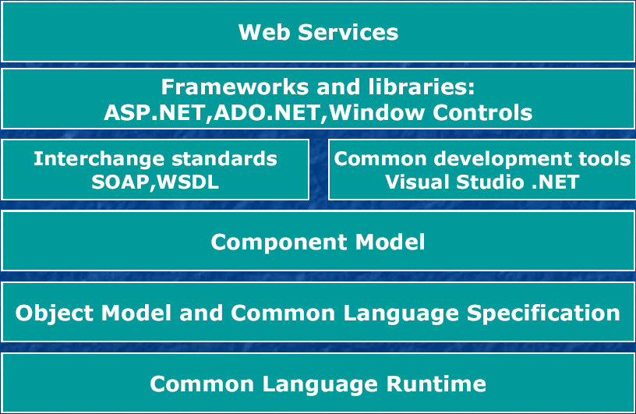
.NET Architecture

Slide 36
Architecture Explained
Web Services
  Top layer provides .NET users with Web Services for e-commerce and business to business applications
Frameworks and Libraries
  ASP.NET for developing smart web pages
  ADO.NET which is an XML based improvement for databases and object relational processing
Interchange Standards
  Platform independent means of exchanging objects
  SOAP (Simple Object Access Protocol)
  WSDL (Web Services Description Language)

Slide 37
Architecture Explained (cont’d)
Development Environment
  Visual Studio .NET
  Visual C++, Visual BASIC, Visual C#
Component Model
  Derived from original component based development: CORBA, J2EE, COM
  .NET allows building “assemblies” consisting of a number of classes with well defined interface
  IDL absent in .NET

Slide 38
Architecture Explained (cont’d)
Object Model
  Conceptual basis for everything in .NET
Common Language Runtime
  Basic set of mechanisms for executing .NET programs regardless of language of origin

Slide 39
.NET Framework
ASP.NET
Windows Forms
Web Services
Web Forms
Controls
Drawing
ASP.NET Application Services
Windows Application Services
Framework Class Library
ADO.NET
XML
Threading
IO
Network
Security
Diagnostics
Etc.
Common Language Runtime
Memory Management
Common Type System
Lifecycle Monitoring

Slide 40
Framework Class Library
The FCL is a hierarchical class library that can be utilized across multiple languages and platforms.
Contains reusable classes, interfaces, and components that can be used for:
  Developing components and Web Services.
  Developing Windows Forms applications.
  Developing Web Forms applications.
  Working with Directory Services, Event Logs, Processes, Message Queues, and Timers.
  Creating and managing threads.
  Managing application security.
Key features and benefits
  Cross-Language Interoperability
  Consistent and Unified Programming Model
  Object-Oriented and Extensible Class Library

Slide 41
Common Language Runtime
The CLR is at the core of the .NET platform - the execution engine. A unifying framework for designing, developing, deploying, and executing distributed components and applications.
Loads and runs code written in any runtime-aware programming language (approx. 22 as of now).
Manages memory, thread execution, type safety verification and garbage collection.
Performs compilation (Just In-time Compiler)
Makes use of a new common type system capable of expressing the semantics of most modern programming languages. The common type system defines a standard set of types and rules for creating new types.
Inheritance/Reference NOT dependent on source language

Slide 42
MSIL and JIT Compilation
Source code is compiled into MSIL (Microsoft Intermediate Language). Similar to Java bytecode.
MSIL allows for runtime type-safety and security, as well as portable execution platforms (all Windows). MSIL code cannot play tricks with pointers or illegal type conversions.
The MSIL architecture results in apps that run in one address space - thus much less OS overhead.
Compilers also produce “metadata”:
  Definitions of each type in your code.
  Signatures of each type’s members.
  Members that your code references.
  Other runtime data for the CLR.
Metadata along with the MSIL enables code to be self-describing - no need for separate type libraries, IDL, or registry entries.
When code is executed by the CLR, a JIT compilation step occurs. Code is compiled method-by-method to native machine code.

Slide 43
Packaging: Modules, Types, Assemblies, and the Manifest
Assembly
Manifest
Module
Metadata
MSIL
Type
Type
Type

Slide 44
Packaging: Modules, Types, Assemblies, Manifest
A “module” refers to a binary, such as an EXE or DLL.
Modules contain definitions of types, such as classes, interfaces, structures, and enumerations.
An assembly contains a “manifest”, which is a catalog of component metadata containing:
  Assembly name.
  Version (major, minor, revision, build).
  Assembly file list - all files “contained” in the assembly.
  Type references - mapping the managed types included in the assembly with the files that contain them.
  Scope - private or shared.
  Referenced assemblies.
No MSIL code can be executed unless there is a manifest associated with it.

Slide 45
Packaging: Modules, Types, Assemblies, Manifest
An assembly can be defined as one or more modules that make up a unit of functionality. Assemblies also can “contain” other files that make up an application, such as bitmaps and resource files.
An assembly is not a physical file.
An assembly is the fundamental unit of deployment, version control, activation scoping, and security permissions.
Two types of assemblies:
  Private - Usually deployed in the same directory as the client application and used only by a single application.
  Shared - Used by any application and usually installed in a special Global Assembly Cache.

Slide 46
.NET Component Model
Offers developers an component model directly based on OO.
Removes distinction between a program element and a software component. Thus it provides significant benefits over technologies like CORBA and COM.
.Net gets rid of the IDL - we can use a .Net assembly directly as a component.
Uses interface documentation already present in the source code. Compliers for .Net supported languages retain this information as metadata - self documented components.
Metadata is also available in XML format, any application whether it is a part of .NET or not can obtain information about components.

Slide 47
Microsoft C#
A modern, object-oriented programming language built from the ground up to exploit the power of XML-based Web services on the .NET platform.
The main design goal of C# was simplicity rather than pure power.
Features of C#
  Simplicity Type Safety
  Consistency Version Control
  Modernity Compatibility
  Object Orientation Flexibility

Slide 48
.NET security
The .NET Security Framework Architecture consists of the following five core elements:
  Evidence Based Security - At runtime, the CLR determines permission requests by evaluating the assembly’s evidence.
  Code Access Security - allows code to be trusted to varying degrees, depending on where the code originates and on other aspects of the code's identity.
  Verification - during JIT, the CLR ensures memory type safety.
  Role Based Security - .NET applications can make authorization decisions based on identity and role membership.
  Cryptography - The .NET Framework provides Random Number Generation and other Cryptographic services.

Slide 49
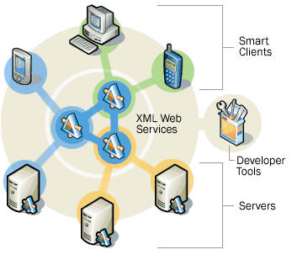
What is a Web Service?
Small, reusable applications written in XML
Client to Client
  Clients can use XML Web Services to communicate data
Client to Server
  Clients can send data to and receive data from servers.
Server to Server
  Servers can share data with each other.
Service to Service
  web services can work together.

Slide 50
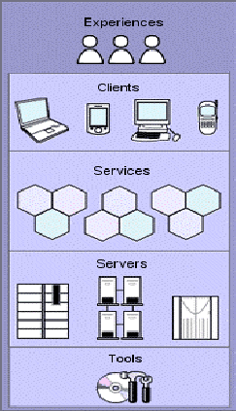
What are the Components of .NET?

Slide 51
.NET Experience
.NET Experiences are XML web services that allow you to access information across the internet in an integrated way
Products transitioning into the .NET experiences are:
  MSN Website
  Visual Studio .NET Website
  Passport Website

Slide 52
Web Services Revisited
Web services are platform independent
  Encompasses Windows, Unix, Mac, Linux, even PalmOS
Web services are agnostic of the object model being used
  Compatible with RPC, DCOM, CORBA, and Sun RMI
Web services are loosely coupled
  Unlike tightly-coupled RPC and distributed object systems, which require all the pieces of an application be deployed at once, you can add clients and servers to Web-based systems as needed
Web services are built on open standards
  XML, SOAP, WSDL, UDDI, HTTP, RPC
Web services are compatible with existing object models
  Replaces internal "plumbing" of the network RPC wire format transparently to user
Web services permit secure transmission
  HTTPS, SSL

Slide 53
Web Services vs. Traditional Web Applications
Web services use SOAP messages instead of MIME messages
  Browsers just need to render web pages; web services need to do more
Web services are not HTTP-specific
  SOAP messages can be sent using SMTP, raw TCP or an instant messaging protocol like Jabber
Web services provide metadata describing the messages they produce and consume.
  XML Schema (XSD) is used to describe various message structures

Slide 54
Extensible Markup Language (XML)
XML is the glue that holds .NET together
XML is the defacto standard for data interoperability.
XML provides a way to put structured data into a form that can be easily and quickly transmitted and then interpreted at the other end
XML looks like HTML, and like HTML, it is readable and text-based
XML is license-free, platform-independent, and well supported

Slide 55
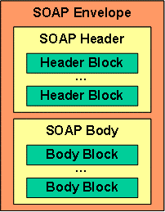
Simple Object Access Protocol (SOAP)
“SOAP provides a simple and lightweight mechanism for exchanging structured and typed information between peers in a decentralized, distributed environment using XML “
A SOAP message is based on XML and contains the following parts:
The Envelope is the top-level container representing the message.
The Header is a generic container for added features to a SOAP message. SOAP defines attributes to indicate who should deal with a feature and whether understanding is optional or mandatory.
The Body is a container for mandatory information intended for the ultimate message receiver.

Slide 56
SOAP (cont’d)
Soap is the communications protocol for XML Web services.
SOAP is a specification that defines the XML format for messages—and that's about it – a SOAP implementation will probably include mechanisms for object activation and naming services but the SOAP standard doesn't specify them
Optional parts of SOAP specification describe how to represent program data as XML and how to use SOAP to do Remote Procedure Calls
SOAP is much smaller and simpler to implement than many of the previous protocols.
DCE and CORBA took years to implement, so only a few implementations were ever released; SOAP, however, can use existing XML Parsers and HTTP libraries to do most of the hard work, so a SOAP implementation can be completed in a matter of months – so several implementations for it have been released (> 70 to date).
SOAP obviously doesn't do everything that DCE or CORBA do, but the lack of complexity in exchange for features is what makes SOAP so readily available

Slide 57
Web Service Description Language (WSDL)
A Web Service Description defines all the supported methods that a Web Service provides.
WSDL is an XML grammar that developers and development tools use to represent the capabilities and syntax of a Web Service.
Similar to IDL for COM and CORBA
Imagine you want to start calling a SOAP method provided by one of your business partners. WSDL specifies what a request message must contain and what the response message will look like in unambiguous notation.

Slide 58
Universal Discovery Description and Integration (UDDI)
UDDI is the yellow pages of Web Services
you can search for a company that offers the services you need, read about the service offered and contact someone for more information
A UDDI directory entry is an XML file that describes a business and the services it offers.
There are three parts to an entry in the UDDI directory
  "white pages" describe the company offering the service: name, address, contacts, etc.
  "yellow pages" include industrial categories based on standard taxonomies such as the North American Industry Classification System and the Standard Industrial Classification.
  "green pages" describe the interface to the service in enough detail for someone to write an application to use the Web service.
UDDI defines a document format and protocol for searching and retrieving discovery documents - which in turn link to DISCO documents.
DISCO (Discovery of Web Services) is a Microsoft protocol for retrieving the contracts for Web Services (WDSL documents).

Slide 59
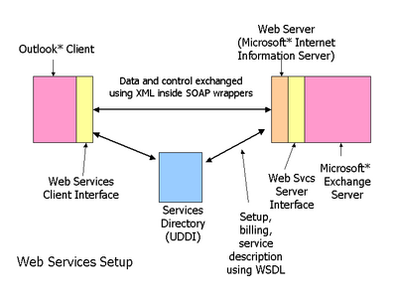
Web Services: An Example

Slide 60
Conclusion
.Net creates a new concept, “the Internet Operating System”.
.Net allows cross-platform development to an extent not before possible.
.Net web services can be integrated into existing distributed object technologies today by replacing their RPC wire protocol with SOAP .
Large-scale distributed application development and deployment become possible on a level that presents major difficulties today.
Stricter versioning policies help to ensure greater stability during upgrades, even in shared libraries.
"Software as a service" - a subscription model for application deployment - becomes a feasible option.

