Slide 1







ICACS
2025
International Conference on
Artificial Intelligence, Communication Technologies & Smart Cities
MARCH 01, 2025
CHARUSAT, CHANGA, GUJARAT, INDIA

Slide 2
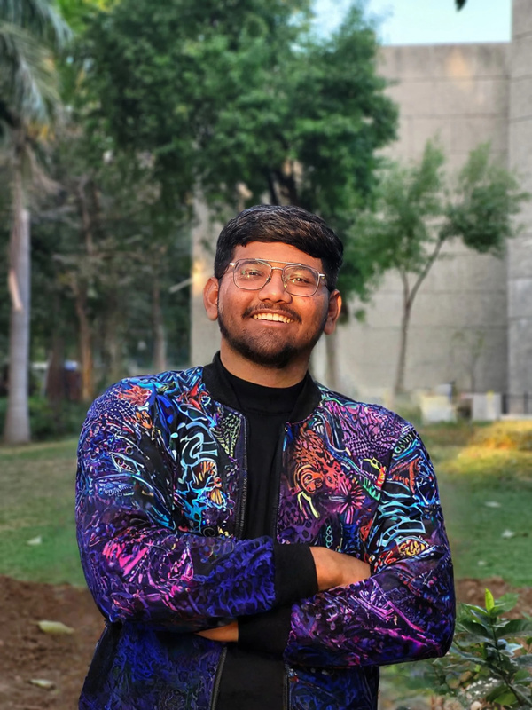
ICACS
International Conference on
Artificial Intelligence, Communication Technologies & Smart Cities
MARCH 01, 2025
2025
PAPER TITLE
A study on fostering Emotional Green Leadership: Advancing Sustainability in Higher Education
Anand, India
Paper ID: 112
AUTHORS
Viraj Patel, Parth Goel & Vraj Patel
Viraj Patel
Charotar University of Science and Technology
Anand, India

Slide 3


Outline
Introduction (try to answer: what it is, why it is, where it is and what is (are) existing problem)
Problem addressed in this work (original contribution and novelty)
Methodology (like Modeling, simulation, hardware experiment or combination of them, tools and major hardware used)
Design/Development/Analysis/Algorithm
Results and Discussion
Conclusions
References

Slide 4
Title of Slide

Slide 5
Thank You

