Slide 1
Tech4Heritage
Sample Phase 1 Submission
Team Name : Coffee Addicts
Team Id : 91
Team Leader Name : Aman Gupta

Slide 2
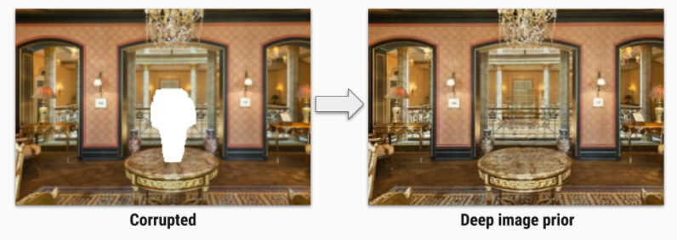
Problem Statement
Planning of art restoration using deep learning to preserve our Heritage. Image below represents one aspect of problem :-

Slide 3
Objective 1: Data Set Selection
We have selected this dataset because it is required to train our model for the solution to the given problem. We need data that have some discontinuity or similar to the given image examples and thus we ingested these images to our Data Folder using the sources given below with the help of Python Script:-
Google Images
Data Inside Folder :-
Martand Sun Temple Damaged Sculptures
Ancient Damaged Wall Painting of India
Ellora Caves Damaged Sculptures
Ajanta Caves Wall Painting
Khajuraho Damaged Sculptures

Slide 4
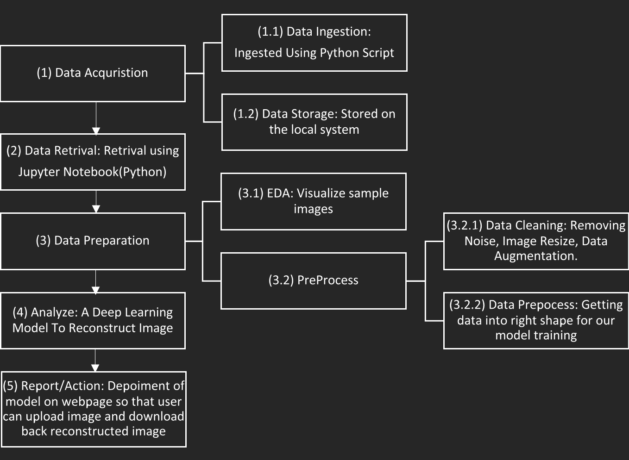
Flow Diagram

Slide 5
Data Acquisition & Storage
We ingested data to our local system using Python Script from Google Images.
After Ingestion, Generally we store data on some database , But for phase 1 and smaller set of problem we used our local system as storage.
Link to google_image_download : https://pypi.org/project/google_images_download/
Acquired Data : https://github.com/ravichaubey/Hack4Heritage-Hackathon/tree/master/Data

Slide 6
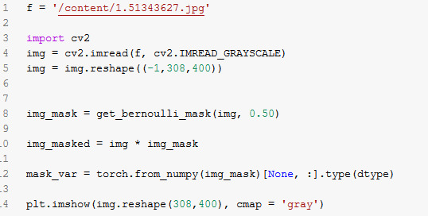
Data Retrieval
We have retrieved our data from local using Python (OpenCV) :-

Slide 7
Data Preparation
For phase 1, We are just creating a simpler solution so we have resized image to a particular pixel. Later for complete solution we are going to build a Pipeline to read image, resize image image and augment image.

Slide 8
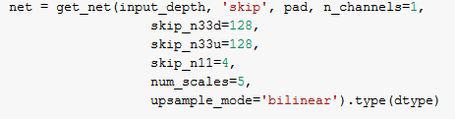
Data Analyse
We have uses encoder-decoder with skip connections . Encoder downsample our image and decoder generate a new image by using upsample the output of encoder. “Our Project is working absolutely fine on Google Colab, Please find link below.”
Parameters of Network are below:
Activation Function : LeakyReLU
Upsample Mode: bilinear
Downsample Mode : stride
Total Trainable Params: 2217573
Google Colab Link :- https://colab.research.google.com/drive/1FRi9AxN8rHdwkc8_91Z6YJKgzibE9o-x?usp=sharing

Slide 9
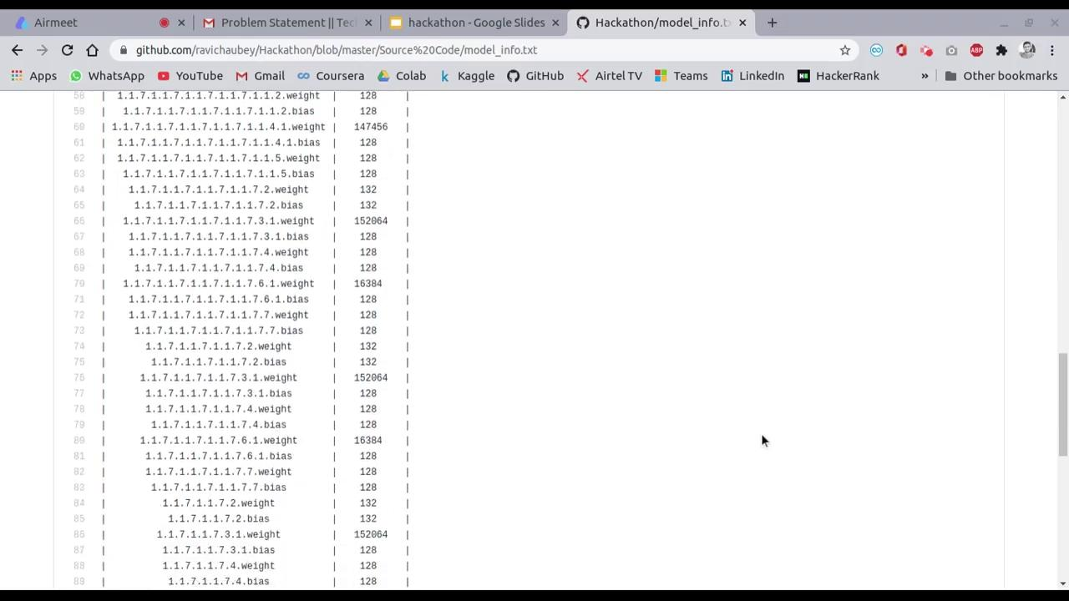
Model Information
We are providing video to show the architecture and parameters for phase 1 model :-

Slide 10
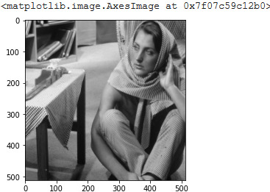
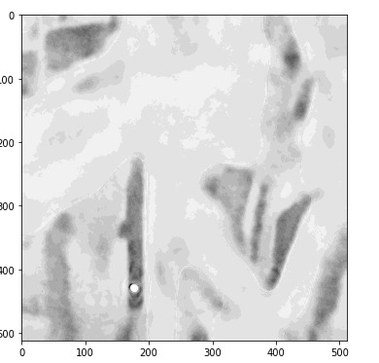
Model Output
We are sharing output, Please remember we need lot of iteration to get actual regenerated image because problem is complex. Due to lack resources we can not afford such large training in this short time. So we are sharing snap of training number 11000 approx , We will optimize this in Phase 2.
Generating Image=>

Slide 11
Reporting and Action
Basically reporting our action of our deep learning model is to bring system to work for users. Reporting is either reporting visuals or reporting information like metrics or some relationship. In this case we are reducing _loss_function_name_.
Action :-
We are going to create a webpage to deploy our model. User can upload an image and get back re-generated image on same webpage. ‘Please note that we are not going to show this webpage in Phase 1, due to lack of time. But we are prepared for phase 2.’

Slide 12
Thank you !!!

