Slide 1

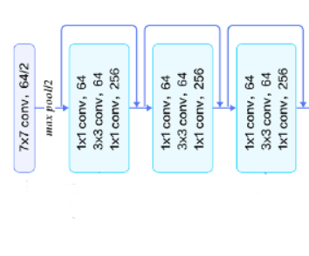
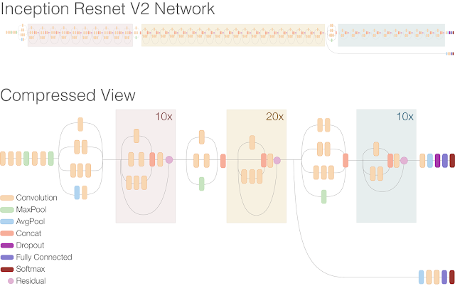
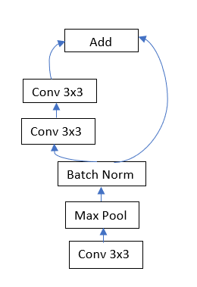
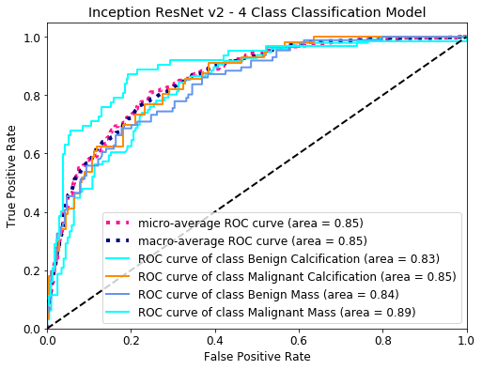
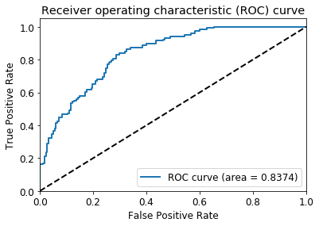
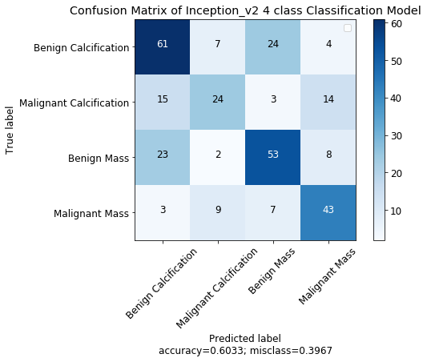
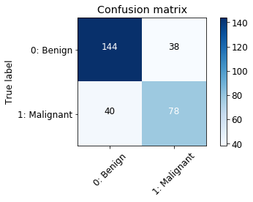
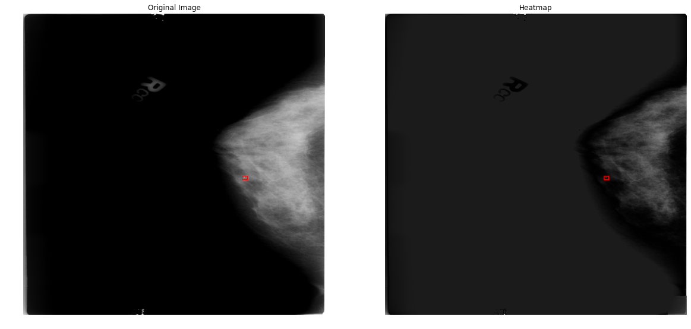
Breast Cancer Detection Through High Resolution Screening Mammograms
Nhung Le, Nithish Addepalli, Ravi Choudhary
New York University, Center For Data Science
Overview
Model Architectures
Data
Classification of Screening Mammograms to detect Malignant Lesions and the type of Lesion (Mass vs Calcification) using CNN.
Resnet - 50
CBIS DDSM (Curated Breast Imaging Subset of Digital Database for Screening Mammography)
50 Blocks
Custom Model
P(Y=1|input)
Metric | Value | Train | Val | Test
# Patients | 1,607 | 1,097 | 349 | 161
# Scans | 3,103 | 2,158 | 645 | 300
Motivation
P(Y=0|input)
Breast cancer is the second most common cancer in women worldwide. The five year survival rates for stage 0 or stage 1 breast cancers are close to 100%, but the rates go down dramatically for later stages: 93% for stage II, 72% for stage III and 22% for stage IV. Screening Mammogram is a routine exam administered to detect abnormalities. Identifying Breast Cancer in the early stages through Screening Mammograms can save the need for follow-up procedures in case of False Positives and save time for follow-ups for True Positives.
Average Pooling
Avg Pool
Conv 3x3
Metric | Train | Val | Test
# Benign | 1,172 | 385 | 182
# Malignant | 986 | 260 | 118
Max Pool
Batch Norm
Discussion and Conclusion
3x
Using the full image increases the model AUC for 4 classes as compared to using Resized images for Resnet18.
Changing the position of Batch Norm does increase the performance in case of 4 classes. So does similar domain pre-training – Chest X-ray.
Increasing the model capacity though a very deep or wide model can overcome most of the hurdles we envisioned with signal to noise ratio as proved by Resnet 50 and Inception Resnet V2.
Patch based model seems to be much more ideal for further improvement in performance since lesions can be very tiny. They have been proven to work by Yasolav Nikulin et. al. and Nan Wu et. al.
Related Work
Results
Krzystof Geras et. al. proposed the use of multi-view CNN architecture on the screening images to predict BIRADS score.
Dezső Ribli et. al. used RCNN to propose regions from a Mammogram and classify the region based on malignancy.
Trent Kyono et. al. proposed the usage of multi-view CNN in addition to the patient’s non-imaging data to reduce the number of patients to be reviewed by a Radiologist.
Yaroslav Nikulin et. al. used a CNN model on the small patches of the image and using the result from this model in another model for final prediction in their winning submission for the DREAM Challenge.
Final model selected over validation performance. AUCs reported on test set. For 4 classes Micro AUC is reported.
Architecture | Transfer Learning | 2 Classes |  | 4 Classes
 |  | AUC | Accuracy | AUC | Accuracy
ResNet18 (full image) | - | - | - | 0.63 | 0.36
Custom CNN with PReLU | - | - | - | 0.64 | 0.35
ResNet18 | Imagenet | 0.71 | 0.65 | 0.53 | 0.32
ResNet34 | Imagenet | 0.67 | 0.65 | - | -
Custom CNN | Chest X-Ray | 0.64 | 0.56 | 0.73 | 0.43
ResNet50 | Imagenet | 0.82 | 0.72 | - | -
Inception Resnet V2 | Imagenet | 0.84 | 0.74 | 0.85 | 0.6
References
Geras, K. J., Wolfson, S., Shen, Y., Wu, N., Kim, S. G., Kim, E., . . . Cho, K. (2018, June 28). High-Resolution Breast Cancer Screening with Multi-View Deep Convolutional Neural Networks.
Ribli, D., Horváth, A., Unger, Z., & Pollner, I. (2017, November 09). Detecting and classifying lesions in mammograms with Deep Learning.
Kyono, T., Gilbert, F., & Schaar, M. V. (2018, October 30). MAMMO: A Deep Learning Solution for Facilitating Radiologist-Machine Collaboration in Breast Cancer Diagnosis.
Nikulin, Y. (n.d.). DM Challenge Yaroslav Nikulin (Therapixel) Submission.
Wu, N., Phang, J., Park, J., Shen, Y., Huang, Z., Zorin, M., Jastrzębski, S., Févry, T., Katsnelson, J., Kim, E., Wolfson, S., Parikh, U., Gaddam, S., Lin, L., Ho, K., Weinstein, J., Reig, B., Gao, Y., Toth, H., Pysarenko, K., Lewin, A., Lee, J., Airola, K., Mema, E., Chung, S., Hwang, E., Samreen, N., Kim, S., Heacock, L., Moy, L., Cho, K. and Geras, K. (2019). Deep Neural Networks Improve Radiologists' Performance in Breast Cancer Screening.
Proposed Architecture Changes
We believe that the signal to Noise ratio in the Mammograms is very low, compared to Imagenet data. Therefore, we propose a few changes to the Resnet architecture.
Batch Norm after activations instead of before activations to prevent loss of signal.
Use of Leaky ReLU/ Exponential Linear Unit (ELU) / PReLU instead of ReLU to get more representations.
Usage of full image instead of resized image to prevent loss of information.
Use of multiple views to get the model to learn about characteristics of Lesion.
Heat Map

