Slide 1

Why do they leave???
Ravi Choudhary, Delhi Metro Rail Corporation
Data Science Career Track Capstone Project,2020
Thanks to my Mentor
Mr.Kumar Vishwesh
Sr. Data Scientist

Slide 2
The problem
Company
Context
Problem statement
ZZZ company is transportation company which deal with Public transport and other service for their passengers.
From past several year they are trying to improve their network but still not they are in loss overall.
They required some solution to cut down the cost of some departement.
Hiring process cost in terms of money and time.They want to retain their employee and if not they want to know prior. so that they could manage the shortage of staff.

Slide 3
Challenges deep-dive
Success:Retention %
Constraints
85%
Increase conversion
-Labour Law
-Skilled people demand
-Hike in salary

Slide 4
Dataset
Dataset consist of 35 feature of 1407 employee.
Provided by Manpower Planning cell

Slide 5
Implementation:
Library used:
-Numpy
-Pandas
-Seaborn
-Matplotlib
Model used:
-LogisticRegression
-RandomForestClassifier
-RandomSearchCV

Slide 6
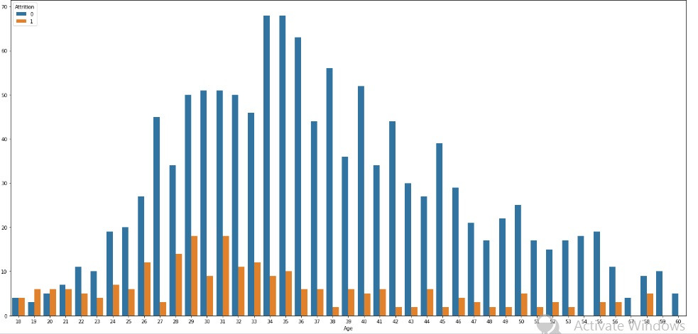
Age Factor:
Critical Age Range

Slide 7
Sales representative leave more
Less involved people leave first
Less experienced leave more
Job Role
Marital status
Job Involvement
Job Level
Year of Experience
Single prefer to leave
Lower grade employee leave early

Slide 8
Performance Metrics
Model
Classification
Logistic Regression
Performance
Random Forest
Performance
Accuracy
Recall
Precision
Recall
Precision
.84(0)/.75(1)
.98(0)/.28(1)
.82(0)/.62(1)
83.6%
.98(0)/0.14(1)

Slide 9
Tunined Model
Model
Random Forest
RandomSearchCV
Accuracy
Recall
Precision
.83(0)/.80(1)
.99(0)/.22(1)
83%

Slide 10
Recommendation
max growth
-Focus on new candidate.
-Give more responsibilities to new people.
-Try to Provide accommodation to staff nearby.

Slide 11

Thank you
Mr. Ravi Choudhary
Delhi Metro Rail Corporation
Linkedin-linkedin.com/in/ravichoudharyy
Github-github.com/ravicodry/Employee_leaving.git

