Slide 1

Credit Card Approval Prediction Model
Presented By:-
Akshit
Amrrita
Geofrey
Nikhil

Slide 2
Why this Topic?
Commercial banks receive a lot of applications for credit cards.
Many of them get rejected for many reasons, like high loan balances, low income levels, or too many inquiries on an individual's credit report, for example.
This task has been automated with the power of machine learning and pretty much every commercial bank does so nowadays.
We tried to make an automatic credit card approval predictor using machine learning techniques, just like the real banks do.

Slide 3
Data Source
UCI Machine Learning Repository -> Credit Approval Data Set
Link

Slide 4
Approach & Tools Used
Data Understanding -> Tableau
Data Preparation -> Pandas
Data Description and Distribution -> Matplotlib
Data Modelling and Evaluation ->Pandas
Visualization -> Flask App, HTML/CSS

Slide 5
What does our data look like?

Slide 6
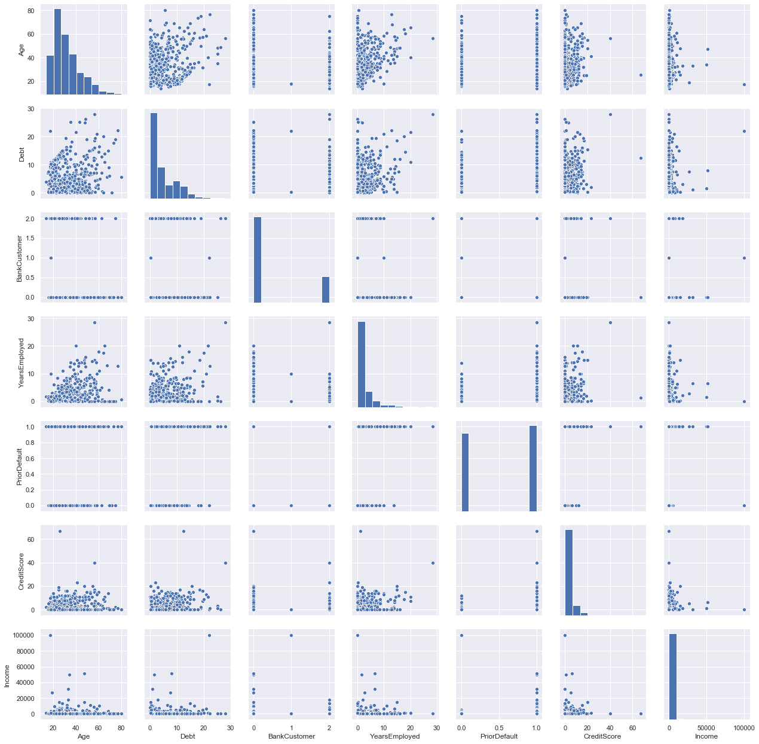
Scatter Plots

Slide 7
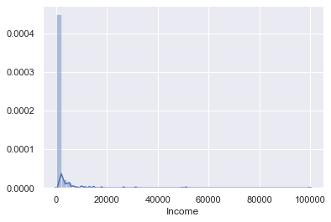
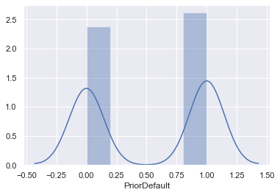
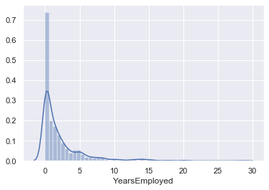
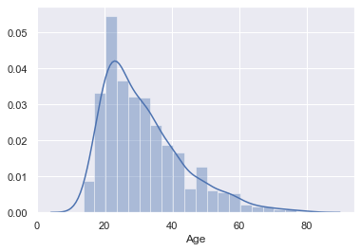
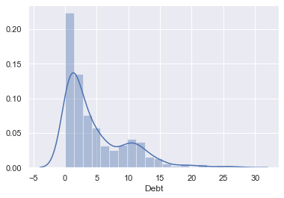
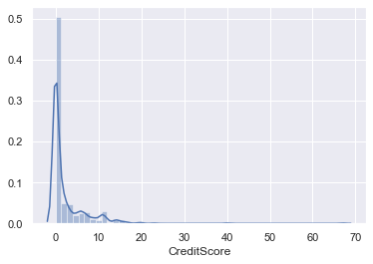
Distribution Plots

Slide 8

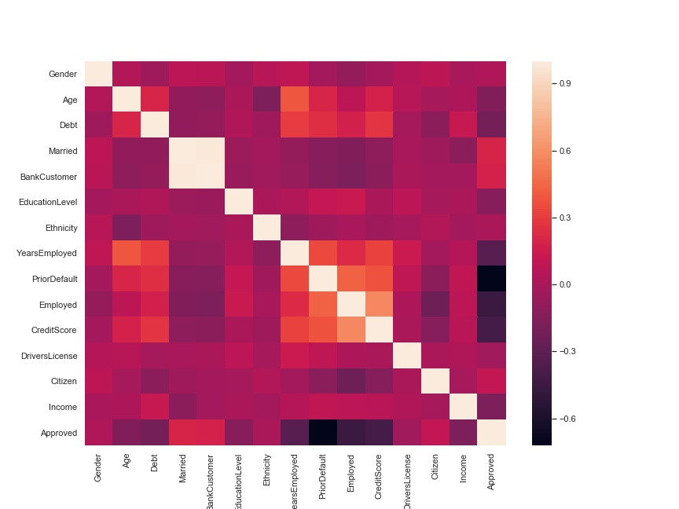
Correlation Matrix

Slide 9
Models Used
Random Forest
K-Means

Slide 10
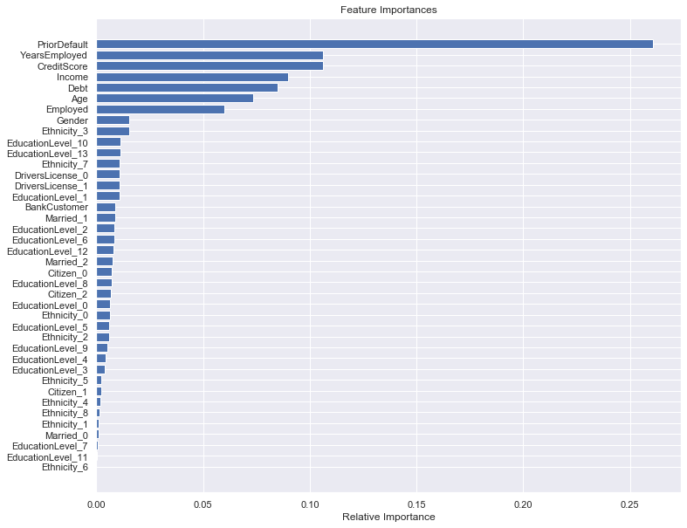
Random Forest – Feature Importance

Slide 11
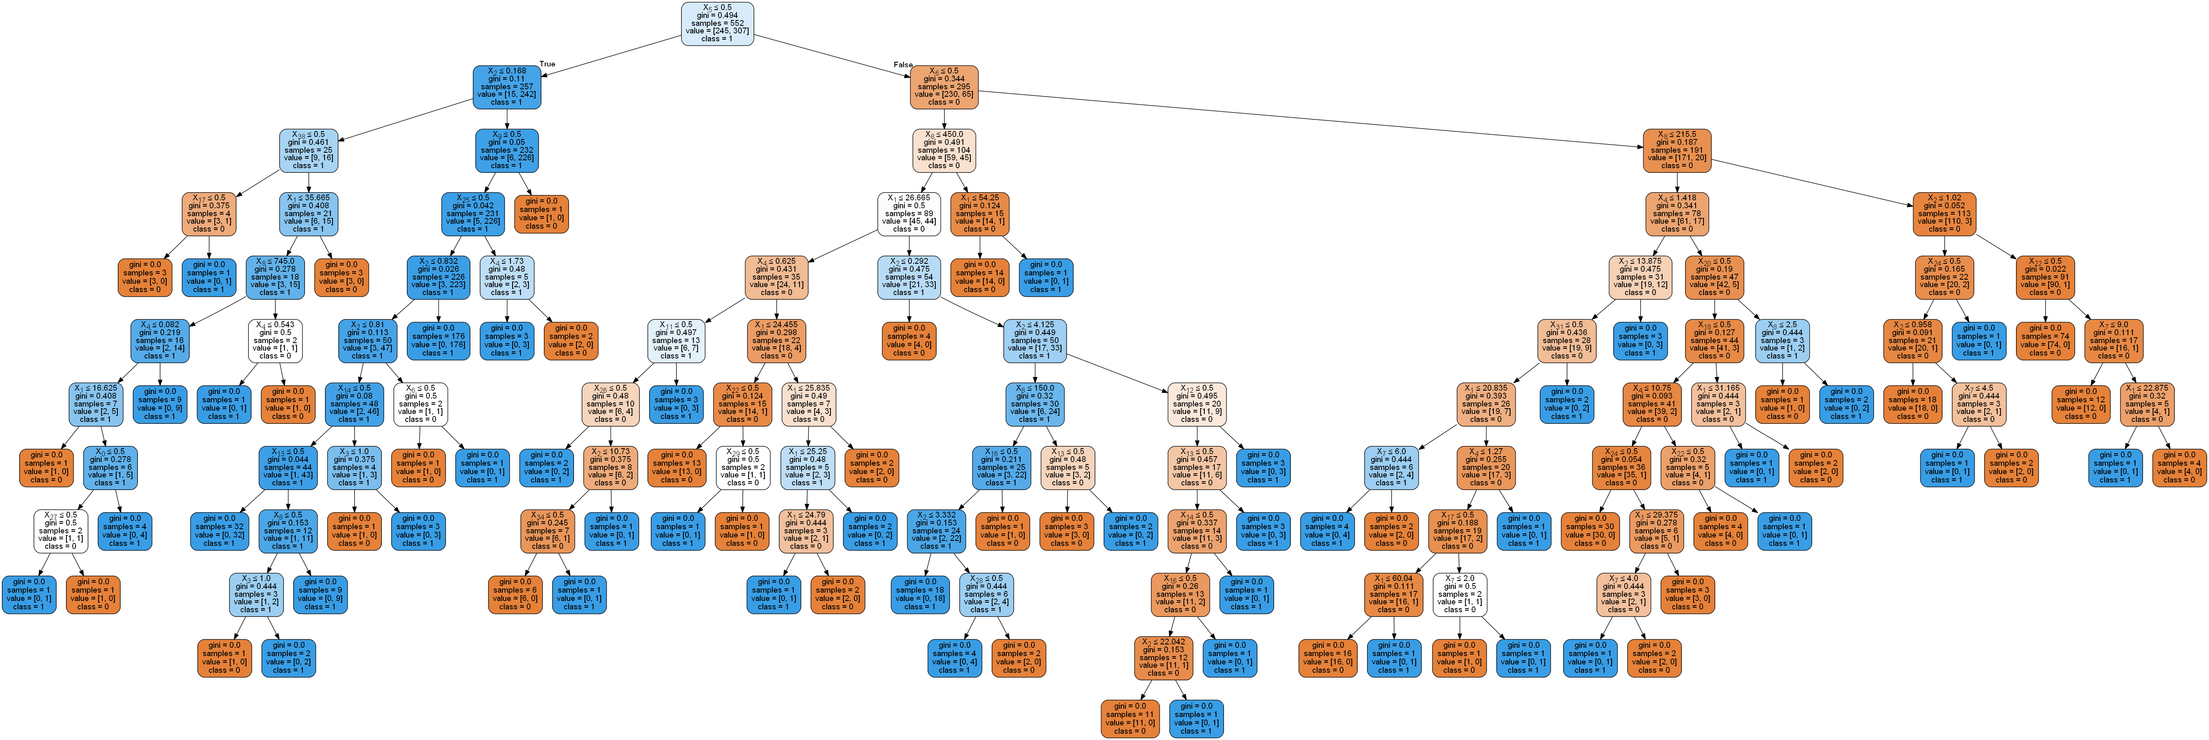
Decision Tree Classifier

Slide 12
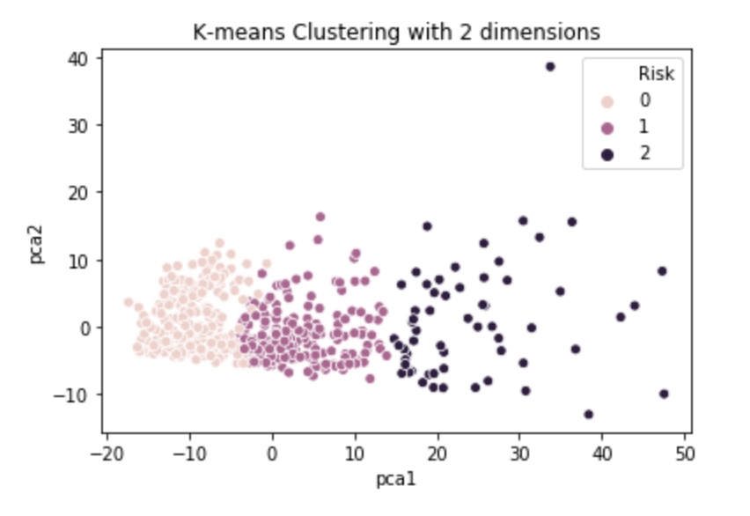
K-Means

Slide 13
Web Application

Slide 14
Questions?

