Slide 1
Course Details
HTML
CSS
Project(Website Design)

Slide 2
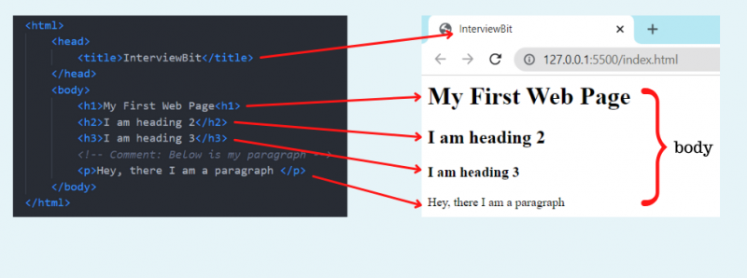
What is HTML?
Hyper-Text-Markup-Language (HTML) is a markup language that is used to define the basic structure of any website. The basic structure consists of the header, body (main content), and footer of the website. And, what is a markup language? Any language that is understood by the browser and which tells the browser how to render the data is known as a markup language.

Slide 3
Explanation
The html tag is the root tag from where the document starts.
The head tag is used to contain metadata (it means information about other data).
The body tag contains the actual content that needs to be displayed on the browser.
Inside the body tag, we can use any tag from the list of HTML standard tags.
The h1, h2, and h3 tags are heading tags of different font sizes.
The p tag is our paragraph tag.
The following image shows the tree-like structure of the above HTML code. <html> tag is the root element and then we have two child elements <head> and <body>. Inside the <head> tag we have a <title> tag and inside <body> tag we have its 4 child elements as shown in the image.

Slide 4
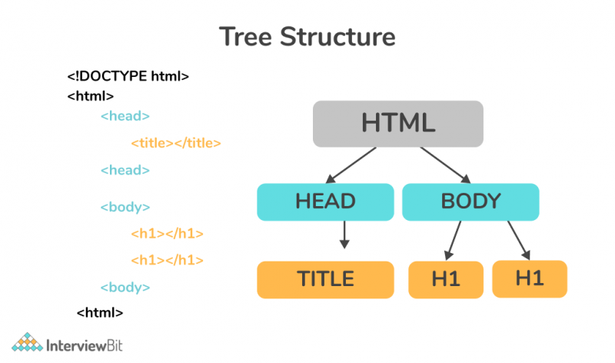

Slide 5
Features of HTML
HTML is not case-sensitive language, meaning <html> is equivalent to <HTML>.
HTML is platform-independent because we can view it on any operating system.
HTML follows a tree-like structure. The HTML tag acts as a root element, then head and body tags act as child elements of the head tag, and so on.
HTML language is easy to understand and learn.
HTML tags contain display information (or render information) that is useful to browsers like Chrome, Firefox, etc.
It facilitates users to add images, videos, and hyper images to web pages which makes it awesome and more user-friendly.

Slide 6
What is CSS?
CSS stands for Cascading Style Sheet. It is a style sheet language used to style the markup language like HTML. If we consider HTML as the skeleton structure of the body, then CSS is the skin/overall look that covers it. CSS allows you to handle multiple web pages using only one CSS file. CSS facilitates you to modify various properties of HTML elements like you can modify background color/image, alignment to tags using margin, position properties, can provide different font properties(font-family, font-size, color, etc), or you also can remove existing properties of HTML tags (like you can convert block elements to inline).
Another amazing property of CSS is its amazing transitions, which allow you to change property values smoothly, over a given duration (useful to improve the look and feel). CSS also facilitates the feature of animation, which lets HTML elements gradually change from one style to another. Let’s look at one basic example of CSS.

Slide 7
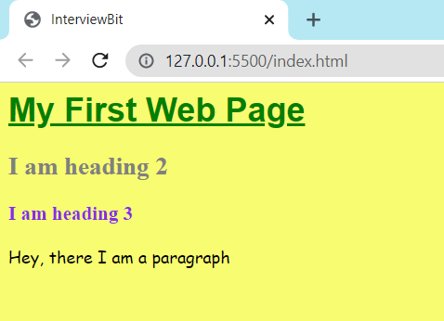
* {
background-color: #f7fc70;
}
h1 {
color: green;
text-decoration: underline;
font-family: sans-serif;
}
h2 {
color: grey;
}
h3 {
color:blueviolet;
}
p {
font-size: 16px;
font-family: Comic Sans MS;
}

Slide 8
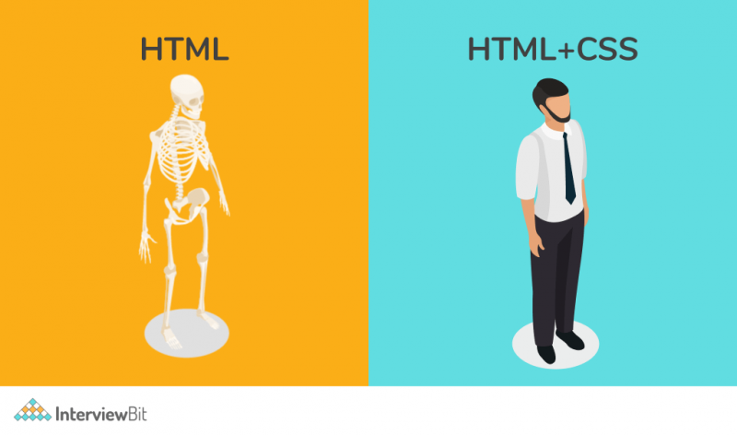

Slide 9
Basic Structure of HTML
<!DOCTYPE html>
<html>
<head>
<title>Webpage Title</title>
</head>
<body> (this is visiable part)
<p>Contents of webpage</p>
</body>
</html>

Slide 10
HTML <!DOCTYPE> Declaration
All HTML documents must start with a <!DOCTYPE> declaration.
The declaration is not an HTML tag. It is an "information" to the browser about what document type to expect.
In HTML 5, the declaration is simple: <!DOCTYPE html>
Older HTML Documents
In older documents (HTML 4 or XHTML), the declaration is more complicated because the declaration must refer to a DTD (Document Type Definition).
HTML 4.01:
<!DOCTYPE HTML PUBLIC "-//W3C//DTD HTML 4.01 Transitional//EN" "http://www.w3.org/TR/html4/loose.dtd">
XHTML 1.1:
<!DOCTYPE html PUBLIC "-//W3C//DTD XHTML 1.1//EN" "http://www.w3.org/TR/xhtml11/DTD/xhtml11.dtd">

Slide 11
What is Tags, Elements, and Attributes in html?
Elements:- An HTML element is defined by a start tag, some content, and an end tag.
<tagname>Content goes here...</tagname>
Examples of some HTML elements:
<h1>My First Heading</h1>
<p>My first paragraph.</p>
Empty HTML Elements
HTML elements with no content are called empty elements.
The <br> tag defines a line break, and is an empty element without a closing tag:
Attributes
HTML attributes provide additional information about HTML elements.
All HTML elements can have attributes
Attributes provide additional information about elements
Attributes are always specified in the start tag
Attributes usually come in name/value pairs like: name="value"

Slide 12
The href Attribute
The <a> tag defines a hyperlink. The href attribute specifies the URL of the page the link goes to:
Ex: <a href="https://www.w3schools.com">Visit W3Schools</a>
The src Attribute
The <img> tag is used to embed an image in an HTML page. The src attribute specifies the path to the image to be displayed:
Ex: <img src="img_girl.jpg">

Slide 13
HTML indentation: how to indent?
This will make your code more readable by other developers and shows the relationship between the child and parent HTML elements.
Ex:
<html>
<head>
<title>Profile Page</title>
</head>
<body>
<p>Hello Word</p>
</body>
</html>
<html>
<head>
<title>Profile Page</title>
</head>
<body>
<p>Hello Word</p>
</body>
</html>

Slide 14
HTML Comments
HTML comments are not displayed in the browser, but they can help document your HTML source code.
HTML Comment Tag
You can add comments to your HTML source by using the following syntax:
<!-- Write your comments here -->
Notice that there is an exclamation point (!) in the start tag, but not in the end tag.
Note: Comments are not displayed by the browser, but they can help document your HTML source code.

