Slide 1
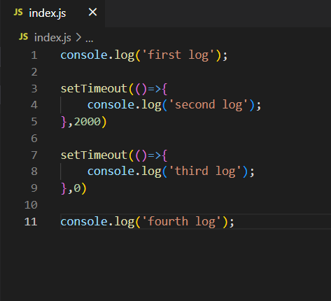

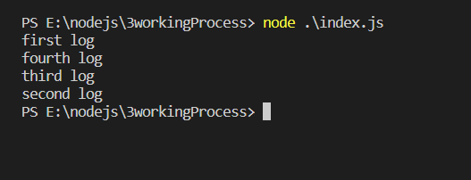
Call Stack
Node API’s
setTimeOut (2 Sec.)
setTimeOut (0 Sec.)
setTimeOut (0 Sec.)
Main()
setTimeOut (2 Sec.)
Output
Event Loop’s
Callback Queue
setTimeOut (2 Sec.)
setTimeOut (0 Sec.)

