Slide 1
comparative study of IOT Data Anomaly Detection using Deep Learning methods
Ravi Ashvin Divecha
LJMU Master’s in Data Science

Slide 2
Agenda
Introduction/Background
Aims & Objectives
Literature Review
Methodology
Results & Discussion
Conclusion and Future Recommendations

Slide 3
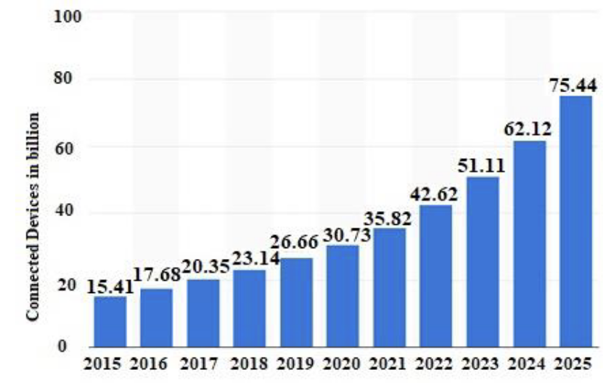
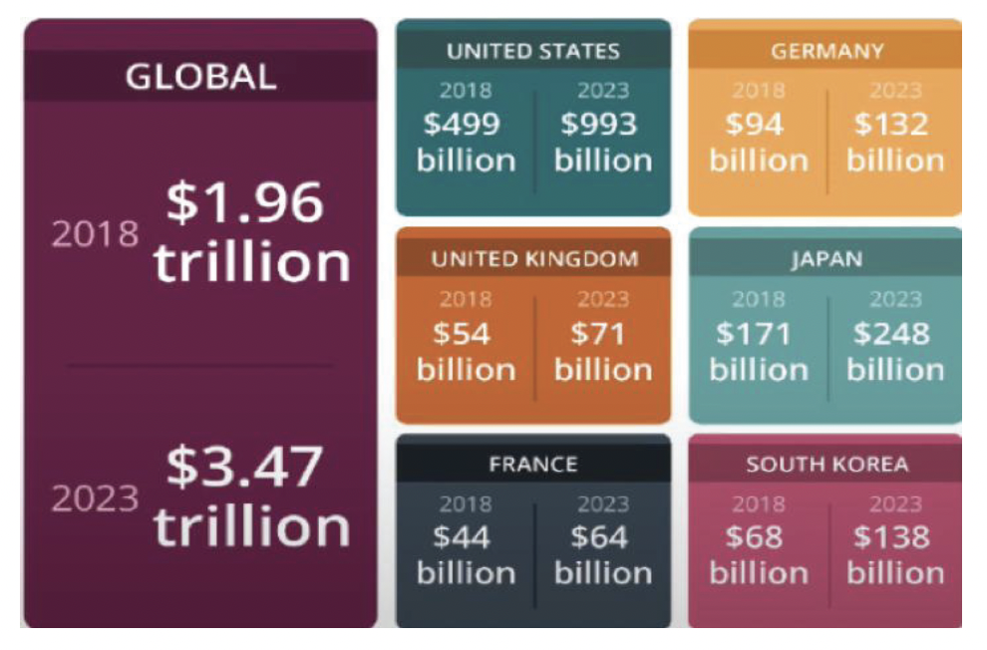
Background
Total no. of connected devices by 2025
Global market for Wi-Fi
Roughly 75.44 billion connected devices by 2025.
Wi-Fi market share will increase to $3.47 trillion by 2023.
Wi-Fi 7, support for low-latency operation opens the door to many IoT use cases.
Wi-Fi 8, support for Artificial Intelligence and Machine Learning will be incorporated through device telemetry.
Notes:
This enormous rise in shares is comparable to the tremendous rise in the number of Wi-Fi-enabled gadgets. The network traffic will grow as a direct result of this

Slide 4
Problem Description
High scale IOT device deployments face network failures or cybersecurity attacks.
Botnets are often involved in various types of attacks, including spamming, data theft, DDoS attacks, scanning or other forms of network attacks.
Available intrusion prevention techniques are CPU intensive and hence may not be possible to deploy on IOT devices.
Machine Learning and Deep Learning methods are deployed for IOT anomaly detection however there is still room for research in the area of 1D CNN and GAN.

Slide 5
Aim & Objectives
To analyse the relationship and pattern between various IOT network packets.
To find a suitable IOT dataset rich in samples and features.
To suggest a suitable deep learning model that can be applied on IOT anomalous packets.
To evaluate the performance of the various ML/DL models based on different evaluation methods.

Slide 6
Literature Review .. 1
Publicly Available IOT Dataset Name
Yahoo time-series
KDD Cup 99
NSL-KDD
LWSNDR
CFDR
SWaT
UNSW-NB15
IoT-23
MQTT-IoT-IDS2020
BOT-IOT
TON-IOT
Enriched Dataset (BOT-IOT + TON-IOT)
CIC IOT Dataset Dec 2022
N-BaIoT
There is a shortage of datasets in IOT domain which are publicly available.
IOT networks are managed by private firms and therefore real time datasets are not easily available.
These datasets include network attacks such as DOS, DDOS, Scanning which are realistic threats in an IOT network.
Enriched Dataset (BOT-IOT + TON-IOT) is selected as the dataset for this research.
BOT-IOT and TON-IOT datasets are merged vertically based on similar attack types and further enriched horizontally through derived features.
14 publicly available dataset for IOT anomaly detection

Slide 7
Literature Review .. 2
~3000 relevant research published for IOT anomaly detection between January 2019 and Jan 2023
60 research papers, surveys and journals were referenced.
Most of the research on IOT anomaly detection is with Machine Learning algorithms
Use of 1D CNN model along with GAN, Cycle GAN and Alternate GAN can be further explored
Research Area | Count
Wi-Fi / IOT Technology Survey & Journals | 14
Anomaly Detection Statistical Learning | 1
Anomaly Detection Machine Learning | 21
Anomaly Detection Deep Learning | 13
Anomaly Detection Reinforcement Learning | 2
Anomaly Detection GAN | 6
IOT Dataset | 3
Wi-FI & IOT research papers referenced

Slide 8

Methodology
Stage1: Pre-processing of data though scaling, one-hot encoding and correlation.
Stage2: Unsupervised Packet Classification though DBSCAN and KMeans
Stage3: MLP and 1D-CNN model applied on Enriched IOT Dataset for accuracy and loss measurement
Stage4: GAN, Cycle GAN ad Alternate GAN applied for synthetic data generation
Model evaluation for Stage2 – Stage4
Unsupervised Packet Classification
Deep Learning Model
GAN
GAN
Dataset
KMeans
MLP
Pre-processing
Cycle GAN
DBSCAN
1D-CNN
Alternate GAN
Model Evaluation
4 stage Methodology for IOT Anomaly Detection

Slide 9
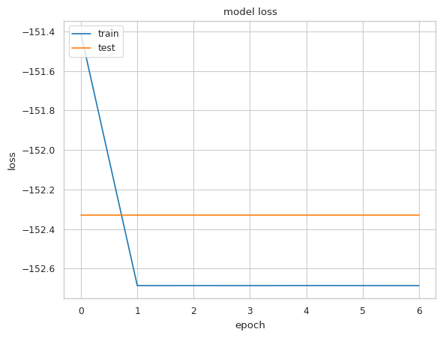
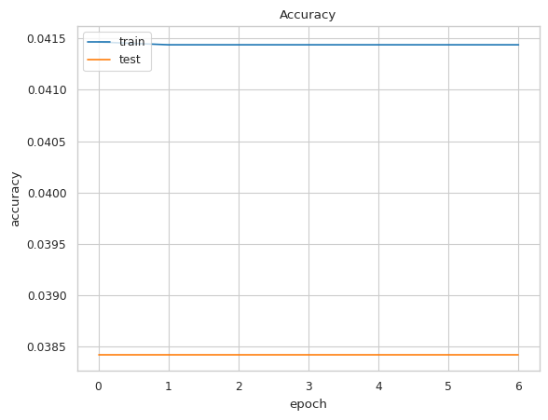
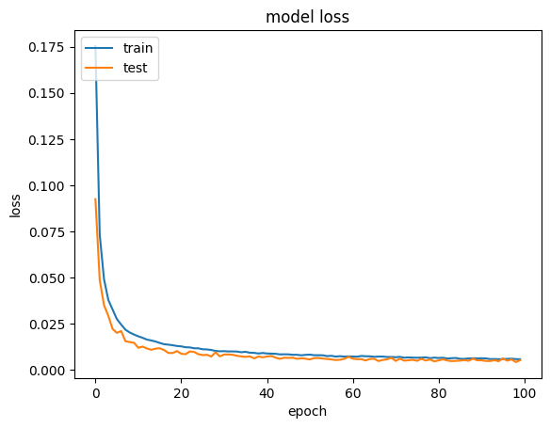
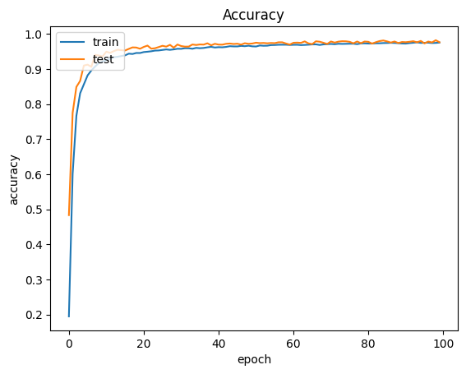
Results & Discussions .. 1
Dataset is classified into 25 clusters using KMeans. The final dataset for model evaluation is of size (46456, 68)
Decision Tree Machine Learning algorithm applied for anomaly detection yielded accuracy of 97%
Multi-Layer Perceptron applied as base model for Deep Learning yielded a model accuracy of 4.15%
1D-CNN model with 4 1D CNN layers, 3 hidden layers yielded an accuracy of 98% when trained over 100 epochs
Multi-Layer Perceptron Model Loss and Accuracy
1D CNN Model Loss and Accuracy

Slide 10
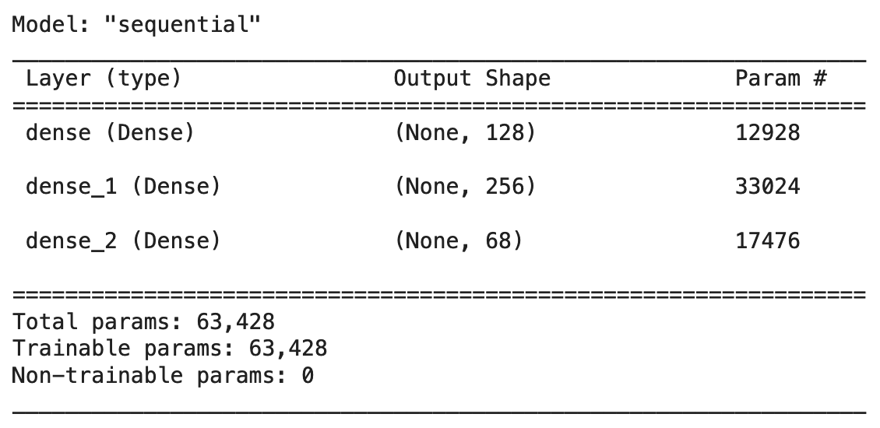
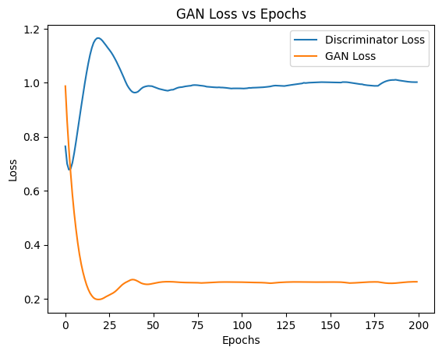
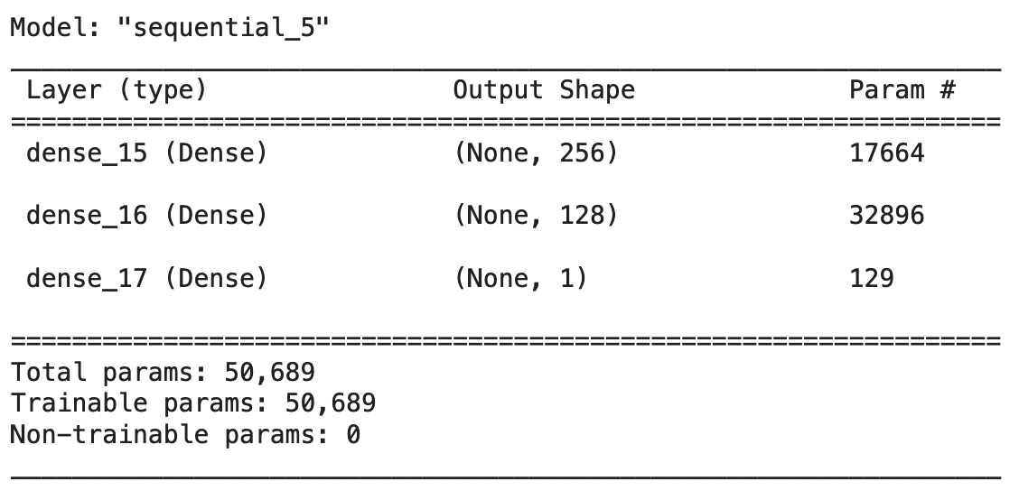
Results & Discussions .. 2
A base GAN model is created using 3 dense layers in Generator and Discriminator.
GAN loss and Discriminator loss both stabilize after about 30 epochs.
The number of samples is set to 46456 in order to recreate an entire dataset.
GAN loss is 0.24 and Discriminator loss is 1.02
Base GAN Model for Generator & discriminator
Base GAN model Loss vs Epochs

Slide 11
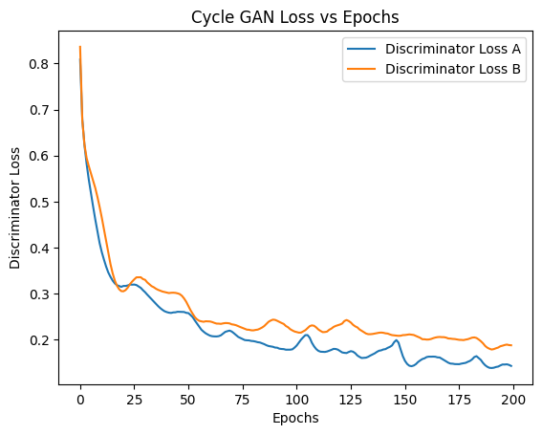
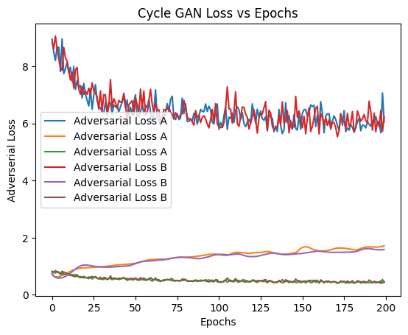
Results & Discussions .. 3
cycle GAN Model Discriminator Loss
cycle GAN Model Adversarial Loss
Cycle GAN model is created using same 3 dense layers (like base GAN model) for both Generator (BA, AB) and Discriminator (A , B).
Adversarial loss and Discriminator loss both stabilize after about 150 epochs.
The number of samples is set to 46456 in order to recreate an entire dataset.
Adversarial loss and Discriminator loss are both found to be lesser than base GAN model

Slide 12
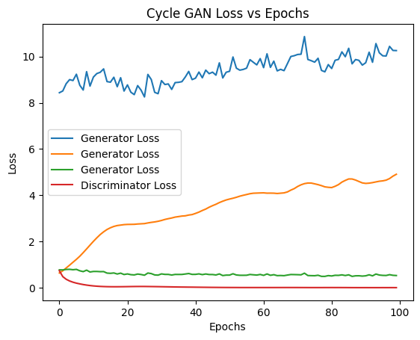
Results & Discussions .. 3
Alternate Cycle GAN model is created using same 3 dense layers (like base GAN model) for both Generator (BA, AB) and Discriminator (A , B).
Adversarial loss and Discriminator loss both show an increasing trend ove 100 epochs.
The number of samples is set to 46456 in order to recreate an entire dataset.
GAN loss and Discriminator loss are both found to be more than the base cycle GAN model but less than the cycle GAN model
Alternate GAN Model Generator & Discriminator Loss

Slide 13
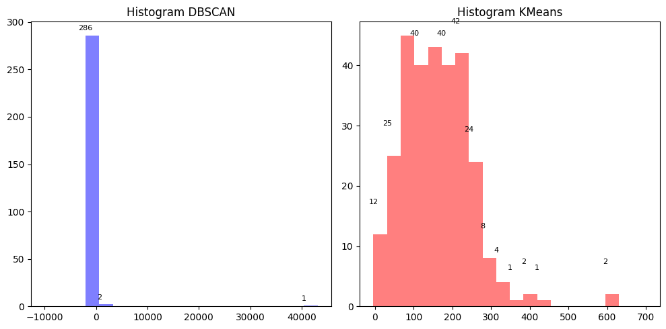
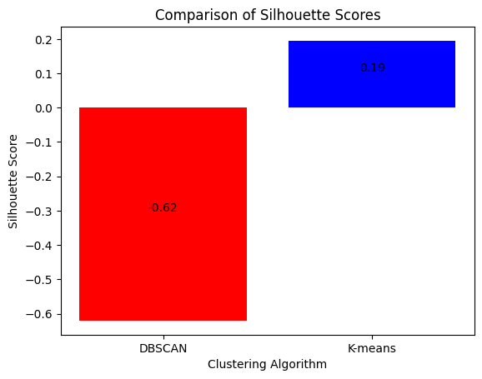
Conclusion & Future Recommendations .. 1
Objective 1: To analyse the relationship and pattern between various IOT network packets
Cluster Histogram from DBSCAN and KMeans
Silhouette Score
Multiple clusters on KMeans histogram vs only three clusters DBSCAN histogram.
Silhouette score of KMeans is positive compared to a negative score for DBSCAN.
Positive score for KMeans indicates that the clusters are apart from each other compared to DBSCAN with overlapping clusters.

Slide 14
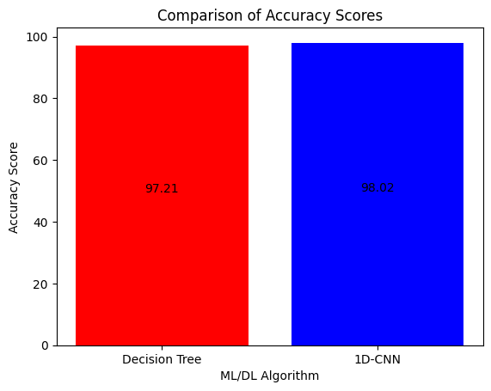
Conclusion & Future Recommendations .. 2
Objective 2: To find a suitable IOT dataset rich in samples and features
Enriched IOT dataset is found to be suitable dataset. It combines BOT-IOT and TON-IOT datasets to create a new vertically and horizontally enhanced publicly available IOT dataset.
Objective 3: To suggest a suitable deep learning model that can be applied on IOT anomalous packets.
1D CNN is suitable for IOT network traffic since there is no spatial element to the dataset and features in each sample are a complete representation of that sample
1 % increase in accuracy is observed between Deep Learning model and Machine Learning Models

Slide 15
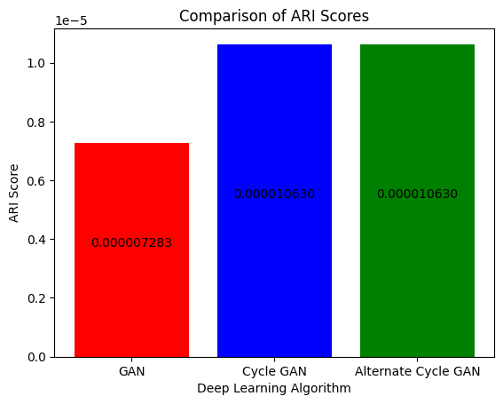
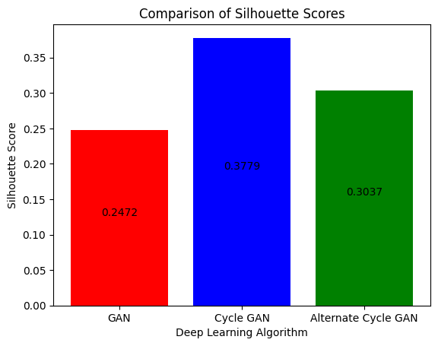
Conclusion & Future Recommendations .. 3
Objective 4: To evaluate the performance of the various ML/DL models based on different evaluation methods
Silhouette Score and ARI score for GAN, cycle GAN and Alternate GAN show that cycle GAN is able to best classify the generated data. A Silhouette score of 0.38 indicates that clusters are able to be formed with their neighbours with appropriate distance

Slide 16
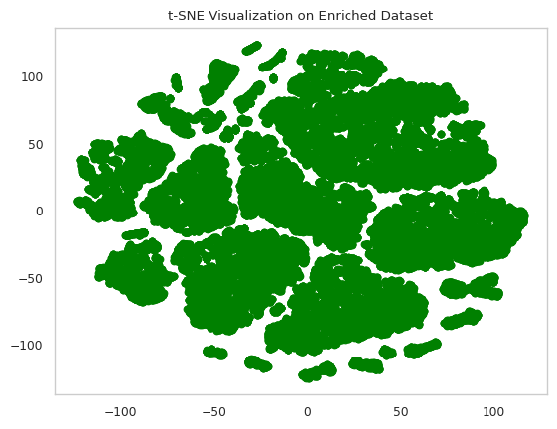
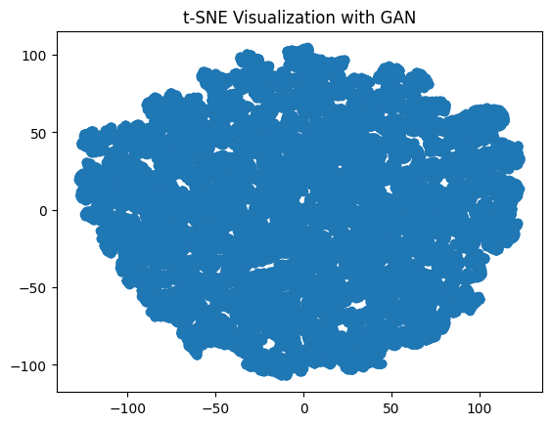
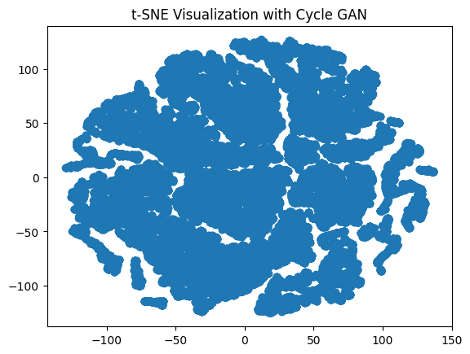
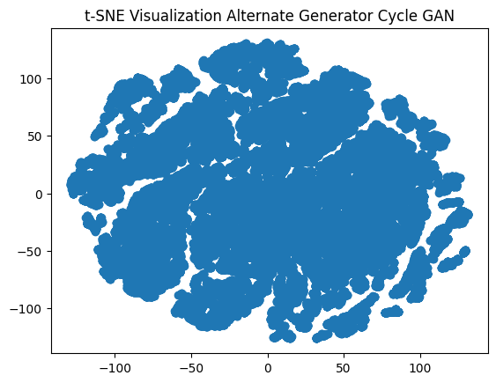
Conclusion & Future Recommendations .. 4
Objective 4: To evaluate the performance of the various ML/DL models based on different evaluation methods
T-SNE plots clearly show visually that cycle-GAN is closest to the original dataset (green).
GAN is not able to generate network packets which can be easily clustered.
Cycle GAN and Alternate GAN both out perform GAN in terms of synthetic network packet generation.

Slide 17
Conclusion & Future Recommendations .. 5
Enriched IOT dataset is recommended to be used as publicly available IOT dataset for future work on IOT anomaly detection.
GAN models can be fine-tuned to better mimic IOT network data traffic.
TimeGAN for temporal correlations unique to time series data can be applied to find any spatial correlation amongst the samples.

Slide 18
Thank You

