Slide 1
Bab 4 Properties of Regular Languages
General Discussion of “Properties”
The Pumping Lemma
Membership, Emptiness, Etc.

Slide 2
Properties of Language Classes
A language class is a set of languages.
We have one example: the regular languages.
We’ll see many more in this class.
Language classes have two important kinds of properties:
Decision properties.
Closure properties.

Slide 3
Representation of Languages
Representations can be formal or informal.
Example (formal): represent a language by a RE or DFA defining it.
Example: (informal): a logical or prose statement about its strings:
{0^{n}1^{n} | n is a nonnegative integer}
“The set of strings consisting of some number of 0’s followed by the same number of 1’s.”

Slide 4
Decision Properties
A decision property for a class of languages is an algorithm that takes a formal description of a language (e.g., a DFA) and tells whether or not some property holds.
Example: Is language L empty?
Diketahui regular languages L dan M, apakah L = M?
Diketahui regular languages L dan M, apakah L ⊆ M?

Slide 5
Closure Properties
A closure property of a language class says that given languages in the class, an operator (e.g., union) produces another language in the same class.
Example: the regular languages are obviously closed under union, concatenation, and (Kleene) closure.
Use the RE representation of languages.

Slide 6
Why Closure Properties?
Helps construct representations.
Helps show (informally described) languages not to be in the class.

Slide 7
Example: Use of Closure Property
We can easily prove L₁ = {0^{n}1^{n} | n > 0} is not a regular language.
L₂ = the set of strings with an = number of 0’s and 1’s isn’t either, but that fact is trickier to prove.
Regular languages are closed under ∩.
If L₂ were regular, then L₂ ∩L(0*1*) = L₁ would be, but it isn’t.

Slide 8
The Membership Question
Our first decision property is the question: “is string w in regular language L?”
Assume L is represented by a DFA A.
Simulate the action of A on the sequence of input symbols forming w.

Slide 9
Example: Testing Membership
0 1 0 1 1
Next
symbol
0
0,1
1
1
A
B
C
Start
0
Current
state

Slide 10
Example: Testing Membership
0 1 0 1 1
Next
symbol
0
0,1
1
1
A
B
C
Start
0
Current
state

Slide 11
Example: Testing Membership
0 1 0 1 1
Next
symbol
0
0,1
1
1
A
B
C
Start
0
Current
state

Slide 12
Example: Testing Membership
0 1 0 1 1
Next
symbol
0
0,1
1
1
A
B
C
Start
0
Current
state

Slide 13
Example: Testing Membership
0 1 0 1 1
Next
symbol
0
0,1
1
1
A
B
C
Start
0
Current
state

Slide 14
Example: Testing Membership
0 1 0 1 1
Next
symbol
0
0,1
1
1
A
B
C
Start
0
Current
state

Slide 15
What if the Regular Language Is not Represented by a DFA?
There is a circle of conversions from one form to another:
RE
ε-NFA
DFA
NFA

Slide 16
The Emptiness Problem
Given a regular language, does the language contain any string at all.
Assume representation is DFA.
Construct the transition graph.
Compute the set of states reachable from the start state.
If any final state is reachable, then yes, else no.

Slide 17
The Infiniteness Problem
Is a given regular language infinite?
Start with a DFA for the language.
Key idea: if the DFA has n states, and the language contains any string of length n or more, then the language is infinite.
Otherwise, the language is surely finite.
Limited to strings of length n or less.

Slide 18
Proof of Key Idea
If an n-state DFA accepts a string w of length n or more, then there must be a state that appears twice on the path labeled w from the start state to a final state.
Because there are at least n+1 states along the path.

Slide 19
Proof – (2)
w = xyz
y
x
z
Then xy^{i}z is in the language for all i > 0.
Since y is not ε, we see an infinite
number of strings in L.

Slide 20
Infiniteness – Continued
We do not yet have an algorithm.
There are an infinite number of strings of length > n, and we can’t test them all.
Second key idea: if there is a string of length > n (= number of states) in L, then there is a string of length between n and 2n-1.

Slide 21
Proof of 2nd Key Idea
y
Remember:
We can choose y to be the first cycle on the path.
So |xy| < n; in particular, 1 < |y| < n.
Thus, if w is of length 2n or more, there is a shorter string in L that is still of length at least n.
Keep shortening to reach [n, 2n-1].
x
z

Slide 22
The Pumping Lemma
We have, almost accidentally, proved a statement that is quite useful for showing certain languages are not regular.
Called the pumping lemma for regular languages.

Slide 23
Statement of the Pumping Lemma
Number of
states of
DFA for L
For every regular language L
There is an integer n, such that
For every string w in L of length > n
We can write w = xyz such that:
|xy| < n.
|y| > 0.
For all i > 0, xy^{i}z is in L.
Labels along
first cycle on
path labeled w

Slide 24
Example: Use of Pumping Lemma
We have claimed {0^{k}1^{k} | k > 1} is not a regular language.
Suppose it were. Then there would be an associated n for the pumping lemma.
Let w = 0^{n}1^{n}. We can write w = xyz, where x and y consist of 0’s, and y ≠ ε.
But then xyyz would be in L, and this string has more 0’s than 1’s.

Slide 25
Ilustrasi

Slide 27
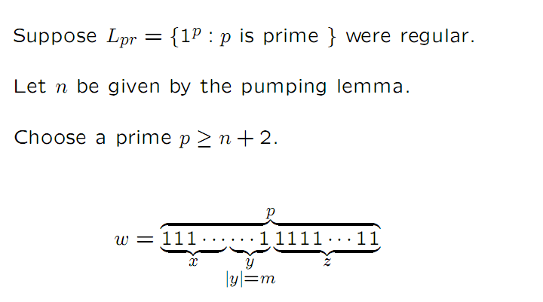
Contoh
Perlihatkan dengan Pumping Lemma
L_{pr} = { 1 ^{p} | p = prima}
Jawab: Ide pembuktian dengan kontradiksi.
Bilangan prima adalah bilangan yg merupakan perkalian 1 dan bilangan tersebut.

Slide 28
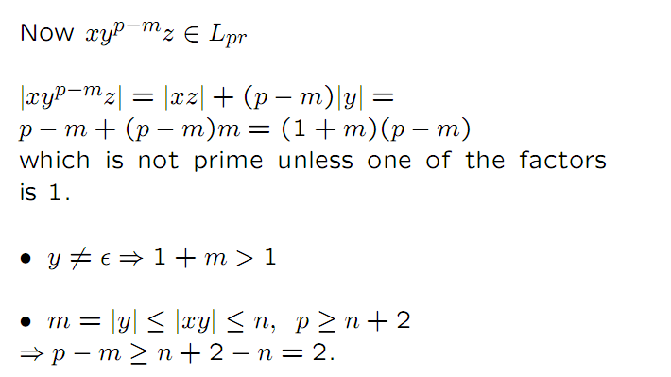

Slide 31
Decision Properties
A decision property for a class of languages is an algorithm that takes a formal description of a language (e.g., a DFA) and tells whether or not some property holds.
Example: Is language L empty?
Diketahui regular languages L dan M, apakah L = M?
Diketahui regular languages L dan M, apakah L ⊆ M?

Slide 32
Pemeriksaan Kesamaan Dua Finite Automata

Slide 33
Teknik Untuk Memeriksa Kesamaan 2 Finite Automata
Teknik Perkalian Finite Automata
Teknik Minimisasi State pada Finite Automata dgn Distinguishable Table (Table Filling Algorithm)

Slide 34
Teknik Untuk Memeriksa Kesamaan 2 Finite Automata
Teknik Perkalian Finite Automata
Buatlah sebuah FA baru yang merupakan hasil perkalian 2 FA lama
Tetapkan state akhir pada FA baru yaitu state baru merupakan gabungan dari 2 state lama dimana hanya salah satu state pada FA lama merupakan state akhir. State final merepresentasikan status perbedaan string diterima dari 2 FA lama tsb
Hubungkan setiap state (tetapkan transition function) pada FA baru berdasar transition function FA lama
Jika pada FA baru, tidak ada string yang bisa diterima, maka dapat dinyatakan bahwa 2 FA tsb adalah sama

Slide 35
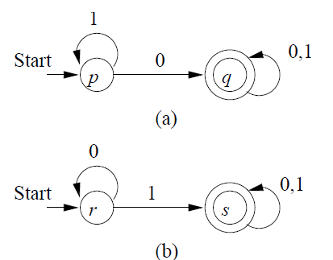
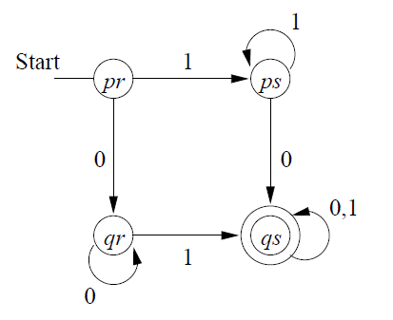
Teknik dgn Perkalian FA
Hasil perkalian:
Karena FA hasil perkalian di atas dapat menerima string (cth: 1,11,0,00,dst; dgn final state berupa ps dan qr) maka 2 FA ini tidak ekuivalen
qs

Slide 36
Product DFA utk Equivalence
0
0
1
0
A
B
[A,C]
[A,D]
0, 1
1
1
1
0
0
1
[B,C]
[B,D]
0
1
0
C
D
[A,C] dan [B,D] tidak boleh tercapai:
Ada yg diterima di salah satu FA tp
tdk diterima di FA lainnya
1

Slide 37
Decision Property: Containment
Diketahui regular languages L dan M, apakah L ⊆ M?
Menggunakan product automaton

Slide 38
Product DFA utk Containment
0
0
1
0
A
B
[A,C]
[A,D]
0, 1
1
1
1
0
0
1
[B,C]
[B,D]
0
1
0
C
D
[B,D] tidak boleh tercapai:
diterima di L,
tp tdk diterima di M
1

Slide 39
Teknik Untuk Memeriksa Kesamaan 2 Finite Automata
Teknik Minimisasi State pada Finite Automata dgn Distinguishable Table (Table Filling Algorithm)
Buatlah sebuah distinguishable table yang jumlah kolom dan barisnya mewakili gabungan semua state pada 2 FA yang lama.
Jika state awal dan state akhir pada 2 FA bernilai indistinguishable (tidak bisa dibedakan) maka 2 FA merupakan FA yang sama.
Untuk mengisi x pada table filling sbb

Slide 40
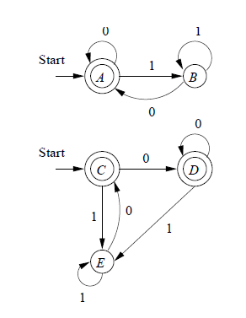
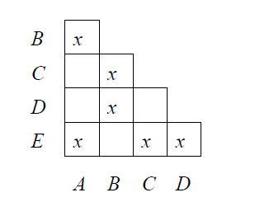
Teknik dgn Distinguishable Table (Table Filling Algorithm)
Karena start state tidak bisa dibedakan maka 2 FA ini adalah sama

Slide 41
The Minimum-State DFA for a Regular Language
In principle, since we can test for equivalence of DFA’s we can, given a DFA A find the DFA with the fewest states accepting L(A).
Test all smaller DFA’s for equivalence with A.
But that’s a terrible algorithm.

Slide 42
Efficient State Minimization
Construct a table with all pairs of states.
If you find a string that distinguishes two states (takes exactly one to an accepting state), mark that pair.
Algorithm is a recursion on the length of the shortest distinguishing string.

Slide 43
Constructing the Minimum-State DFA
Suppose q₁,…,q_{k} are indistinguishable states.
Replace them by one state q.
Then δ(q₁, a),…, δ(q_{k}, a) are all indistinguishable states.
Key point: otherwise, we should have marked at least one more pair.
Let δ(q, a) = the representative state for that group.

Slide 44
Example: State Minimization
r b
r b
A B C
B D E
C D F
D D G
E D G
F D C
G D G
{1}
{2,4} {5}
{2,4}
{2,4,6,8} {1,3,5,7}
Here it is
with more
convenient
state names
{5}
{2,4,6,8} {1,3,7,9}
{2,4,6,8}
{2,4,6,8} {1,3,5,7,9}
{1,3,5,7}
{2,4,6,8} {1,3,5,7,9}
* {1,3,7,9}
{2,4,6,8} {5}
*
* {1,3,5,7,9}
{2,4,6,8} {1,3,5,7,9}
*
Remember this DFA? It was constructed for the
chessboard NFA by the subset construction.

Slide 45
Example – Continued
r b
A B C
B D E
C D F
D D G
E D G
F D C
G D G
G F E D C B
A
B
C
D
E
F
x
x
x
x
x
x
x
x
x
x
*
*
Start with marks for
the pairs with one of
the final states F or G.

Slide 46
Example – Continued
r b
A B C
B D E
C D F
D D G
E D G
F D C
G D G
G F E D C B
A
B
C
D
E
F
x
x
x
x
x
x
x
x
x
x
*
*
Input r gives no help,
because the pair [B, D]
is not marked.

Slide 47
Example – Continued
r b
A B C
B D E
C D F
D D G
E D G
F D C
G D G
G F E D C B
A
B
C
D
E
F
x
x
x
x
x
x
x
x
x
x
x
x
x
x
x
x
*
x
*
But input b distinguishes {A,B,F}
from {C,D,E,G}. For example, [A, C]
gets marked because [C, F] is marked.

Slide 48
Example – Continued
r b
A B C
B D E
C D F
D D G
E D G
F D C
G D G
G F E D C B
A
B
C
D
E
F
x
x
x
x
x
x
x
x
x
x
x
x
x
x
x
x
x
x
*
x
*
[C, D] and [C, E] are marked
because of transitions on b to
marked pair [F, G].

Slide 49
Example – Continued
r b
A B C
B D E
C D F
D D G
E D G
F D C
G D G
G F E D C B
A
B
C
D
E
F
x
x
x
x
x
x
x
x
x
x
x
x
x
x
x
x
x
x
x
*
x
*
[A, B] is marked
because of transitions on r
to marked pair [B, D].
[D, E] can never be marked,
because on both inputs they
go to the same state.

Slide 50
Example – Concluded
r b
A B C
B D E
C D F
D D G
E D G
F D C
G D G
r b
A B C
B H H
C H F
H H G
F H C
G H G
G F E D C B
A
B
C
D
E
F
x
x
x
x
x
x
x
x
x
x
x
x
x
x
x
x
x
x
x
*
*
x
*
*
Replace D and E by H.
Result is the minimum-state DFA.

Slide 51
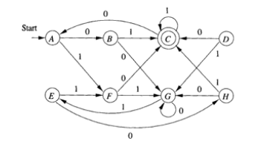
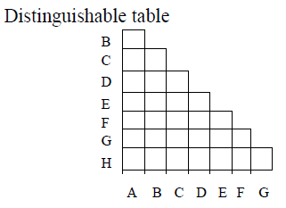
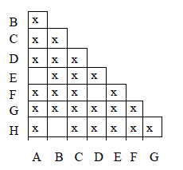
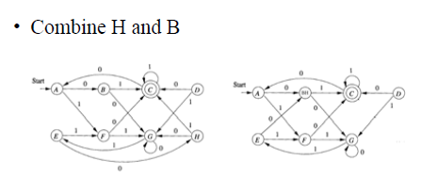
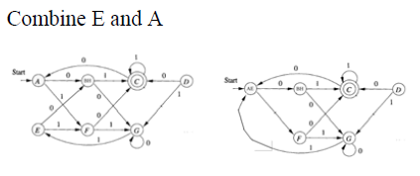
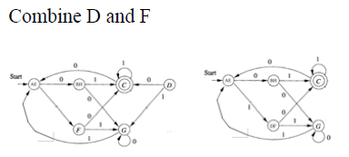

Slide 52
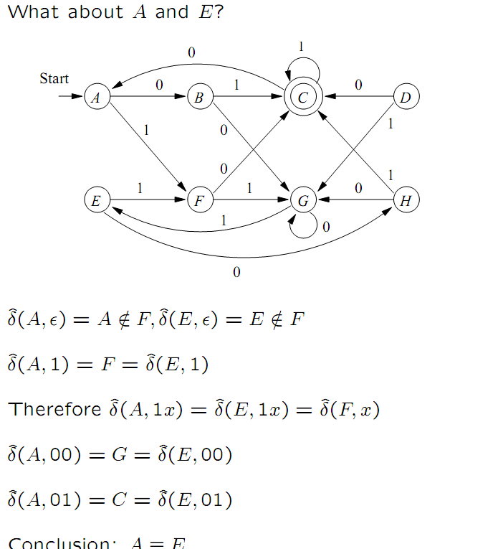

Slide 53
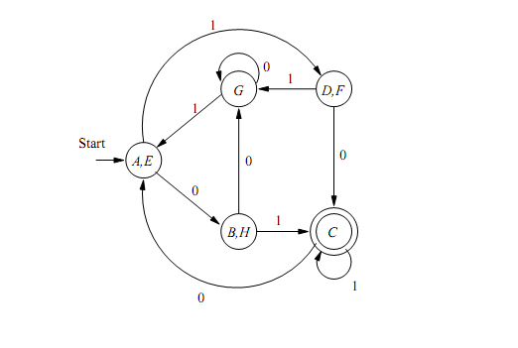

Slide 54
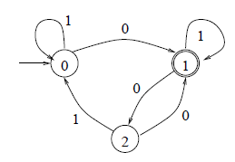
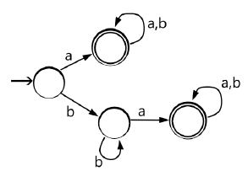
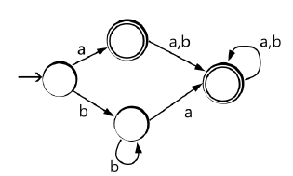
Soal Latihan
Minimalkan state pada FA
Apakah dua FA di bawah ini ekuivalen? Bagaimanakah bentuk FA dgn minimal statenya?

Slide 56
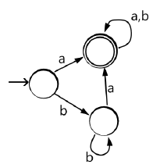
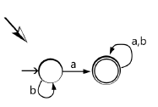

Slide 57
Closure Properties of Regular Languages
Union, Intersection, Difference, Concatenation, Kleene Closure, Reversal, Homomorphism, Inverse Homomorphism

Slide 58
Closure Properties
Recall a closure property is a statement that a certain operation on languages, when applied to languages in a class (e.g., the regular languages), produces a result that is also in that class.
For regular languages, we can use any of its representations to prove a closure property.

Slide 59
Closure Under Union
If L and M are regular languages, so is L ∪ M.
Proof: Let L and M be the languages of regular expressions R and S, respectively.
Then R+S is a regular expression whose language is L ∪ M.

Slide 60
Closure Under Concatenation and Kleene Closure
Same idea:
RS is a regular expression whose language is LM.
R* is a regular expression whose language is L*.

Slide 61
Closure Under Intersection
If L and M are regular languages, then so is L ∩ M.
Proof: Let A and B be DFA’s whose languages are L and M, respectively.
Construct C, the product automaton of A and B.
Make the final states of C be the pairs consisting of final states of both A and B.

Slide 62
Example: Product DFA for Intersection
0
0
1
0
A
B
[A,C]
[A,D]
0, 1
1
1
1
0
0
1
[B,C]
[B,D]
0
1
0
C
D
1

Slide 63
Closure Under Difference
If L and M are regular languages, then so is L – M = strings in L but not M.
Proof: Let A and B be DFA’s whose languages are L and M, respectively.
Construct C, the product automaton of A and B.
Make the final states of C be the pairs where A-state is final but B-state is not.

Slide 64
Example: Product DFA for Difference
0
0
1
0
A
B
[A,C]
[A,D]
0, 1
1
1
1
0
0
1
[B,C]
[B,D]
0
1
0
C
D
1
Notice: difference
is the empty language

Slide 65
Closure Under Complementation
The complement of a language L (with respect to an alphabet Σ such that Σ* contains L) is Σ* – L.
Since Σ* is surely regular, the complement of a regular language is always regular.

Slide 66
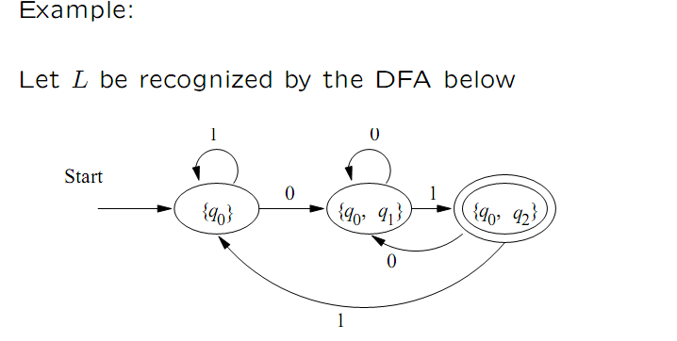

Slide 67
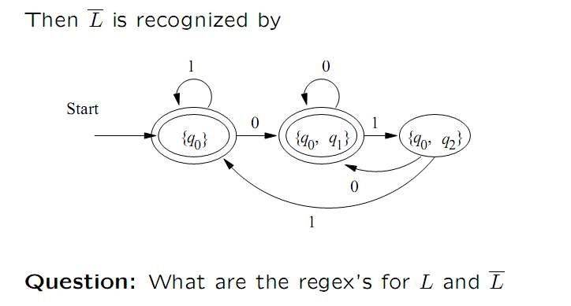

Slide 68
Closure Under Reversal
Recall example of a DFA that accepted the binary strings that, as integers were divisible by 23.
We said that the language of binary strings whose reversal was divisible by 23 was also regular, but the DFA construction was very tricky.
Good application of reversal-closure.

Slide 69
Closure Under Reversal – (2)
Given language L, L^{R} is the set of strings whose reversal is in L.
Example: L = {0, 01, 100}; L^{R} = {0, 10, 001}.
Proof: Let E be a regular expression for L.
We show how to reverse E, to provide a regular expression E^{R} for L^{R}.

Slide 70
Reversal of a Regular Expression
Basis: If E is a symbol a, ε, or ∅, then E^{R} = E.
Induction: If E is
F+G, then E^{R} = F^{R} + G^{R}.
FG, then E^{R} = G^{R}F^{R}
F*, then E^{R} = (F^{R})*.

Slide 71
Example: Reversal of a RE
Let E = 01* + 10*.
E^{R} = (01* + 10*)^{R} = (01*)^{R} + (10*)^{R}
= (1*)^{R}0^{R} + (0*)^{R}1^{R}
= (1^{R})*0 + (0^{R})*1
= 1*0 + 0*1.

Slide 72
Homomorphisms
A homomorphism on an alphabet is a function that gives a string for each symbol in that alphabet.
Example: h(0) = ab; h(1) = ε.
Extend to strings by h(a₁…a_{n}) = h(a₁)…h(a_{n}).
Example: h(01010) = ababab.

Slide 73
Closure Under Homomorphism
If L is a regular language, and h is a homomorphism on its alphabet, then h(L) = {h(w) | w is in L} is also a regular language.
Proof: Let E be a regular expression for L.
Apply h to each symbol in E.
Language of resulting RE is h(L).

Slide 74
Example: Closure under Homomorphism
Let h(0) = ab; h(1) = ε.
Let L be the language of regular expression 01* + 10*.
Then h(L) is the language of regular expression abε* + ε(ab)*.
Note: use parentheses
to enforce the proper
grouping.

Slide 75
Example – Continued
abε* + ε(ab)* can be simplified.
ε* = ε, so abε* = abε.
ε is the identity under concatenation.
That is, εE = Eε = E for any RE E.
Thus, abε* + ε(ab)* = abε + ε(ab)* = ab + (ab)*.
Finally, L(ab) is contained in L((ab)*), so a RE for h(L) is (ab)*.

Slide 76
Inverse Homomorphisms
Let h be a homomorphism and L a language whose alphabet is the output language of h.
h⁻¹(L) = {w | h(w) is in L}.

Slide 78
Example: Inverse Homomorphism
Let h(0) = ab; h(1) = ε.
Let L = {abab, baba}.
h⁻¹(L) = the language with two 0’s and any number of 1’s = L(1*01*01*).
Notice: no string maps to
baba; any string with exactly
two 0’s maps to abab.

Slide 79
Closure Proof for Inverse Homomorphism
Start with a DFA A for L.
Construct a DFA B for h⁻¹(L) with:
The same set of states.
The same start state.
The same final states.
Input alphabet = the symbols to which homomorphism h applies.

Slide 80
Proof – (2)
The transitions for B are computed by applying h to an input symbol a and seeing where A would go on sequence of input symbols h(a).
Formally, δ_{B}(q, a) = δ_{A}(q, h(a)).

Slide 81
Example: Inverse Homomorphism Construction
a
1
Since
h(1) = ε
B
B
1
a
A
b
A
0
b
b
0
Since
h(0) = ab
C
C
a
1
, 0
h(0) = ab
h(1) = ε

Slide 82
Proof – (3)
Induction on |w| shows that δ_{B}(q₀, w) = δ_{A}(q₀, h(w)).
Basis: w = ε.
δ_{B}(q₀, ε) = q₀, and δ_{A}(q₀, h(ε)) = δ_{A}(q₀, ε) = q₀.

Slide 83
Proof – (4)
Induction: Let w = xa; assume IH for x.
δ_{B}(q₀, w) = δ_{B}(δ_{B}(q₀, x), a).
= δ_{B}(δ_{A}(q₀, h(x)), a) by the IH.
= δ_{A}(δ_{A}(q₀, h(x)), h(a)) by definition of the DFA B.
= δ_{A}(q₀, h(x)h(a)) by definition of the extended delta.
= δ_{A}(q₀, h(w)) by def. of homomorphism.

