Slide 1
Bab 3 Regular Expressions
Definitions
Equivalence to Finite Automata

Slide 2
RE’s: Introduction
Regular expressions are an algebraic way to describe languages.
They describe exactly the regular languages.
If E is a regular expression, then L(E) is the language it defines.
We’ll describe RE’s and their languages recursively.

Slide 3
RE’s: Definition
Basis 1: If a is any symbol, then a is a RE, and L(a) = {a}.
Note: {a} is the language containing one string, and that string is of length 1.
Basis 2: ε is a RE, and L(ε) = {ε}.
Basis 3: ∅ is a RE, and L(∅) = ∅.

Slide 4
RE’s: Definition – (2)
Induction 1: If E₁ and E₂ are regular expressions, then E₁+E₂ is a regular expression, and L(E₁+E₂) = L(E₁)∪L(E₂).
Induction 2: If E₁ and E₂ are regular expressions, then E₁E₂ is a regular expression, and L(E₁E₂) = L(E₁)L(E₂).
Concatenation : the set of strings wx such that w
Is in L(E₁) and x is in L(E₂).

Slide 5
RE’s: Definition – (3)
Induction 3: If E is a RE, then E* is a RE, and L(E*) = (L(E))*.
Closure, or “Kleene closure” = set of strings
w₁w₂…w_{n}, for some n > 0, where each w_{i} is
in L(E).
Note: when n=0, the string is ε.

Slide 6
Precedence of Operators
Parentheses may be used wherever needed to influence the grouping of operators.
Order of precedence is * (highest), then concatenation, then + (lowest).

Slide 7
Examples: RE’s
L(01) = {01}.
L(01+0) = {01, 0}.
L(0(1+0)) = {01, 00}.
Note order of precedence of operators.
L(0*) = {ε, 0, 00, 000,… }.
L((0+10)*(ε+1)) = all strings of 0’s and 1’s without two consecutive 1’s.

Slide 8
Contoh

Slide 9
Equivalence of RE’s and Automata
We need to show that for every RE, there is an automaton that accepts the same language.
Pick the most powerful automaton type: the ε-NFA.
And we need to show that for every automaton, there is a RE defining its language.
Pick the most restrictive type: the DFA.

Slide 10
Converting a RE to an ε-NFA
Proof is an induction on the number of operators (+, concatenation, *) in the RE.
We always construct an automaton of a special form (next slide).

Slide 11
Form of ε-NFA’s Constructed
No arcs from outside,
no arcs leaving
Start state:
Only state
with external
predecessors
“Final” state:
Only state
with external
successors

Slide 12
RE to ε-NFA: Basis
Symbol a:
ε:
∅:
a
ε

Slide 13
RE to ε-NFA: Induction 1 – Union
For E₁
ε
ε
For E₂
ε
ε
For E₁ ∪ E₂

Slide 14
RE to ε-NFA: Induction 2 – Concatenation
For E₁
For E₂
ε
For E₁E₂

Slide 15
RE to ε-NFA: Induction 3 – Closure
ε
For E
ε
ε
ε
For E*

Slide 16
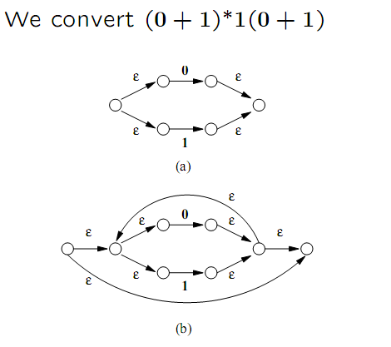
Contoh RE –NFA epsilon

Slide 17
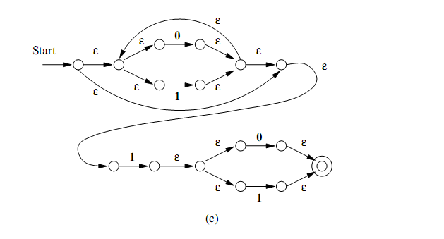

Slide 18
DFA-to-RE
A strange sort of induction.
States of the DFA are assumed to be 1,2,…,n.
We construct RE’s for the labels of restricted sets of paths.
Basis: single arcs or no arc at all.
Induction: paths that are allowed to traverse next state in order.

Slide 19
k-Paths
A k-path is a path through the graph of the DFA that goes though no intermediate state numbered higher than k.
Endpoints are not restricted; they can be any state.

Slide 20
Example: k-Paths
1
0-paths from 2 to 3:
RE for labels = 0.
1
2
0
0
0
1
1
1-paths from 2 to 3:
RE for labels = 0+11.
3
2-paths from 2 to 3:
RE for labels =
(10)*0+1(01)*1
3-paths from 2 to 3:
RE for labels = ??

Slide 21
k-Path Induction
Let R_{ij}^{k} be the regular expression for the set of labels of k-paths from state i to state j.
Basis: k=0. R_{ij}⁰ = sum of labels of arc from i to j.
∅ if no such arc.
But add ε if i=j.

Slide 22
Example: Basis
1
1
2
0
0
0
1
1
3
R₁₂⁰ = 0.
R₁₁⁰ = ∅ + ε = ε.

Slide 23
k-Path Inductive Case
A k-path from i to j either:
Never goes through state k, or
Goes through k one or more times.
R_{ij}^{k} = R_{ij}^{k-1} + R_{ik}^{k-1}(R_{kk}^{k-1})* R_{kj}^{k-1}.
Goes from
i to k the
first time
Then, from
k to j
Doesn’t go
through k
Zero or
more times
from k to k

Slide 24
Illustration of Induction
Path to k
Paths not going
through k
i
From k to k
Several times
j
k
States < k
From k
to j

Slide 25
Final Step
The RE with the same language as the DFA is the sum (union) of R_{ij}^{n}, where:
n is the number of states; i.e., paths are unconstrained.
i is the start state.
j is one of the final states.

Slide 26
Example
1
1
2
0
0
0
1
1
3
R₂₃³ = R₂₃² + R₂₃²(R₃₃²)*R₃₃² = R₂₃²(R₃₃²)*
R₂₃² = (10)*0+1(01)*1
R₃₃² = 0(01)*(1+00) + 1(10)*(0+11)
R₂₃³ = [(10)*0+1(01)*1] [(0(01)*(1+00) + 1(10)*(0+11))]*

Slide 27
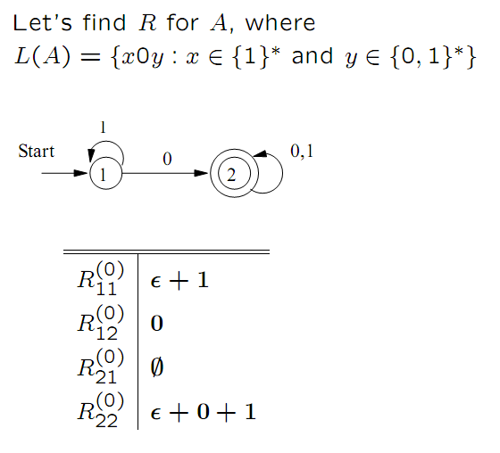

Slide 28
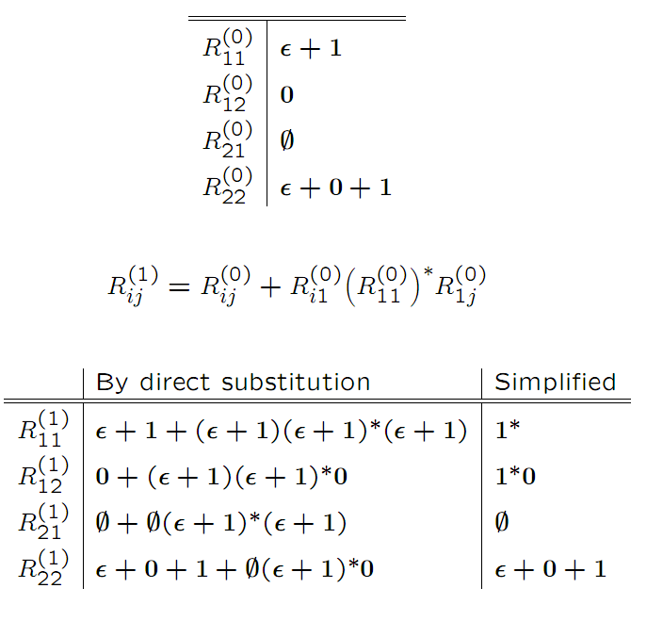

Slide 29
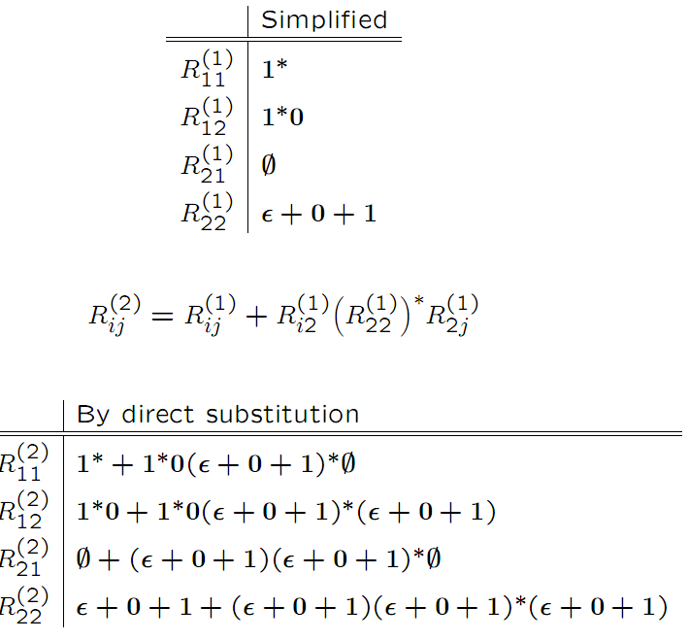

Slide 30
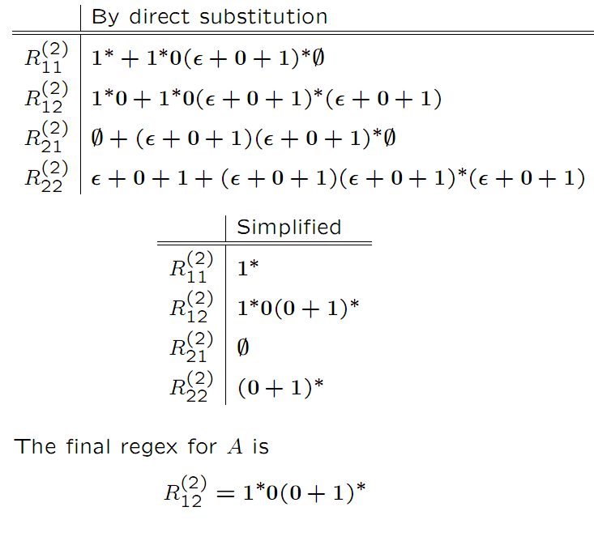

Slide 38
Summary
Each of the three types of automata (DFA, NFA, ε-NFA) we discussed, and regular expressions as well, define exactly the same set of languages: the regular languages.

Slide 39
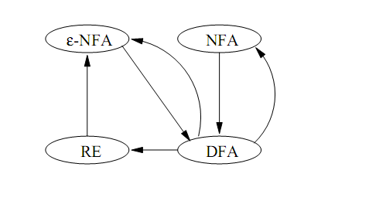

Slide 40
Algebraic Laws for RE’s
Union and concatenation behave sort of like addition and multiplication.
+ is commutative and associative; concatenation is associative.
Concatenation distributes over +.
Exception: Concatenation is not commutative.

Slide 41
Identities and Annihilators
∅ is the identity for +.
R + ∅ = R.
ε is the identity for concatenation.
εR = Rε = R.
∅ is the annihilator for concatenation.
∅R = R∅ = ∅.

Slide 42
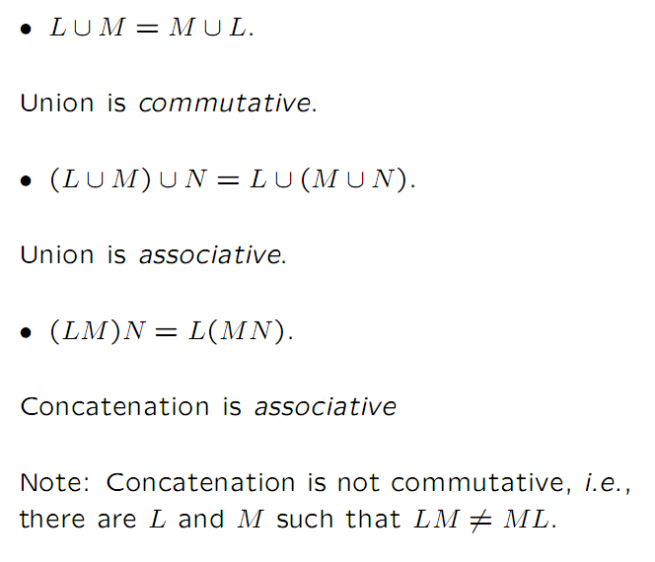

Slide 43
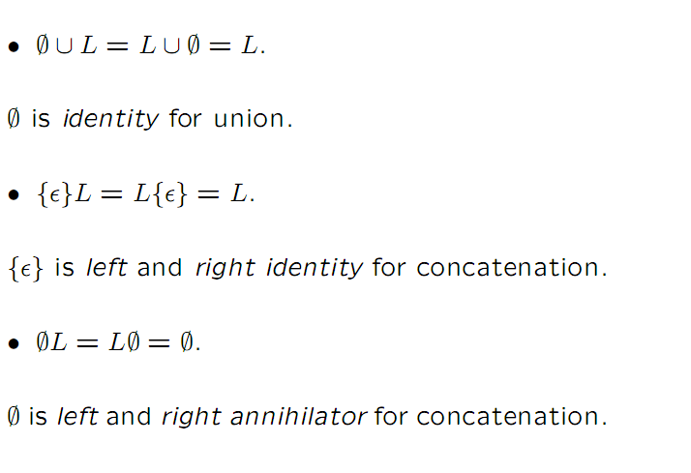

Slide 44
