Slide 1
Bab 6 Pushdown Automata
Definition
Moves of the PDA
Languages of the PDA
Deterministic PDA’s

Slide 2
Pushdown Automata
The PDA is an automaton equivalent to the CFG in language-defining power.
Only the nondeterministic PDA defines all the CFL’s.
But the deterministic version models parsers.
Most programming languages have deterministic PDA’s.

Slide 3
Intuition: PDA
Think of an ε-NFA with the additional power that it can manipulate a stack.
Its moves are determined by:
The current state (of its “NFA”),
The current input symbol (or ε), and
The current symbol on top of its stack.

Slide 4
Intuition: PDA – (2)
Being nondeterministic, the PDA can have a choice of next moves.
In each choice, the PDA can:
Change state, and also
Replace the top symbol on the stack by a sequence of zero or more symbols.
Zero symbols = “pop.”
Many symbols = sequence of “pushes.”

Slide 5
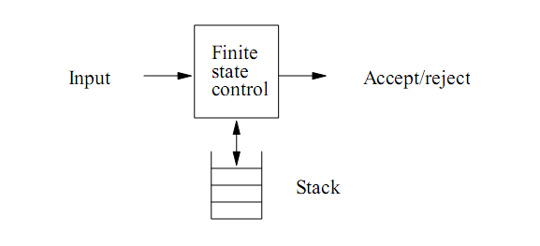
Ilustrasi PDA

Slide 6
PDA Formalism
A PDA is described by:
A finite set of states (Q, typically).
An input alphabet (Σ, typically).
A stack alphabet (Γ, typically).
A transition function (δ, typically).
A start state (q₀, in Q, typically).
A start symbol (Z₀, in Γ, typically).
A set of final states (F ⊆ Q, typically).

Slide 7
Conventions
a, b, … are input symbols.
But sometimes we allow ε as a possible value.
…, X, Y, Z are stack symbols.
…, w, x, y, z are strings of input symbols.
α, β,… are strings of stack symbols.

Slide 8
The Transition Function
Takes three arguments:
A state, in Q.
An input, which is either a symbol in Σ or ε.
A stack symbol in Γ.
δ(q, a, Z) is a set of zero or more actions of the form (p, α).
p is a state; α is a string of stack symbols.

Slide 9
Actions of the PDA
If δ(q, a, Z) contains (p, α) among its actions, then one thing the PDA can do in state q, with a at the front of the input, and Z on top of the stack is:
Change the state to p.
Remove a from the front of the input (but a may be ε).
Replace Z on the top of the stack by α.

Slide 10
Example: PDA
Design a PDA to accept {0^{n}1^{n} | n > 1}.
The states:
q = start state. We are in state q if we have seen only 0’s so far.
p = we’ve seen at least one 1 and may now proceed only if the inputs are 1’s.
f = final state; accept.

Slide 11
Example: PDA – (2)
The stack symbols:
Z₀ = start symbol. Also marks the bottom of the stack, so we know when we have counted the same number of 1’s as 0’s.
X = marker, used to count the number of 0’s seen on the input.

Slide 12
Example: PDA – (3)
The transitions:
δ(q, 0, Z₀) = {(q, XZ₀)}.
δ(q, 0, X) = {(q, XX)}. These two rules cause one X to be pushed onto the stack for each 0 read from the input.
δ(q, 1, X) = {(p, ε)}. When we see a 1, go to state p and pop one X.
δ(p, 1, X) = {(p, ε)}. Pop one X per 1.
δ(p, ε, Z₀) = {(f, Z₀)}. Accept at bottom.

Slide 13
Actions of the Example PDA
0 0 0 1 1 1
q
Z₀

Slide 14
Actions of the Example PDA
0 0 1 1 1
q
X
Z₀

Slide 15
Actions of the Example PDA
0 1 1 1
q
X
X
Z₀

Slide 16
Actions of the Example PDA
1 1 1
q
X
X
X
Z₀

Slide 17
Actions of the Example PDA
1 1
p
X
X
Z₀

Slide 18
Actions of the Example PDA
1
p
X
Z₀

Slide 19
Actions of the Example PDA
p
Z₀

Slide 20
Actions of the Example PDA
f
Z₀

Slide 21
Instantaneous Descriptions
We can formalize the pictures just seen with an instantaneous description (ID).
A ID is a triple (q, w, α), where:
q is the current state.
w is the remaining input.
α is the stack contents, top at the left.

Slide 22
The “Goes-To” Relation
To say that ID I can become ID J in one move of the PDA, we write I⊦J.
Formally, (q, aw, Xα)⊦(p, w, βα) for any w and α, if δ(q, a, X) contains (p, β).
Extend ⊦ to ⊦*, meaning “zero or more moves,” by:
Basis: I⊦*I.
Induction: If I⊦*J and J⊦K, then I⊦*K.

Slide 23
Example: Goes-To
Using the previous example PDA, we can describe the sequence of moves by:
(q, 000111, Z₀)⊦(q, 00111, XZ₀)⊦
(q, 0111, XXZ₀)⊦(q, 111, XXXZ₀)⊦(p, 11, XXZ₀)⊦
(p, 1, XZ₀)⊦(p, ε, Z₀)⊦ (f, ε, Z₀)
Thus, (q, 000111, Z₀)⊦*(f, ε, Z₀).
What would happen on input 0001111?

Slide 24
Answer
Legal because a PDA can use
ε input even if input remains.
(q, 0001111, Z₀)⊦(q, 001111, XZ₀)⊦(q, 01111, XXZ₀)⊦(q, 1111, XXXZ₀)⊦ (p, 111, XXZ₀)⊦(p, 11, XZ₀)⊦(p, 1, Z₀)⊦ (f, 1, Z₀)
Note the last ID has no move.
0001111 is not accepted, because the input is not completely consumed.

Slide 25
Aside: FA and PDA Notations
We represented moves of a FA by an extended δ, which did not mention the input yet to be read.
We could have chosen a similar notation for PDA’s, where the FA state is replaced by a state-stack combination, like the pictures just shown.

Slide 26
FA and PDA Notations – (2)
Similarly, we could have chosen a FA notation with ID’s.
Just drop the stack component.
Why the difference? My theory:
FA tend to model things like protocols, with indefinitely long inputs.
PDA model parsers, which are given a fixed program to process.

Slide 27
Language of a PDA
There are 2 approach to defining language of a PDA: PDA final state, PDA empty stack
The common way to define the language of a PDA is by final state.
If P is a PDA, then L(P) is the set of strings w such that (q₀, w, Z₀) ⊦* (f, ε, α) for final state f and any α.

Slide 28
Language of a PDA – (2)
Another language defined by the same PDA is by empty stack.
If P is a PDA, then N(P) is the set of strings w such that (q₀, w, Z₀) ⊦* (q, ε, ε) for any state q.

Slide 29
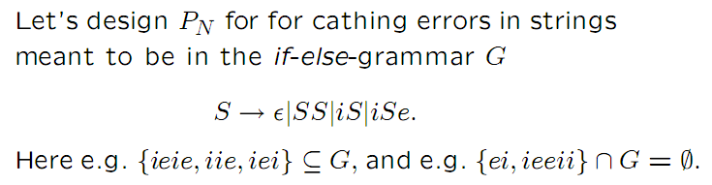
Contoh CFG if-else

Slide 30
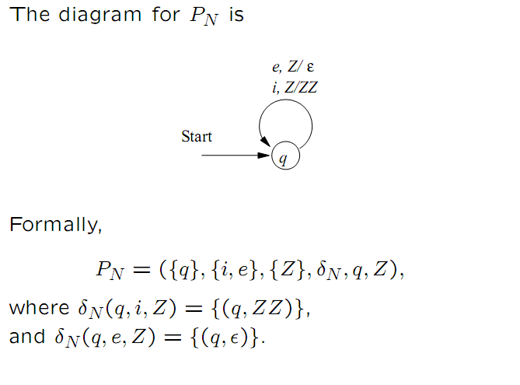

Slide 31
Equivalence of Language Definitions
If L = L(P), then there is another PDA P’ such that L = N(P’).
If L = N(P), then there is another PDA P’’ such that L = L(P’’).

Slide 32
Proof: L(P) -> N(P’) Intuition
P’ will simulate P.
If P accepts, P’ will empty its stack.
P’ has to avoid accidentally emptying its stack, so it uses a special bottom-marker to catch the case where P empties its stack without accepting.

Slide 33
Proof: L(P) -> N(P’)
P’ has all the states, symbols, and moves of P, plus:
Stack symbol X₀, used to guard the stack bottom against accidental emptying.
New start state s and “erase” state e.
δ(s, ε, X₀) = {(q₀, Z₀X₀)}. Get P started.
δ(f, ε, X) = δ(e, ε, X) = {(e, ε)} for any final state f of P and any stack symbol X.

Slide 34
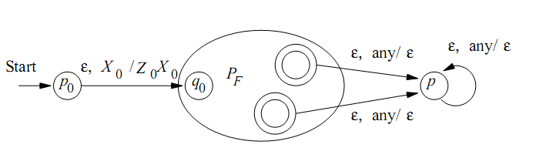

Slide 35
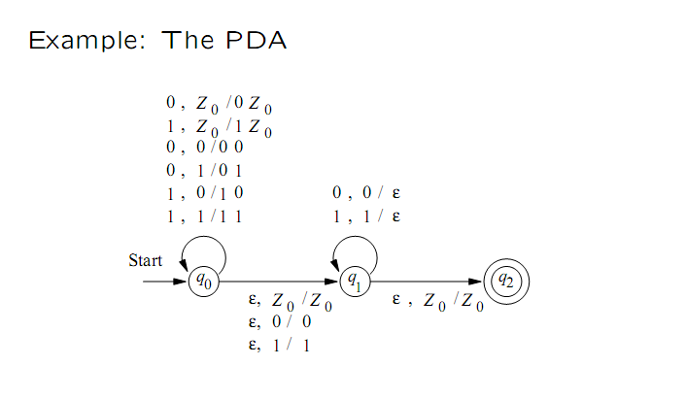

Slide 36
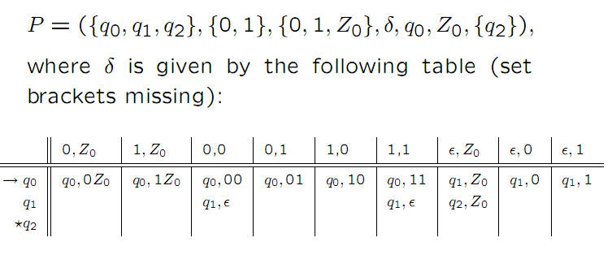

Slide 37

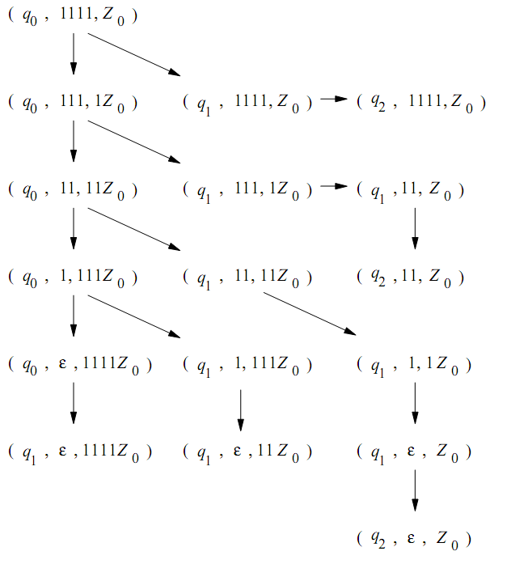

Slide 38
Proof: N(P) -> L(P’’) Intuition
P” simulates P.
P” has a special bottom-marker to catch the situation where P empties its stack.
If so, P” accepts.

Slide 39
Proof: N(P) -> L(P’’)
P’’ has all the states, symbols, and moves of P, plus:
Stack symbol X₀, used to guard the stack bottom.
New start state s and final state f.
δ(s, ε, X₀) = {(q₀, Z₀X₀)}. Get P started.
δ(q, ε, X₀) = {(f, ε)} for any state q of P.

Slide 40
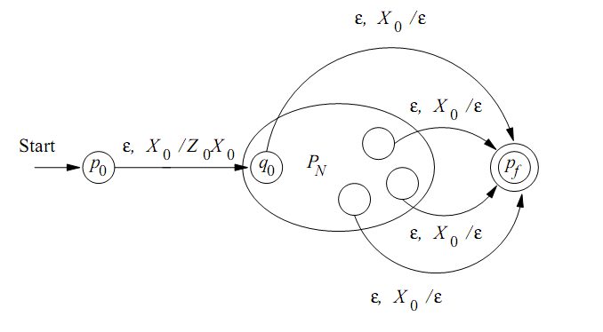

Slide 41
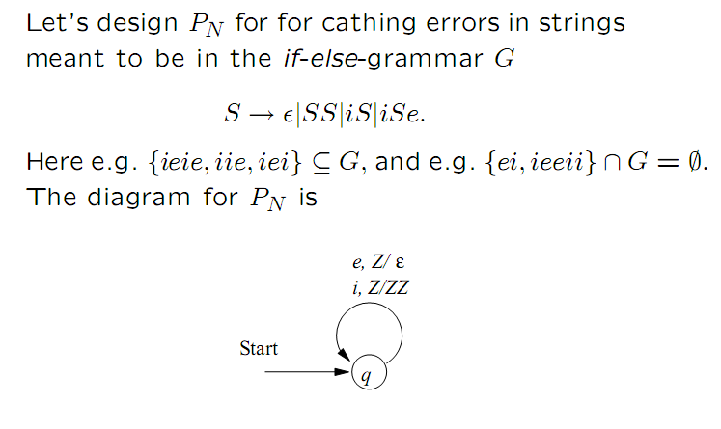

Slide 42
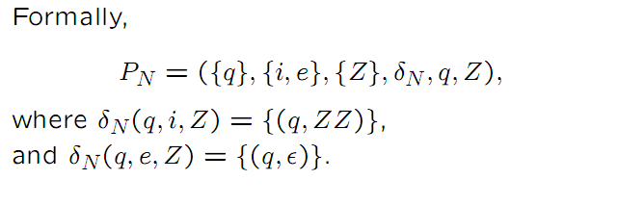

Slide 43
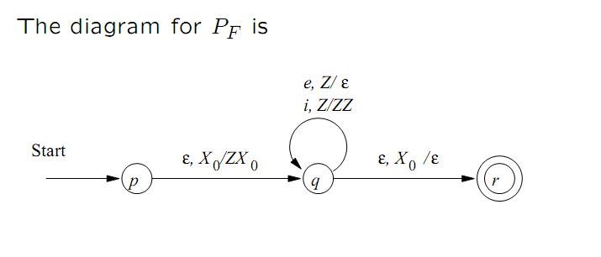

Slide 44
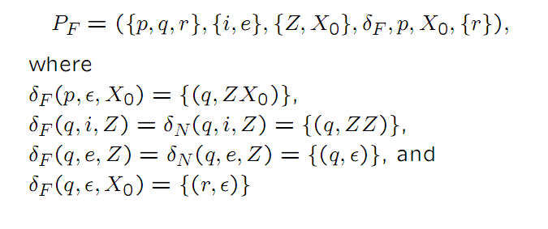

Slide 46
Ekivalensi antara PDA dan CFG

Slide 47
Ekivalen PDA dan CFG
CFG
PDA dgn empty stack
PDA dgn final state
CFG G = (V, T, Q, S)
P = (Q, Σ, Γ, δ, q₀, Z₀)
Stack symbol
A → 0C
δ(q₀,1,Z₀)=(q₀,1Z₀)
Variable
(non terminal)
Terminal
state
Input symbol

Slide 48
CFG ke PDA dgn Empty Stack
Ide Konversi, G= (V,T,P,S)
semua isi pada aturan produksi di CFG G akan diproses sebagai manipulasi stack shg hanya akan ada satu state q pada PDA dan banyak simbol stack.
Maka arti dari A → α akan berarti untuk “top symbol of the stack adalah A”, “gantilah top tsb dgn α” atau “pop A dan push α”
maka PDA-nya (P = (Q, Σ, Γ, δ, q₀, Z₀)) adalah:
P = ({q}, T, V U T, δ, q, S)
dimana {q} adl states(Q); T adl input symbol (Σ); V U T adl stack alphabet (Γ); δ adl transition function; q adl start state dan S adalah start stack symbol

Slide 49
CFG ke PDA dgn Empty Stack (2)
CFG G = (V, T, Q, S)
V: variable (non terminal); T: terminal; Q: aturan produksi; S: start variable
PDA P = ({q}, T, V U T, δ, q, S)
P = (Q, Σ, Γ, δ, q₀, Z₀)
Q:state; Σ:input symbol; Γ:stack symbol; δ: transition function; q₀:start state; Z₀:start stack
Dengan δ adl:
Utk setiap terminal a bagian dari T akan ada δ(q,a,a) = {(q,ε)}
Utk setiap variable A bagian dari V, akan ada δ(q,ε,A) = {(q,β)|A→ β adalah produksi di Q}

Slide 50
Contoh CFG ke PDA
CFG = ({I, E}, {0,1,+,*},G,E) dimana G
I → 0 | 1 | I0 | I1
E → I | E + E | E * E
PDA = ({q}, T, V U T, δ, q, S) = ({q}, {0,1,+,*}, {I,E,0,1,+,*}, δ, q, E) dgn δ adl
Utk setiap terminal: δ(q,0,0) = (q, ε); δ(q,1,1)=(q,ε); δ(q,+,+) = (q, ε); δ(q,*,*) = (q, ε)
Utk setiap non terminal:
δ(q, ε,I) = {(q, 0), (q, 1), (q,I0), (q,I1)}
δ(q, ε,E) = {(q, I), (q, E+E), (q,E*E)}

Slide 51
Latihan
6.3.1
Konversi grammar berikut ke PDA empty stack:
S → 0 S 1 | A
A → 1 A 0 | S | ϵ

Slide 52
PDA (P) ke CFG (G)
Misalkan P = (Q, Σ, Γ, δ, q₀, Z₀)
Maka G = (V, Σ, R, S) dimana:
simbol Terminal adalah sama dengan input symbol pada PDA P yaitu Σ;
Ditambahkan satu non terminal S sbg start symbol
Simbol non terminal V adalah S ditambah dengan hasil kombinasi antara simbol stack dan state sbb: [pXq] dimana p dan q adalah state dan X adalah stack. Pada akhirnya, [pXq] ini bisa diganti dgn satu karakter spt misalnya A.

Slide 53
Ide Dasar PDA ke CFG
Non Terminal (CFG)
Berdasar pada transisi pada PDA
Transisi dari satu state asal ke state tujuan
state asal bisa sama dengan state tujuan
Aksi pada stack
Pop
Push
Tetap
[q Z p] yg artinya dari mewakili transisi dari state q ke state p dgn aksi pada top of stack berupa Z
Tulis semua kombinasi state dan stack yang mungkin untuk semua non terminal pada CFG
Contoh: [qZp], [qZq], [pZp], [pZq]
Target adalah [q₀ Z₀ q_{f}] yaitu transisi dari state awal q₀ ke state final q_{f} dengan mem-pop Z₀ start stack
karena PDA dgn empty stack, maka q_{f} diganti dgn semua state yg ada

Slide 54
Aturan Produksi (1)
Utk semua state p pada P, buat aturan produksi sbb S → [q₀ Z₀ p], dimana q₀ adalah start state pada P dan Z₀ adalah start stack pada P. Jumlah aturan produksi ini sama dengan jumlah state yang ada pada P. Misalkan selain p, ada state q, maka akan ada aturan S → [q₀ Z₀ q]

Slide 55
Aturan Produksi (2)
Target adalah S → [q₀ Z₀ q_{f}]
Prinsip CFG: mengurai dari solusi total ke sub-nya → pohon ke sub pohon dst
Untuk setiap fungsi transisi pada PDA, buatlah aturan produksi sbb:
Jika transisi di pop:
δ(q,0,Z) = (p,ϵ) maka pd CFG: [qZp] → 0
Jika transisi tetap atau diganti:
δ(q,0,Z) = (p,Y) maka pd CFG: [qZr] → 0 [pYr] dimana r adalah semua state yg ada pd PDA
Jika transisi di push:
δ(q,0,Z) = (p,YZ) maka [qZr] → 0 [pYs] [sZr] dimana r dan s adalah semua state yg ada pd PDA

Slide 56
Aturan Produksi (3)
Untuk fungsi transisi δ(q,a,X)=(r, Y₁Y₂...Y_{k}), maka buatlah aturan produksi untuk setiap kombinasi state sbb:
[q X Δ] → a [r Y₁ ♣][♣ Y₂ ...] ... [... Y_{k} Δ]

Slide 57
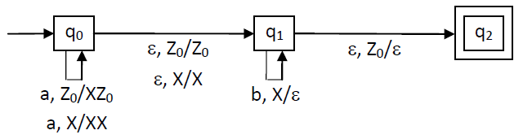
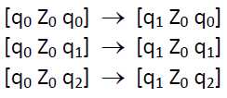
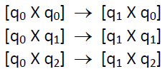

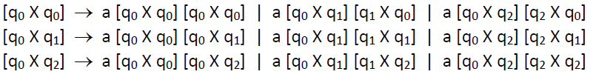
Contoh: untuk {a^{n}b^{n}}
S → [q₀ Z₀ q₂]
[q₁ Z₀ q₂] →ϵ
[q₁ X q₁] →b

Slide 58
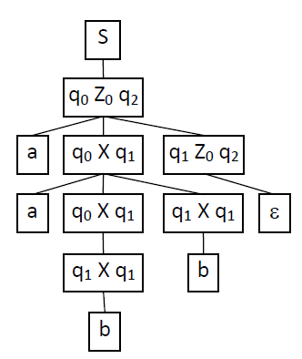
aabb
q₀
Z₀
X
a
q₀
Z₀
a
q₀
X
X
ϵ
q₁
Z₀
b
q₁
X
Z₀
b
q₁
Z₀
ϵ
q₂

Slide 59
Latihan
6.3.3

Slide 60
Contoh Soal 6.3.3
Dengan 2 state yaitu p dan q maka dari start symbol S , start state q dan start stack symbol Zo, diperoleh aturan produksi:
S → [q Zo q]
S → [q Zo p]

Slide 61
Contoh Soal 6.3.3
Dari transition function 1 yaitu δ(q,1,Zo)=(q,X Zo) , diperoleh aturan produksi:
[q Zo q] → 1 [q X q] [q Zo q]
[q Zo q] → 1 [q X p] [p Zo q]
[q Zo p] → 1 [q X q] [q Zo p]
[q Zo p] → 1 [q X p] [p Zo p]

Slide 62
Contoh Soal 6.3.3
Dari transition function 3 yaitu δ(q,0,X)=(p,X) , diperoleh aturan produksi:
[q X q] → 0 [p X q]
[q X p] → 0 [p X p]
Dari transition function 4 yaitu δ(q,ε,X)=(q,ε) , diperoleh aturan produksi:
[q X q] → ε

Slide 63
6.3.3
In the following, S is the start symbol, e stands for the empty string, and Z is used in place of Z₀.
S -> [qZq] | [qZp]
The following four productions come from rule (1).
[qZq] -> 1[qXq][qZq]
[qZq] -> 1[qXp][pZq]
[qZp] -> 1[qXq][qZp]
[qZp] -> 1[qXp][pZp]
The following four productions come from rule (2).
[qXq] -> 1[qXq][qXq]
[qXq] -> 1[qXp][pXq]
[qXp] -> 1[qXq][qXp]
[qXp] -> 1[qXp][pXp]
The following two productions come from rule (3).
[qXq] -> 0[pXq]
[qXp] -> 0[pXp]
The following production comes from rule (4).
[qXq] -> e
The following production comes from rule (5).
[pXp] -> 1
The following two productions come from rule (6).
[pZq] -> 0[qZq]
[pZp] -> 0[qZp]

Slide 64
Deterministic PDA’s
To be deterministic, there must be at most one choice of move for any state q, input symbol a, and stack symbol X.
In addition, there must not be a choice between using input ε or real input.
Formally, δ(q, a, X) and δ(q, ε, X) cannot both be nonempty.

