Slide 1
Bab 5 Context-Free Grammars
Formalism
Derivations
Backus-Naur Form
Left- and Rightmost Derivations

Slide 2
Gambaran Bahasa Context –Free Grammar
Buatlah sebuah Language yang dapat menerima string palindrom
  Contoh:
    MALAM
    MAKAM
    KASUR NABABAN RUSAK

Slide 3
Informal Comments
A context-free grammar is a notation for describing languages.
It is more powerful than finite automata or RE’s, but still cannot define all possible languages.
Useful for nested structures, e.g., parentheses in programming languages.

Slide 4
Informal Comments – (2)
Basic idea is to use “variables” to stand for sets of strings (i.e., languages).
These variables are defined recursively, in terms of one another.
Recursive rules (“productions”) involve only concatenation.
Alternative rules for a variable allow union.

Slide 5
Example: CFG for { 0^{n}1^{n} | n > 1}
Productions:
  S -> 01
  S -> 0S1
Basis: 01 is in the language.
Induction: if w is in the language, then so is 0w1.

Slide 6
CFG Formalism
There are 4 components.
Terminals = symbols of the alphabet of the language being defined.
Variables = nonterminals = a finite set of other symbols, each of which represents a language.
Start symbol = the variable whose language is the one being defined.

Slide 7
Productions
A production has the form variable -> string of variables and terminals.
Convention:
  A, B, C,… are variables.
  a, b, c,… are terminals.
  …, X, Y, Z are either terminals or variables.
  …, w, x, y, z are strings of terminals only.
  α, β, γ,… are strings of terminals and/or variables.

Slide 8
Example: Formal CFG
Here is a formal CFG for { 0^{n}1^{n} | n > 1}.
Terminals = {0, 1}.
Variables = {S}.
Start symbol = S.
Productions =
  S -> 01
  S -> 0S1

Slide 9
Derivations – Intuition
We derive strings in the language of a CFG by starting with the start symbol, and repeatedly replacing some variable A by the right side of one of its productions.
  That is, the “productions for A” are those that have A on the left side of the ->.

Slide 10
Derivations – Formalism
We say αAβ => αγβ if A -> γ is a production.
Example: S -> 01; S -> 0S1.
S => 0S1 => 00S11 => 000111.

Slide 11
Iterated Derivation
=>* means “zero or more derivation steps.”
Basis: α =>* α for any string α.
Induction: if α =>* β and β => γ, then α =>* γ.

Slide 12
Example: Iterated Derivation
S -> 01; S -> 0S1.
S => 0S1 => 00S11 => 000111.
So, S =>* S; S =>* 0S1; S =>* 00S11; S =>* 000111.

Slide 13
Sentential Forms
Any string of variables and/or terminals derived from the start symbol is called a sentential form.
Formally, α is a sentential form iff S =>* α.

Slide 14
Language of a Grammar
If G is a CFG, then L(G), the language of G, is {w | S =>* w}.
  Note: w must be a terminal string, S is the start symbol.
Example: G has productions S -> ε and S -> 0S1.
L(G) = {0^{n}1^{n} | n > 0}.
Note: ε is a legitimate
right side.

Slide 16
Context-Free Languages
A language that is defined by some CFG is called a context-free language.
There are CFL’s that are not regular languages, such as the example just given.
But not all languages are CFL’s.
Intuitively: CFL’s can count two things, not three.

Slide 17
BNF Notation
Grammars for programming languages are often written in BNF (Backus-Naur Form ).
Variables are words in <…>; Example: <statement>.
Terminals are often multicharacter strings indicated by boldface or underline; Example: while or WHILE.

Slide 18
BNF Notation – (2)
Symbol ::= is often used for ->.
Symbol | is used for “or.”
  A shorthand for a list of productions with the same left side.
Example: S -> 0S1 | 01 is shorthand for S -> 0S1 and S -> 01.

Slide 19
BNF Notation – Kleene Closure
Symbol … is used for “one or more.”
Example: <digit> ::= 0|1|2|3|4|5|6|7|8|9
<unsigned integer> ::= <digit>…
  Note: that’s not exactly the * of RE’s.
Translation: Replace α… with a new variable A and productions A -> Aα | α.

Slide 20
Example: Kleene Closure
Grammar for unsigned integers can be replaced by:
U -> UD | D
D -> 0|1|2|3|4|5|6|7|8|9

Slide 21
BNF Notation: Optional Elements
Surround one or more symbols by […] to make them optional.
Example: <statement> ::= if <condition> then <statement> [; else <statement>]
Translation: replace [α] by a new variable A with productions A -> α | ε.

Slide 22
Example: Optional Elements
Grammar for if-then-else can be replaced by:
S -> iCtSA
A -> ;eS | ε

Slide 23
BNF Notation – Grouping
Use {…} to surround a sequence of symbols that need to be treated as a unit.
  Typically, they are followed by a … for “one or more.”
Example: <statement list> ::= <statement> [{;<statement>}…]

Slide 24
Translation: Grouping
You may, if you wish, create a new variable A for {α}.
One production for A: A -> α.
Use A in place of {α}.

Slide 25
Example: Grouping
L -> S [{;S}…]
Replace by L -> S [A…] A -> ;S
  A stands for {;S}.
Then by L -> SB B -> A… | ε A -> ;S
  B stands for [A…] (zero or more A’s).
Finally by L -> SB B -> C | ε C -> AC | A A -> ;S
  C stands for A… .

Slide 26
Leftmost and Rightmost Derivations
Derivations allow us to replace any of the variables in a string.
Leads to many different derivations of the same string.
By forcing the leftmost variable (or alternatively, the rightmost variable) to be replaced, we avoid these “distinctions without a difference.”

Slide 27
Leftmost Derivations
Say wAα =>_{lm} wβα if w is a string of terminals only and A -> β is a production.
Also, α =>*_{lm} β if α becomes β by a sequence of 0 or more =>_{lm} steps.

Slide 28
Example: Leftmost Derivations
Balanced-parentheses grammmar:
S -> SS | (S) | ()
S =>_{lm} SS =>_{lm} (S)S =>_{lm} (())S =>_{lm} (())()
Thus, S =>*_{lm} (())()
S => SS => S() => (S)() => (())() is a derivation, but not a leftmost derivation.

Slide 29
Rightmost Derivations
Say αAw =>_{rm} αβw if w is a string of terminals only and A -> β is a production.
Also, α =>*_{rm} β if α becomes β by a sequence of 0 or more =>_{rm} steps.

Slide 30
Example: Rightmost Derivations
Balanced-parentheses grammmar:
S -> SS | (S) | ()
S =>_{rm} SS =>_{rm} S() =>_{rm} (S)() =>_{rm} (())()
Thus, S =>*_{rm} (())()
S => SS => SSS => S()S => ()()S => ()()() is neither a rightmost nor a leftmost derivation.

Slide 31
Parse Trees
Definitions
Relationship to Left- and Rightmost Derivations
Ambiguity in Grammars

Slide 32
Parse Trees
Parse trees are trees labeled by symbols of a particular CFG.
Leaves: labeled by a terminal or ε.
Interior nodes: labeled by a variable.
  Children are labeled by the right side of a production for the parent.
Root: must be labeled by the start symbol.

Slide 33
Example: Parse Tree for ( () )()
S -> SS | (S) | ()
S
S
S
(
S
)
(
)
(
)

Slide 34
Yield of a Parse Tree
The concatenation of the labels of the leaves in left-to-right order
  That is, in the order of a preorder traversal.
is called the yield of the parse tree.
Example: yield of is (())()
S
S
S
(
S
)
(
)
(
)

Slide 35
Parse Trees, Left- and Rightmost Derivations
For every parse tree, there is a unique leftmost, and a unique rightmost derivation.
We’ll prove:
  If there is a parse tree with root labeled A and yield w, then A =>*_{lm} w.
  If A =>*_{lm} w, then there is a parse tree with root A and yield w.

Slide 36
Proof – Part 1
Induction on the height (length of the longest path from the root) of the tree.
Basis: height 1. Tree looks like
A -> a₁…a_{n} must be a production.
Thus, A =>*_{lm} a₁…a_{n}.
A
a₁
. . .
a_{n}

Slide 37
Part 1 – Induction
Assume (1) for trees of height < h, and let this tree have height h:
By IH, X_{i} =>*_{lm} w_{i}.
  Note: if X_{i} is a terminal, then X_{i} = w_{i}.
Thus, A =>_{lm} X₁…X_{n} =>*_{lm} w₁X₂…X_{n} =>*_{lm} w₁w₂X₃…X_{n} =>*_{lm} … =>*_{lm} w₁…w_{n}.
A
X₁
. . .
X_{n}
w₁
w_{n}

Slide 38
Proof: Part 2
Given a leftmost derivation of a terminal string, we need to prove the existence of a parse tree.
The proof is an induction on the length of the derivation.

Slide 39
Part 2 – Basis
If A =>*_{lm} a₁…a_{n} by a one-step derivation, then there must be a parse tree
A
a₁
. . .
a_{n}

Slide 40
Part 2 – Induction
Assume (2) for derivations of fewer than k > 1 steps, and let A =>*_{lm} w be a k-step derivation.
First step is A =>_{lm} X₁…X_{n}.
Key point: w can be divided so the first portion is derived from X₁, the next is derived from X₂, and so on.
  If X_{i} is a terminal, then w_{i} = X_{i}.

Slide 41
Induction – (2)
That is, X_{i} =>*_{lm} w_{i} for all i such that X_{i} is a variable.
  And the derivation takes fewer than k steps.
By the IH, if X_{i} is a variable, then there is a parse tree with root X_{i} and yield w_{i}.
Thus, there is a parse tree
A
X₁
. . .
X_{n}
w₁
w_{n}

Slide 42
Parse Trees and Rightmost Derivations
The ideas are essentially the mirror image of the proof for leftmost derivations.
Left to the imagination.

Slide 43
Ambiguous Grammars
A CFG is ambiguous if there is a string in the language that is the yield of two or more parse trees.
Example: S -> SS | (S) | ()
Two parse trees for ()()() on next slide.

Slide 44
Example – Continued
S
S
S
S
S
S
S
S
(
)
(
)
S
S
(
)
(
)
(
)
(
)

Slide 48
Ambiguity, Left- and Rightmost Derivations
If there are two different parse trees, they must produce two different leftmost derivations by the construction given in the proof.
Conversely, two different leftmost derivations produce different parse trees by the other part of the proof.
Likewise for rightmost derivations.

Slide 49
Ambiguity, etc. – (2)
Thus, equivalent definitions of “ambiguous grammar’’ are:
  There is a string in the language that has two different leftmost derivations.
  There is a string in the language that has two different rightmost derivations.

Slide 50
Ambiguity is a Property of Grammars, not Languages
For the balanced-parentheses language, here is another CFG, which is unambiguous.
B -> (RB | ε
R -> ) | (RR
B, the start symbol,
derives balanced strings.
R generates strings that
have one more right paren
than left.

Slide 51
Example: Unambiguous Grammar
B -> (RB | ε R -> ) | (RR
Construct a unique leftmost derivation for a given balanced string of parentheses by scanning the string from left to right.
  If we need to expand B, then use B -> (RB if the next symbol is “(” and ε if at the end.
  If we need to expand R, use R -> ) if the next symbol is “)” and (RR if it is “(”.

Slide 52
The Parsing Process
Remaining Input:
(())()
Steps of leftmost derivation:
B
Next
symbol
B -> (RB | ε R -> ) | (RR

Slide 53
The Parsing Process
Remaining Input:
())()
Steps of leftmost derivation:
B
(RB
Next
symbol
B -> (RB | ε R -> ) | (RR

Slide 54
The Parsing Process
Remaining Input:
))()
Steps of leftmost derivation:
B
(RB
((RRB
Next
symbol
B -> (RB | ε R -> ) | (RR

Slide 55
The Parsing Process
Remaining Input:
)()
Steps of leftmost derivation:
B
(RB
((RRB
(()RB
Next
symbol
B -> (RB | ε R -> ) | (RR

Slide 56
The Parsing Process
Remaining Input:
()
Steps of leftmost derivation:
B
(RB
((RRB
(()RB
(())B
Next
symbol
B -> (RB | ε R -> ) | (RR

Slide 57
The Parsing Process
Remaining Input:
)
Steps of leftmost derivation:
B (())(RB
(RB
((RRB
(()RB
(())B
Next
symbol
B -> (RB | ε R -> ) | (RR

Slide 58
The Parsing Process
Remaining Input:
Steps of leftmost derivation:
B (())(RB
(RB (())()B
((RRB
(()RB
(())B
Next
symbol
B -> (RB | ε R -> ) | (RR

Slide 59
The Parsing Process
Remaining Input:
Steps of leftmost derivation:
B (())(RB
(RB (())()B
((RRB (())()
(()RB
(())B
Next
symbol
B -> (RB | ε R -> ) | (RR

Slide 60
LL(1) Grammars
As an aside, a grammar such B -> (RB | ε R -> ) | (RR, where you can always figure out the production to use in a leftmost derivation by scanning the given string left-to-right and looking only at the next one symbol is called LL(1).
  “Leftmost derivation, left-to-right scan, one symbol of lookahead.”

Slide 61
LL(1) Grammars – (2)
Most programming languages have LL(1) grammars.
LL(1) grammars are never ambiguous.

Slide 62
Inherent Ambiguity
It would be nice if for every ambiguous grammar, there were some way to “fix” the ambiguity, as we did for the balanced-parentheses grammar.
Unfortunately, certain CFL’s are inherently ambiguous, meaning that every grammar for the language is ambiguous.

Slide 63
Example: Inherent Ambiguity
The language {0^{i}1^{j}2^{k} | i = j or j = k} is inherently ambiguous.
Intuitively, at least some of the strings of the form 0^{n}1^{n}2^{n} must be generated by two different parse trees, one based on checking the 0’s and 1’s, the other based on checking the 1’s and 2’s.

Slide 64
One Possible Ambiguous Grammar
S -> AB | CD
A -> 0A1 | 01
B -> 2B | 2
C -> 0C | 0
D -> 1D2 | 12
A generates equal 0’s and 1’s
B generates any number of 2’s
C generates any number of 0’s
D generates equal 1’s and 2’s
And there are two derivations of every string
with equal numbers of 0’s, 1’s, and 2’s. E.g.:
S => AB => 01B =>012
S => CD => 0D => 012

Slide 65
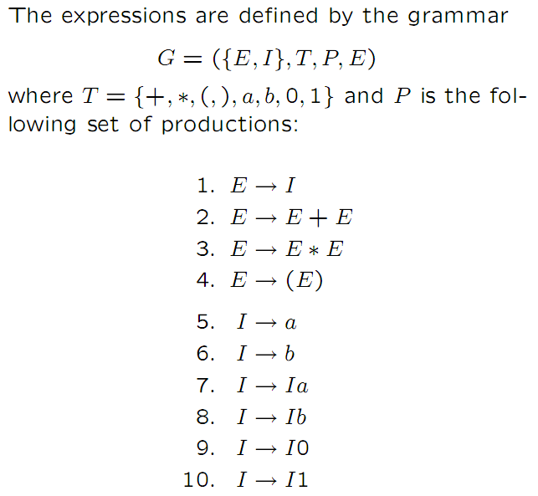

Slide 66
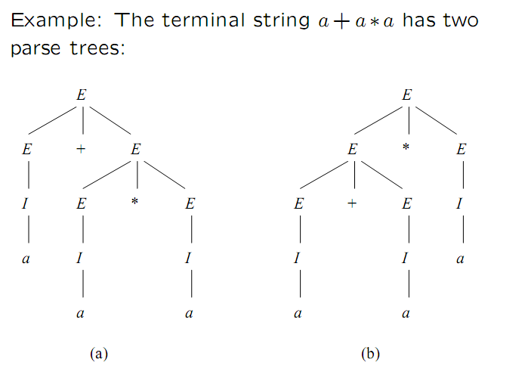

Slide 67
Latihan
Desain context free grammar :
menerima palindrom string utk simbol terminal {0,1}.
menerima string () yg berpasangan, contoh: (), (()), ()()
menerima string dengan jumlah 1 sama dengan jumlah 0.
menerima string berupa ekspresi matematika untuk simbol terminal {0, 1, +, *, (, )}.
menerima string dengan jumlah 1 adalah dua kali jumlah 0

