Slide 1




SUBMITTED BY : R.D.GOKULNATH D.SAKTHIVEL C.MANOJ K.RAVI
THEME : SMART WATER FOUNTAINS
PHASE III
DEVELOPMENT PART 1
Name of Institution : Ganesh college of Engineering
E-mail : gokulnathrdofficial@gmail.com
Contact no : 6380343694

Slide 2
S.no | CONTENT | Pg.no
1. | INTRODUCTION | 3
2. | DRAWBACKS OF WATER FOUNTAIN | 4
3. | HARDWARE COMPONENTS | 5
4. | SOFTWARE COMPONENTS | 6
5. | STEPS TO CREATE THE SMART WATER FOUNTAIN | 7
6. | CODING | 8
7. | DESIGN | 9
8. | DEVELOPMENT | 10
9. | ACKNOWLEDGEMENT | 11

Slide 3
Introduction
Water is an essential part in our day to day life.
smart water fountain is an automated system that provides a continuous flow of water in a controlled manner. It incorporates various technologies and features to enhance functionality, efficiency, and convenience.

Slide 4
Drawbacks of water fountains
Waste of water resources
Man power is need to operate
Difficult to find errors
Different style
Purpose of fountain to flow

Slide 5
Hardware Components
1. Raspberry Pi 3 Model B or later
2. Water pump
3. Relay module
4. Water level sensor (optional)
5. Power supply for the pump
6. Tubing and fountain nozzle
7. Waterproof container for the water reservoir
8. Various cables, connectors, and a breadboard

Slide 6
Software Components
1. Raspbian OS (or a suitable Raspberry Pi OS)
2. Python for programming
3. IoT platform (e.g., MQTT, AWS IoT, or Google Cloud IoT Core)
4. Libraries for GPIO control (e.g., RPi.GPIO)
5. Optional: Web server and HTML/CSS/JavaScript for a web-based user interface

Slide 7
Steps to Create the Smart Water Fountain
Set Up Raspberry Pi
Hardware Setup
Install Required Libraries
Code the Fountain Control
IoT Integration
Web Interface
Assemble and Test
Finalize and Deploy

Slide 8
coding
#import RPi.GPIO as GPIO
import time
# Set the GPIO mode and pin numbers
GPIO.setmode(GPIO.BCM)
water_pump_pin = 17
status_led_pin = 18
# Setup GPIO pins
GPIO.setup(water_pump_pin, GPIO.OUT)
GPIO.setup(status_led_pin, GPIO.OUT)
def water_fountain_on():
print("Water fountain turned on")
GPIO.output(water_pump_pin, GPIO.HIGH)
GPIO.output(status_led_pin, GPIO.HIGH)
def water_fountain_off():
print("Water fountain turned off")
GPIO.output(water_pump_pin, GPIO.LOW)
GPIO.output(status_led_pin, GPIO.LOW)
# Main loop
try:
while True:
# Check if the water level is low
if is_water_level_low():
water_fountain_on()
else:
water_fountain_off()
# Delay for 1 second
time.sleep(1)
except KeyboardInterrupt:
# Clean up GPIO on keyboard interrupt
GPIO.cleanup()

Slide 9
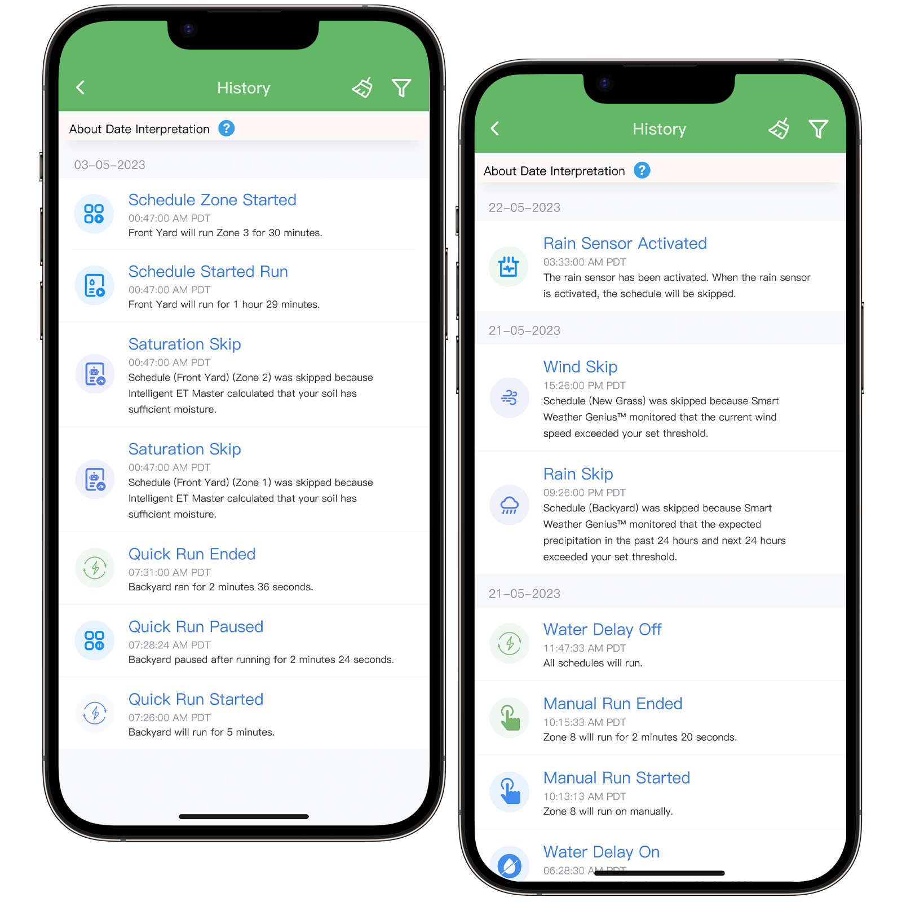
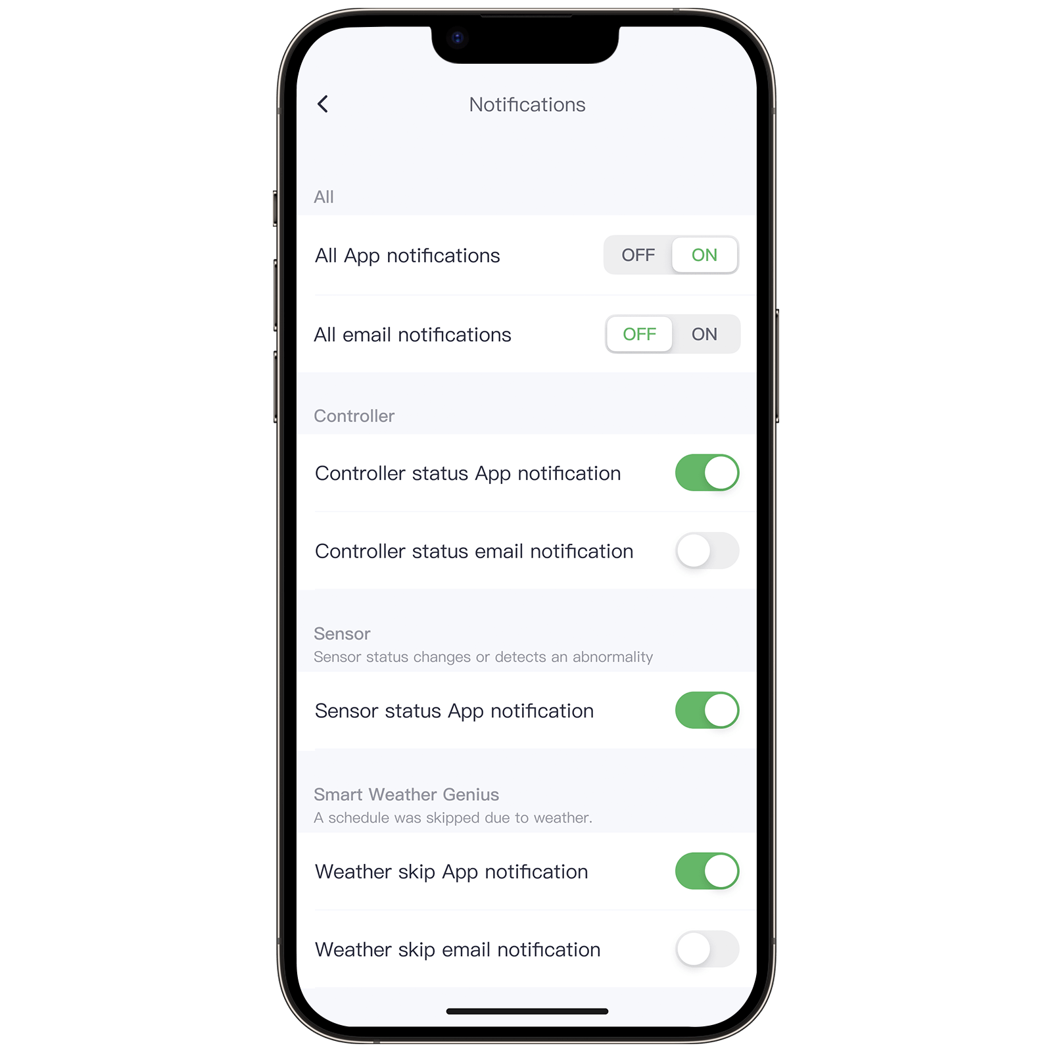
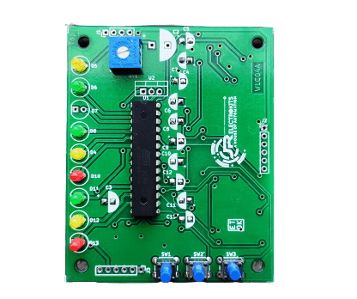
Design

Slide 10

Development

Slide 11
Thank you
Our acknowledgement to our mentors, naan mudhalvan team, IBM team, and also our management.

