Slide 1
Cypress
Modern Automation Testing Tool

Slide 2
Agenda
What is Cypress
Why Adopt Cypress
Cypress vs Selenium
Cypress Test Runner
Cross Browser Testing
View Ports
Object Inspector
Developer Console
Intercept Http Requests
Test Execution through CLI
Screenshots
Execution Video Records
Cypress.config.js
Cross Browser Testing
Shadow Dom
Cypress Dashboard

Slide 3
What is Cypress?
A tool for reliably testing anything that runs on a web browser
Used to test applications built using modern JavaScript frameworks.
One of the Alternatives to Protractor(Deprecated)
Free & Open Source under MIT License
Time Travel: Cypress takes snapshots as your tests run
Debuggability: Stop guessing why your tests are failing. Debug directly from familiar tools like Developer Tools.
Automatic Waiting: Never add waits or sleeps to your tests. Cypress automatically waits for commands and assertions before moving on. No more async hell.
Screenshots and Videos: View screenshots taken automatically on failure, or videos of your entire test suite when run from the CLI
Cross browser Testing: Run tests within Firefox and Chrome-family browsers (including Edge and Electron)

Slide 4
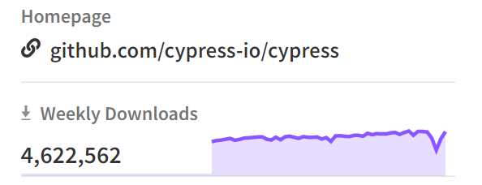

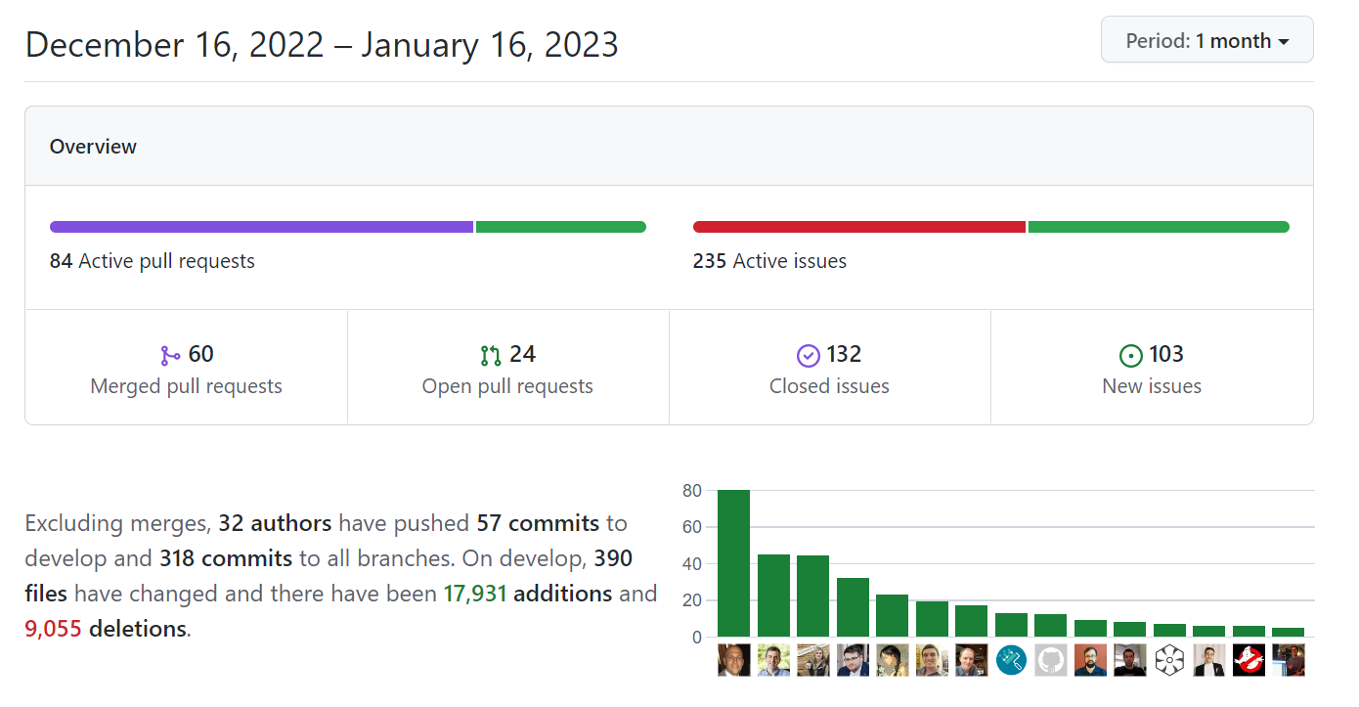
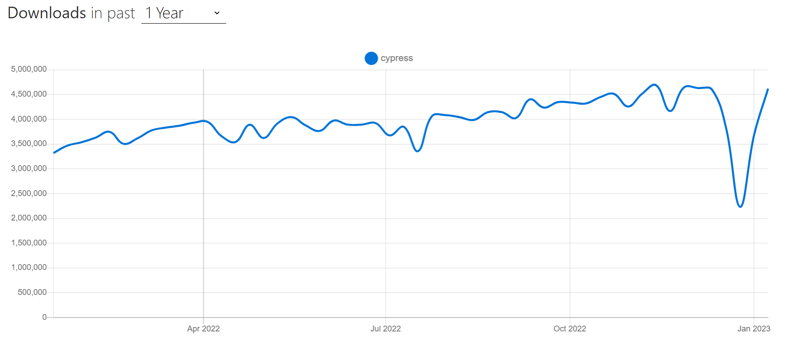
Why Adopt Cypress
~46M npm weekly downloads
~42K GitHub Stars
Active Community
4,617,853

Slide 5
Cypress vs Selenium
 | Cypress | Selenium
Testing | Front end and APIs, end-to-end | End-to-end, doesn’t support API testing
Supported languages | JavaScript/Typescript | Multiple languages are supported, such as Java, JavaScript, Perl, PHP, Python, Ruby, C#, etc.
Audience | Developers as well as testers | Automation engineers, testers
Ease of Use | If you’re familiar with JavaScript, it will be a breeze. Otherwise, it will be slightly tricky. | As it supports multiple languages, people can quickly start writing tests, but it’s more time-consuming than Cypress as you have to learn specific syntax.
 | It’s developer-friendly as it was designed keeping developers in mind. It also has a super helpful feature called “travel back in time.”
Speed | It has a different architecture that doesn’t utilize a web driver and therefore is faster. | Because of its architecture, it’s hard to create simple, quick tests. However, the platform itself is fast, and you can run many tests at scale, in parallel, and cross-browser.
Ease of Setup | Just run the following command: npm install Cypress –save-dev | As it has two component bindings and a web driver. Installation is more involved and time-consuming.
 | It requires no other component installation (web driver) as Selenium does. Everything is bundled.
Integrations & Plugins | It has limited integrations but a rich set of plugins. | It integrates with CI, CD, visual testing, cloud vendors, and reporting tools.
Supported Browsers | All chromium-based browsers (Chrome, Edge, Brave) and Firefox. | All browsers: Chrome, Opera, Firefox, Edge, Internet Explorer, etc.
Documentation | Good code samples and documentation. | Average documentation.
Online Community & support | It has a growing community. | It has a mature online community

Slide 6
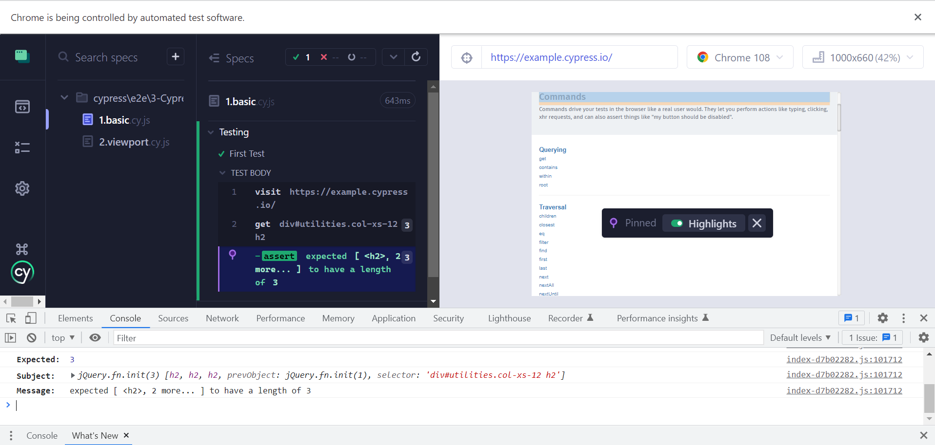
Cypress Test Runner
Specs
Object Spy
Browser
View Port
Dev Console

Slide 7
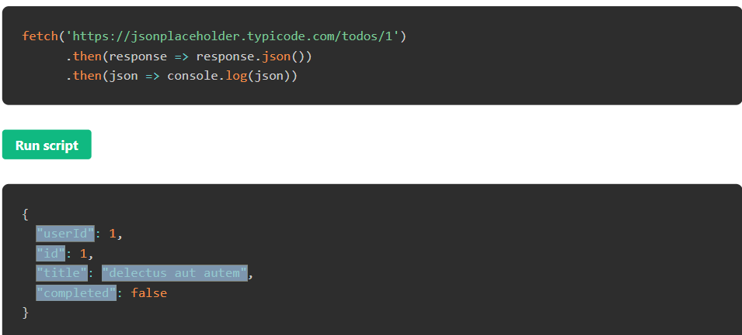
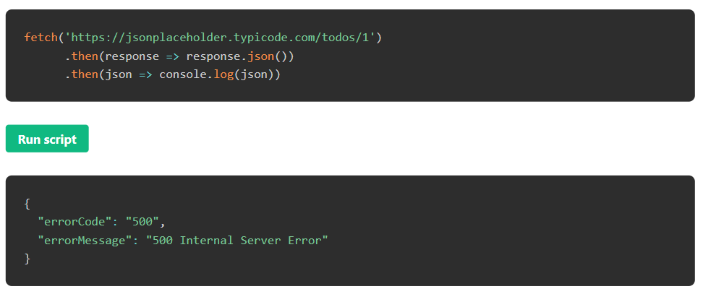
Intercepting HTTP API calls
Cypress has the capability to Spy and stub network requests and responses.
This feature can greatly help in testing negative scenarios concerning to unexpected to API responses due to downtime or other issues
All intercepts are automatically cleared before every test.

Slide 8
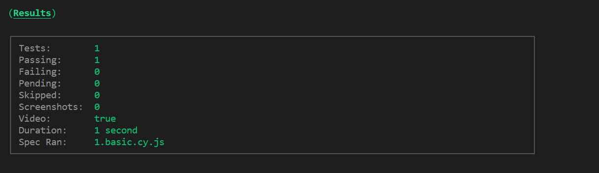
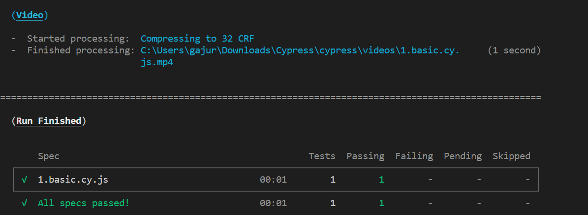
Cypress Execution - CLI

Slide 9
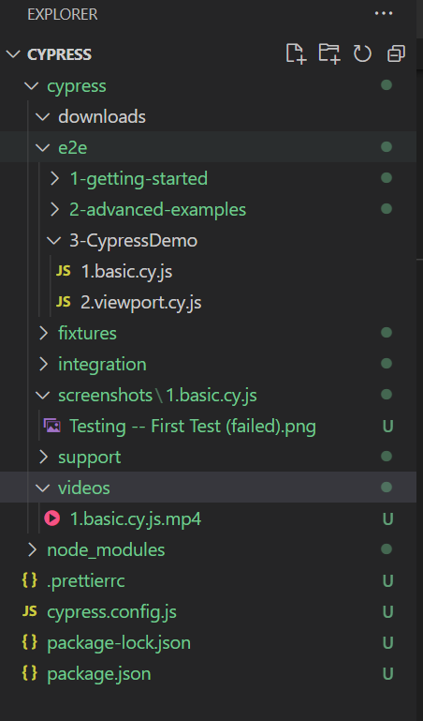
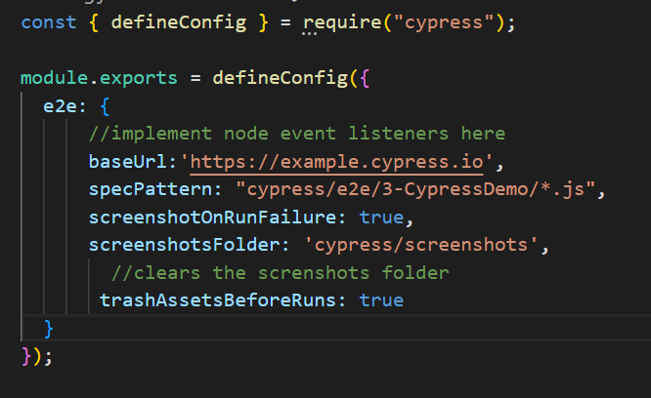
Screenshots/Videos - Config

Slide 10
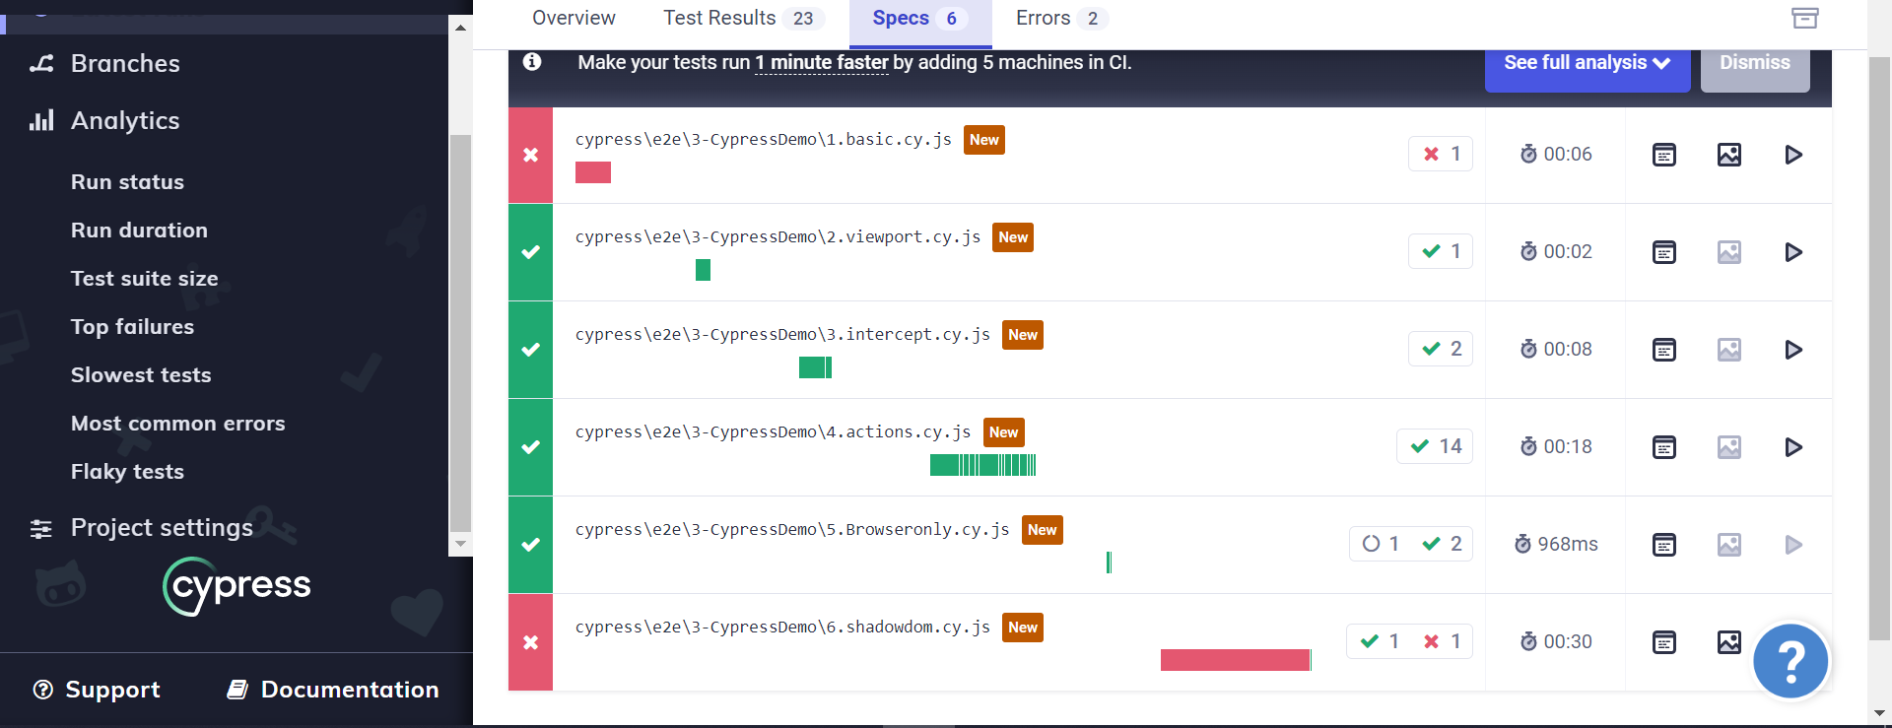
Cypress Dashboard
Video
Image
Log

Slide 11
Thank you

