Slide 1
Case Study

Slide 2
Table of Contents
Use Case
Solution Architecture
High Level Sequence Diagram
API Led Integration Architecture
Integration List
Identified Integration Patterns
Generic Non function requirement

Slide 3
Use-Case
Classic Firm is creating a platform which is going on run some data reporting and analytics on Orders.
All Orders from any regions are placed is OMS and OMS can call external APIs via HTTP protocol
OMS cannot filter or do any sort of customization at their end.

Slide 4

Solution Architecture
Salesforce
Ecommerce Website
OMS & Fulfilment Systems
Orders
Payments
Logistics
MuleSoft Anypoint Platform
OrderInfo
Database
Third Party API
Centralized Logging
MQ Broker

Slide 5
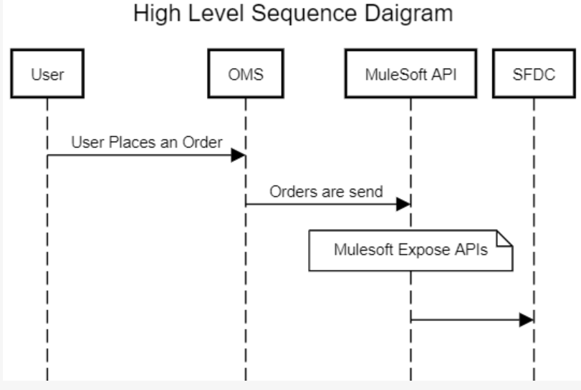
User Places an Order on ecommerce Website.
Order goes to OMS.
OMS calls MuleSoft Anypoint Platform APIs.
MuleSoft Anypoint iPaaS Platform takes care of Orchestration and sending data to Salesforce CRM for Reporting and Analytics.

Slide 6


API Led Integration Architecture
Mobile API
Experience Layer
Orders Analytics Process API
Process Layer
Customer Search API
Order Creation API
System Layer

Slide 7
Interface List
API Name | MuleSoft Application Name | Interface | Operation
Mobile API | mule-mobile-i-eapi | IN001 | OP001
Orders Analytics Process API | mule-order-papi | IN002 | OP001
Customer Search API | mule-db-customer-sapi | IN003 | OP001
Order Creation API | mule-sf-order-sapi | IN004 | OP001
Note : IN004 will not be implemented. Customer Search System API implementation will be done for demo purpose.

Slide 8
Identified & Used Design Patterns
API Led Architecture
Broadcasting Events Pattern
Publisher and Subscriber
Reliability
Data Synchronization

Slide 9
Identified & Used Design Patterns
API Led Architecture
Broadcasting Events Pattern
Publisher and Subscriber
Reliability
Data Synchronization

