Slide 1
Case Study

Slide 2
Low Level Design Components
E2E Sequence Diagram
Process Sequence Diagram & Steps : mule-mobile-i-eapi
Process Sequence Diagram & Steps : mule-order-papi
Process Sequence Diagram & Steps : mule-db-customer-sapi
Process Sequence Diagram & Steps : mule-sf-order-sapi :: Skipped

Slide 3
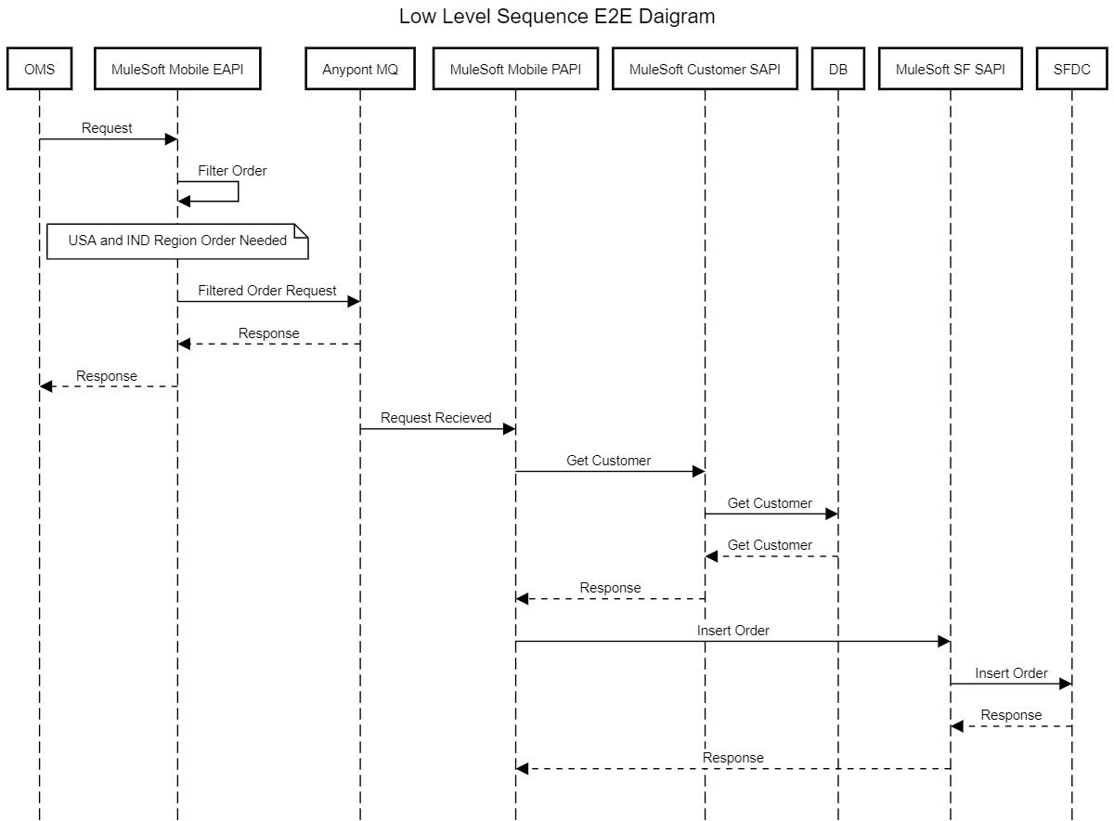
E2E Sequence Diagram
MuleSoft EAPI will expose an API endpoint for OMS.
OMS will call MuleSoft Mobile EAPI
MuleSoft EAPI will filter orders based on 2 regions. India and United States of America and publish to Anypoint MQ (order-q).
MuleSoft Mobile PAPI will subscribe to Anypoint MQ (order-q)
MuleSoft Mobile PAPI will get customer Id from MuleSoft Customer SAPI.
MuleSoft Customer SAPI will go DB Query and send Customer Id response back to MuleSoft Mobile PAPI
MuleSoft Mobile PAPI will send Details to be inserted in Salesforce via MuleSoft SF SAPI.

Slide 4
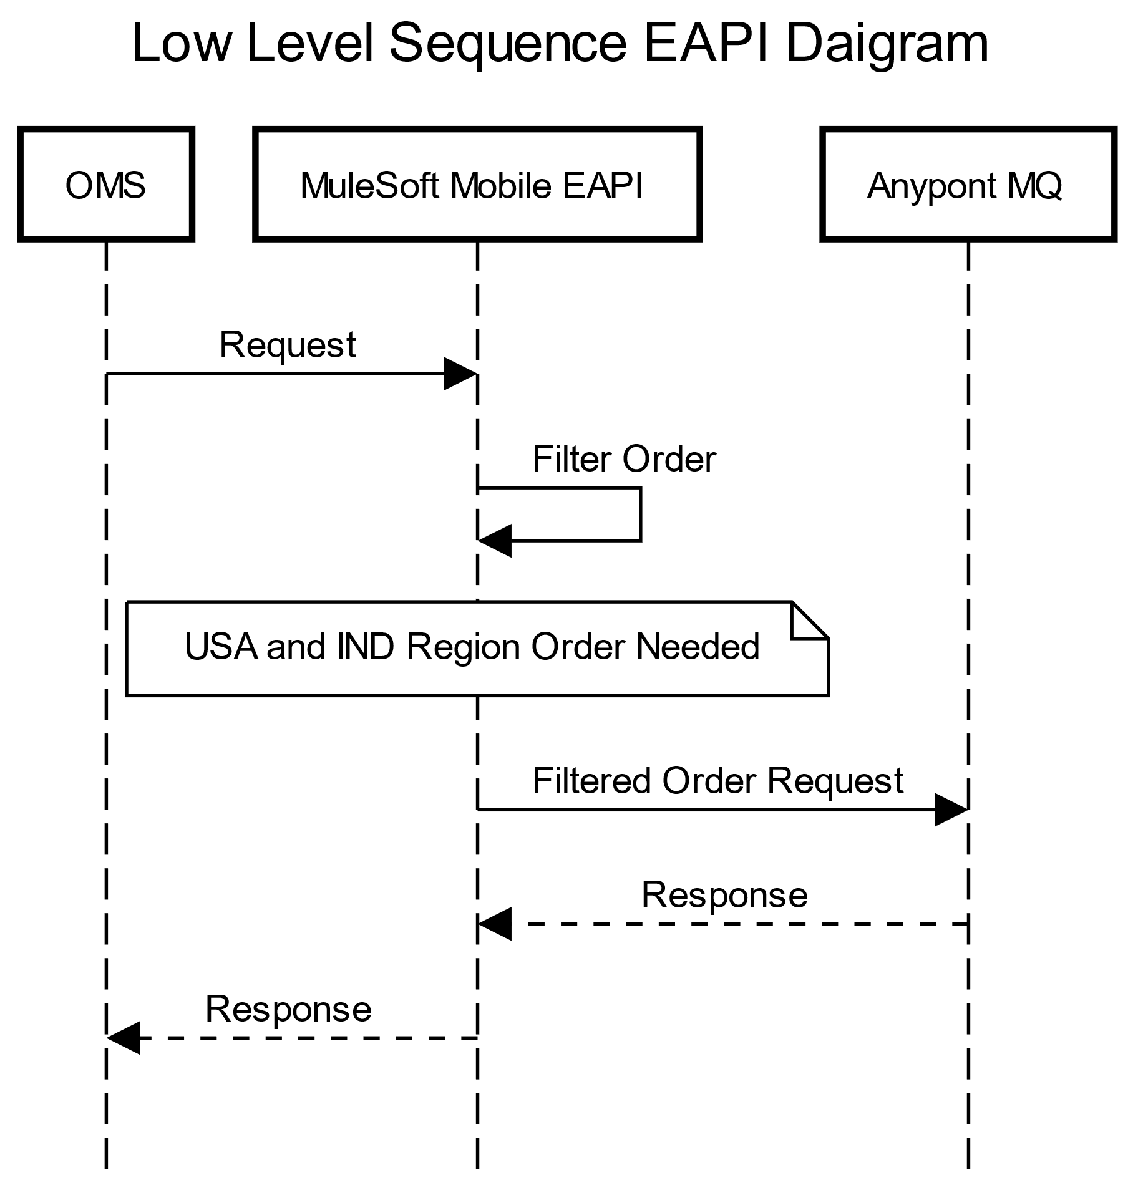
Process Sequence Diagram & Steps : mule-mobile-i-eapi
MuleSoft Mobile will expose an API endpoint for OMS.
OMS will send order details to MuleSoft Mobile EAPI.
MuleSoft Mobile EAPI will validate the mandatory fields send by OMS.
Post validation, MuleSoft Mobile EAPI will filter orders based on countryOfOrigin (India and United States of America)
Filter data is then Publish to Anypoint MQ (order-q) for further processing.
MuleSoft Mobile EAPI will send success OK response to OMS.
Error Code Details
HTTP Status Codes | Error Desciption | Error Code
400 | Bad Request | API001
404 | Resource not found | API002
405 | Method not allowed | API003
406 | Not acceptable | API004
415 | Unsupported media type | API005
501 | Not Implemented | API006
500 | UNKNOWN INTERNAL SERVER ERROR | API006

Slide 5
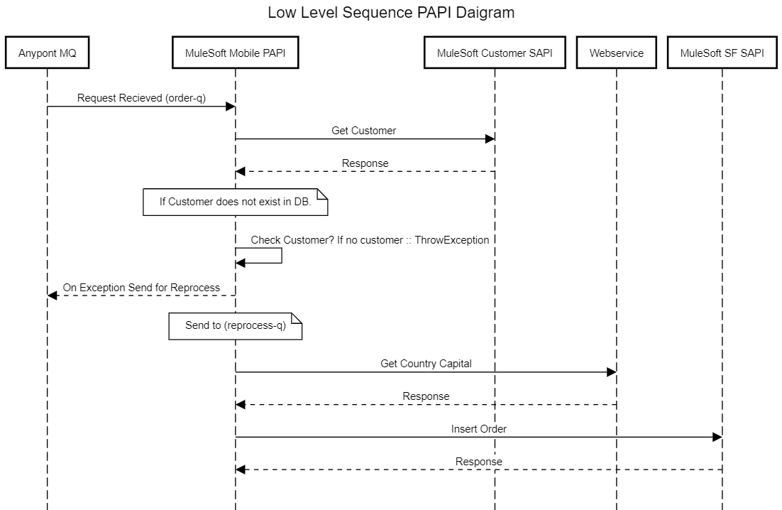
Process Sequence Diagram & Steps : mule-order-papi
MuleSoft Mobile PAPI will subscribe to Anypoint MQ (order-q).
MuleSoft Mobile PAPI will call MuleSoft Customer SAPI to get the Customer Id.
If customer is not found, then break and send data to reprocess-q along with Error details.
If customer found , Pick Country information from incoming request and call webservice to get Country Capital.
Combine all data and send to MuleSoft SF SAPI to insert record in OrderAnalysis Object.
Error Details :
Error Type | Error Desciption | Error Code
CUSTOM:DATAERROR | Customer was not found in DB | EROO1
CUSTOM:DATAERROR | Any Other Errors (Like SF Limits) | EROO2
SALESFORCE:CONNECTIVITY, SALESFORCE:TIMEOUT, WSC:CANNOT_DISPATCH, WSC:CONNECTIVITY, HTTP:BAD_GATEWAY, HTTP:CONNECTIVITY, HTTP:GATEWAY_TIMEOUT | Any Connectivity Issues or TimeOut Issues | EROO3

Slide 6
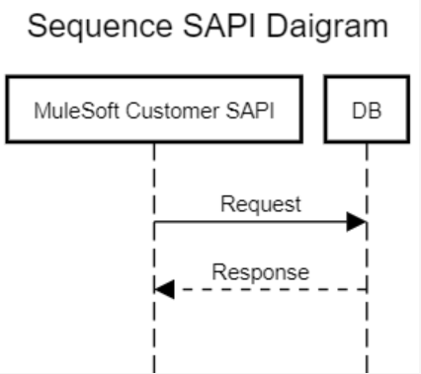
Process Sequence Diagram & Steps : mule-db-customer-sapi
MuleSoft Customer SAPI will query DB with email received in request.
If customer is found, send back success OK response along with the customer Id.
If customer not found, send OK success but response as null.
Error Code Details
HTTP Status Codes | Error Desciption | Error Code
400 | Bad Request | API001
404 | Resource not found | API002
405 | Method not allowed | API003
406 | Not acceptable | API004
415 | Unsupported media type | API005
501 | Not Implemented | API006
500 | UNKNOWN INTERNAL SERVER ERROR | API006

Slide 7
NFR (Non function requirements)
Use Default Anypoint logging or any centralized.
API exposed has to be secured.
Reliability
Performance 2 order per request 4 request every seconds
Note : For Reference only to show NFR is part . Not validated in API Implementation.

