Slide 1
Case Study

Slide 2
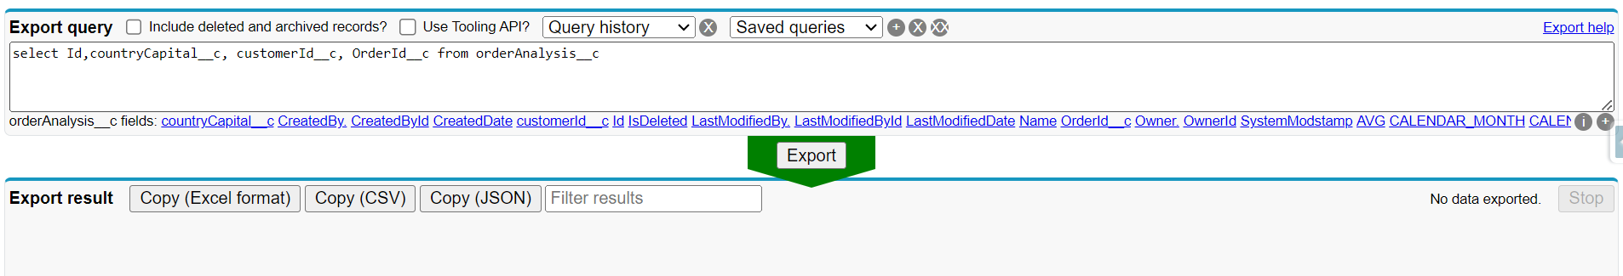
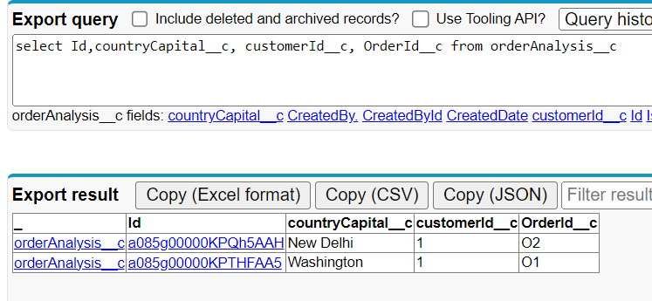
Testing Scenario & Evidences
Scenario 1 : Sending 2 Orders successfully to Salesforce.
Test Steps :
Send 2 Orders (O1 and O2) .
O1 with Country USA and O2 with country IND.
Both placed by same customer that email ("email": raj.kisan@gmail.com) exist in Customer DB.
Acceptance Criteria : OrderAnalysis Salesforce Object is populated with 2 Orders O1 and O2.

Slide 3
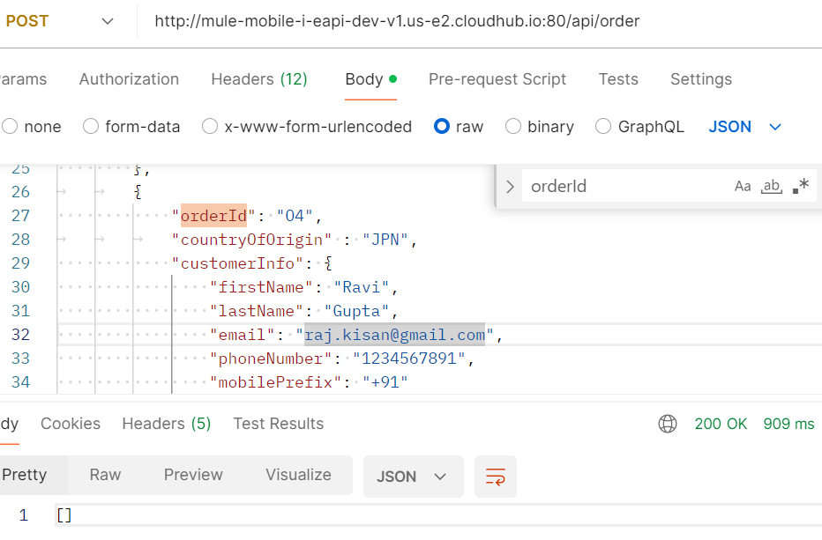
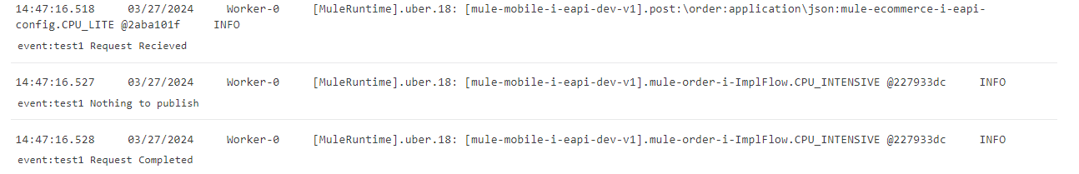
Testing Scenario & Evidences
Scenario 2 : Sending 2 Orders to MuleSoft Mobile EAPI with different country.
Test Steps :
Send 2 Orders (O3 and O4) .
Both O1 and O2 with Country JPN.
Both placed by same customer that email ("email": raj.kisan@gmail.com) exist in Customer DB.
Acceptance Criteria : MuleSoft Mobile EAPI will filter and not publish to Anypoint MQ

Slide 4
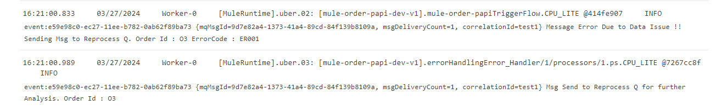
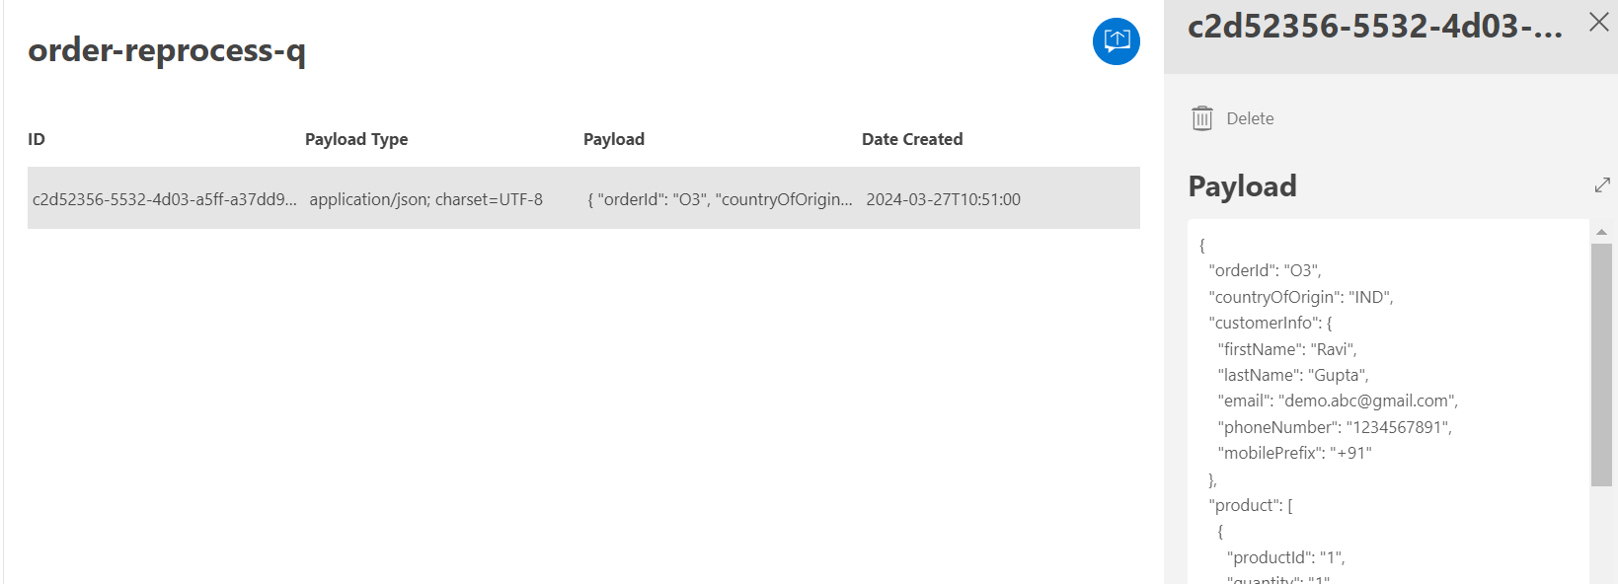
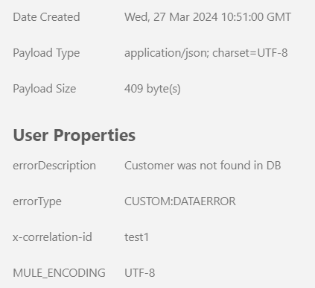
Testing Scenario & Evidences
Scenario 3 : Sending an Orders with valid country and invalid email .
Test Steps :
Send an Orders (O3) .
O3 Order has valid Country i.e. IND or USA.
Placed by customer with email ("email": demo.abc@gmail.com) does not exist in Customer DB.
Acceptance Criteria :
ER001 is printed in mule-order-papi logs
Order fails and send to reprocess-q for further analysis.
Error details are populated in User Properties

Slide 5
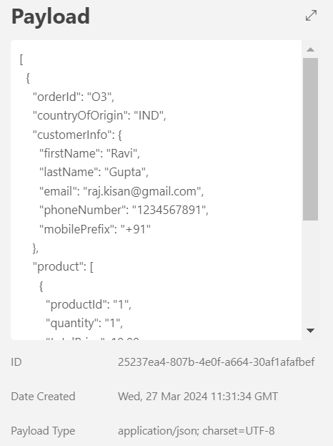
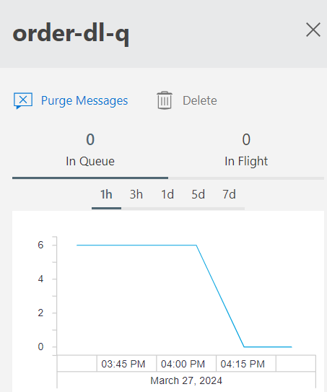
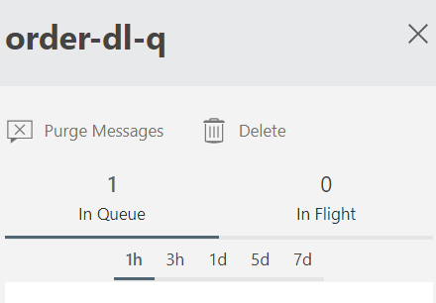
Testing Scenario & Evidences
Scenario 3 : Sending an Orders with valid country and valid email but connectivity failure.
Test Steps :
Send an Orders (O3) .
O3 with valid Country IND or USA.
Placed by same customer that email ("email": raj.kisan@gmail.com) exist in Customer DB.
Acceptance Criteria :
Request has 2 be tried twice by mule-order-papi incase of Connectivity Issues.
If Order fails twice msg should go to order-dl-q .

Slide 6
Postman Collection
Postman Collection for Local Testing
Postman Collection for Dev

