Slide 1
Troubleshooting Exercise

Slide 2
Table of Content
Issue Details.
Current Design
Troubleshooting Details
Root Cause Analysis
Suggested Approaches
Detailed Steps Performed to address the Issue

Slide 3
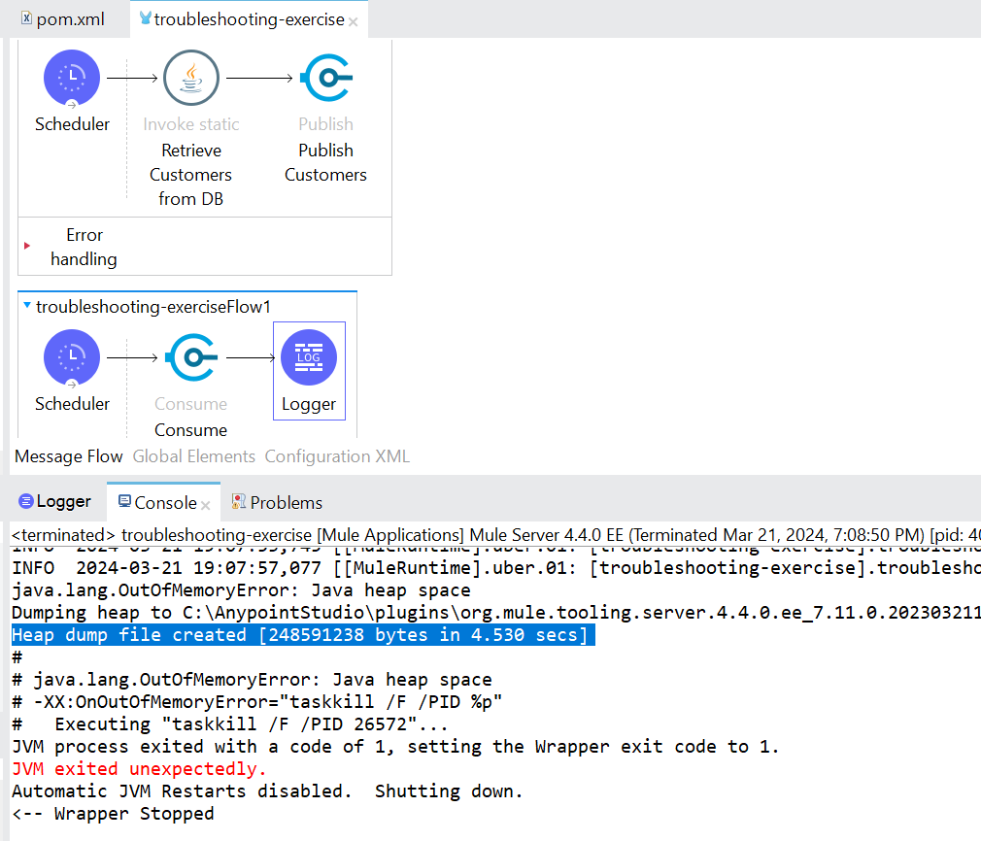
Issue Details
Issue Details

Slide 4
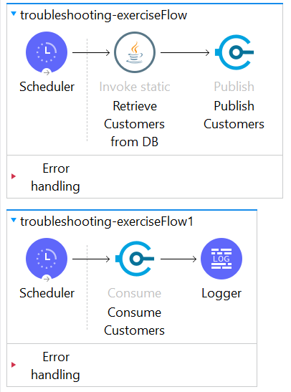
Current Design
Application had 2 processes:
troubleshooting-exerciseFlow -> Producer Flow :
Producing a message every second to TRANSIENT VM Queue (i.e customers). One message has 1 lakh Customers.
troubleshooting-exerciseFlow1 -> Consumer Flow :
Consuming a message every five seconds.

Slide 5
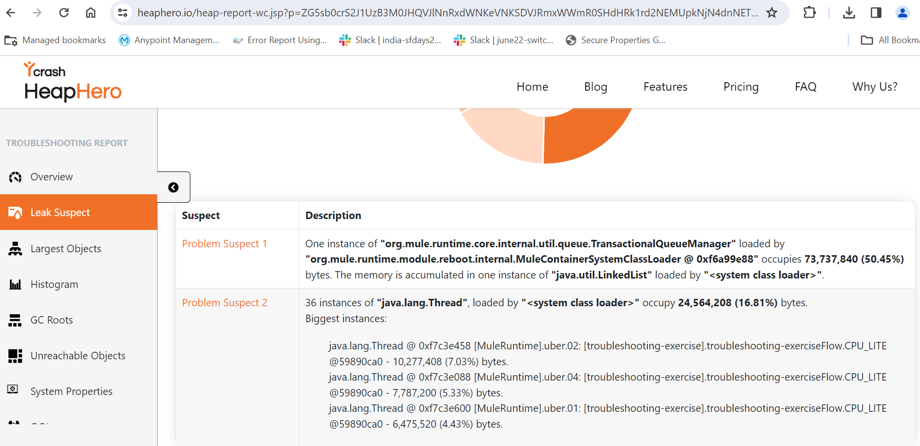
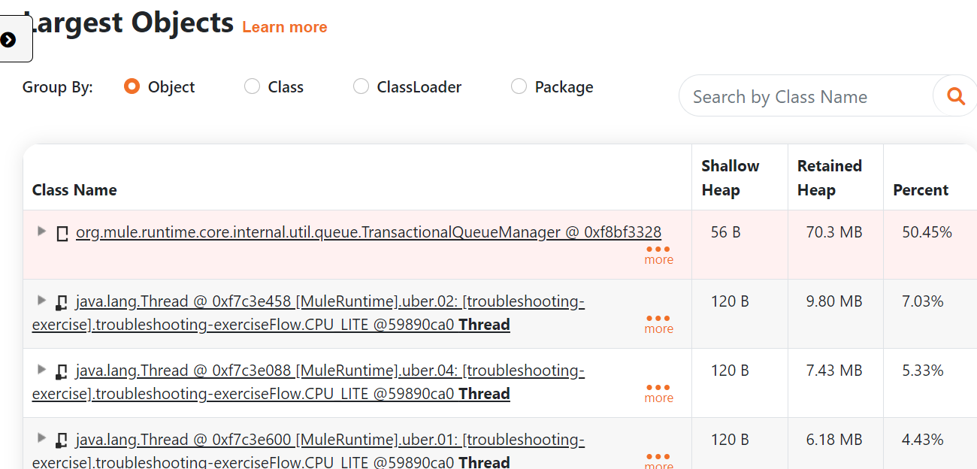
Troubleshooting Steps and Details
Picked up the heap dump from location provided from Console.
Dumping heap to C:\AnypointStudio\plugins\org.mule.tooling.server.4.4.0.ee_7.11.0.202303211414\mule\logs\dump_mule-42df4989-ec55-4c18-96a8-bcdc768be67d.hprof ...
Heap dump file created [248591238 bytes in 4.530 secs]
Performed Heap Dump analysis. PFB the Heap analysis report.

Slide 6
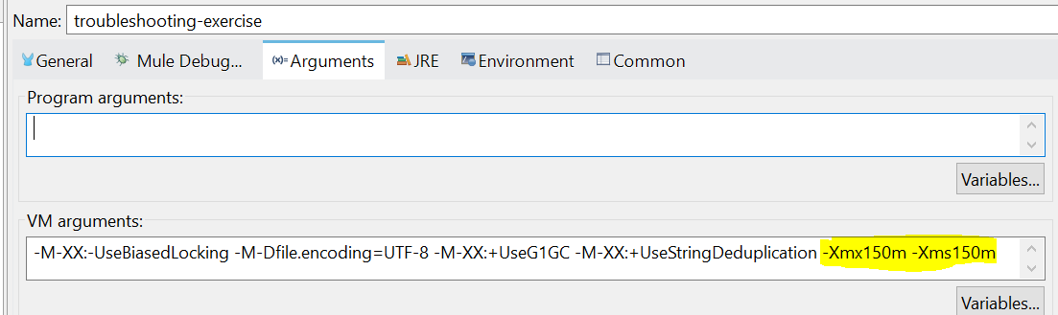
RCA
Application is using TRANSIENT VM Queue which is in-memory. Along with Max outstanding messages is set as -1 which means application can keep on accumulating any number of messages in-memory.
We have set 150 MB of Heap Space via VM Arguments.
JVM Heap soon Heap space is consumed via data published to TRANSIENT VM Queue and JVM goes out of memory which causes Mule Application to crash.

Slide 7
Suggested Solutions
Approach 1:
Update VM Queue configuration to be PERSISTENT which uses File based storage instead.
Pros:
JVM Heap is not used instead file-based storage is used to store the messages.
Reliability: Messages not lost in case of restart.
Cons:
VM Queues are internal Virtual queues.
Consume Disk Space of hosted environment of the application.
If too much data is produced and not consumed data remains in file storage. Since File storage and application runs on same Disk. It can cause disk memory issues if application runs for longer period.
In long run application might become slow.
Approach 2:
Any Messaging broker (Rabbit MQ, Active MQ) or MuleSoft provided Cloud hosted Anypoint MQ can be leveraged which can decouple application and Storage. It can be used to store messages and enhance reliability we can appropriate scale if more storage is needed.
We can also use different Listener/Consumer/Subscriber Operations as per different Connector Options to get the data from queue and control the number of messages we pick.
Pros:
External storage systems are used to store the messages.
Reliability: Message not lost in case of restart.

Slide 8
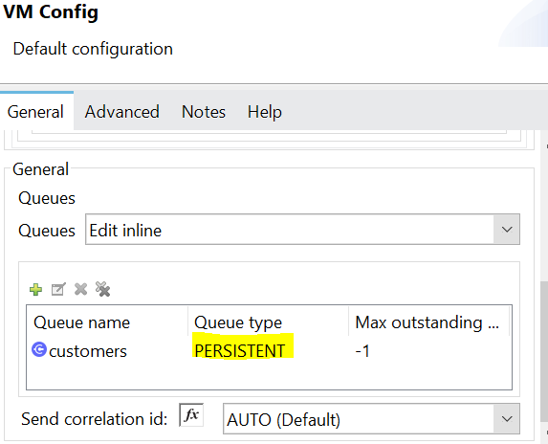
Steps to Fix Troubleshooting App Issue
Fix is applied on existing application considering we don’t have any other Messaging Broker available, Update the VM Queue configurations to Persistent

