Slide 1
Case Study

Slide 2
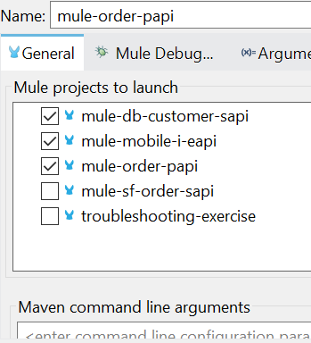
Project Setup Guide
Unzip Project.zip and directly import projects in Anypoint Studio.
Update DB details in mule-db-customer-sapi properties file. Local and Dev Properties YAML file.
Run Multiple Applications on Anypoint Stuidio :
Right click on mule-mobile-i-eapi.
Select all applications mule-mobile-i-eapi, mule-order-papi and mule-db-customer-sapi
Put blow VM Arguments in RUN Configurations.
-Danypoint.platform.gatekeeper=disabled -Denv=local -DsecureKey=mulesoft@1234567
Use attached Local postman collection to test.
Run Multiple Applitcation on Runtime Manager Anypoint Platform.
Use attached Dev postman collection to test.
mule-mobile-i-eapi , mule-order-papi and mule-db-customer-sapi are deployed to anypoint platform public cloud.

Slide 3
DB Setup Guide
CREATE TABLE public.customer (
id VARCHAR(10),
emailid VARCHAR(100)
);
INSERT INTO public.customer (id, emailid) VALUES ('2', 'robin.basu@gmail.com');
INSERT INTO public.customer (id, emailid) VALUES ('1', 'raj.kisan@gmail.com');
INSERT INTO public.customer (id, emailid) VALUES ('3', 'john.doe@gmail.com');

Slide 4
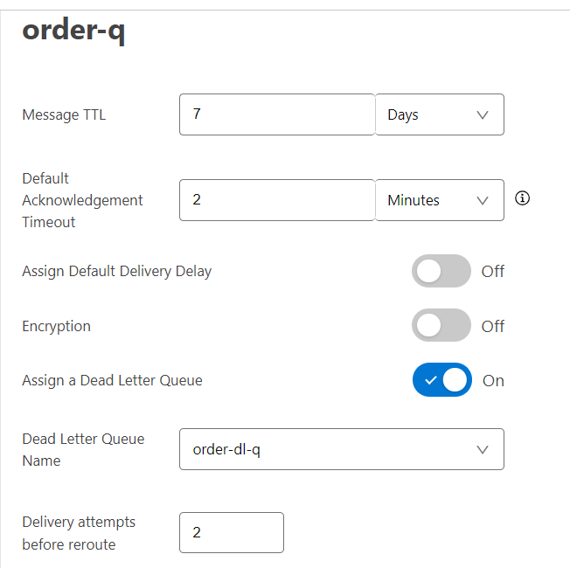
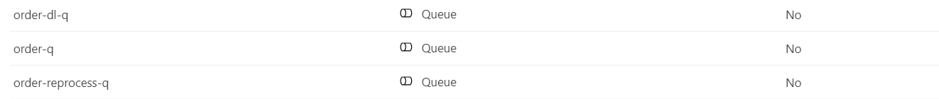
Anypoint MQ Setup Guide
Create 3 Queues.
Order-q (Main Data Recieving Queue)
Order-reprocess-q (Used for Data Error Queue)
Order-dl-q (Used as Dead Letter Queue)

