Slide 1
Blood Bank Management System
RAVICHANADRA K G PES1201701581
AMBARISH D Y PES1201701635
PAVAN MITRA PES1201700239

Slide 2
Overview
Our blood bank system ties together and manages various aspects of a blood bank, including blood intake, events, donor-recipient compatibility and staff member access.
We also have a website that allows recipients to check availability based on their requirements. Staff login is also allowed, where they can view and update blood info.
Our database encompasses Branch, Donors, Recipients and events for a comprehensive retrieval mechanism.

Slide 3
Objectives
Reduce the hassle and time required by plausible recipients to look for blood
To ensure functionalities of a standard database
To ensure simplicity and usability of user interface (here, website).
To try and introduce scalability
To allow populous availability

Slide 4
Case Study
BloodBankIndia, a community driven website to help find blood donors near you.
http://www.bloodbankindia.net/
Insights
The paper focuses on simplicity and ease of use.
Also, scalability is at the back of the mind while writing queries and designing schema.
Finally, geographical inclusion is given importance i.e. try and include all blood banks in a given location.

Slide 5
1
SIMILARITIES
Retrieves according to blood type
Uses recipient input to search
Separate Staff and Donor Login

Slide 6
Differences from case study and reasons
Recipient-centred
OpenAccess
Optional Donor Registration
End user is recipient
Donor-recipient interaction is permitted.
Blood-centred
Staff and Donor Access
Donor simultaneously updated alongside blood, manually.
End user is Staff
All donor-recipient interactions are purely via the bank.

Slide 7
Problems faced and how we solved them
Linking PostGreSQL to website was complex.
Hence, we used PHP MyAdmin instead.
Wouldn’t accept date even when entered.
Found out that PHP requires input in YYYY-MM-DD and forged accordingly.

Slide 8
What else we could’ve used and why we didn’t
Android application.
Why not: Idea was to make it quicker and easier.
Since blood is required in emergency situations, it takes time to download separate application and use it.
A current snapshot of all available data, in graphical form.
Why not: Blood is requirement is specific and intensive. Knowing statistics will not help end user, will only help staff and management understand needs.

Slide 9
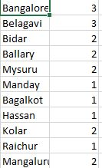
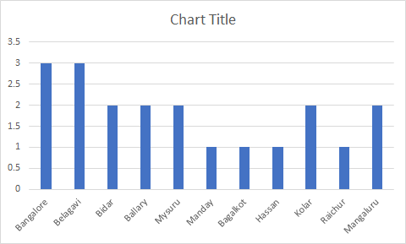
Data Analysis Overview
City vs No. of donors
We observe urban areas have higher proportion of donors.

Slide 10

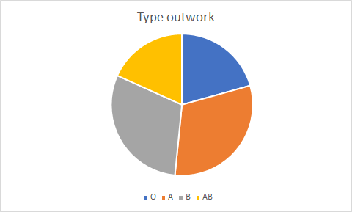
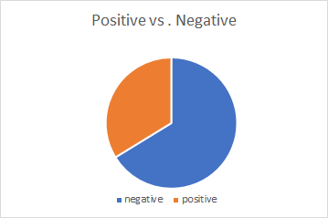

Slide 11
THANK YOU

