Slide 1

Mutual Fund Analytics Project
Bluestock Fintech Capstone Project
Prepared By:
Rachit Gupta
Bachelor of Computer Applications
Amity University Noida

Slide 2
Problem & Objectives
Problem Statement
Mutual fund data is large and complex.
Manual analysis is time-consuming.
Need for a data-driven analytics solution.
Objectives
Clean and prepare data
Store data in database
Perform data analysis
Build Power BI dashboards
Generate business insights

Slide 3
Data Sources
Datasets Used Tools Used
AUM by Fund House -> Python
Scheme Performance -> SQLite
Investor Transactions -> SQL
Benchmark Indices -> Power BI
-> Pandas
-> Numpy
-> VS Code
-> Git Hub

Slide 4
Project Architecture
Raw CSV Data
Data Cleannig
SQLiteDatabase
SQL Analysis
POWER BI DASHBOARD
Business Insights

Slide 5
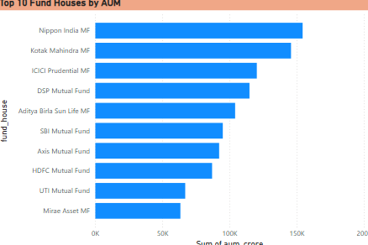
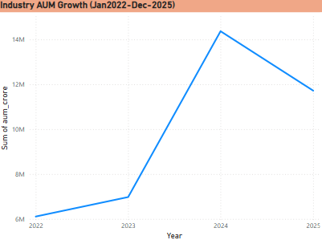
EDA Highlights (Part 1)
Key Findings:
* Multiple mutual fund categories identified
* Fund house-wise AUM distribution analyzed
* Missing values successfully handled
* Duplicate records removed
* Dataset prepared for advanced analytics

Slide 6
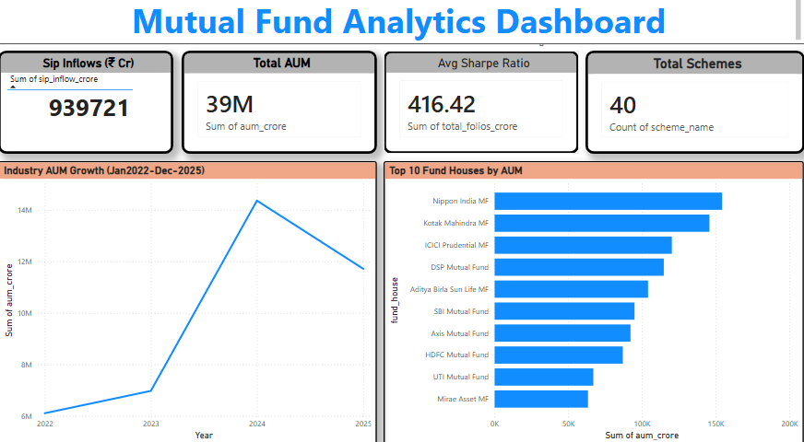
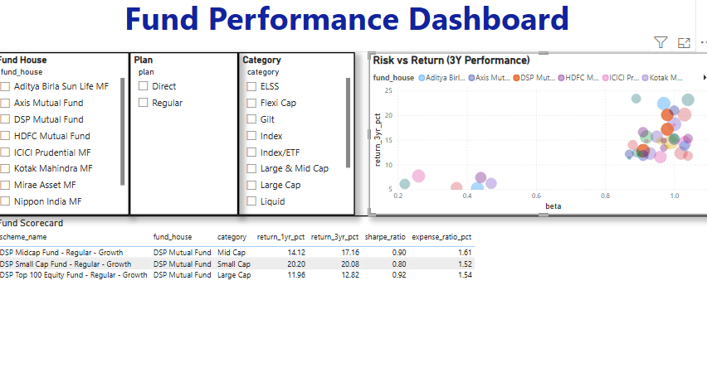
EDA Highlights (Part 2)
Key Insights:
Top fund houses hold a major share of total AUM
Fund performance varies across categories
Higher returns are often associated with higher risk
Investor activity differs across schemes
Category-wise trends help identify investment opportunities

Slide 7
Performance Metrics
Metrics Evaluated:
* 1-Year Return %
* Sharpe Ratio
* Expense Ratio
AUM
Purpose:
* Measure performance
* Compare risk-adjusted returns
* Evaluate efficiency
* Support investment decisions

Slide 8
Perfomance Analysis
Key Findings:
*Strong performing schemes identified
*Higher returns often imply higher risk
* Better Sharpe Ratio = better risk-adjusted return
* Expense ratios vary by fund
* Top fund houses dominate AUM
Business Impact:
* Better investment decisions
* Easy fund comparison
* Risk assessment support

Slide 9
Provides a high-level overview of mutual fund performance, fund categories, and fund house distribution.

Slide 10
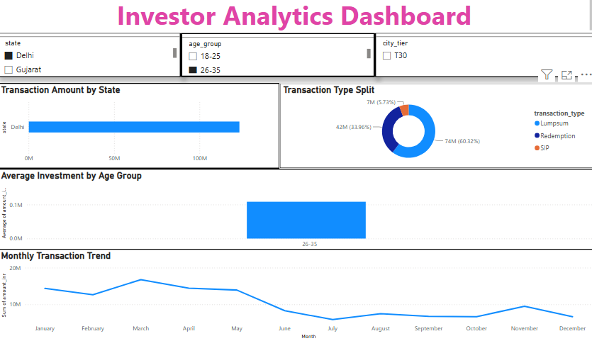
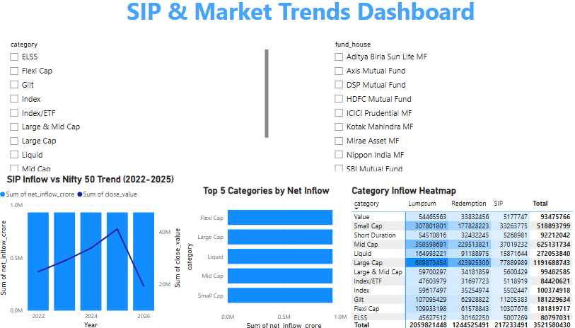
Dashboard Visualizations

Slide 11
Key Findings
*Leading fund houses dominate AUM
* Performance differs by category
* Higher return often means higher risk
* Sharpe Ratio helps evaluate efficiency
* SIP remains a preferred investment method
* Dashboard supports better decisions

Slide 12
THANK YOU
Questions?
Rachit Gupta
Bluestock Fintech Capstone Project

