Slide 1
Questions:
Q What is required to deploy Jaeger.
It needs K8 and Docker for the deployment. Also need jar file for jaeger clients. In-memory data storage provided by the Jaeger we can use also pluggable component like Cassandra, Elastic Search, Kafka.
Q How does it fit into State Street Ecosystem?
Jaeger is good fit for State Street ecosystem. But we need to confirm about the in-memory storage capacity of Jaeger.
Q Is any alternative option available?
Yes, We can use zipkin. We compared zipkin on last slide.
Q Any co-existence tools required to deploy or run Jaeger?
No, We need to only configure Jaeger client in each microservices and deploy into pod of K8.

Slide 2
Jaeger
Jaeger is a distributed tracing system released as open source by Uber Technologies. It is used for monitoring and troubleshooting microservices based distributed systems, including:
Distributed context propagation
Distributed transaction monitoring
Root cause analysis
Service dependency analysis
Performance / latency optimization

Slide 3
Major Component Of Jaeger
Jaeger Client : Provide specific implementations of the OpenTracing API.
Agents: — The Jaeger agent is a network daemon that listens for spans sent over UDP, which it batches and sends to the collector.
Collector — The Jaeger collector receives traces from Jaeger agents and runs them through a processing pipeline.
Query — Query is a service that retrieves traces from storage and hosts a UI to display them.
Ingester — Ingester is a service that reads from Kafka topic and writes to another storage backend (Cassandra, Elasticsearch).

Slide 4
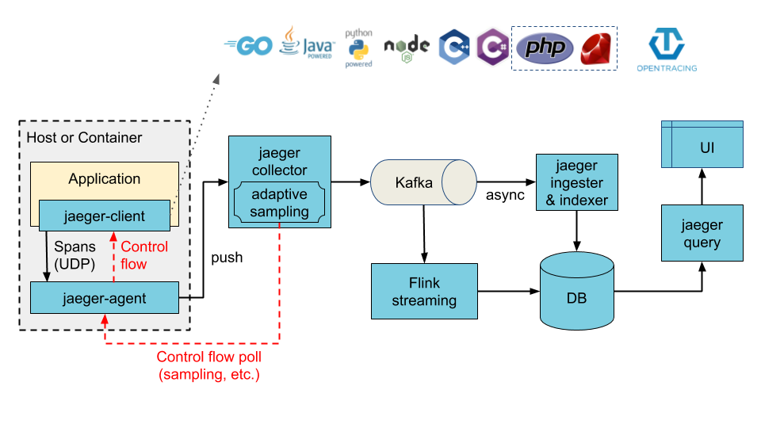
Architecture Of Jaeger

Slide 5
Jaeger Client Sampling Configuration
Constant : Sampler always makes the same decision for all traces.
Probabilistic : Sampler makes a random sampling decision with the probability of sampling.
Rate Limiting: It will sample requests with the rate of X traces per second.
Remote : Sampler consults Jaeger agent for the appropriate sampling strategy to use in the current service.

Slide 6
How to Setup Jaeger
Step1: Setup Docker in VM (by exe or bin file).
Step 2: Run this command –
docker run -d --name jaeger -e COLLECTOR_ZIPKIN_HOST_PORT=:9411 -p 5775:5775/udp -p 6831:6831/udp -p 6832:6832/udp -p 5778:5778 -p 16686:16686 -p 14268:14268 -p 14250:14250 -p 9411:9411 jaegertracing/all-in-one:1.9
Step 3 : Add jaeger dependency in pom.xml file of the project.
Step 4 : Configure Jaeger into the project.
Step 5 : Up all the services. To trace the detail we can go to Jaeger port (by default 16686) which we define earlier.

Slide 7
Jaeger vs Zipkin
Jaeger
Zipkin
Jaeger also provides dynamic sampling, a REST API, a ReactJS-based UI
It has in-memory storage and pluggable component which currently supports Cassandra, Elasticsearch and Kafka
Good for scaling, Implementation of OpenTracing is available.
Small Developer Community as compare to Zipkin Community.
Zipkin doesn’t provide varieties of sampling like probalistics and
It also has in-memory storage and pluggable component which currently supports Cassandra, Elasticsearch and Kafka
All Implementation of OpenTracing is not available.
Large Developer Community

