Slide 1
🧩 Title Slide
Title: Hangman Game
Subtitle: A Word Guessing Game
Presented by : Varsha Rani
Subject: (Python / Programming / Mini Project)
Notes:
1

Slide 2
Introduction
Hangman is a word guessing game
Player guesses letters of a hidden word
Wrong guesses reduce available chances
Objective is to guess the word before chances end

Slide 3
🎮 Objective of the Game
To improve vocabulary skills
To practice logical thinking
To make learning fun and interactive
To demonstrate programming concepts

Slide 4
⚙ Technologies Used
Programming Language: Python
Platform: Command Line / Terminal
Tools: Python Interpreter

Slide 5
🧠 Game Logic
A random word is selected
User enters a letter as input
Program checks:
If letter is in the word → correct guess
Else → chances decrease
Game continues until:
Word is guessed ✅
Chances become zero ❌

Slide 6
🔄 Flow of the Game
Start the game
Select a random word
Take user input
Check correctness
Update guessed letters
Display result (Win / Lose)

Slide 7
🧾 Code Explanation
(Overview)
Word list is stored in a variable
Random function selects a word
Loop runs until game ends
Conditions check win or loss
Output is shown to the user

Slide 8
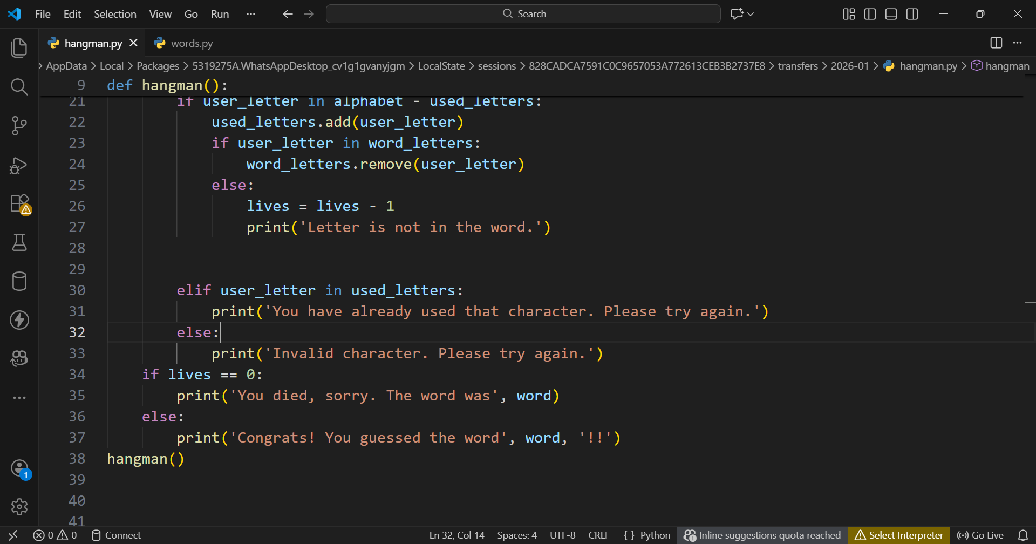

Slide 9
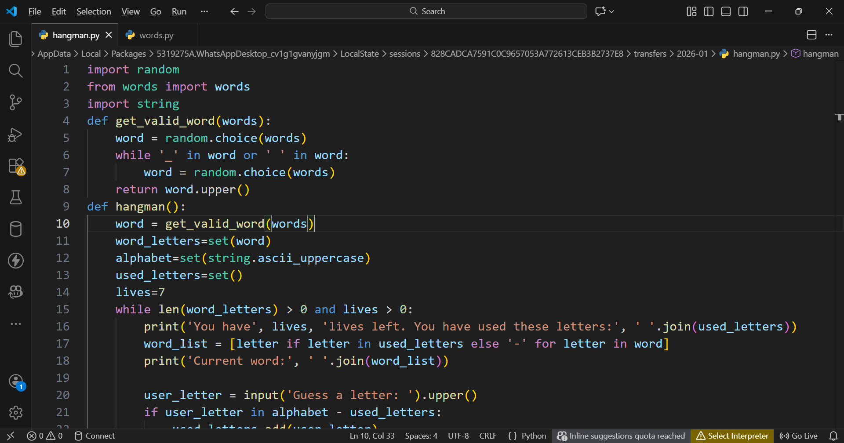
Code

Slide 10
🧪 Sample Output
Shows guessed letters
Displays remaining chances
Shows win or lose message

Slide 11
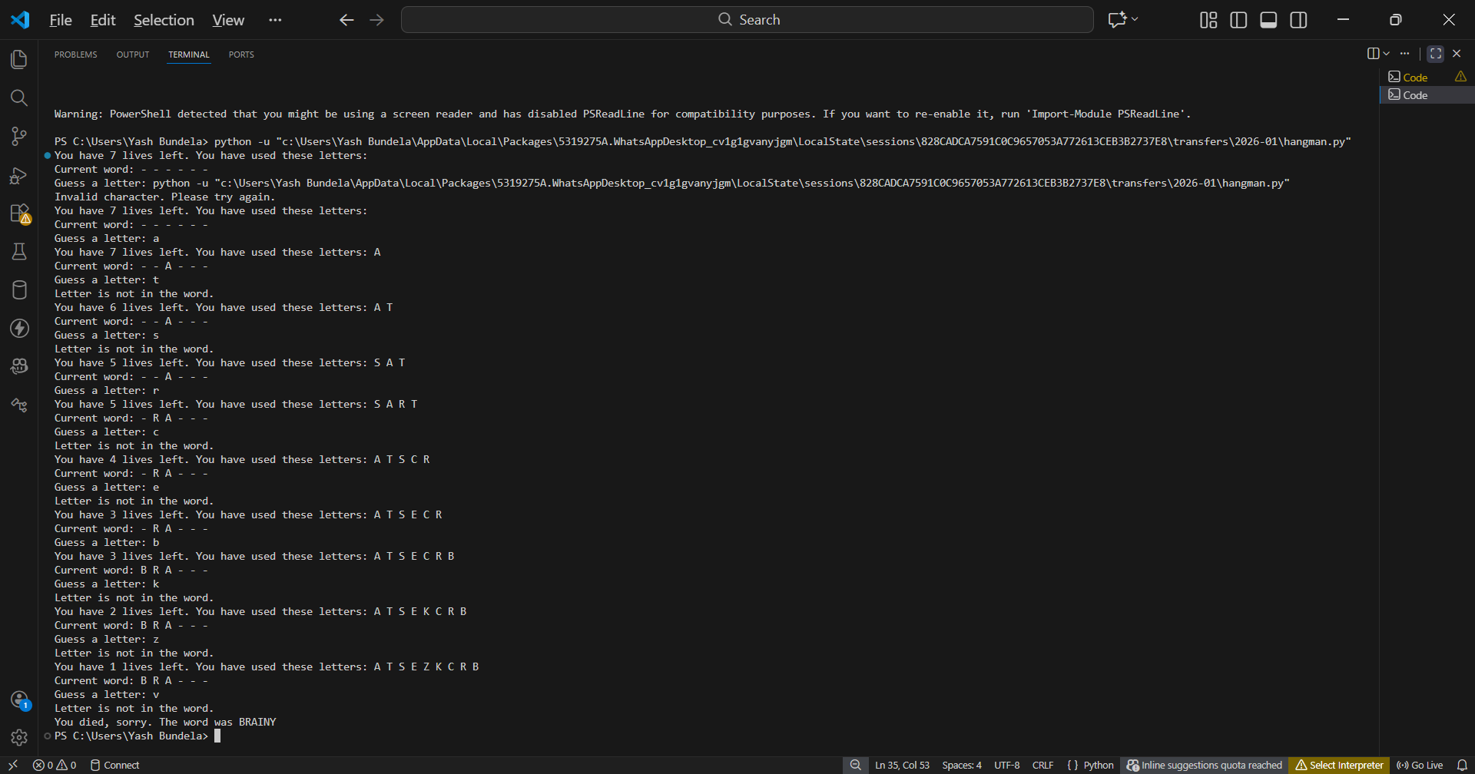
Wrong answer

Slide 12
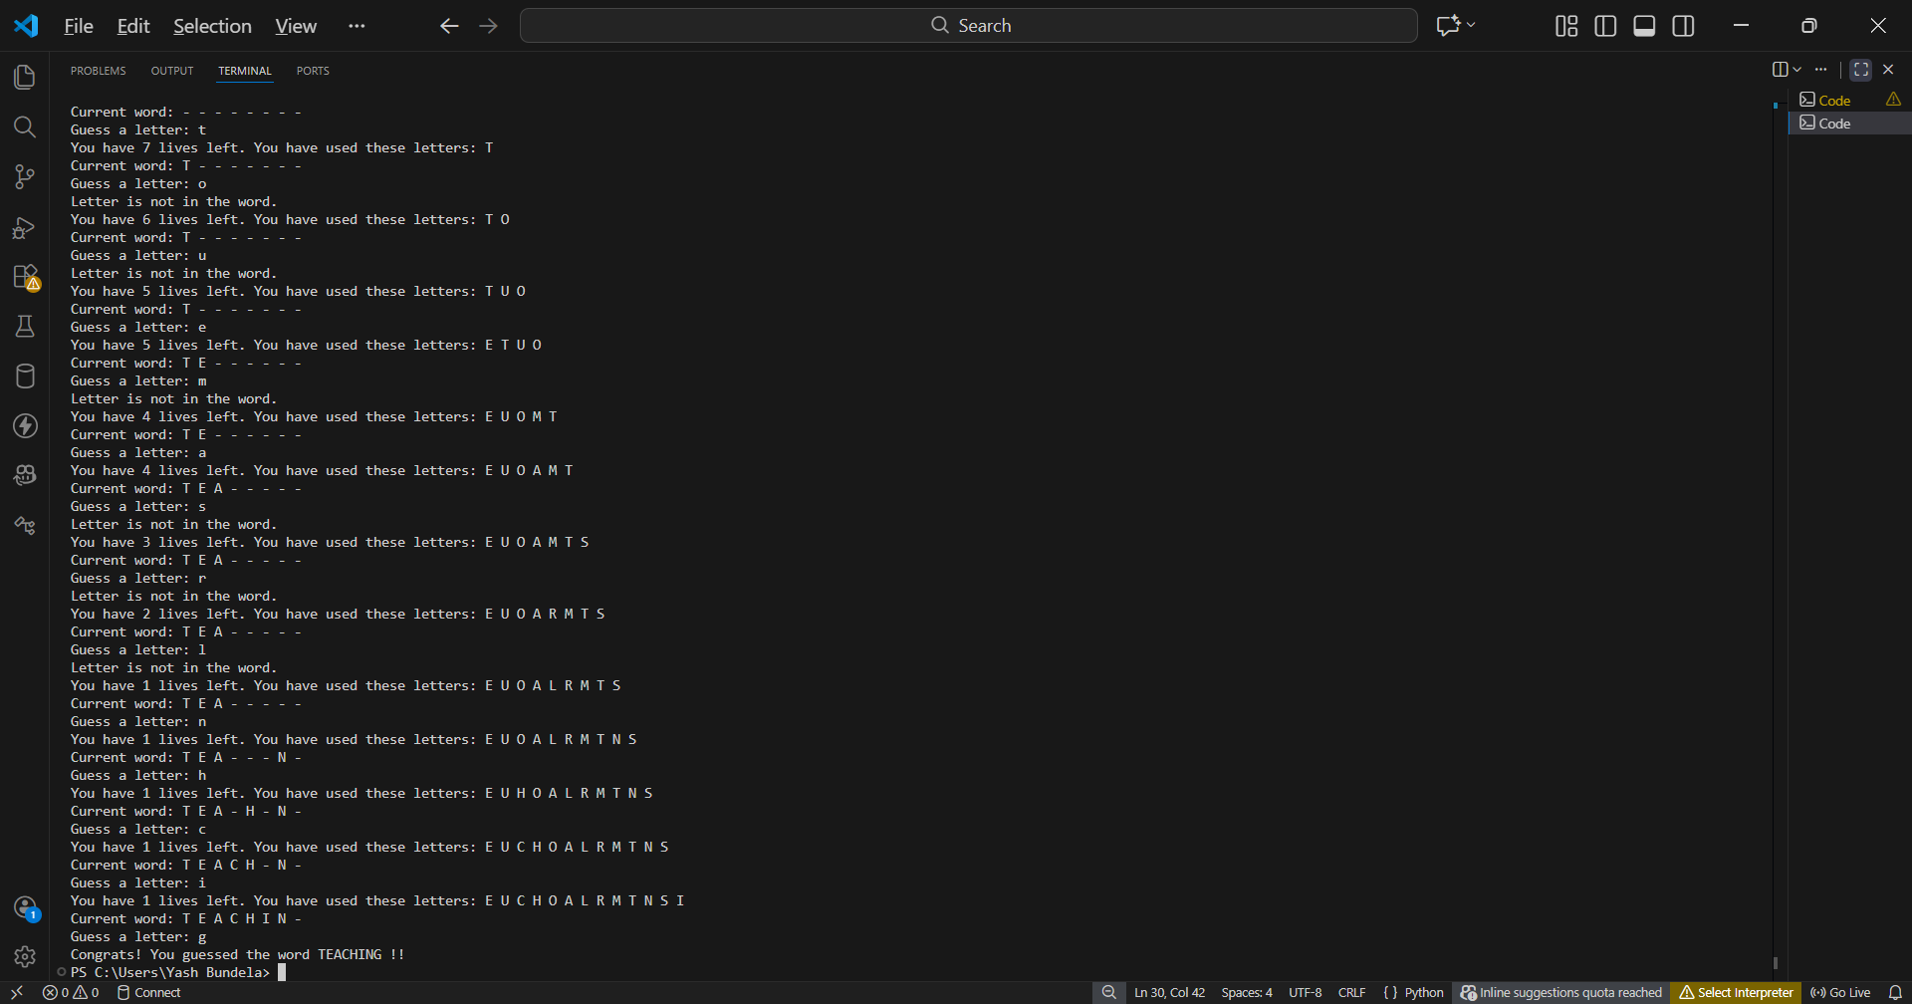
Right answer

Slide 13
🌟 Features of the Game
Simple and user-friendly
Interactive input system
Clear win/lose conditions
Easy to modify and extend

Slide 14
🚀 Future Improvements
Add graphical interface (GUI)
Add difficulty levels
Add hints for words
Store high scores

Slide 15
✅ Conclusion
Hangman game was successfully implemented
Helped understand loops and conditions
Improved Python programming skills
Project achieved its objective

Slide 16
🙏 Thank You
Thank You

