Slide 1

Indian Premier League
Exploratory Data Analysis
Presented By - Ravi Jagtap

Slide 2

Overview
12
696
13
215020
8157
Total Seasons Till Now
Total Matches
Total Teams
Total Runs
Total Wickets

Slide 3
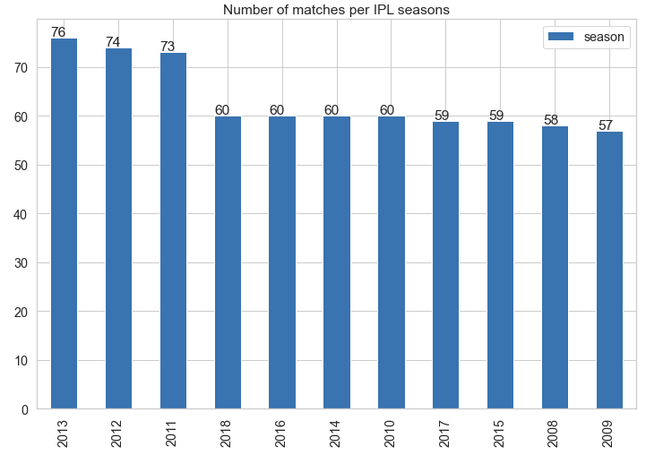
How many matches were played in each season?
Most number of matches were played in the year of 2013 (76 matches)
Followed by 74 matches in 2012 and 73 matches in 2011

Slide 4
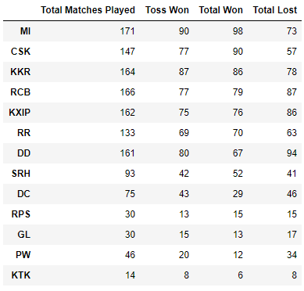
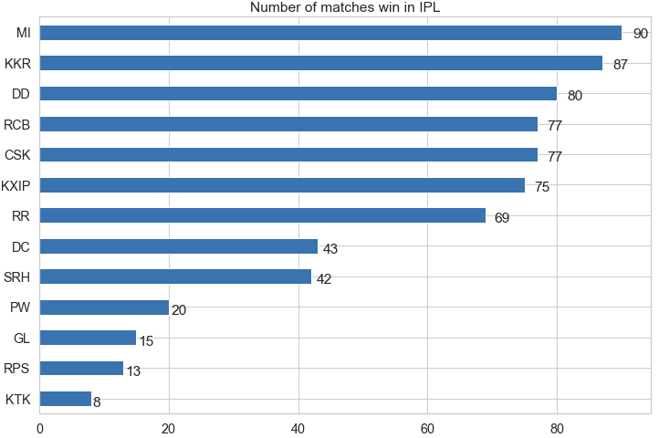
Matches played, toss won, wins and losses
Mumbai Indians has played most matches, most toss wins and they also won most matches.
Delhi Daredevils has lost most matches i.e. 94
KTK didn't played much seasons and games.

Slide 5
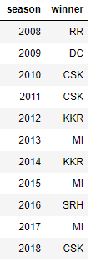
Winners of each season
CSK and MI has won most seasons (3 each)
MI has won seasons 2013, 2015, 2017
CSK has won seasons 2010, 2011, 2018

Slide 6
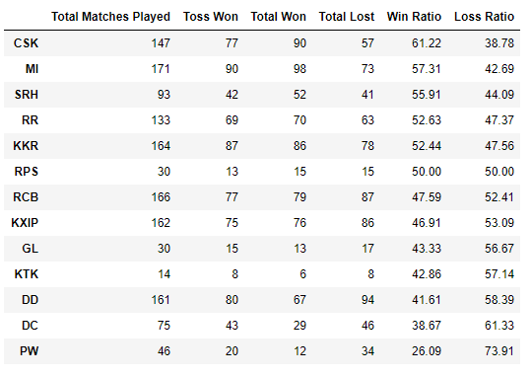
Win ratio of each team
CSK and MI has won most seasons (3 each)
MI has won seasons 2013, 2015, 2017
CSK has won seasons 2010, 2011, 2018
CSK has the best winning percentage of 61.22%
PW is at the bottom of the table in term of winning %

Slide 7
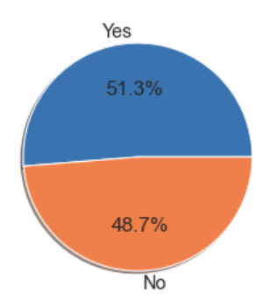
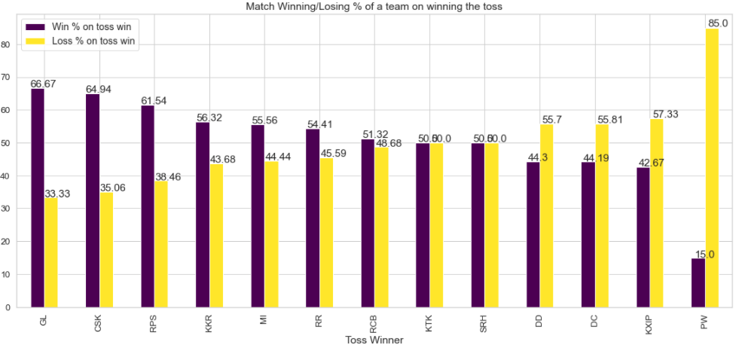
Has Toss-winning helped in winning matches?
51.3% times team has won the match when they won the toss as well.
For most of the teams winning the toss has helped winning the match as well.

Slide 8
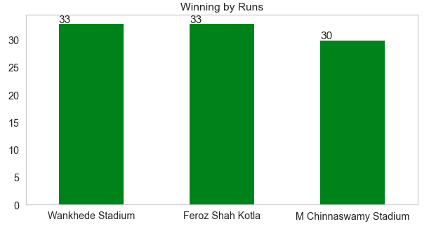
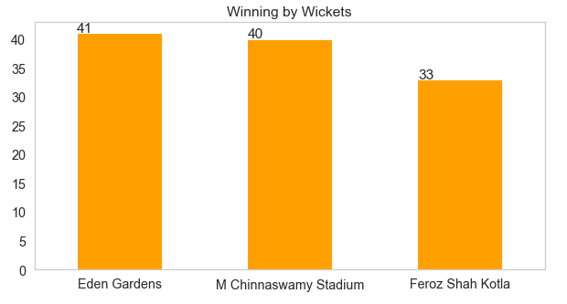
Which stadium is best for winning by runs and wickets?
Wankhede Stadium is best stadium to defend the total
Eden Gardens stadium is the best stadium to chase.

Slide 9
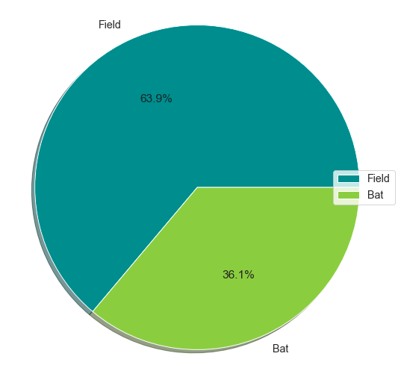
Does batting or bowling first helped in match winning?
63.9% time team has won the game when they choose to field first.

Slide 10
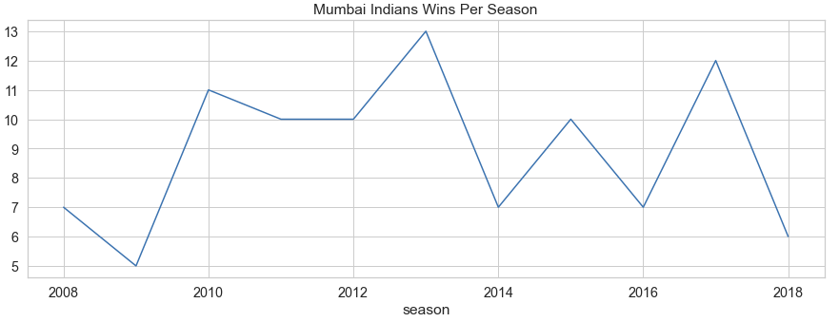
Number of matches won by Mumbai Indians per season?

Slide 11
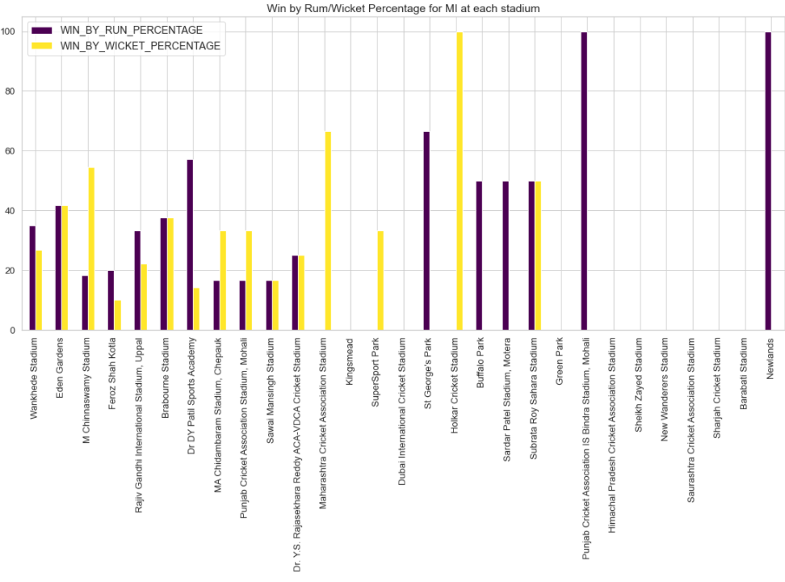
Batting first or bowling first helped MI in winning matches at each venue
This gives an overview of winning by runs and winning by wickets for each venue
At some stadiums like Wankhede or Dr. DY Patil, MI have a good record of defending their total
Some stadiums like M. Chinaswamy and PCA are good for chasing the total for MI.

Slide 12
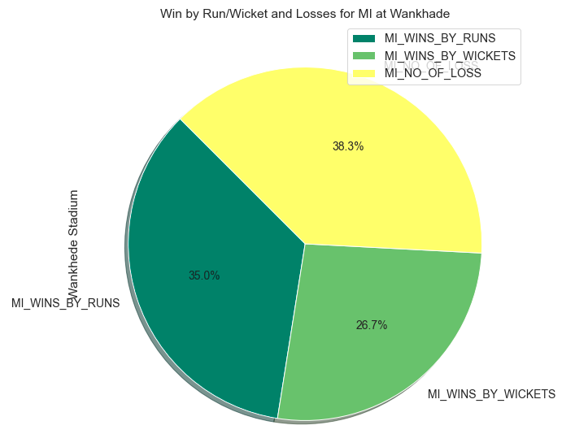
How's the performance of MI at home ground (Wankhede)
35% times MI has won by runs at Wankhede stadium
26.7% time MI has won by runs at Wankhede Stadium
38.3% times MI has lost the match at Wankhede stadium

Slide 13
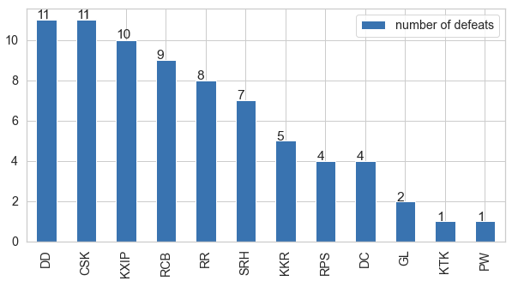
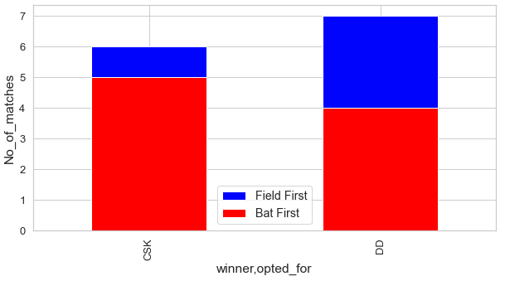
Against which team Mumbai Indians got the most defeats
CSK and DD defeated MI 11 times each.
Most of the times both CSK and DD opted to field first against MI in which MI lost the matches

Slide 14
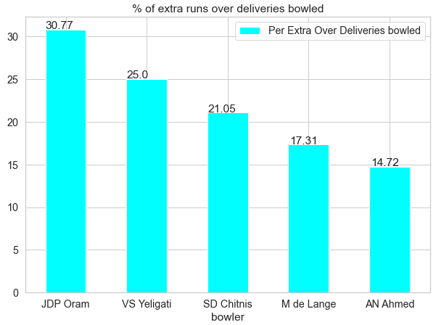
Bowler with most extra runs for Mumbai Indians
Took only the bowlers who bowled atleast 4 overs.
JDP Oram has given the most extra runs compared to the deliveries he bowled.
Followed by VS Yeligati

Slide 15
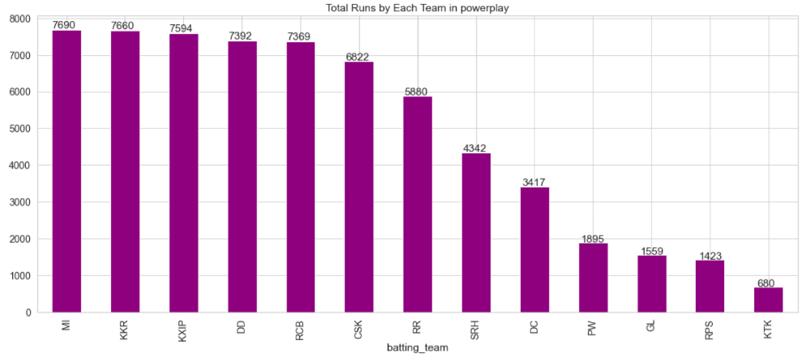
Total runs scored by each team in power plays
Mumbai Indians tops the table by scoring most runs in powerplays – 7690 Runs
Followed by Kolkata Knight Riders – 7660 Runs

Slide 16
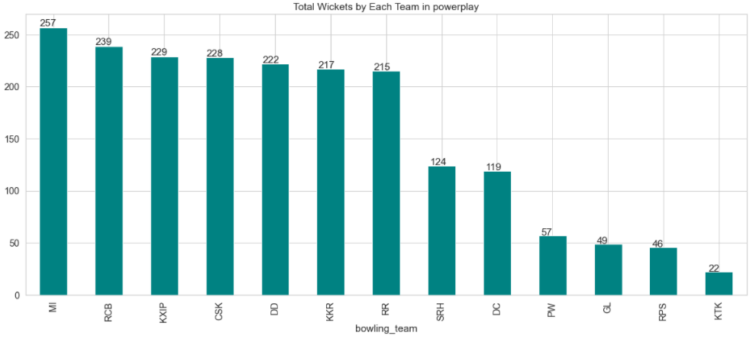
Total wickets taken by each team in power play
Mumbai Indians again tops the table by taking most wickets in powerplays – 257 Wickets
Followed by Royal Challengers Bangalore – 239 Wickets

Slide 17
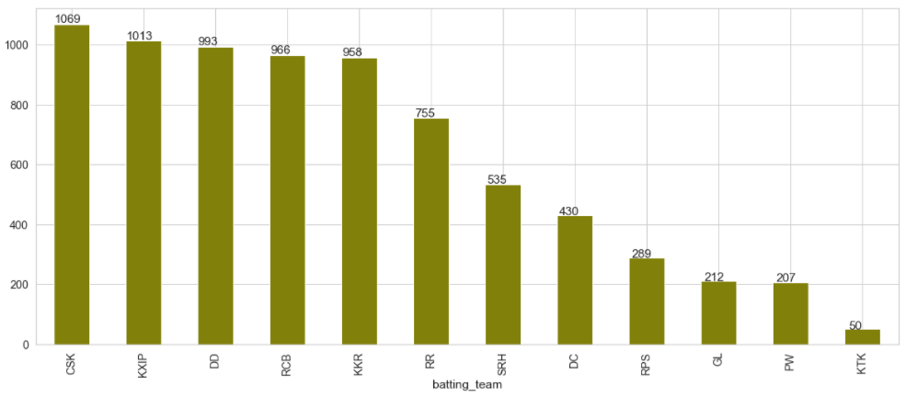
Which team scored highest runs in powerplay against MI
CSK Scored most runs, 1069 runs against Mumbai Indians in powerplays
Followed by Kings Eleven Punjab – 1013 Runs

Slide 18
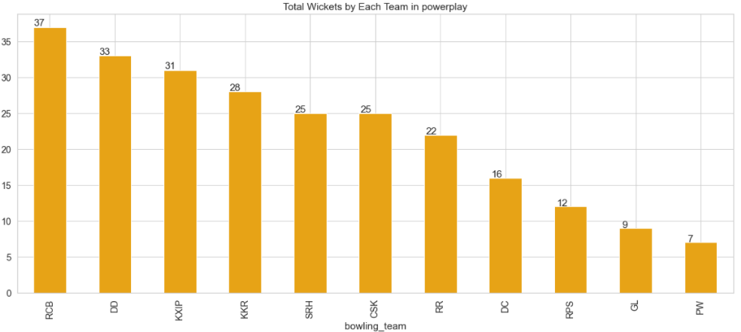
Which team took most MI wickets in powerplay
RCB took most wickets, 37 wickets of Mumbai Indians in powerplays
Followed by Delhi Daredevils – 33 Wickets

Slide 19
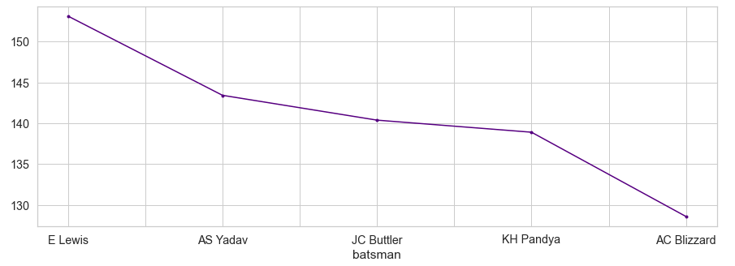
MI batsman with maximum strike rate in powerplays
These are the top 5 Mumbai Indians batsman with highest strike rate
E Lewis has the maximum strike rate of 166

Slide 20
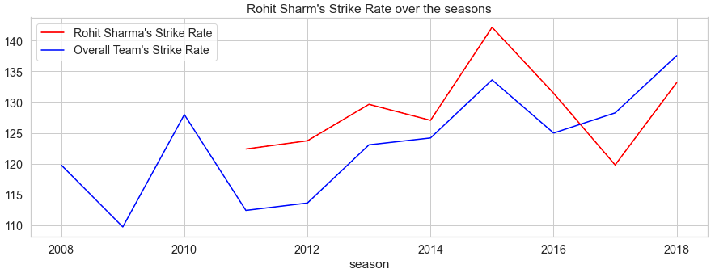
Rohit Sharma’s Strike Rate over the season

Slide 21
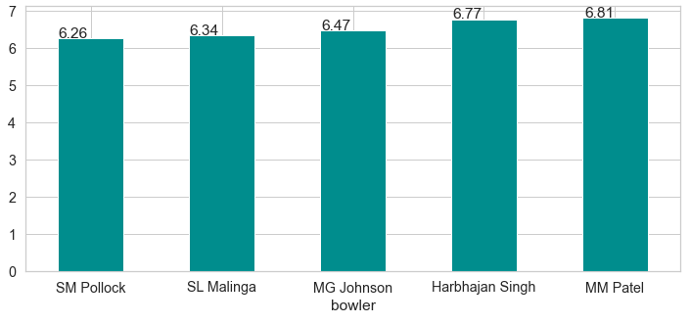
Most Economical Bowler for MI in powerplays
SM Pollock is the most economical bowler for MI with economy of 6.26 runs per over

Slide 22
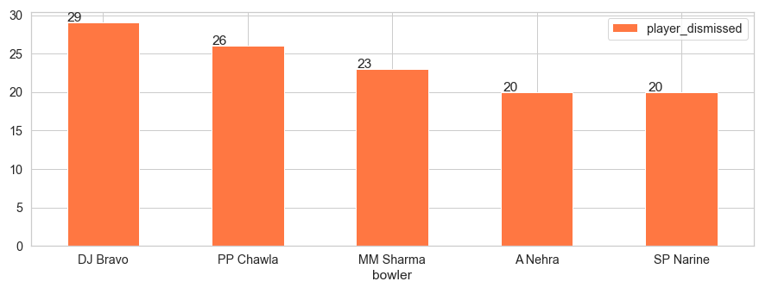
Which bowler has taken most wickets against MI
DJ Bravo has taken most MI wickets (29) in all season

Slide 23
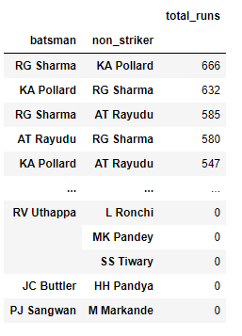
For MI which players partnership is successful
RG Sharma and KA Pollards partnership is most successful for MI as they scored total 666 + 632 = 1298 Runs together.
Its followed by RG Sharma and AT Rayudu's partnership with total 585 + 580 = 1165 Runs

Slide 24
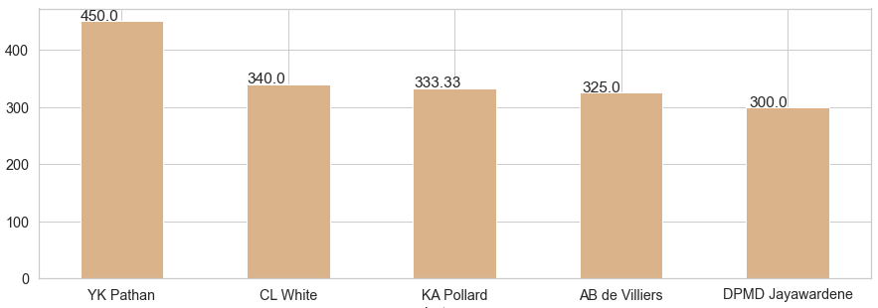
Which top 5 batsman are most successful in super overs
YK Pathan has the highest strike rate ok 450 in super overs

Slide 25
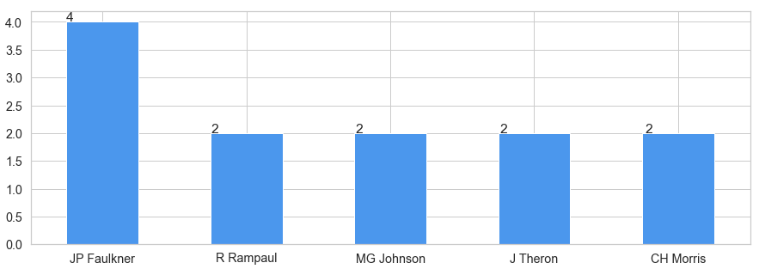
Which top 5 bowlers are most wickets in super overs
JP Faulkner has taken most wickets in super over

Slide 26
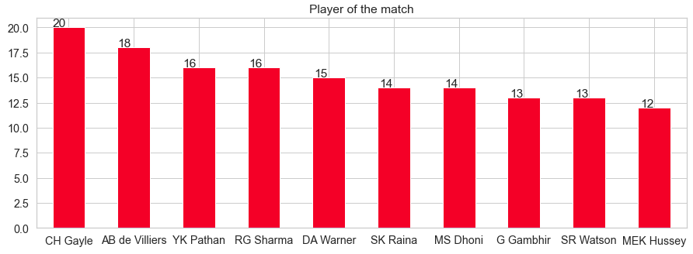
Players with most Man of the Match titles
CH Gayle has got 20 times Man of the Match award followed by AB de Villiers, YK Pathan and RG Sharma

Slide 27
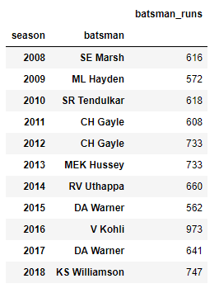
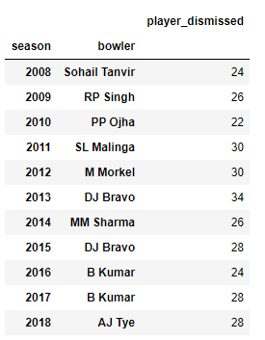
Orange Cap and Purple Cap winners per Season
SE Marsh is the first Orange Cap holder
DA Warner and CH Gayle has been awarded twice with the Orange Cap
Sohail Tanvir is the first Purple Cap holder
B Kumar and DJ Bravo has been awarded twice with the Purple Cap

Slide 28
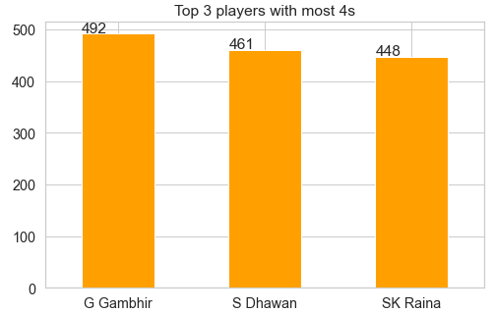
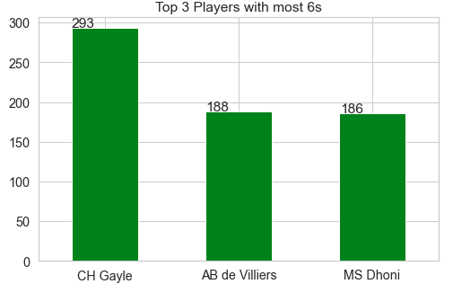
Orange Cap and Purple Cap winners per Season
G Gambhir hit the most 492 boundaries
CH Gayle hit the most 6s, that is 293

Slide 29
THANK YOU
Indian Premier League
Exploratory Data Analysis

