Slide 1
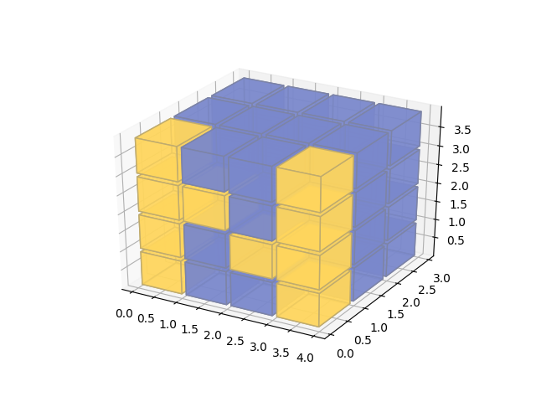
NumPy…..

Slide 2
What is NumPy?
NumPy is the fundamental package for scientific computing in Python.
It is a Python library that provides a multidimensional array object, various derived objects (such as matrices),

Slide 3
What is NumPy?
Numpy Contains an assortment of routines for fast operations on arrays, including
mathematical
logical
shape manipulation
sorting
selecting
I/O
discrete Fourier transforms
basic linear algebra
basic statistical operations
random simulation and much more.

Slide 4
What is NumPy?
NumPy’s features which are the basis of much of its power:
Vectorization
Broadcasting.

Slide 5
Vectorization
Vectorization describes the absence of the following in the code
explicit looping,
indexing
of course, these things are taking place, just “behind the scenes” in optimized, pre-compiled C code.

Slide 6
Vectorization
Vectorized code has many advantages, among which are:
vectorized code is more concise and easier to read
fewer lines of code generally means fewer bugs
the code more closely resembles standard mathematical notation (making it easier, typically, to correctly code mathematical constructs)
vectorization results in more “Pythonic” code. Without vectorization, our code would be littered with inefficient and difficult to read for loops.

Slide 7
Broadcasting
Broadcasting is the term used to describe the implicit element-by-element behavior of operations
In NumPy all operations, including
arithmetic operations
Logical
Bit-wise
functional, etc.,
behave in this implicit element-by-element fashion called broadcasting

