Slide 1
Mission Zero Defect
- Ravi Kalla

Slide 2
Defects Are Expensive & Unnecessary
We have come to accept defects as fact of software development lifecycle. But it does not have to be this way. We can and we should strive to prevent defects and completely eliminate them.
True Cost of Defects
Defects account for roughly 50% of project cost
Developers develop code, testers test and find defects, developers fix defects, testers retest and find more defects…
Defects found later in lifecycle are more expensive
Defect costs 1X in analysis, 10X in design, 100X during coding and 1000X during testing
Defects delay time to market by roughly 3 times
Functionality that can be released in 1 month take 3 months to release due to defect-fix-retest cycles
Defects decrease overall team productivity by 50%
Defect is taking 2 step forward and 1 step backward. It is symptomatic of inefficient team collaboration.
Only software industry spends such inordinate money/time in finding & fixing defects
You don’t build a home and then spend time fixing building defects. We do this in software because we can.

Slide 3
We do Iterative development in name of Agile
Sprints | Sprint-1 | Sprint-1 | Sprint-2 | Sprint-3 | Sprint-4 | Sprint-5 | Sprint-6
BA | Analysis | Analysis | Analysis |  |  |  | Release
Dev |  | Dev | Dev | Dev | Bug Fix | Bug Fix
Test |  |  |  |  | Test | Test
Different sprints for development and testing, testing sprint usually follows development sprint
Stories for a sprint evolve/change during the sprint requiring release freeze exceptions
Developers have a “coding” mindset not a “quality” mindset, the intent to get it right first time
Developers often do not know how testers will test them and it gives rise to many defects
The BA, Dev, QA team do not have a uniform understanding of the story and its behavior
Extensive manual testing employed impacting repeatability and quality of test scenarios
Code changes are not isolated, requiring extensive manual testing for small changes
Regression test automation is developed after release, thus does not benefit the sprint in scope
Manually detected defects do not feed into regression automated test suite
Lack of continuous integration impacts speed of delivery

Slide 4
We need to do Agile the right way
Core Philosophy: The team collectively has 2 weeks of a sprint to deliver best results. They need to start sprint with best preparation, execute at full speed without interruption and end the sprint with best results.
Sprint
Start
No Change (addition, removal, update) during Sprint
Sprint
End
Definition of Ready (Sprint Start)
Stories Completed (BA) Acceptance Test Cases/Data Ready (BA) System Test Cases/Data Ready (QA) Integration Test Cases/Data Ready (QA)
Definition of Done (Sprint End)
Stories Implemented (Dev) Unit Test Cases Implemented (Dev) System Test Cases Implemented (Dev/QA) Integration Test Cases Implemented (Dev/QA) Acceptance Test Cases Implemented (Dev/QA) Deployment Script Implemented (DevOps)
In sprint planning meeting, the entire team will review the story and all test cases and discuss how to implement the story and automate all the test cases and agree on what subset of test cases will be automated by developers and what subset will be automated by testers.

Slide 5
Recommended Agile Collaboration
Grooming1
Grooming2
Sprint Planning
Sprint Demo
Sprint Retrospective
Sprint-1
Sprint-2
Grooming: Entire team (BA, Dev, QA) discuss the upcoming stories and test cases/data for them.
Sprint Planning: Entire team (BA, Dev, QA) goes through the prioritized stories in the backlog, picks up stories that are complete with test cases/data (system, integration, acceptance), decide which test cases will be automated by developers and which will be automated by testers, assign story points and efforts for development and test automation and agree on the scope of the sprint.
Sprint Demo: Entire team (BA, Dev, QA) demos the completed product to stakeholders.
Sprint Retrospective: Entire team (BA, Dev, QA) reflects on what worked, what did not and what to change.

Slide 6


Recommended Approach for Test Automation
Test | Test Number | Environment | Approach
Unit Test | L0 | Local
Component Test | L1 | Local
Component Integration Test | L2 | Local
Component Integration Test | L2.5 | CI
End to End Integration Test | L2.5 | CI
Enterprise Integration Test | L3 | ST2/ST4
User Acceptance Test | L4 | ST2/ST4
Test Scenarios
WIP

Slide 7
What happens before Sprint Grooming?
BA write stories in ALM / Jira
QA analyzes stories and write test cases
QA prepares test data
QA and BA set the priority(High, Medium, Low) of each story
Frequency of test execution is based on the priority

Slide 8
What happens in Sprint Grooming?
BA, QA & DEV come together and pick the stories for the sprint

Slide 9
What happens in Sprint Execution? – Development Methodology
Developer write test automation to execute on Developer machines.
Quality Engineer write test automation to execute in “SauceLabs” over the environment in which application is deployed.
Create Test Automation for execution on developer machine (DevQA Tests)
“Integration + Acceptance tests” can be part of this
80% of the total test cases should be covered as part of this
Developer write and maintain the test automation code for the tests written by QA.(Developer still need to create unit test cases. DevQA tests doesn’t replace them.)
Technology stack for Web Based applications
Protractor, Spring-Junit, Spring-Cucumber, Mockito, Mockito, Hoverfly, FongoDB
Create Test Automation for execution on environment after deployment (External Tests)
“System + Acceptance + E2E tests” can be part of this
20% of the total test cases can be covered as part of this
Quality Engineer(QE) write and maintain the test automation code for the tests written by Quality Analyst(QA).
Assign an attribute called “Priority” to each test that is automated. Test Execution Frequency is based on the priority of the tests.
Technology stack for Web Based applications
Selenium, Protractor, CA Service Virtualization, SoapUI Pro
Technology stack for Mobile Based applications
Appium

Slide 10
What happens in Sprint Execution? – Execution Methodology
DevQA Tests (Integration + Acceptance tests)
They are executed on developer machine before code-checkin
Same tests execute in Continuous Integration(CI) pipeline on every new commit
Code quality is identified based on the coverage of the code that is obtained from tools like ‘Sonar’ or JaCoCo – and not based on the number of passed test cases as 100% of the tests should pass all the time
External Tests (System + Acceptance + E2E tests)
They execute on test environment like “SauceLabs” with below frequency -
When “Priority” = “High”, they will execute every time the code is deployed at the end of CI/CD pipeline.
When “Priority” = “Medium”, they will execute once a day - at the first execution of CI/CD pipeline.
When “Priority” = “Low”, they will execute once a week - at the first execution of CI/CD pipeline – or when they are manually triggered.
Code quality is based on the number of critical defects found. “Extent” reporting tool can be used to publish the reports to the entire team.
DevOps pipeline should create ephemeral environments in OpenShift or AWS platforms and tests should be executed on them.
“ProdShadow” can be maintained as a standalone environment where test data is incremental and real time. This data can’t be virtualized.

Slide 11
How does Developer & Quality Engineer automate?
Stories, Test Cases and Test Data should be ready before the application development start
Developer:
Automates DevQA Tests (Integration + Acceptance tests)
Utilizes the test cases and test data previously created by QA and BA
Should write the test code(in separate folder) inside application work space
Should avoid altering the application for testing purposes
Should not connect to external system
Virtualization of external Webservices and DB calls should be done
Test execution happens in Developer’s local computer and CI/CD pipeline before application build happens
Ownership lies with the person who changes the application the last time
Quality Engineer:
Automates External Tests (System + Acceptance + E2E tests)
Utilizes the test cases and test data previously created by QA and BA
Test automation code should be maintained in a separate workspace
May connect to external system.
Virtualization of Webservices and DB calls to be done if external systems are not available
Test execution happens in test server (with Sauce Labs support) after is deployed to respective server
Ownership lies with the Quality Engineer and should continuously monitor if any tests failed

Slide 12
Required DevOps pipeline changes
DevOps pipeline stages (written in Jenkins Job):
Code Quality Check (Sonar)
Build (Maven, Gradle)
Repository Mgmt. (Artifactory)
Env Config (Chef, Puppet)
Deploy
DevQA Tests
Auto Trigger for every build
External Tests
Auto Trigger based on test priority

Slide 13
How to push changes to DevOps pipeline?
No manual push to DevOps pipeline
Changes related to developer:
Write the test code & application code together
Check-in the changes to application workspace in Gitlab
DevOps pipeline download the code and trigger tests before every code build. These tests run in Jenkins slave.
Application build happens if all tests are successful
Changes related to QualityEngineer:
Write the test code
Check-in the changes to testing workspace in Gitlab
Automation scripts are deployed to test server after every checkin
DevOps pipeline will trigger these tests after application deployment. These tests run in external test server.
Application Certification happens if all tests are successful

Slide 14
How does automated tests run on a target test environment?
External tests are triggered by CI/CD pipeline after the code is deployed
URL of the environment is passed to the test scripts as parameter
Test automation scripts run on this new application environment dynamically

Slide 15
How to deploy application on cloud (OpenStack, AWS or OnPremise environment)?
OpenStack:
Ephemeral environments can be created
Native build and deployment tools are available
Deployment script integrates with Jenkins pipeline easily
Sample projects are available in the organization
AWS:
Ephemeral environments can be created
‘Cloud Formation’ can be used for Orchestration and ‘Puppet’ can be used for configuration management and application deployment
Deployment script integrates with Jenkins pipeline easily
OnPremise environment:
Predefined environments are available
Deployment scripts can be written(in ‘Puppet’)
Deployment script integrates with Jenkins pipeline easily

Slide 16


Testing Tasks Distribution
Sprint1 Grooming
Write Stories
Write Stories
Write Stories
Sprint1 Grooming
Sprint1 Planning
Sprint1 Execution
Sprint2 Grooming
Sprint1 Execution
Write Test Automation for L0, L1, L2
- Cucumber + Spring, Mockito
Write Test Automation for L3
- Cucumber + Selenium + SauceLabs
Application development and test
Test after deployment
Move old tests to Regression
Move old tests to regression
Create Service Virtualization
- H2, Hoverfly, Fongo
Create Service Virtualization
- SoapUI Pro, Service V Pro, CA-Lisa
100% Test Pass – GIT Commit
100% Test Pass – Certify Sprint

Slide 17

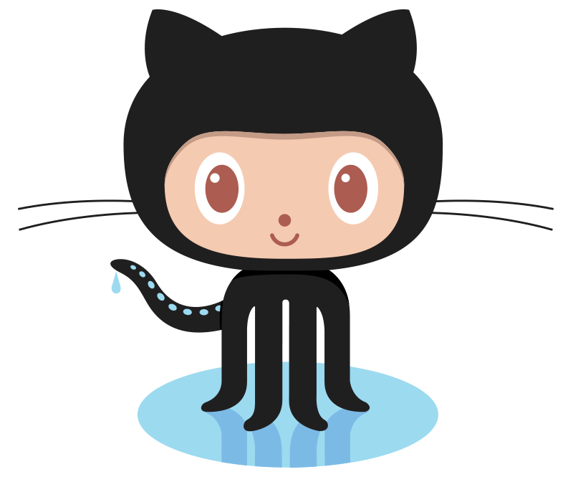



DevOps Integration
Code Quality Check (Sonar)
Build (Maven, Gradle)
Repository Mgmt. (Artifactory)
Env Config (Chef, Puppet)
Deploy
Functional Test (Selenium)
DevQA Tests
BDD Test
GIT Repo
Ephemeral environments –
Test Shadow, ST, UAT, Pre-Prod
BDD Test
Developer
UI Test
Dev Test Code
QA Test Code
Test Server

Slide 18

Test Flow Diagram
Application
External Services
No Communication
No Communication
Virtualization Module
Virtualization Module
Rest Controller
Business Services
External
BRMS
Deployed Application
Webservices
MQ
Call REST API in local
UI call using Selenium
Bean Configuration
Virtual Service 1
DB
Virtual Service 1
Spring Application Context
Integration + Acceptance Tests
Bean Configuration
(for spying)
Integration + Acceptance Tests
Common Stories + Data – by QA
(Cucumber Features)
Automation Code
by QE & Dev
(Cucumber, REST Assured)
Mock Code
by Dev
(Mockito)
Service Virtualization
by Dev
(Java APIs)
Automation Code
by QE (Cucumber, Selenium
Service Virtualization
by QE
(CA Virtualization, SoapUI Pro)

Slide 19
Test Automation Details
L0 – Unit Tests
Tests that cover individual methods and classes or (less ideally) small groups of related classes.
May be implemented with JUnit or Gherkin.
Generally for the development team to either detect issues early or test non-functional requirements at the individual class level
Each test should assert one fact.
L1 – Domain Asset Tests
Tests the Component or Service as a "black box".
Uses in-memory Mongo Database and mocks other services on which it depends.
When used to communicate what the service does, how it was tested, or to certify it, these tests should be written in Gherkin syntax to facilitate communication.
L2 – Cross-Domain Asset Tests
Similar to L1 tests, but instead of mocking dependencies, use real instances of those other services.
Additionally, cucumber tests that define input files and expected results at framework level:
Gherkins/Cucumber feature file will have all the columns from CR record for a participant.
Any issues between domain interaction could be identified through the L2 tests.

Slide 20
Test Automation Details (Contd.)
L2.5 - Cross Domain End-to-end Tests
BDD is used to test end to end flow of application.
Cucumber tests that define input files and expected results from processing those files end-to-end.
100% automated tests and validation that run in a real environment during the build pipeline and automatically fail the build when tests fail. In general these tests would be “end-to-end” within OSS (Engine, Web Services, MuleSoft, Toolkits).
The environments used for L2.5 are generally known as CI environments (Continuous Integration). No humans are allowed to conduct any testing of any kind in these environments. No defects are logged when these tests fail; developers must react immediately and fix the problem to get the build passing.
L3 - End-to-end Tests
Humans are involved in the execution of the tests. This testing generally occurs in ST2, ST4, and IT1. The tests may be manual or highly automated via scripts, but humans are preparing the data for each test run, kicking of the scripts, checking the results, and reporting defects (e.g. in ALM) when they detect a problem
Many “end-to-end” test scenarios conceived by business SMEs may start out conceptually as “L3”, but we’ll look at them and consider what we can put in L2.5 to maximize the quality that is delivered to L3
L2.5 and L3 may at times run in parallel as feasible but L3 can be completed only after L2.5 is complete

Slide 21
Step by Step Intro to BDD
Step 1 : Create Feature File - Responsibility of QA/BA
A Feature File is an entry point to the Cucumber tests. This is a file where you will describe your tests in Descriptive language (Like English). A feature file can contain a scenario or can contain many scenarios in a single feature file but it usually contains a list of scenarios written in Gherkin language.
Gherkin is a Business Readable, Domain Specific Language created especially for behavior descriptions. It gives you the ability to remove logic details from behavior tests. Gherkin serves two purposes: serving as your project’s documentation and automated tests.
Step 2: Automate Step Definitions - Responsibility of QE/Dev
For every Feature File automation tester creates step definition file
A step definition file consists of
Application controller call
Virtualization code (External Calls)
Mocking
Assertions

Slide 22
Step by Step Intro to BDD (Contd.)
Step 3: Make App Call – Responsibility of Dev
Under the test code Developer will need to call the right controller of the flow that need to be tested
Step 4: Update Expected Test Data (QA/SME)
QA/SME will create the expected .xml files and upload to the workspace
The .xml expected files should match with the expected file names given in the feature file
As long as the expected behavior of the code doesn’t change, the expected files do not need to be updated

Slide 23
Step by Step Intro to BDD (Contd.)
Step 5: Virtualization
Under the test code Developer will need to call the right controller of the flow that need to be tested
Step 6: Maintenance of feature files, reporting
QA/SME will create the expected .xml files and upload to the workspace
The .xml expected files should match with the expected file names given in the feature file
As long as the expected behavior of the code doesn’t change, the expected files do not need to be updated

