Slide 1
Dev-QA Framework
- BDD methodology that fits in DevOps pipeline
Ravi Kalla
15-Nov-2017

Slide 2

Testing Stages
Current State
Target State
$$$
UI Testing
API Testing
JUnit level Testing
UI Testing
API Testing
JUnit level Testing
¢¢¢

Slide 3




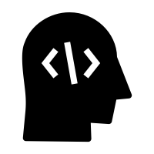
DevOps pipeline
Pull from GIT
Unit + DevQA Tests
Code Quality Check (Sonar)
Build (Maven, Gradle)
Repository Mgmt. (Artifactory)
Env Config (Chef, Puppet)
Deploy
Functional Test (Selenium)
BDD Test
GIT Repo
BDD Test
Local Computer
UI Test
Developer, Tester, Business Analyst

Slide 4



Contribution by 3 Amigos
Non-Prod Server
Prod Server
GIT Workspace
Features
(Stories)
Business Analyst
20% testing post deployment
Scenarios
(Test Cases)
Quality Analyst
Step Definition
(Automation Code)
Test Server
Developer
Application Code
(Automation Code)
80% testing before
code check-in

