Slide 1


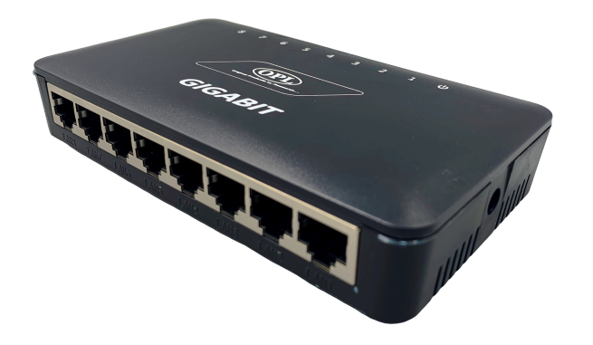
Gigabit Reverse PoE Switch
Model: RPoE-8P-AG
Power In: 12-48V DC @ Port 2-8
Power Out: 12-48V DC @ DC Socket
Working Rate: 10/100/1000 Mbps
What is Does
8Port 10/100/1000 Reverse PoE Switch which has latest generation of fast Ethernet Reverse PoE Switching technology. It contains 7 Port (10/100/1000) Downlink Port, 1 Port (10/100/1000) Link Port and 12V DC out for powering ONU/AP.
This switch can be powered using remote power from customer end using special designed PoE of OPL or any standard PoE 24V – 0.5Amp.
This eliminates the need to arrange for power at building top and no UPS is needed and no money to be paid to the society, to provide power from switch to the customers.
This saves lot of money for ISPs and improves service delivery as there is no dependency on any one and any customer switching on PoE will provide power to the switch.
Intelligent power management feature of the switch will ensure smooth functioning even when customer providing power switched off his PoE, Intelligent power management ensures smooth switch over to alternate power from another customer without anyone noticing it.
Features
VLAN
The feature of port isolation is implemented in this unit where in the Ethernet Data of the uplink port can be transferred to any of the downlink ports but the individual downlink port cannot communicate with each other.
SURGE PROTECTION
We provide surge protection on each port to protect against high voltage surge on data ports or link ports.
1

Slide 2
SPECIFICATION
Brand | OPL
Manufacturer | Original Products Private Limited, New Delhi (INDIA)
Model | RPoE-8P-AG
Interface | 8 Ethernet Ports 7 Passive PoE In Ports 1 Link Port 10/100/1000 Mbps Auto-Negotiation
LED Indicators | 1x Power LED 8x Port Connected
Chipset | RTL8370N Flash Memory 16 MB, RAM 128 MB
Input | 12-48V DC @ Port 2-8
Output | 12-48V DC @ DC Socket
Data Rate | Ethernet: 10 Mbps (Half Duplex), 20 Mbps (Full Duplex) Fast Ethernet: 100 Mbps (Half Duplex), 200 Mbps (Full Duplex) Gigabit Ethernet: 2000 Mbps (Full Duplex)
Switching Capacity | 16 Gbps
Network Media | 10Base-T: UTP category 3, 4, 5 cable (maximum 100 m) EIA/TIA-568 100 Q UTP (maximum 100 m) 100Base-T: UTP category 5, 5e cable (maximum 100 m) EIA/TIA-568 100 Q UTP (maximum 100 m) 1000Base-T: UTP category 5e cable (maximum 100 m) EIA/TIA-568 100 Q UTP (maximum 100 m)
2

Slide 3
IEEE Standards | IEEE Std. 802.3 10Base-T, IEEE Std. 802.3u 100Base-TX, IEEE Std. 802.3x Flow control and Back pressure. IEEE Std. 802.3az Energy Efficient Ethernet IEEE 802.3ab 1000Base-T, IEEE 802.1p QoS
MAX Power Consumption | 3.98 W (with no PD connected) 18.01 W (24V with PD connected)
MAX Heat Dissipation | 13.57 BTU/h (with no PD connected) 61.41 BTU/h (24V with PD connected)
Included Components | 1 Main Switch 1 DC Lead
Origin Country | INDIA
Operating Temperature / Humidity | -20°C to 60°C / 10% to 90% (Non-condensing)
Storage Temperature / Humidity | -40°C to 70°C / 5% to 90% (Non-condensing)
Dimensions | 7.5 x 13.9 x 2.4 cm (W x L x H)
Weight | 200 Grams
Warranty | 1 Year
2

