Slide 1
BLOCKCHAIN PRACTICAL
FROM B.S.C (HONOURS)COMPUTER SCIENCE

Slide 2
WHAT IS BITCOIN?
Bitcoin is a decentralized digital currency that was invented in 2008 by an anonymous person or group of people using the pseudonym Satoshi Nakamoto. It was introduced as an open-source software in 2009, and it remains the most well-known and widely used cryptocurrency.
Bitcoin operates on a technology called blockchain, which is a distributed ledger that records all transactions made with the currency. Unlike traditional currencies issued by governments, Bitcoin is not controlled by any central authority such as a bank or government. Instead, it relies on a network of computers (known as miners) to validate and verify transactions.
Bitcoins are created through a process called mining, where powerful computers solve complex mathematical problems to secure the network and add new transactions to the blockchain. As a reward for their efforts, miners are awarded newly created bitcoins. There is a maximum supply of 21 million bitcoins that can ever be created, which gives Bitcoin a deflationary nature.

Slide 3
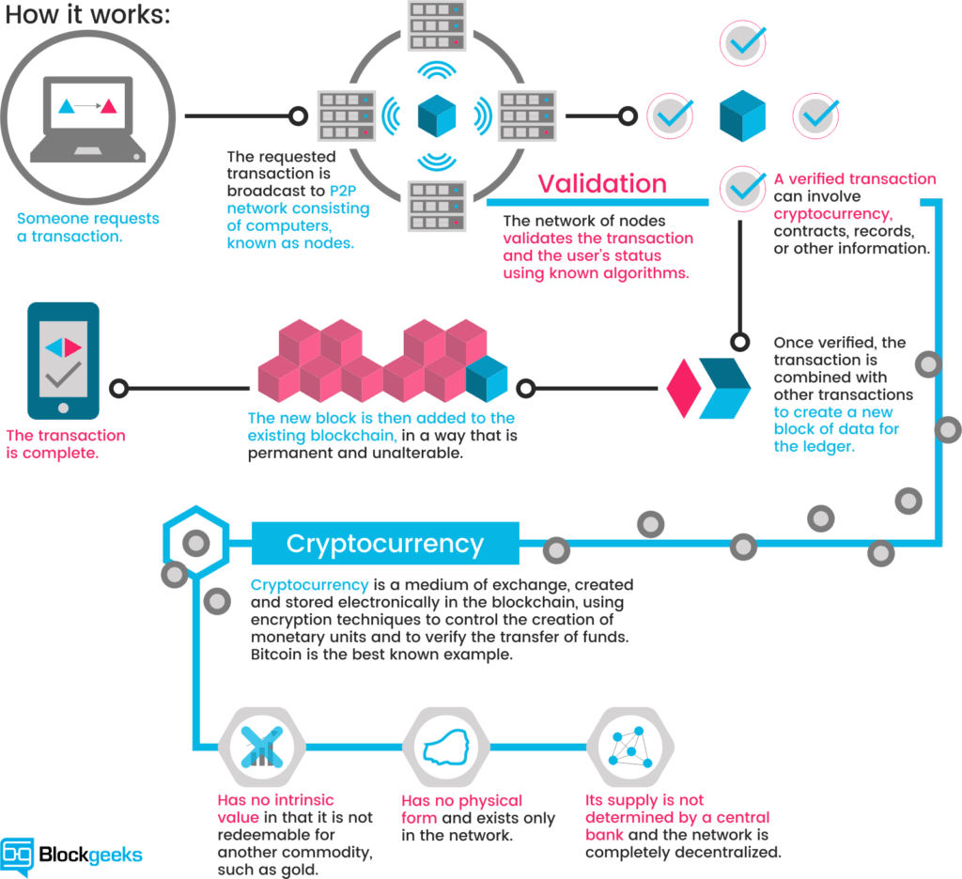

Slide 4
History of Bitcoins
Bitcoin is a decentralized digital currency that was created by an unknown person or group of people using the pseudonym Satoshi Nakamoto. It was introduced in a whitepaper titled "Bitcoin: A Peer-to-Peer Electronic Cash System," published in October 2008.
The history of Bitcoin can be divided into several key phases:
Creation and Early Development (2008-2010):
In October 2008, Satoshi Nakamoto published the Bitcoin whitepaper, which outlined the concept and technical details of the cryptocurrency. In January 2009, the Bitcoin network was launched with the release of the first open-source Bitcoin client and the mining of the first block, known as the "genesis block." This marked the beginning of the Bitcoin blockchain.
In the early days, Bitcoin gained attention within the cypherpunk and cryptography communities. It started to be used as a medium of exchange and store of value among a niche group of enthusiasts. The first notable transaction took place in May 2010 when Laszlo Hanyecz purchased two pizzas for 10,000 bitcoins, which is now widely recognized as the first real-world transaction involving Bitcoin.

Slide 5
Expansion and Market Growth (2010-2013): Bitcoin began to gain broader recognition and acceptance during this period. Online platforms and exchanges started to emerge, enabling users to trade Bitcoin for other currencies. In July 2010, the Mt. Gox exchange was established, which became one of the most prominent Bitcoin exchanges at the time.
Over the next few years, the value of Bitcoin saw significant fluctuations. It experienced its first major price rally in 2011, reaching a peak of around $31 per bitcoin before experiencing a sharp correction. In 2013, Bitcoin gained more mainstream attention and media coverage, which led to a surge in its value, reaching an all-time high of over $1,100 in November 2013.
Maturation and Volatility (2014-2017): Bitcoin faced various challenges and controversies during this period. In February 2014, Mt. Gox, once the largest Bitcoin exchange, filed for bankruptcy after losing hundreds of thousands of bitcoins due to hacking and security breaches. This incident highlighted the need for improved security measures and regulation within the Bitcoin ecosystem.
Despite these setbacks, Bitcoin continued to evolve, with more businesses and merchants accepting it as a form of payment. The underlying technology, blockchain, also gained attention for its potential applications beyond cryptocurrencies.

Slide 6
In 2017, Bitcoin witnessed an unprecedented bull run, with its price soaring to new all-time highs. It reached a peak of nearly $20,000 in December 2017, driven by increasing investor interest and speculation. This surge in price brought Bitcoin into the mainstream consciousness and sparked a broader interest in cryptocurrencies.

Slide 7



Slide 8
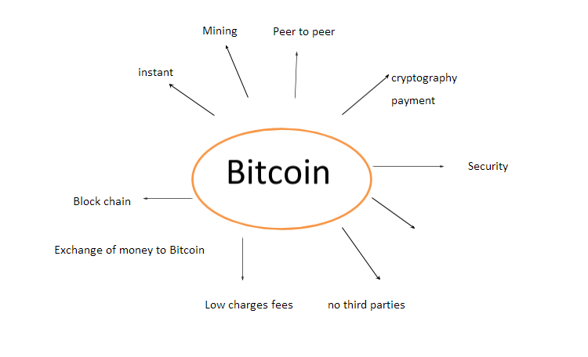
USE OF BITCOINS

Slide 9
KEY IN BITCOIN SYSTEM
In the context of Bitcoin, a key refers to a cryptographic key used to control access to Bitcoin funds. There are two primary types of keys: private keys and public keys.
Private Key: A private key is a randomly generated secret number that is known only to the owner. It is used to create digital signatures, which are necessary to authorize Bitcoin transactions. A private key is essentially a secret password or code that grants ownership of the associated Bitcoin funds. It must be kept secure and should never be shared with anyone else.
Public Key: A public key is derived from a private key using mathematical algorithms. It is a unique identifier associated with a specific Bitcoin address. Public keys are publicly shared and used to verify digital signatures created by the corresponding private keys. They do not pose any security risk if shared with others.
The relationship between private and public keys is asymmetric, meaning that while a public key can be derived from a private key, it is computationally infeasible to reverse-engineer a private key from a public key.

Slide 10
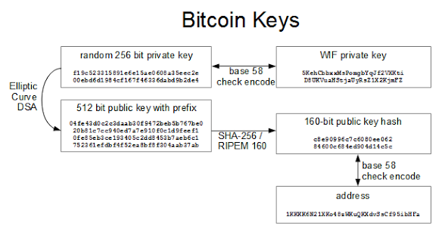
This Photo by Unknown Author is licensed under CC BY-SA

Slide 11
SYMMETRIC AND ASYMMETRIC KEY
Symmetric and asymmetric key algorithms are two types of cryptographic systems used for encryption and decryption of data.
Symmetric key encryption, also known as secret key encryption or single-key encryption, involves the use of a single shared secret key for both encryption and decryption. The same key is used by both the sender and the recipient to encrypt and decrypt the data. The key must be kept secret and known only to the communicating parties. The encryption and decryption processes are fast and efficient, making symmetric key algorithms suitable for large amounts of data. However, the primary challenge in symmetric key encryption is securely distributing the key to all the parties involved.
Asymmetric key encryption, also known as public-key encryption, involves the use of a pair of mathematically related keys: a public key and a private key. The public key is freely distributed, while the private key is kept secret. The public key is used for encryption, and the private key is used for decryption. Data encrypted with the public key can only be decrypted using the corresponding private key, ensuring confidentiality. Additionally, the private key can be used to create digital signatures, which provide data integrity and authentication. Asymmetric key encryption eliminates the key distribution problem present in symmetric key encryption, as the public keys can be freely shared. However, the encryption and decryption processes are computationally more intensive, making asymmetric key algorithms slower than symmetric key algorithms.

Slide 12
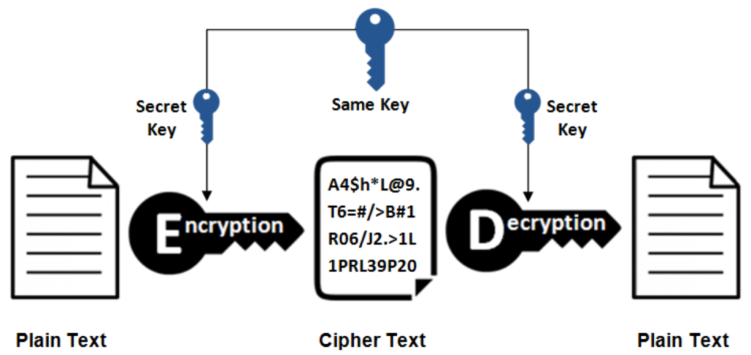
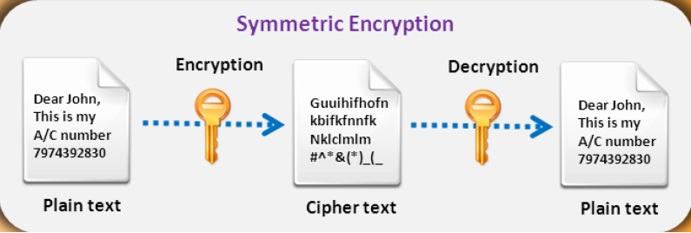

Slide 13
RSA (RIVEST-SHAMIR-ADLEMAN)
RSA, which stands for Rivest-Shamir-Adleman, is a widely used public-key encryption algorithm. It was first proposed by Ronald Rivest, Adi Shamir, and Leonard Adleman in 1977 and remains one of the most popular and secure encryption methods.
RSA is a form of asymmetric encryption, meaning it uses a pair of keys: a public key and a private key. The public key is used for encryption, while the private key is used for decryption. The keys are mathematically related, but it is computationally infeasible to determine the private key from the public key.
The RSA algorithm is based on the difficulty of factoring large composite numbers into their prime factors. Here's a high-level overview of how RSA encryption and decryption work:
The security of RSA is based on the difficulty of factoring large numbers. Breaking RSA encryption requires factoring the modulus, n, into its prime factors, which becomes computationally expensive as the size of the numbers increases. Therefore, the security of RSA relies on the assumption that factoring large numbers is a difficult problem.

Slide 14
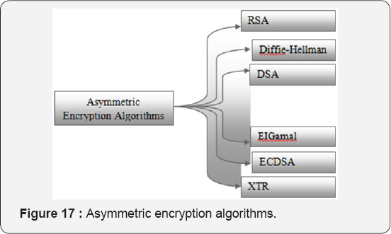

Slide 15
Elliptic-curve cryptography (ECC)
Elliptic-curve cryptography (ECC) is a type of public-key cryptography that relies on the mathematics of elliptic curves over finite fields. It is widely used for secure communication and data encryption in various applications, including secure internet protocols, digital signatures, and secure key exchange.
The fundamental idea behind ECC is based on the difficulty of solving the elliptic curve discrete logarithm problem (ECDLP). The ECDLP states that given a point P on an elliptic curve E, it is computationally difficult to find an integer k such that kP = Q, where Q is another point on the curve. This property makes ECC resistant to attacks using classical computers as well as quantum computers.
Compared to other public-key cryptosystems like RSA or DSA, ECC offers several advantages:

Slide 16
Shorter key sizes: ECC provides equivalent security to other systems using much shorter key lengths. For example, a 256-bit ECC key is considered to provide roughly the same level of security as a 3072-bit RSA key.
Lower computational requirements: ECC operations require less computational power and memory, making it suitable for resource-constrained devices such as smartphones and embedded systems.
Efficient performance: ECC algorithms can be implemented with faster execution times compared to other cryptosystems, resulting in quicker encryption, decryption, and key generation operations.
Bandwidth efficiency: ECC algorithms require fewer bits to represent the same level of security, leading to lower bandwidth usage in communication protocols.
5. It's worth mentioning that ECC is not without challenges. The security of ECC relies on the proper choice of elliptic curves and the correct implementation of algorithms. If weak curves are used or if there are implementation flaws, the security of the system can be compromised. Therefore, it is important to follow best practices and standards when deploying ECC in real-world applications.

Slide 17
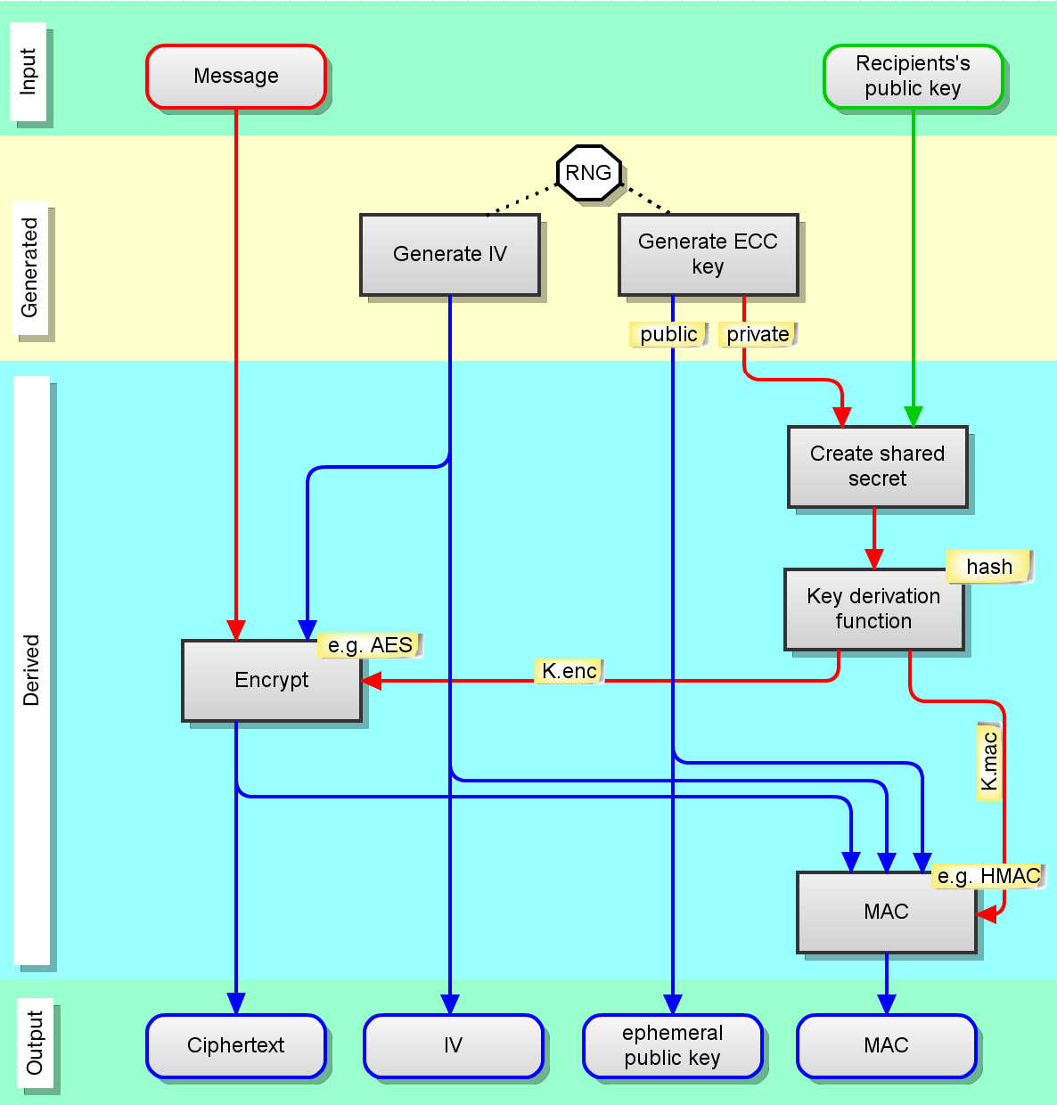
This Photo by Unknown Author is licensed under CC BY-SA

Slide 18
CypherPunk [1992]:
Cypherpunk refers to a movement that emerged in the early 1990s, primarily composed of individuals who advocated for widespread use of strong cryptography and privacy-enhancing technologies. The term "cypherpunk" is a combination of "cypher," which refers to encryption, and "punk," which symbolizes the rebellious and DIY (do-it-yourself) ethos of the movement.
The cypherpunks aimed to promote privacy, individual liberties, and freedom of expression in the digital realm. They recognized the growing importance of cryptography in protecting personal information and securing communications in an increasingly interconnected world. Their ideas and discussions centered around using cryptography as a tool to resist government surveillance, censorship, and control.
The movement attracted a diverse group of individuals, including computer scientists, mathematicians, activists, and hackers. They engaged in discussions and debates on online forums, such as the Cypherpunks mailing list, where they exchanged ideas, developed cryptographic protocols, and explored ways to empower individuals through technology.

Slide 19
Although the original cypherpunk movement faded over time, its ideas and principles continue to influence discussions around privacy, cryptography, and online freedoms. The concepts advocated by cypherpunks remain relevant in the context of debates on surveillance, encryption, data protection, and the balance between security and privacy in.
One of the notable contributions of the cypherpunks was the development of anonymous digital currencies. In 2009, an individual or group known as Satoshi Nakamoto, who was influenced by cypherpunk ideas, introduced Bitcoin—a decentralized cryptocurrency that enabled pseudonymous transactions. Bitcoin's underlying technology, blockchain, also drew inspiration from the cypherpunk movement's focus on decentralization and censorship resistance.

Slide 20


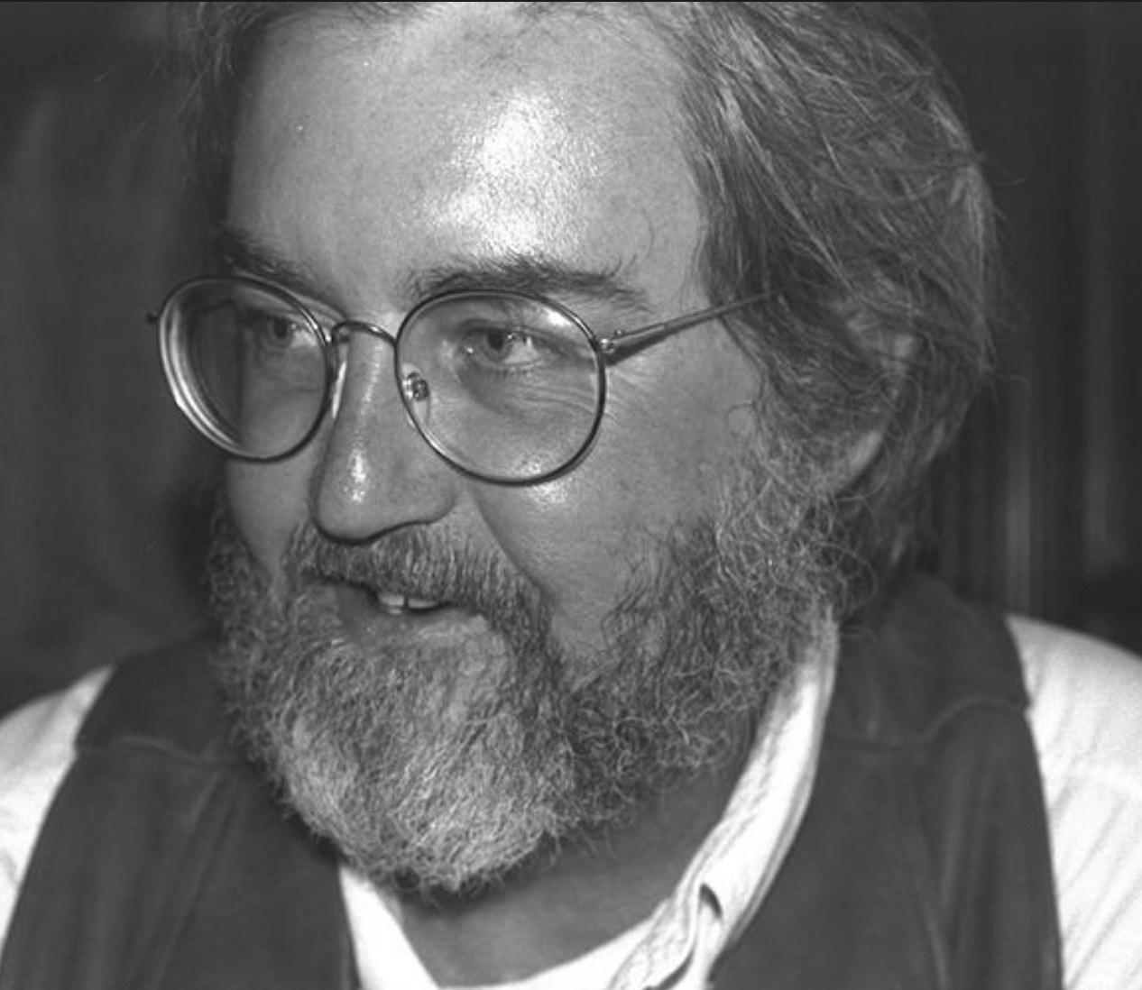
A cypherpunk is any individual advocating widespread use of strong cryptography and privacy-enhancing technologies as a route to social and political change. Originally communicating through the Cypherpunks electronic mailing list, informal groups aimed to achieve privacy and security through proactive use of cryptography. Cypherpunks have been engaged in an active movement since at least the late 1980s.
Founded by Eric Hughes, Timothy C. May, and John Gilmore.
The Cypherpunks mailing list was started in 1992, At its peak, it was a very active forum with technical discussions ranging over mathematics, cryptography, computer science, political and philosophical discussion, personal arguments and attacks, etc.
Main Principles
Privacy
Anonymity
Hiding the act of hiding:
An important set of discussions concerns the use of cryptography in the presence of oppressive authorities.

Slide 21
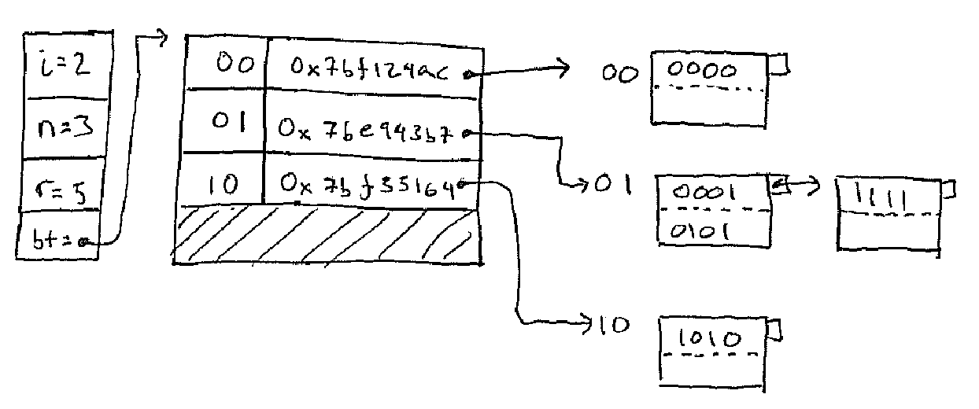
Time Stamp Protocol
The Time-Stamp Protocol, or TSP is a cryptographic protocol for certifying timestamps using X.509 certificates and public key infrastructure. The timestamp is the signer's assertion that a piece of electronic data existed at or before a particular time. The protocol is defined in RFC 3161. One application of the protocol is to show that a digital signature was issued before a point in time, for example before the corresponding certificate was revoked.
HASHING :
Hashing is the process of transforming any given key or a string of characters into another value. This is usually represented by a shorter, fixed-length value or key that represents and makes it easier to find or employ the original string.
A hash function generates new values according to a mathematical hashing algorithm, known as a hash value or simply a hash. To prevent the conversion of hash back into the original key, a good hash always uses a one-way hashing algorithm.
Secure Hash Algo 1 (SHA-1)
Secure Hash Algo 2 (SHA-2)
Secure Hash Algo 3 (SHA-3)
Message Digest MD2
Message Digest MD4
Message Digest MD5

Slide 22
Once Message Digest is hashed, the signature is transformed into a shorter value called a message digest.
Secure Hash Algorithm (SHA) is a standard algorithm used to create a larger (160-bit) message digest. SHA-2 is used to create an even larger (224-bit) message digest.
POST - QUANTUM CRYPTOGRAPHY :
Post-quantum cryptography is the development of cryptographic systems for classical computers that can prevent attacks launched by quantum computers.
In the 1990s, after mathematician Peter Shor successfully demonstrated that a theoretical quantum computer could easily break the algorithm used for public key encryption (PKE), cryptographers around the world began to explore what a post-quantum cryptography system would look like.
In contrast to the threat quantum computing poses to current public-key algorithms, most current symmetric cryptographic algorithms and hash functions are considered to be relatively secure against attacks by quantum computers. While the quantum Grover's algorithm does speed up attacks against symmetric ciphers, doubling the key size can effectively block these attacks.
Algorithms:
Lattice based
Multivariate
Hash-based
Symmetric key quantum resistance

Slide 23

OpenQuantum Safe (OQS) project:
Started in late 2016 and has the goal of developing and prototyping quantum-resistant cryptography. It aims to integrate current post-quantum schemes in one library: liboqs

Slide 24
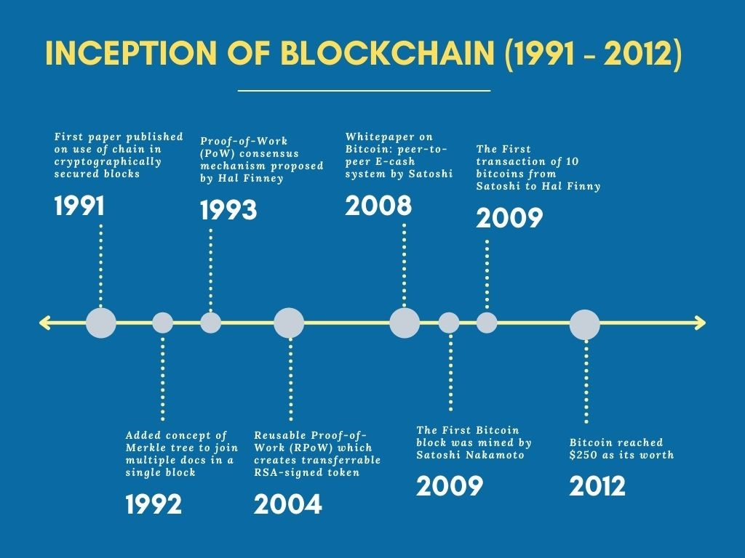
Bitcoin:
Nakamoto stated that work on the writing of the code for Bitcoin began in 2007. On 18 August 2008, he or a colleague registered the domain name bitcoin.org, and created a web site at that address. On 31 October, Nakamoto published a white paper on the cryptography mailing list at metzdowd.com describing a digital cryptocurrency, titled "Bitcoin: A Peer-to-Peer Electronic Cash System".

Slide 25
STANDARDS:
The Internet Engineering Task Force (IETF):
It is a standards organization for the Internet and is responsible for the technical standards that make up the Internet protocol suite (TCP/IP). It has no formal membership roster or requirements and all its participants are volunteers. Their work is usually funded by employers or other sponsors.
The IETF is organized into a large number of working groups and birds of a feather informal discussion groups, each dealing with a specific topic. The IETF operates in a bottom-up task creation mode, largely driven by these working groups.
Rough consensus is the primary basis for decision making. There are no formal voting procedures. Because the majority of the IETF's work is done via mailing lists, meeting attendance is not required for contributors.
The details of IETF operations have changed considerably as the organization has grown, but the basic mechanism remains publication of proposed specifications, development based on the proposals, review and independent testing by participants, and republication as a revised proposal, a draft proposal, or eventually as an Internet Standard.
The Internet Architecture Board (IAB) oversees the IETF's external relationships and relations with the RFC Editor. The IAB provides long-range technical direction for Internet development.

Slide 26
The IETF cooperates with the W3C, ISO/IEC, ITU, and other standards bodies.
European Telecommunications Standards Institute (ETSI):
It is an independent, non-profit, standardization organization in the field of information and communications. ETSI supports the development and testing of global technical standards for ICT-enabled systems, applications and services.
ETSI was set up in 1988 by the European Conference of Postal and Telecommunications Administrations (CEPT) following a proposal from the European Commission. ETSI is the officially recognized body with a responsibility for the standardization of Information and Communication Technologies (ICT).
ETSI develops standards in key global technologies such as: GSM, TETRA, 3G, 4G, 5G, DECT.
National Institute of Standards and Technology (NIST):
An agency of the United States Department of Commerce whose mission is to promote American innovation and industrial competitiveness.
From 1901 to 1988, the agency was named the National Bureau of Standards.

Slide 27
In February 2014 NIST published the NIST Cybersecurity Framework that serves as voluntary guidance for organizations to manage and reduce cybersecurity risk.
It emphasizes the importance of implementing Zero-trust architecture which focuses on protecting resources over the network perimeter. ZTA utilizes zero trust principles which include the following to safeguard users’ assets and resources.
never trust, always verify
assume breach
least privileged access
Since ZTA holds no implicit trust to users within the network perimeter, authentication and authorization are performed before at every stage of a digital transaction. This reduces the risk of unauthorized access of resources.
Institute of Electrical and Electronics Engineers Standards Association (IEEE SA):
IEEE FOR WIFI - 802.11:
IEEE 802.11 is part of the IEEE 802 set of local area network (LAN) technical standards, and specifies the set of media access control (MAC) and physical layer (PHY) protocols for implementing wireless local area network (WLAN) computer communication.
IEEE 802.11 uses various frequencies including, but not limited to, 2.4 GHz, 5 GHz, 6 GHz, and 60 GHz frequency bands.

Slide 28
Although IEEE 802.11 specifications list channels that might be used, the radio frequency spectrum availability allowed varies significantly by regulatory domain.
802.11a uses the 5 GHz U-NII band which, for much of the world, offers at least 23 non-overlapping, 20-MHz-wide channels. This is an advantage over the 2.4-GHz, ISM-frequency band, which offers only three non-overlapping, 20-MHz-wide channels where other adjacent channels overlap (see: list of WLAN channels).
IEEE FOR BLUETOOTH - 802.15:
IEEE 802.15 is a working group of the Institute of Electrical and Electronics Engineers (IEEE) IEEE 802 standards committee which specifies Wireless Specialty Networks (WSN) standards.
Bluetooth technology operates in the unlicensed industrial, scientific and medical (ISM) band at 2.4 to 2.485 GHz, using a spread spectrum, frequency hopping, full-duplex signal at a nominal rate of 1600 hops/sec. The 2.4 GHz ISM band is available and unlicensed in most countries.Bluetooth v4.0 is the most recent version of Bluetooth wireless technology. It includes a low energy feature that is the basis for Bluetooth Smart devices. A product bearing the Bluetooth Smart and Bluetooth Smart Ready logos must include Bluetooth v4.0, but must also meet additional criteria.
RFC :
RFC documents contain technical specifications and organizational notes for the Internet.

Slide 29
RFCs produced by the IETF cover many aspects of computer networking. They describe the Internet's technical foundations, such as addressing, routing, and transport technologies. RFCs also specify protocols like TLS 1.3, QUIC, and WebRTC that are used to deliver services used by billions of people every day, such as real-time collaboration, email, and the domain name system.
The RFC Series includes documents produced by the IETF, the Internet Architecture Board (IAB), the Internet Research Task Force (IRTF), and independent submitters. All RFCs are published by the RFC Editor, which is the authoritative source for retrieving RFCs.
The first document in this series, RFC 1, was written in 1969. It was soon followed by others, including those that describe the core Internet Protocol (IP) still used in the Internet today. The collaborative process used to develop early RFCs remains an important part of the IETF spirit. Today, there are more than 9000 individually numbered documents in the series.
Speculations on the identity
When translated from japanese, Satoshi Nakamoto literally means “The Clever/intelligent one who lives in the middle”. There are many widespread theories surrounding this sure shot obvious made-up name.

Slide 30

Hal Finney:
In 2004, Finney created the first reusable proof of work system before Bitcoin. In January 2009, Finney was the Bitcoin network's first transaction recipient. And received the first bitcoin transaction from bitcoin's creator Satoshi Nakamoto
It is even widely believed that he is Satoshi Nakamoto who introduced Bitcoin transactions that could only take place between two persons. People believed that he hid behind the made-up name. Dorian Satoshi Nakamoto lived in (Temple City, California), adding to speculation that he may have been Bitcoin's creator. Finney denied that he was Satoshi Nakamoto. He may be worried about the backlash of the establishment. This is because the concept was a challenge to the US Dollar.
.

Slide 31
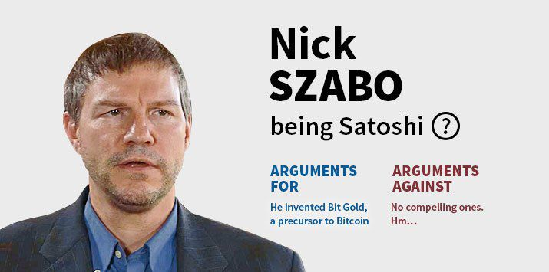
Nick Szabo is a computer scientist and cryptographer who is known for his work on digital currency and smart contracts. Some people believe that Szabo is Satoshi Nakamoto, based on the similarities between his writing style and the Bitcoin white paper. However, Szabo has denied being Satoshi.

Slide 32

Craig Wright:
Craig Wright is a computer scientist and early contributor to the Bitcoin project.
Wright has asserted that he is the true identity of Satoshi Nakamoto, the pseudonym for Bitcoin's otherwise anonymous creator.
Despite his claims, most of the cryptocurrency community either rejects or remains highly skeptical of Craig Wright being Satoshi.
He has been a lecturer and researcher in computer science at Charles Sturt University, authored many articles, academic papers, and books, and has spoken publicly at conferences on IT, security, Bitcoin, and other topics relating to digital currency.
Wright currently works as chief scientist at nChain Inc., a blockchain research and development company.

Slide 33

Dorian Nakamoto:
Several similarities were claimed between Satoshi Nakamoto and Dorian Nakamoto. Dorian graduated in physics from California Polytechnic and worked on classified defense projects. Nakamoto said he was “no longer” involved with Bitcoin and that he had “turned it over” to other people. Dorian Nakamoto later denied and claimed that he had misunderstood the question and had nothing to do with Bitcoin.

Slide 34


This Photo by Unknown Author is licensed under CC BY

