Slide 1
SERIAL INTERCONNECT BUSES
SPI & I2C
CDAC Mumbai

Slide 2
PURPOSE OF SERIAL INTERCONNECT BUSES
Provide low-cost ,i.e. low wire/pin count connection between IC devices
There are lots of serial bus “standards”
  I2C
  SPI
  Micro wire
  Maxim 3-wire
  Maxim/Dallas 1-wire etc.

Slide 3
SERIAL PERIPHERAL INTERFACE (SPI)
Originally developed by Motorola
Synchronous, serial protocol
  Data timing is controlled by an explicit clock signal (SCK)
Master-slave
  Master device controls the clock
Bi-directional data exchange
  data clocked into and out-of device at same time

Slide 4
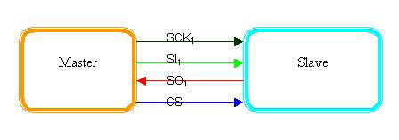
SINGLE MASTER, SINGLE SLAVE SPI IMPLEMENTATION

Slide 5
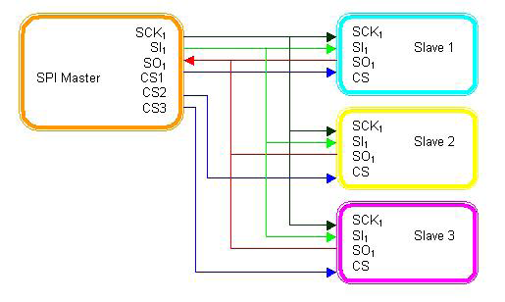
SINGLE MASTER, MULTIPLE SLAVE SPI IMPLEMENTATION

Slide 6
MULTIPLE MASTER MULTIPLE SLAVE
While SPI doesn't describe a specific way to implement multi-master systems, some SPI devices support additional signals that make such implementations possible. However, it's complicated and usually unnecessary, so it's not often done.

Slide 7
SPI MODES
A pair of parameters called clock polarity (CPOL) and clock phase (CPHA) determine the edges of the clock signal on which the data are driven and sampled.
Each of the two parameters has two possible states, which allows for four possible combinations, all of which are incompatible with one another. So a master/slave pair must use the same parameter pair values to communicate.
If multiple slaves are used that are fixed in different configurations, the master will have to reconfigure itself each time it needs to communicate with a different slave.

Slide 8
SPI MODES
SPI -Mode | Cpol | Cpha
0 | 0 | 0
1 | 0 | 1
2 | 1 | 0
3 | 1 | 1
If the phase of the clock is zero, i.e. CPHA = 0,
data is latched at the rising edge of the clock with CPOL = 0, and at the falling edge of the clock with CPOL = 1.
If CPHA = 1, the polarities are reversed.
CPOL = 0 means falling edge, CPOL = 1 rising edge.

Slide 9
I2C
The name stands for “Inter-Integrated Circuit Bus”
A Small Area Network connecting ICs and other electronic systems
Originally intended for operation on one single board / PCB
  Synchronous Serial Signal
  Two wires carry information between a number of devices
  One wire use for the data (SDA)
  One wire used for the clock (SCL)
Today, a variety of devices are available with I2C Interfaces
  Microcontroller, EEPROM, Real-Timer, interface chips, LCD driver, A/D converter etc.

Slide 10
WHAT IS I2C USED FOR?
Data transfer between ICs and systems at relatively low rates
  “Classic” I2C is rated to 100K bits/second
  “Fast Mode” devices support up to 400K bits/second
  A “High Speed Mode” is defined for operation up to 3.4M bits/second
Reduces Board Space and Cost By:
  Allowing use of ICs with fewer pins and smaller packages
  Greatly reducing interconnect complexity
  Allowing digitally controlled components to be located close to their point of use

Slide 11
I2C BUS CHARACTERISTICS
Includes electrical and timing specifications, and an associated bus protocol
Two wire serial data & control bus implemented with the serial data (SDA) and clock (SCL) lines
  For reliable operation, a third line is required:
  Common ground
Unique start and stop condition
Slave selection protocol uses a 7-Bit slave address
  The bus specification allows an extension to 10 bits
Bi-directional data transfer
Acknowledgement after each transferred byte

Slide 12
I2C BUS DEFINITIONS
Master:
  Initiates a transfer by generating
  start and stop conditions
  Generates the clock
  Transmits the slave address
  Determines data transfer direction
Slave:
  Responds only when addressed
  Timing is controlled by the clock line

Slide 13
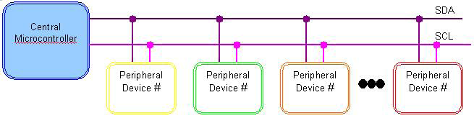
MASTER SLAVE IMPLEMENTATION USING I2C
The I2C protocol supports multiple masters, but most system
designs include only one.
There may be one or more slaves on the bus.
Both masters and slaves can receive and transmit data bytes.

Slide 14
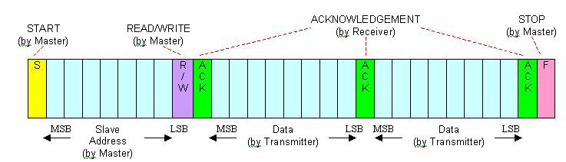
I2C PROTOCOL(COMMUNICATION)

Slide 15
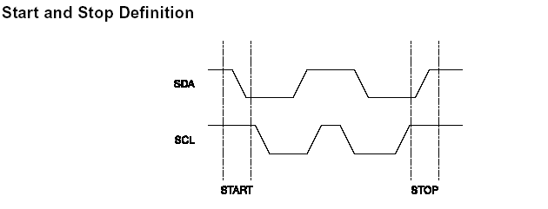
START AND STOP CONDITIONS
START condition: SDA falls while SCL is high – used by master to signal that the bus is starting a new transaction.
STOP condition: SDA rises while SCL is high – used by master to signal that the bus is entering an idle state.
Idle state: Both SDA and SCL idle high.

Slide 16
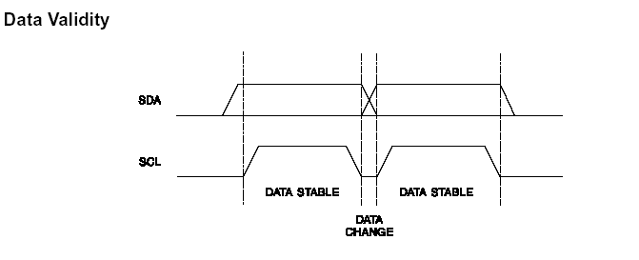
I2C DATA TRANSFER

Slide 17
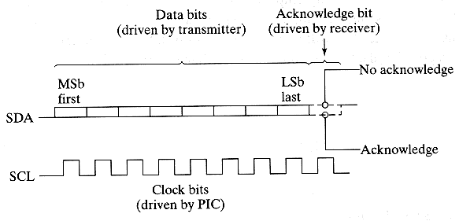
I2C DATA TRANSFER

Slide 18
SPI VS I2C
1) Three bus lines are required;
a data input line (SI),
a data output line (SO) and
a serial clock line (SCK)
[plus 1 Chip Select (CS)]
2) No official specification
(component dependent)
3) Higher data rates
(up to 10 MHz or more)
4) More efficient in point-to-point (single master, single slave) applications
1) Two bus lines are required; a serial data line (SDA) and serial clock line (SCL)
2) With official specification (I2C protocol created by Philips)
3) Support transfer speeds of around 100kHz (original standard, or 400kHz using the most recent standard)
4) More efficient in multi-master, multi-slave applications

Slide 19
SPI VS I2C
5) Lack of built-in device addressing
6) Does not have an acknowledgement mechanism to confirm receipt of data.
7) Less overhead when handling point-to-point application
8) Suited better for applications that are naturally thought of as data streams
5) Built-in addressing scheme and straightforward
6) Have an acknowledgement mechanism to confirm receipt of data
7) More overhead when handling point-to-point application
8) Suited better for communication with on-board devices that are accessed on an occasional basis.

