Slide 1
Non-Linear Data Structures Trees CDAC Mumbai

Slide 2
Trees
• In computing we build trees often because they are useful data structures in evaluating expressions, in sorting, in searching, as well as other areas of computing.
Tree data structures are used to represent hierarchical relationships such as parent-child relationships and boss-worker relationships. There are many different types of trees including: binary trees, AVL trees, B-trees, and general trees.
However:
We can use arrays and linked structures to represent trees, as we will see later.

Slide 3
Definition of Tree
A tree is a set of one or more nodes T such that,
There is specifically designated node called root.
The remaining nodes are partitioned into n disjointed set of nodes T1,T2,T3,…..Tn , Each of which is a tree.
Or
A tree consists of finite set of elements, called nodes, and a finite set of directed lines called branches, that connect the nodes.
The number of branches associated with a node is the degree of the node.

Slide 4
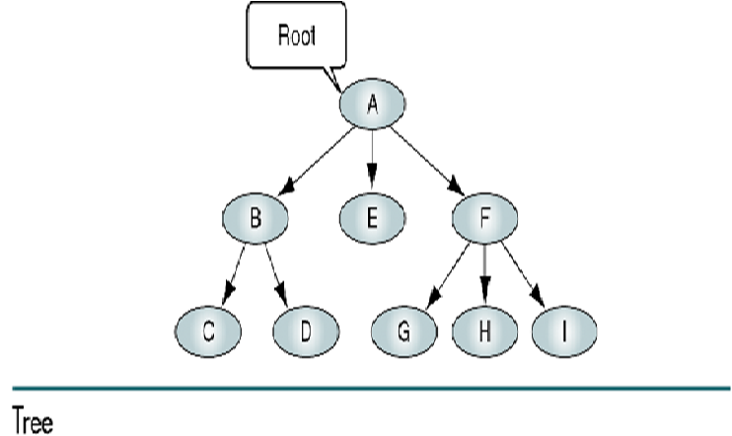

Slide 5
Basic Tree Concepts
When the branch is directed toward the node, it is indegree branch.
When the branch is directed away from the node, it is an outdegree branch.
The sum of the indegree and outdegree branches is the degree of the node.
If the tree is not empty, the first node is called the root.

Slide 6
Basic Tree Concepts
The indegree of the root is, by definition, zero.
With the exception of the root, all of the nodes in a tree must have an indegree of exactly one; that is, they may have only one predecessor.
All nodes in the tree can have zero, one, or more branches leaving them; that is, they may have outdegree of zero, one, or more.

Slide 7
Basic Tree Concepts
A leaf is any node with an outdegree of zero, that is, a node with no successors.
A node that is not a root or a leaf is known as an internal node.
A node is a parent if it has successor nodes; that is, if it has outdegree greater than zero.
A node with a predecessor is called a child.

Slide 8
Basic Tree Concepts
Two or more nodes with the same parents are called siblings.
An ancestor is any node in the path from the root to the node.
A descendant is any node in the path below the parent node; that is, all nodes in the paths from a given node to a leaf are descendants of that node.

Slide 9
Basic Tree Concepts
A path is a sequence of nodes in which each node is adjacent to the next node.
The level of a node is its distance from the root. The root is at level 0, its children are at level 1, etc. …

Slide 10
Basic Tree Concepts
The height of the tree is the level of the leaf in the longest path from the root plus 1. By definition the height of any empty tree is -1.
A subtree is any connected structure below the root. The first node in the subtree is known is the root of the subtree.

Slide 11
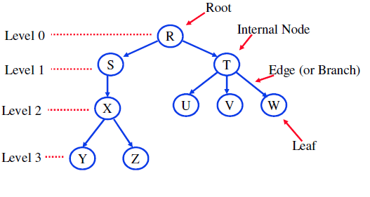
Trees Anatomy
Every Tree starts at the root.
S and T are children of R.
S is the parent of X.
The root is on Level 0.
In a Tree, there is exactly one path from R to any other node.
The descendants of S are X, Y, and Z.
The ancestors of node Y are X, S, and R.
If level of the root is denoted by level 1, then the maximum level number of the tree is known as its height or depth.
The degree of a tree is the maximum of its node’s degrees. The
degree of tree in above fig is 4

Slide 12
Binary Trees
A binary tree is a tree in which no node can have more than two subtrees; the maximum outdegree for a node is two.
In other words, a node can have zero, one, or two subtrees.
These subtrees are designated as the left subtree and the right subtree.

Slide 13
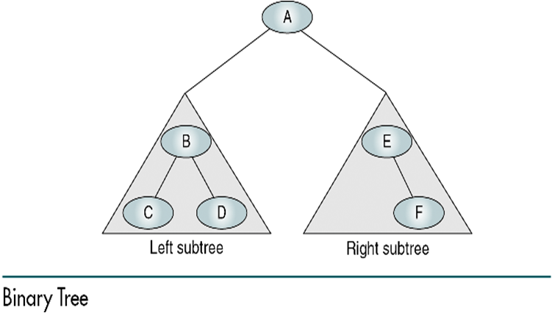

Slide 14
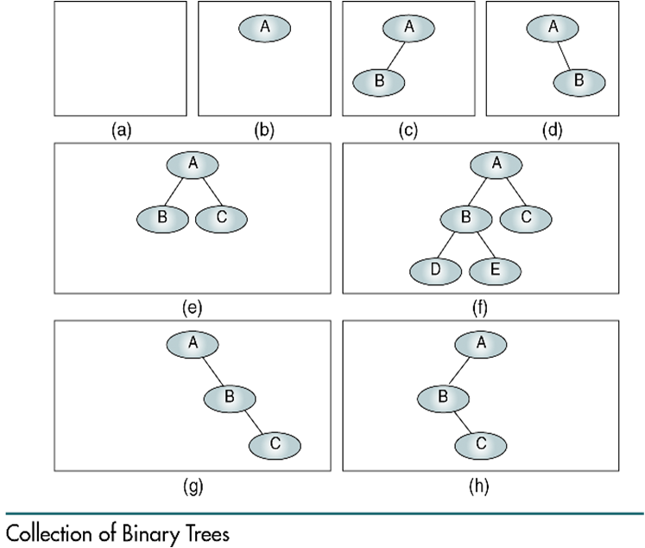
A null tree is a tree with no nodes

Slide 15
Some Properties of Binary Trees
The height of binary trees can be mathematically predicted
Given that we need to store N nodes in a binary tree, the maximum height is
A tree with a maximum height is rare. It occurs when all of the nodes in the entire tree have only one successor.

Slide 16
Some Properties of Binary Trees
The minimum height of a binary tree is determined as follows:
For instance, if there are three nodes to be stored in the binary tree (N=3) then H_{min}=2.

Slide 17
Some Properties of Binary Trees
Given a height of the binary tree, H, the minimum number of nodes in the tree is given as follows:

Slide 18
Some Properties of Binary Trees
The formula for the maximum number of nodes is derived from the fact that each node can have only two descendents. Given a height of the binary tree, H, the maximum number of nodes in the tree is given as follows:

Slide 19
Some Properties of Binary Trees
The children of any node in a tree can be accessed by following only one branch path, the one that leads to the desired node.
The nodes at level 1, which are children of the root, can be accessed by following only one branch; the nodes of level 2 of a tree can be accessed by following only two branches from the root, etc.
The balance factor of a binary tree is the difference in height between its left and right subtrees:

Slide 20

Balance of the tree
B = 0
B = 0
B = 1
B = -1
B = 0
B = 1
B = -2
B = 2

Slide 21
Some Properties of Binary Trees
In the balanced binary tree (definition of Russian mathematicians Adelson-Velskii and Landis) the height of its subtrees differs by no more than one (its balance factor is -1, 0, or 1), and its subtrees are also balanced.

Slide 22
Complete and nearly complete binary trees
A complete tree has the maximum number of entries for its height. The maximum number is reached when the last level is full.
A tree is considered nearly complete if it has the minimum height for its nodes and all nodes in the last level are found on the left

Slide 23
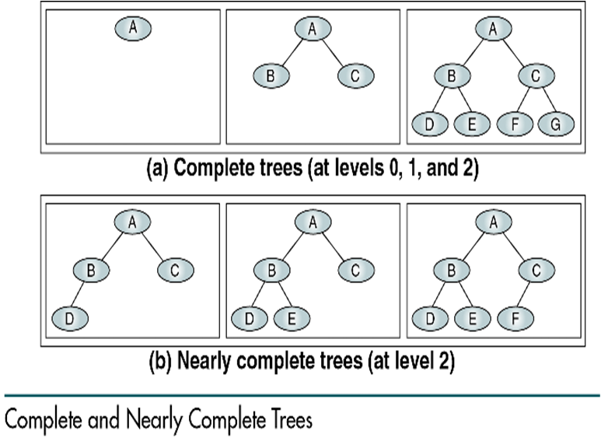

Slide 24
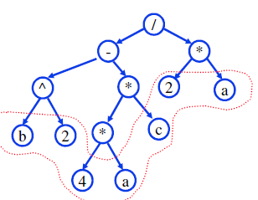
Expression Trees:
A Binary Tree used to represent algebraic expressions formed with binary operators.
Example:
(b2-4ac)/2a
(b^2-4*a*c)/(2*a)
Note:
1. All operands are in leafs.
2. All operations are in internal nodes.

Slide 25
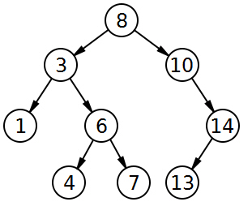
Binary Search trees
Stores keys in the nodes in a way so that searching, insertion and deletion can be done efficiently.
Binary search tree property
For every node X, all the keys in its left subtree are smaller than the key value in X, and all the keys in its right subtree are larger than the key value in X

Slide 26

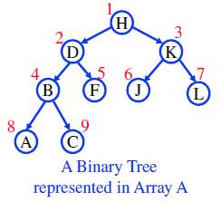
Sequential Binary Trees Representation (array-based)
Lets call the above array, Array A:
1. The Root is A[1]
2. Left Child of A[i] is at A[2i]
3. Right Child of A[i] is at A[2i+1]
4. The Parent of A[i] is A[i/2]
Example: Node ‘B’ at A[4]:
Parent of B: A[4/2] = A[2] has ‘D’
LC of B : A[2*4] = A[8] has ‘A’
RC of B : A[2*4+1] = A[9] has ‘C’
So, we can represent a Binary Tree in an Array, but we have to determine where each item should be located in the array as shown above.

Slide 27
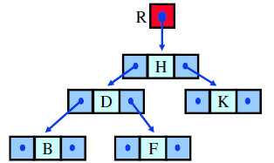

Linked Binary Trees Representation (Linked-based)
TreeNode is a structure contains: item and two references (LC and RC)
Typedef struct treenode
{
struct treenode *LC;
char item;
struct treenode *RC;
}tree;

Slide 28
Common operations on Binary and Binary search trees
Binary trees / Binary search trees
1. Traversal
2. Determining Height
3. Determining the number of nodes
4. determine the number of internal and external nodes
5. Determine its mirror image
Binary Search trees
Insert a new node
Search a node
Find the smallest node
Find the largest node
Delete a node
Remove tree from memory.

Slide 29
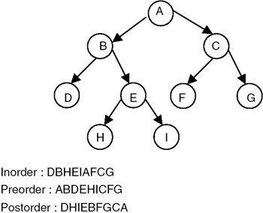
Traversing Binary(Search) Trees:
Three ways to Traverse Binary (Search)Trees:
1. Preorder:
- Visit Root
- Traverse Left subtree in preorder
- Traverse right subtree in preorder.
2. Inorder:
- Traverse Left subtree in inorder
- Visit Root
- Traverse right subtree in inorder.
3. Postorder:
- Traverse Left subtree in Postorder
- Traverse right subtree in Postorder.
- Visit Root

Slide 30
Preorder traversal:
Void preordertraversal(mytree *tree)
{
If(tree != NULL)
{
Printf(“%d”,tree->item);
Preordertraversal(tree->left);
Preordertraversal(tree->right);
}
}
Inorder traversal:
Similarly for inorder and postorder traversal.

Slide 31
findMin/ findMax
Return the node containing the smallest element in the tree
Start at the root and go left as long as there is a left child. The stopping point is the smallest element.
mytree findmin(mytree *tree)
{
If(tree == NULL)
return NULL;
If(tree->left == NULL)
return tree;
Return findmin(tree->left);
}
Similarly for findMax
Time complexity = O(height of the tree)

Slide 32
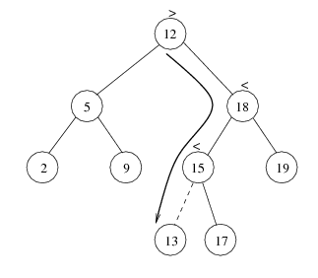
Insert
Proceed down the tree as you would with a find
If X is found, do nothing (or update something)
Otherwise, insert X at the last spot on the path traversed
Time complexity = O(height of the tree)

Slide 33
Insert
void insertelement(mytree **tree, int element)
{
If(*tree == NULL)
{
*tree = (mytree*)malloc(sizeof(mytree));
(*tree)->item = element;
(*tree)->left = (*tree)->right = NULL;
}
else if(element < (*tree)->item)
Insertelement(&((*tree)->left),element);
else
Insertelement(&((*tree)->right),element);
}

Slide 34
Delete
When we delete a node, we need to consider how we take care of the children of the deleted node.
This has to be done such that the property of the search tree is maintained.

Slide 35
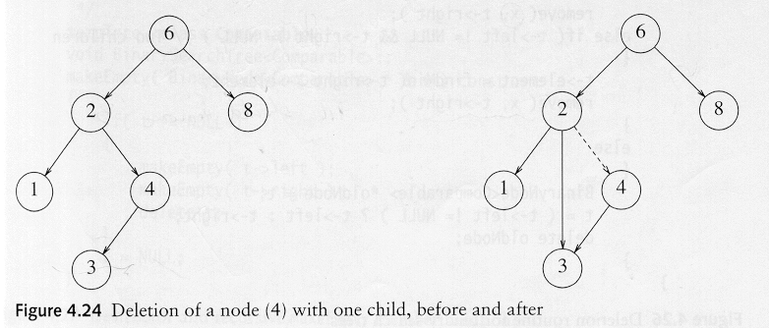
Delete
Three cases:
(1) the node is a leaf
Delete it immediately
(2) the node has one child
Adjust a pointer from the parent to bypass that node

Slide 36
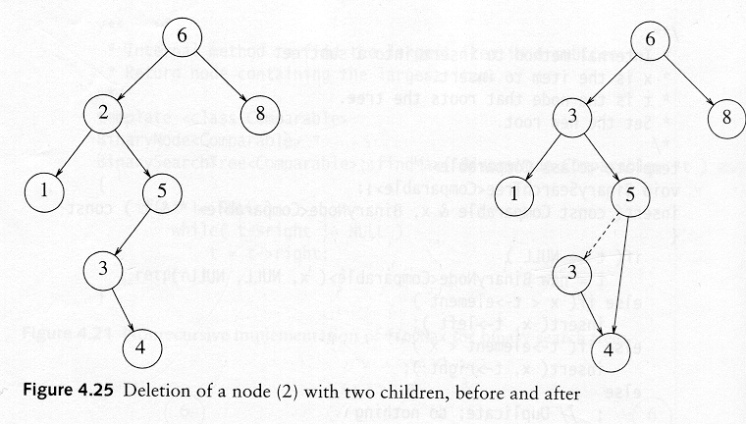
Delete
(3) the node has 2 children
replace the key of that node with the minimum element at the right subtree
delete the minimum element , If it Has either no child or only right child because if it has a left child, that left child would be smaller and would have been chosen. So invoke case 1 or 2.

