Slide 1

Data
Communication
&
Networking

Slide 2

Overview
Overview
➲
➲
➲
➲
➲
Networks,connectivity......
Topologies....
Multiplexing
Protocols
Reference Layer Models....

Slide 3
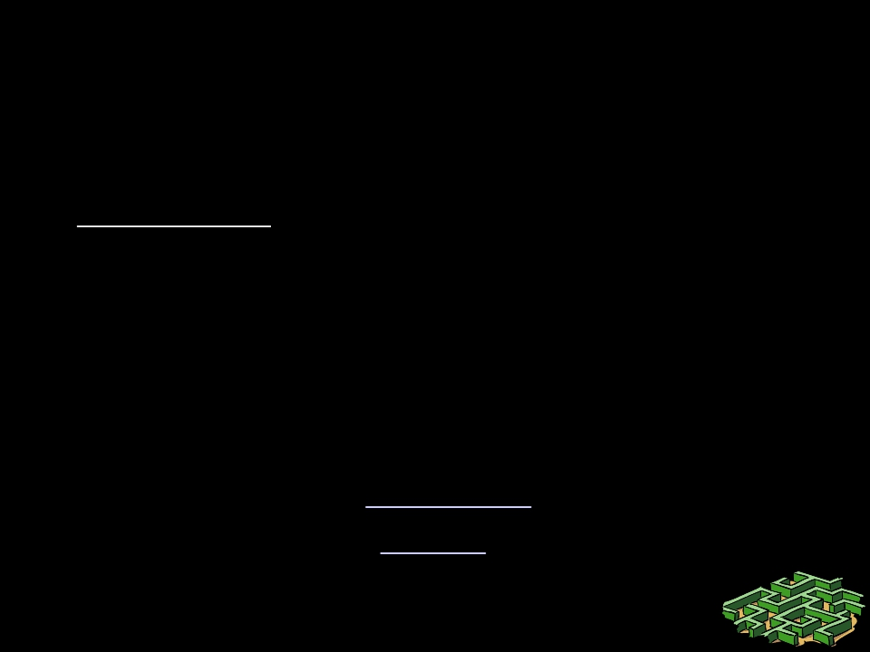
Information, Computers, Networks
• Information: anything that is represented in
bits
– Form (can be represented as bits) vs
– Substance (cannot be represented as bits)
• Properties:
– Infinitely replicable
– Computers can “manipulate” information
– Networks create “access” to information

Slide 4
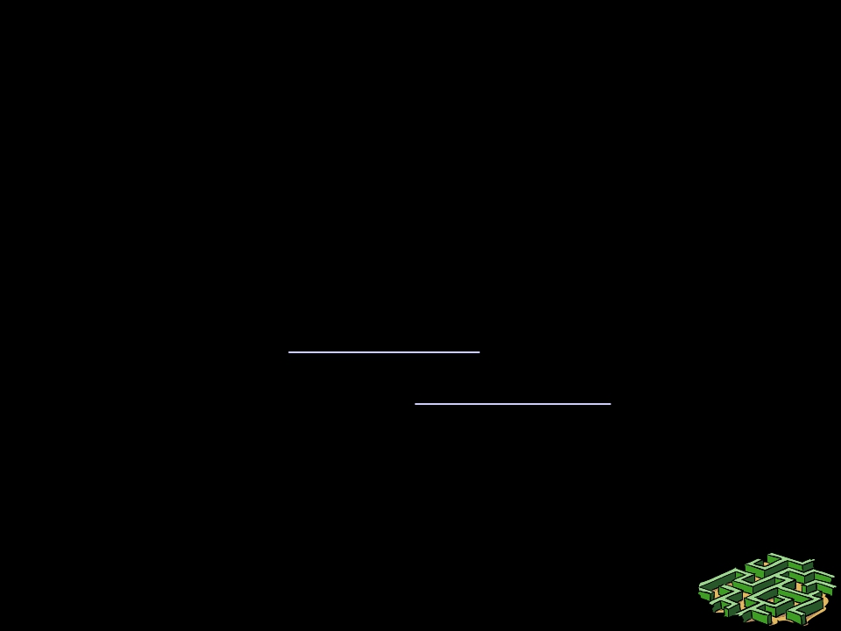
Networks
• Potential of networking:
– move bits everywhere, cheaply, and with
desired performance characteristics
– Break the space barrier for information
• Network provides “connectivity”

Slide 5

What is “Connectivity” ?
• Direct or indirect access to every other
node in the network
• Connectivity is the magic needed to
communicate if you do not have a direct
pt-pt physical link.
– Tradeoff: Performance characteristics worse than
true physical link!

Slide 6
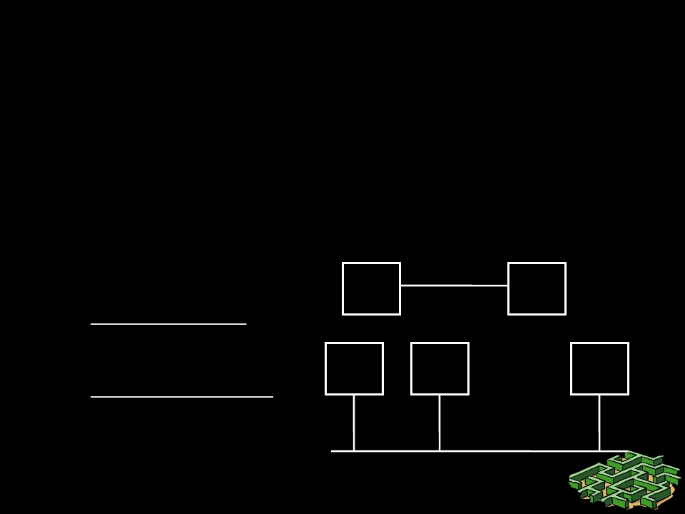
Connectivity.
• Building Blocks
– links: coax cable, optical fiber..
– nodes: general-purpose workstations...
• Direct connectivity:
– point-to-point
– multiple access

Slide 7
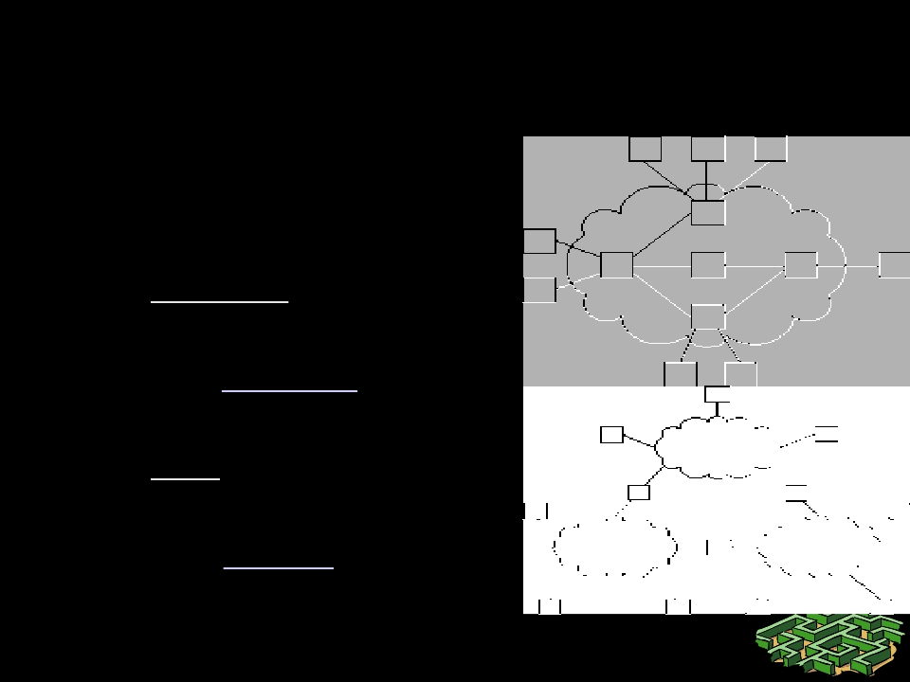
Connectivity..
• Indirect Connectivity
– switched networks
=> switches
– inter-networks
=> routers

Slide 8
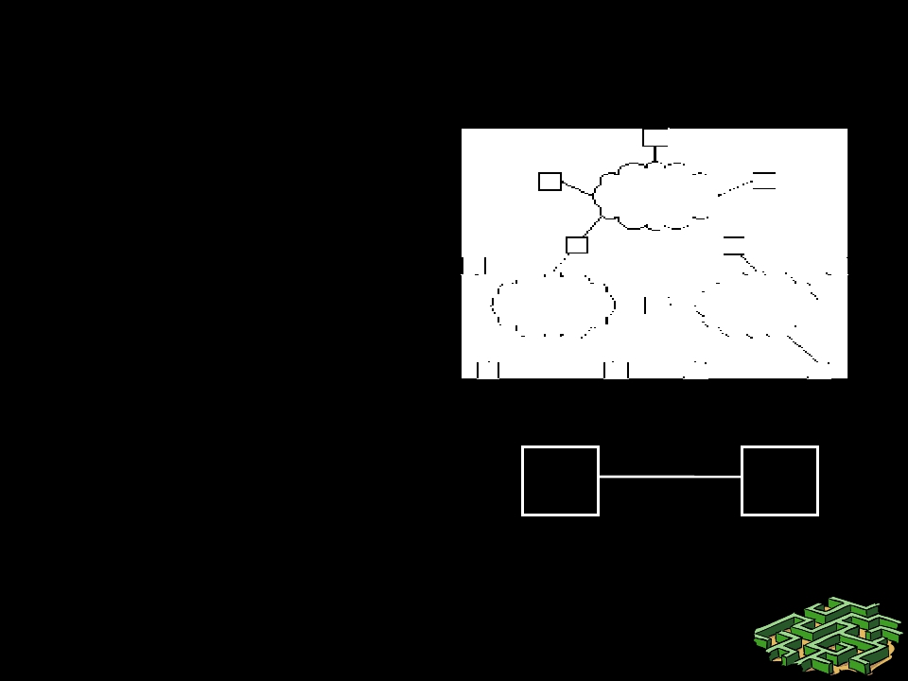
Connectivity …
• Internet:
– Best-effort
(no performance
guarantees)
– Packet-by-packet
• A pt-pt physical link:
– Always-connected
– Fixed bandwidth
– Fixed delay
– Zero-jitter

Slide 9
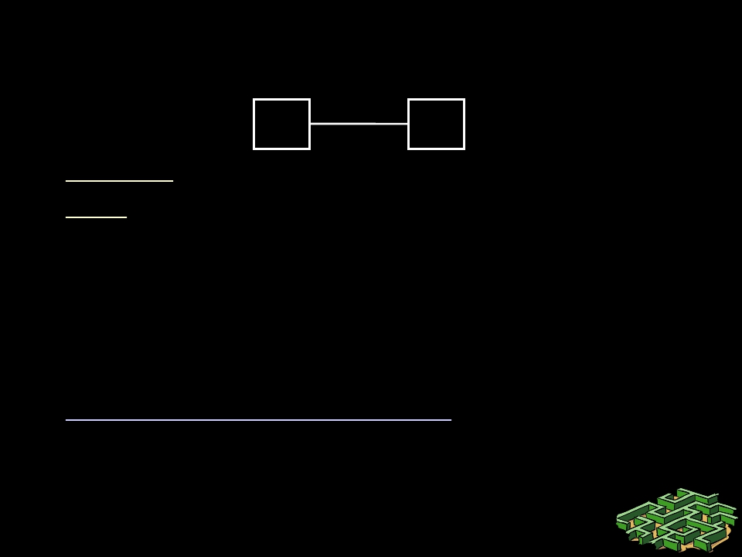
Point-to-Point Connectivity
A
B
• Physical layer: coding, modulation etc
• Link layer needed if the:
– link is shared between apps (framing, medium
access control, multiplexing)
– link is unreliable (reliability)
– link is used sporadically and traffic can flood
receivers (flow control)
• No need for protocol concepts like addressing,
names, routers, hubs, forwarding, filtering …

Slide 10
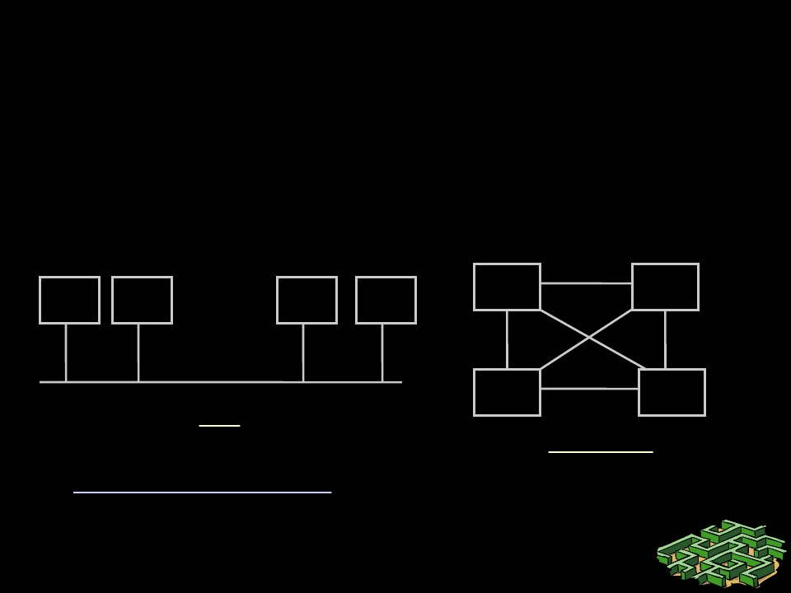
Connecting N users: Directly ...
• Bus: broadcast, collisions, media access
control
• Full mesh: Cost vs simplicity
...
Bus
Full mesh
receiver alone to consume the packet!

Slide 11

List of Problems (so far)
•
•
•
•
•
Topologies
Framing
Error control
Flow control
Multiple access
– How to share a wire

Slide 12

How to build Scalable Networks?
• Scaling: system allows the increase of a
key parameter. Eg: let N increase…
– Inefficiency limits scaling …
• Direct connectivity is inefficient & hence
does not scale
– Mesh: inefficient in terms of # of links
– Bus architecture: 1 expensive link, N cheap
links. Inefficient in bandwidth use

Slide 13
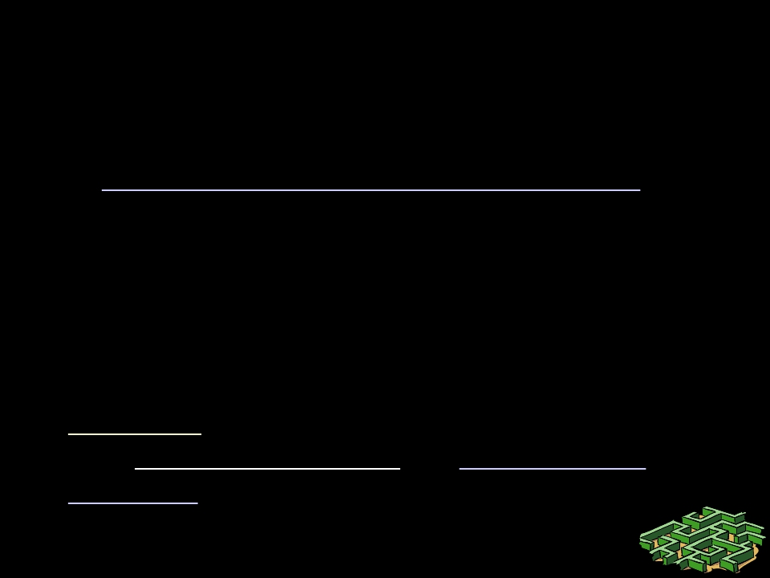
Filtering, forwarding …
• Filtering: choose a subset of elements
from a set
– Filtering is the key to efficiency & scaling
• Forwarding: actually sending packets to a
filtered subset of link/node(s)
– Packet sent to one link/node => efficient
• Solution: Build nodes which filter/forward
and connect indirectly => “switches” &
“routers”

Slide 14
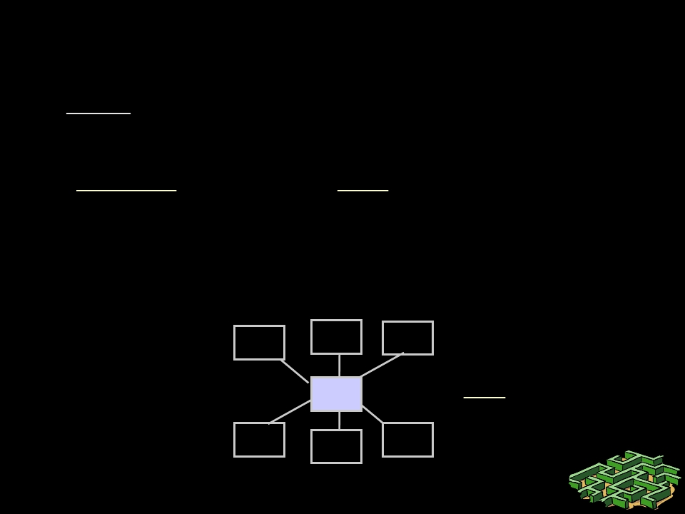
Connecting N users: Indirectly
• Star: One-hop path to any node, reliability,
forwarding function
• “Switch” S can filter and forward!
– Switch may forward multiple pkts in parallel for
additional efficiency!
S
Star

Slide 15
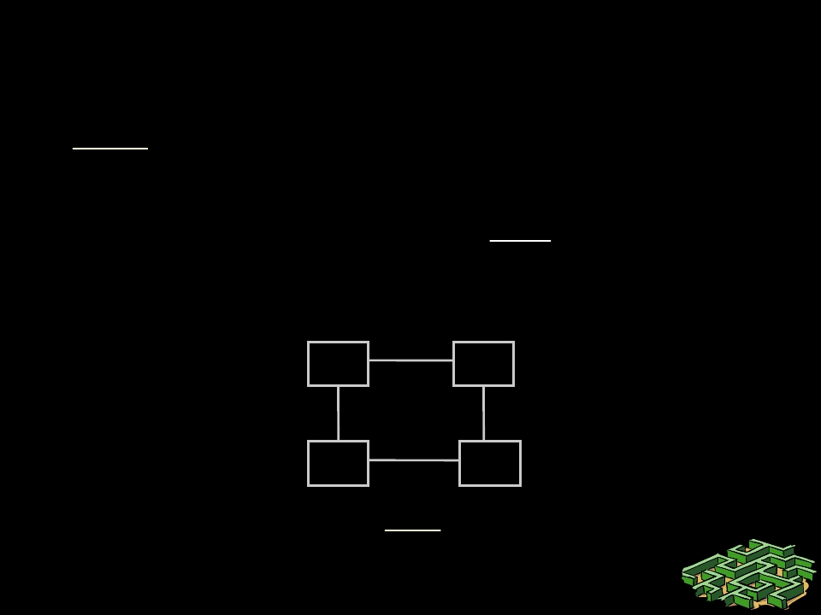
Connecting N users: Indirectly …
• Ring: Reliability to link failure, near-minimal
links
• All nodes do “forwarding” and “filtering”
Ring

Slide 16
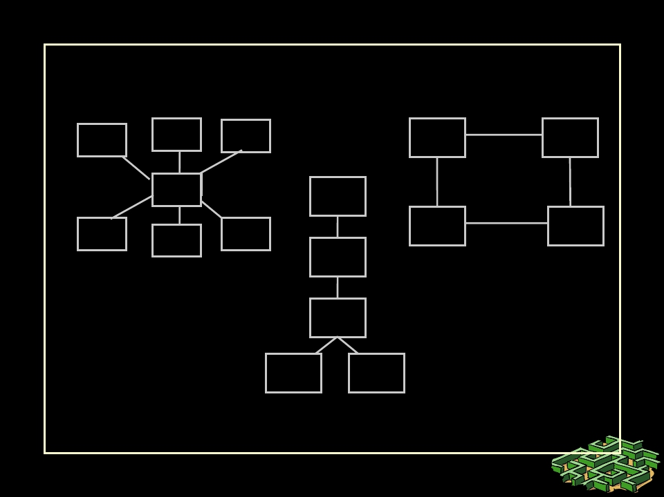
Topologies: Indirect Connectivity
S
Star
Ring
Tree

Slide 17
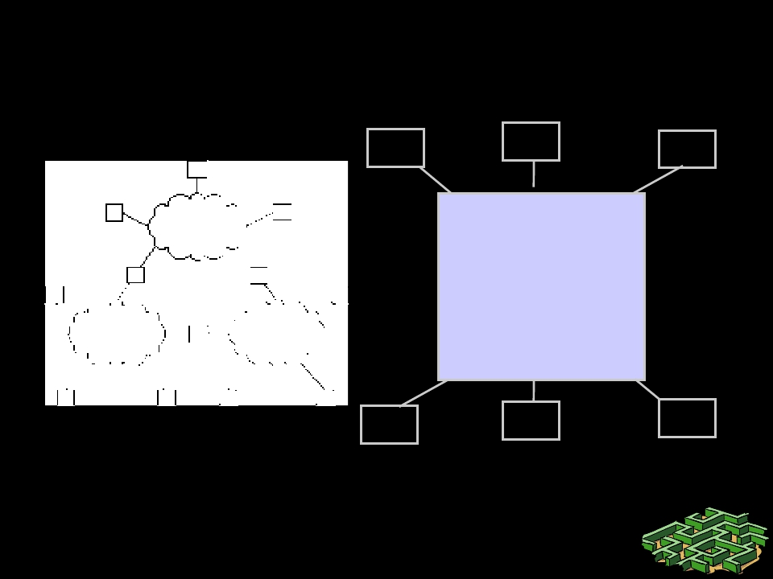
Inter-Networks: Networks of
Networks
…
…
=
Internet
…
…
Our goal is to design this black box on the right

Slide 18
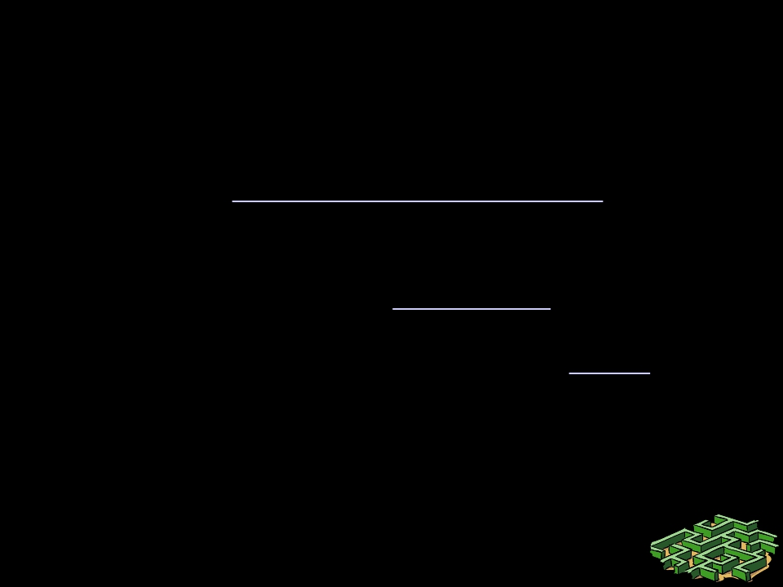
Inter-Networks: Networks of
Networks
• Internetworking involves two fundamental
problems: heterogeneity and scale
• Concepts:
– Translation, overlays, address & name resolution,
fragmentation: to handle heterogeneity
– Hierarchical addressing, routing, naming, address
allocation, congestion control: to handle scaling

Slide 19

Additions to Problem List
• Fragmentation
• Switching, bridging,
routing
• Naming, addressing
• Congestion control,
traffic management
• Reliability

Slide 20

How to do system design ?
• Eg goal: Design an Inter-network…
• Resources:
–
–
–
–
–
Space
Time
Computation
Money
Labor
• Design: trade-off cheaper resources
against expensive ones to meet goals.

Slide 21
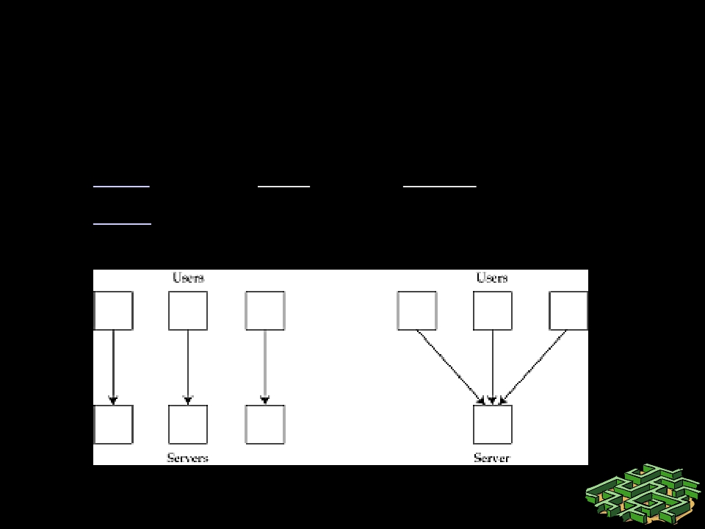
Building blocks: Multiplexing
• Multiplexing = sharing
– Trades time and space for money
– Cost: waiting time, buffer space & packet loss
– Gain: Money => Overall system costs less

Slide 22
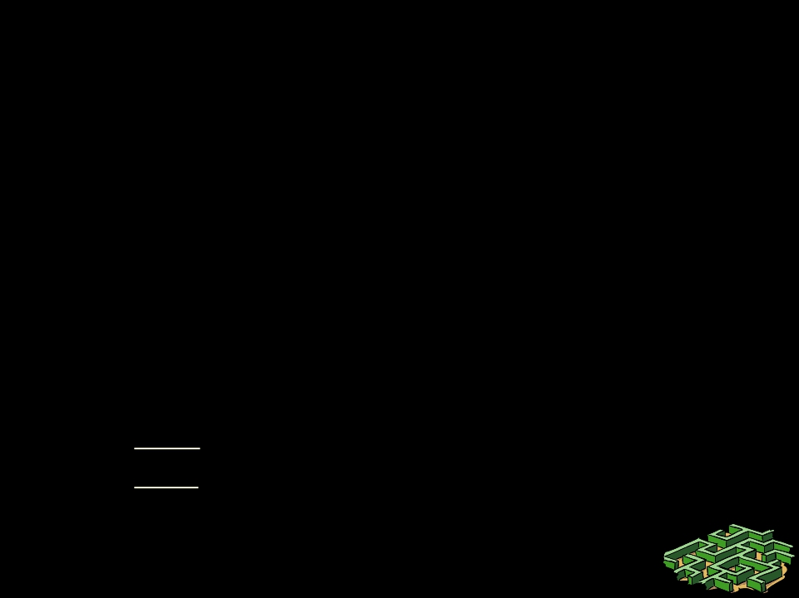
Statistical Multiplexing
• Reduce resource requirements by exploiting
statistical knowledge of the system.
– Eg: average rate <= service rate <= peak rate
– If service rate < average rate, then system
becomes unstable!!
• First design to ensure system stability!!
– Then, for a stable multiplexed system:
• Gain = peak rate/service rate.
• Cost: buffering, queuing delays, losses.

Slide 23
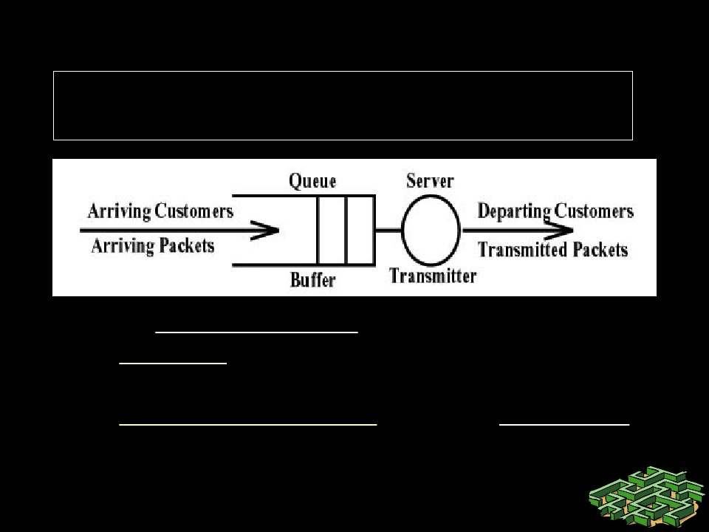
Stability of a Multiplexed System
Average Input Rate > Average Output Rate
=> system is unstable!
How to ensure stability ?
• Reserve enough capacity so that
demand is less than reserved capacity
• Dynamically detect overload and adapt
either the demand or capacity to resolve
overload

Slide 24
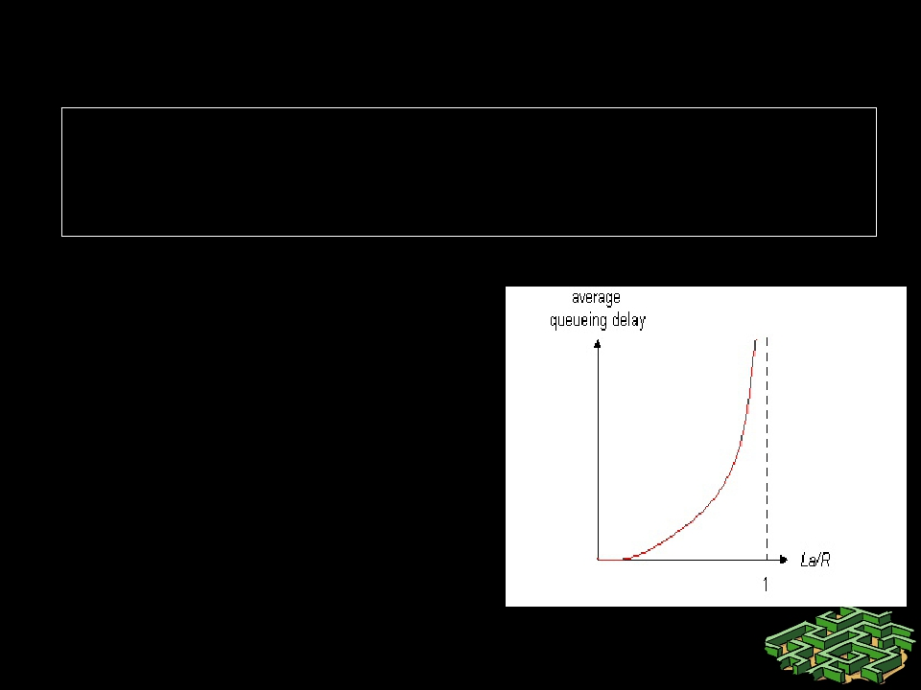
What’s a performance tradeoff ?
• A situation where you cannot get something
for nothing!
• Also known as a zero-sum game.
• R=link bandwidth
(bps)
• L=packet length
(bits)
• a=average packet
arrival rate
Traffic intensity = La/R

Slide 25
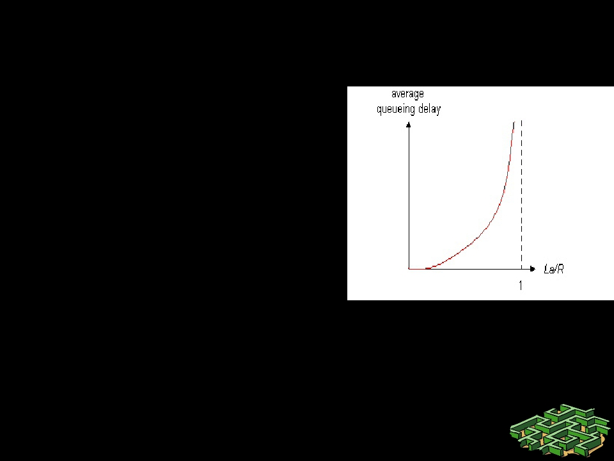
What’s a performance tradeoff ?
• La/R ~ 0: average
queuing delay small
• La/R -> 1: delays
become large
• La/R > 1: average delay
infinite (service degrades
unboundedly =>
instability)!

Slide 26
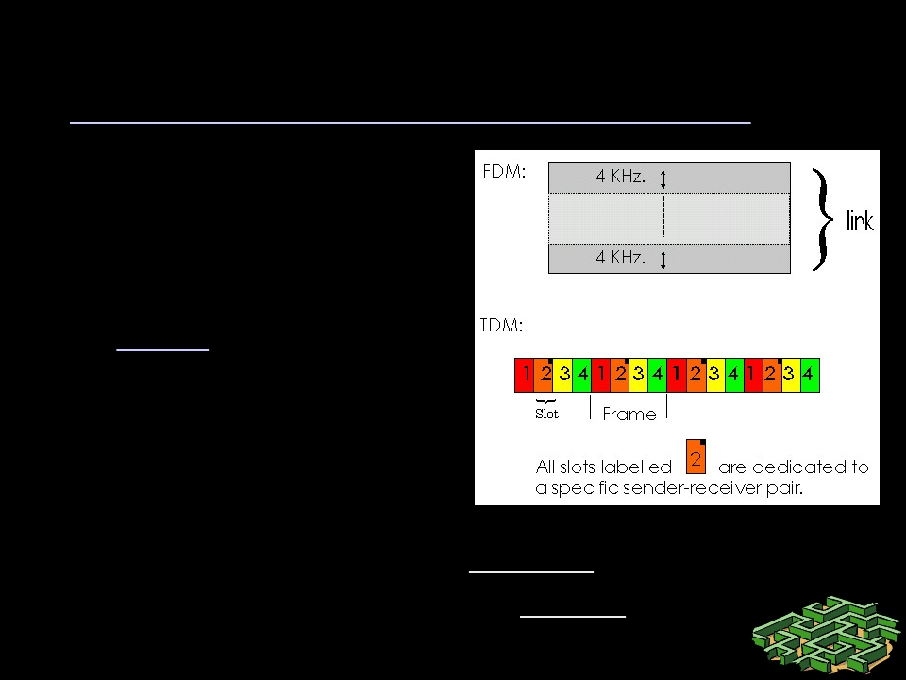
Example Design: Circuit-Switching
Circuit-switching: A form of multiplexing
– Divide link bandwidth
into “pieces”
– Reserve pieces on
successive links and tie
them together to form a
“circuit”
– Map traffic into the
reserved circuits
– Resources wasted if
unused: expensive.
– Mapping can be done without “headers”.
– Everything inferred from timing.

Slide 27
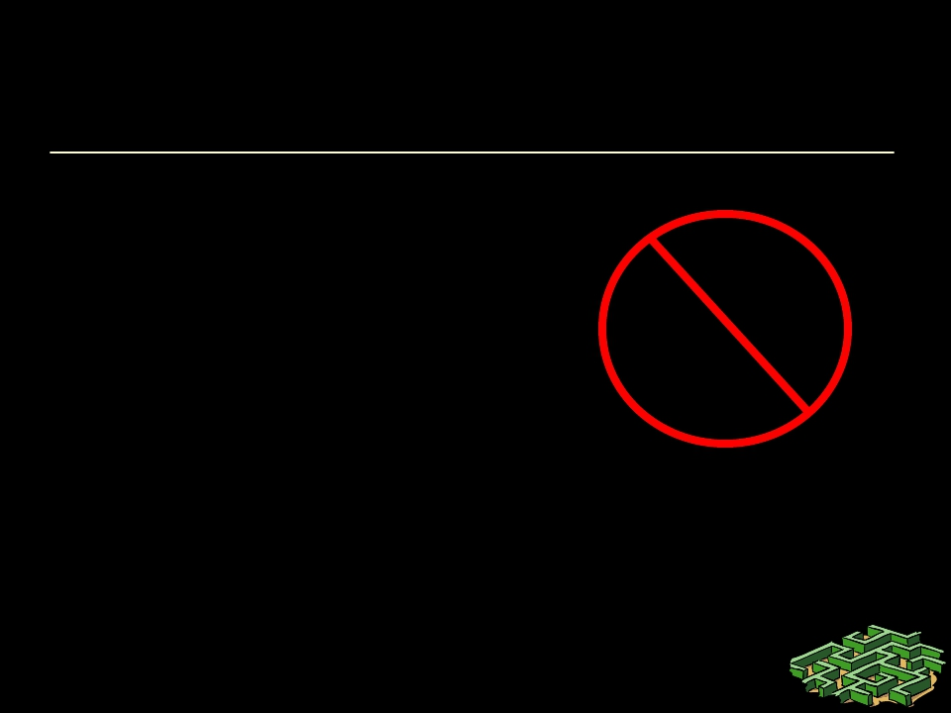
Example Design: Packet-Switching
Packet-switching: Another form of multiplexing:
– Chop up data (not links!)
into “packets”
• Packets: data + meta-data
(header)
– “Switch” packets at
intermediate nodes
• Store-and-forward if
bandwidth is not immediately
available.
Bandwidth division into
“pieces”
Dedicated allocation
Resource reservation

Slide 28
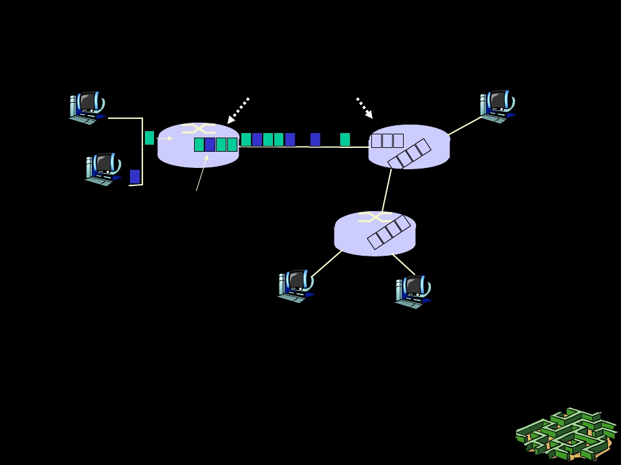
Packet Switching
10 Mbs
Ethernet
statistical multiplexing
1.5 Mbs
A
C
B
queue of packets
waiting for output
link
45 Mbs
D E
Cost: self-descriptive header per-packet,
θ
buffering and delays for applications.
θ
dynamically detect/adapt to overload for stability

Slide 29
Summary of System Design Ideas
• Multiplexing
• Statistical Multiplexing
• Stability and
performance tradeoffs
• Circuit switching
• Packet switching

Slide 30
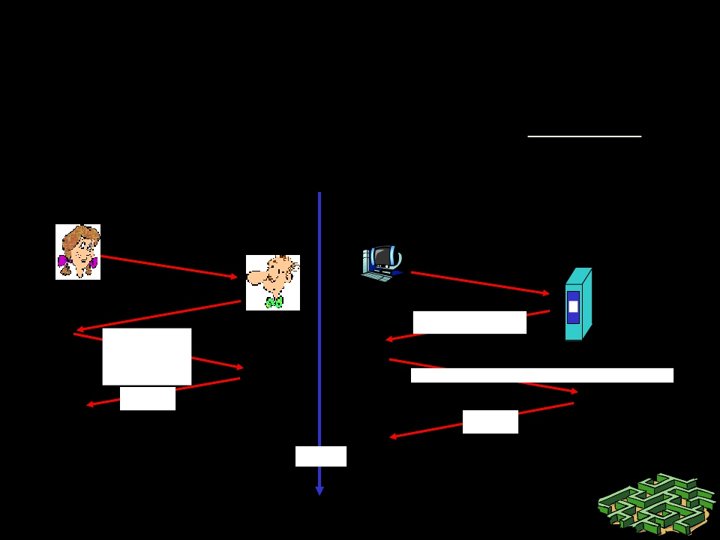
What are protocols ?
• Networking software is organized as protocols
• Eg: Human protocol vs network protocol:
Hi
Hi
Got the
time?
2:00
TCP connection
req.
TCP connection
reply.
Get http://www.rpi.edu/index.htm
<file>
time

Slide 31
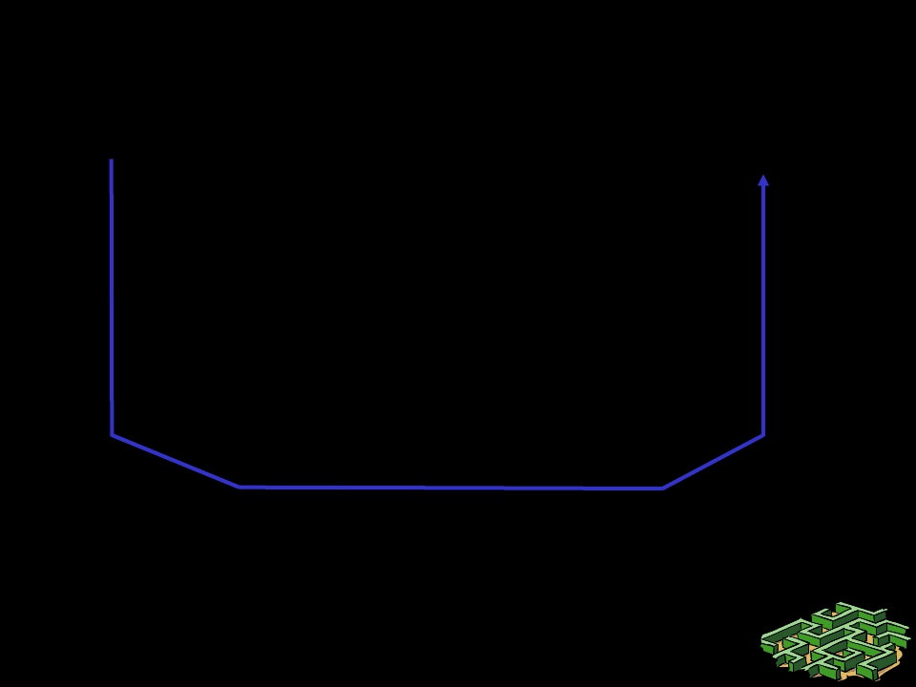
Analogy: Organization of air travel
ticket (purchase)
baggage (check)
gates (load)
runway takeoff
airplane routing
ticket (complain)
baggage (claim)
gates (unload)
runway landing
airplane routing
airplane routing
• Protocols: a series of functions
performed at different locations

Slide 32
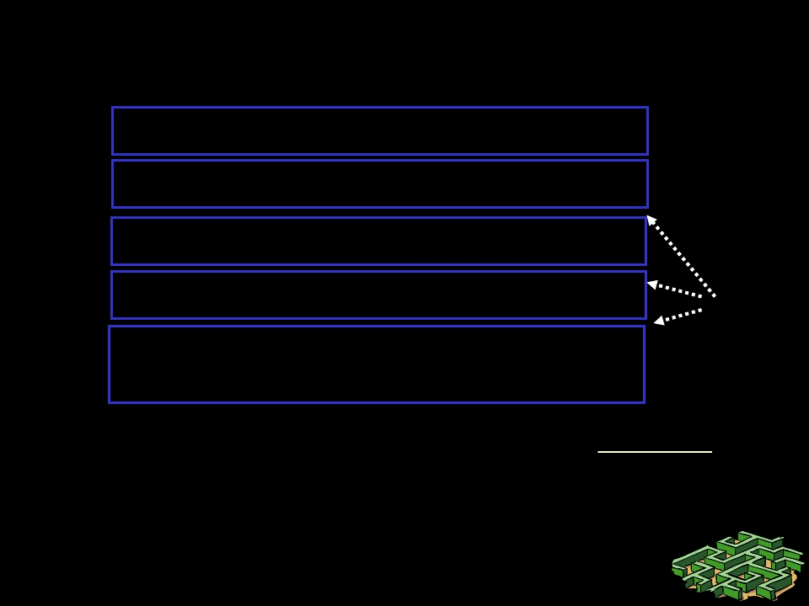
Organization of air travel: a different
view
ticket (purchase)
baggage (check)
gates (load)
ticket (complain)
baggage (claim)
gates (unload)
runway takeoff
airplane routing
runway landing
airplane routing
interface
airplane routing
Layers: each layer implements a service
– via its own internal-layer actions
– relying on services provided by layer below

Slide 33
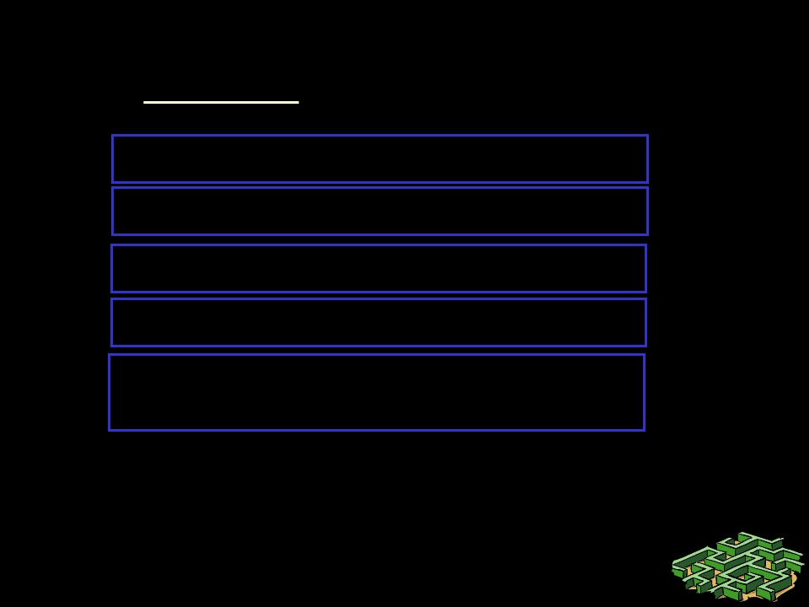
Layered air travel: services
Counter-to-counter delivery of person+bags
baggage-claim-to-baggage-claim delivery
people transfer: loading gate to arrival gate
runway-to-runway delivery of plane
airplane routing from source to
destination
Similarly, we organize network protocols
into a bunch of layers!

Slide 34
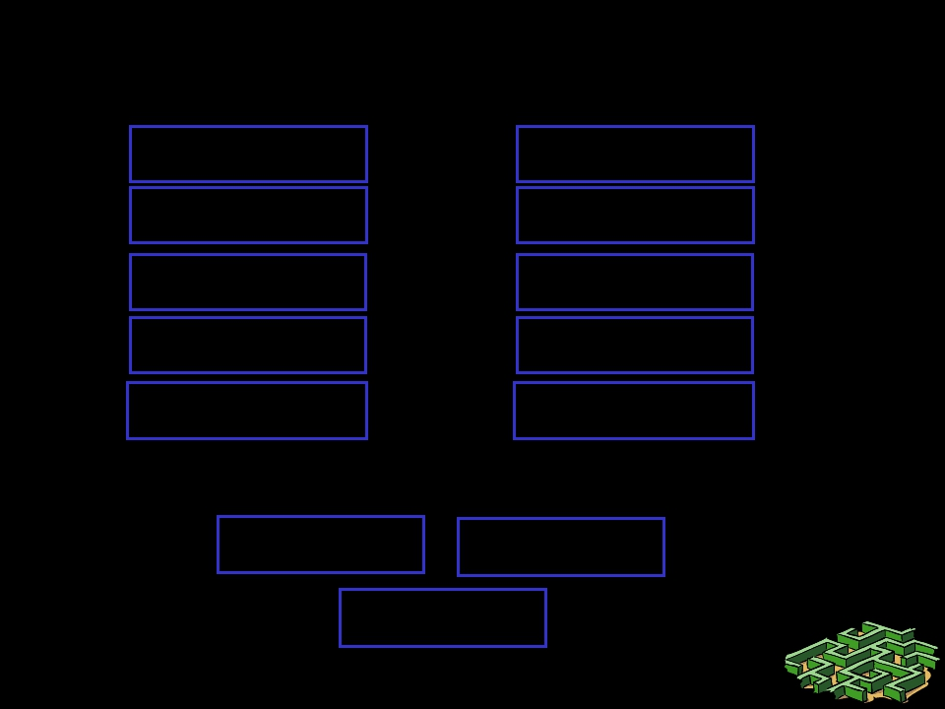
Distributed implementation of layers
ticket (purchase)
baggage (check)
gates (load)
runway takeoff
airplane routing
ticket (complain)
baggage (claim)
gates (unload)
runway landing
airplane routing
Departing
arriving
airport
airport
intermediate air traffic sites
airplane routing
airplane routing
airplane routing

Slide 35
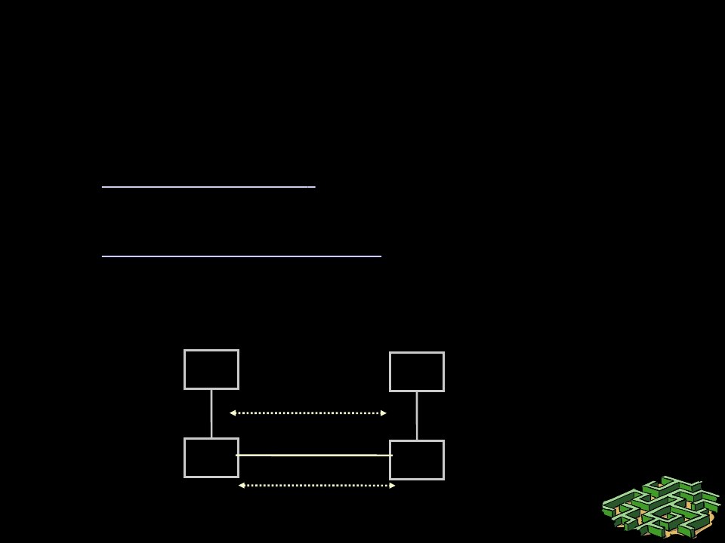
Protocol Implementations
• Are building blocks of a network architecture
• Each protocol object has two different interfaces
– service interface: defines operations on this
protocol
– peer-to-peer interface: defines messages
exchanged with peer
Li+1
Li
Li+1
Li
service interface
peer interface

Slide 36
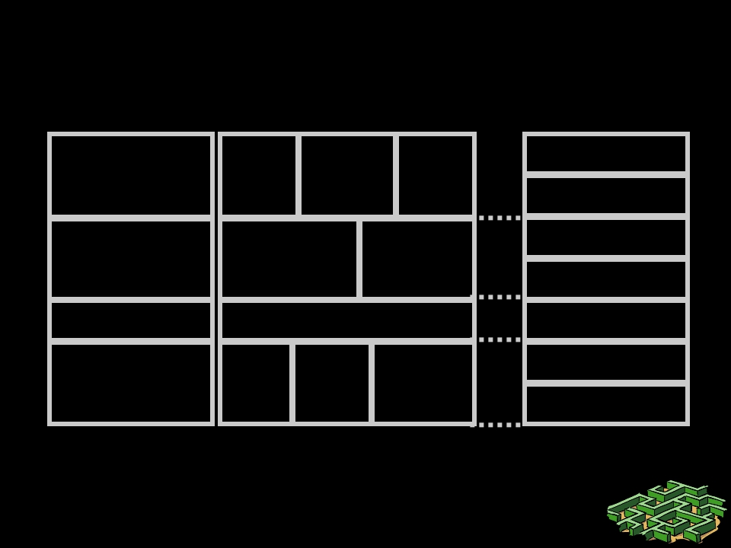
Reference Models for Layering
TCP/IP Model
Application
TCP/IP Protocols
FTP Telnet HTTP
OSI Ref Model
Application
Presentation
Session
Transport
Transport
TCP
UDP
Internetwork
Host to
Network
IP
EtherPacket Point-to-
net Radio Point
Network
Datalink
Physical
“Top-down” approach means we will first learn the
application layer and then learn about lower layers

Slide 37
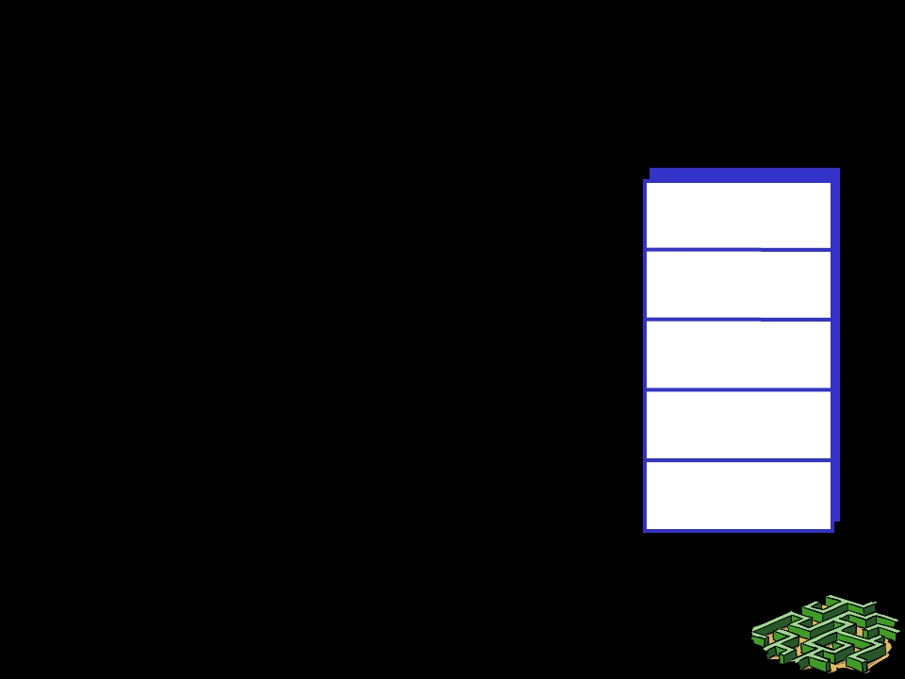
Internet protocol stack
• application: supporting network
applications
– ftp, smtp, http
• transport: host-host data transfer
– tcp, udp
• network: routing of datagrams
from source to destination
– ip, routing protocols
• link: data transfer between
neighboring network elements
– ppp, ethernet
• physical: bits “on the wire”
application
transport
network
link
physical

Slide 38
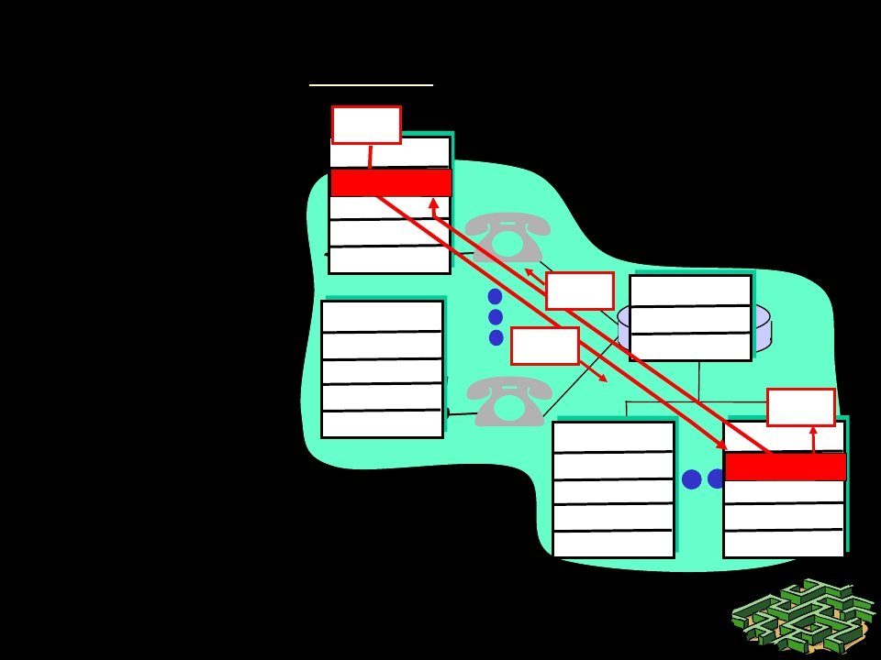
Layering: logical communication
data
application
E.g.: transport
• take data from
app
• add addressing,
reliability check
info to form
“datagram”
• send datagram
to peer
• wait for peer to
ack receipt
• analogy: post
office
transport
network
link
physical
application
transport
network
link
physical
ack network
link
data physical
data
application application
transport transport
network network
link link
physical physical

Slide 39
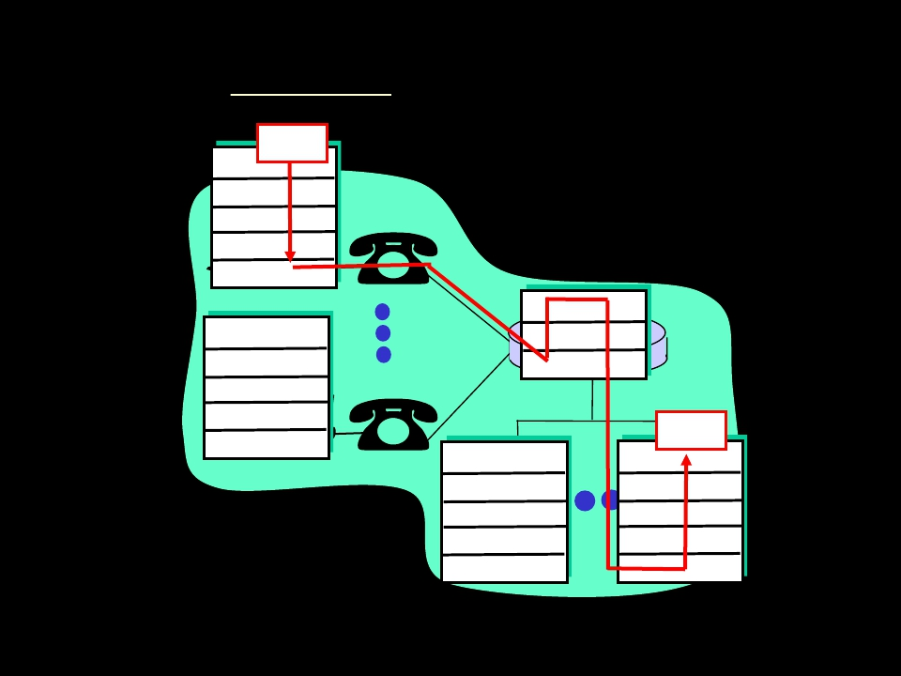
Layering: physical communication
data
application
transport
network
link
physical
network
application
transport
 | link
physical
link
physical
data
application
physical
link
physical

Slide 40
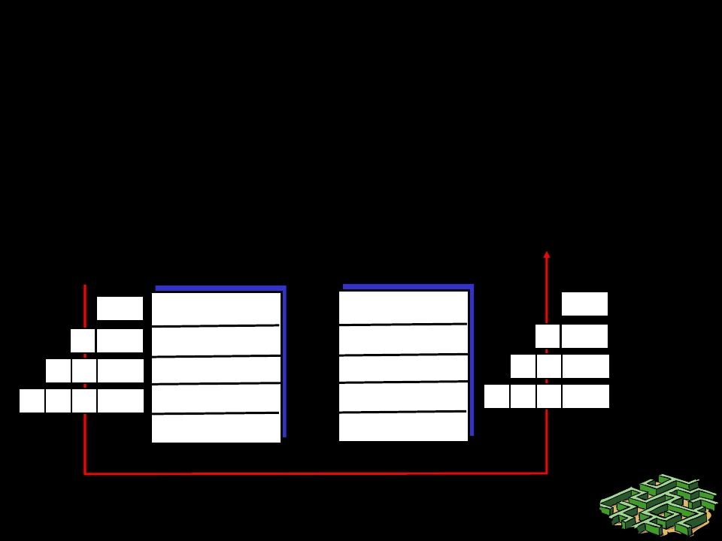
Protocol layering and data
Each layer takes data from above
• adds header information to create new
data unit (“encapsulation”)
• passes new data unit to layer below
source
destination
M
Ht M
HnHt M
Hl HnHt M
application
transport
network
link
application
transport
network
link
M
M
M
M
message
segment
datagram
frame
Ht
HnHt
Hl HnHt
physical
physical

Slide 41
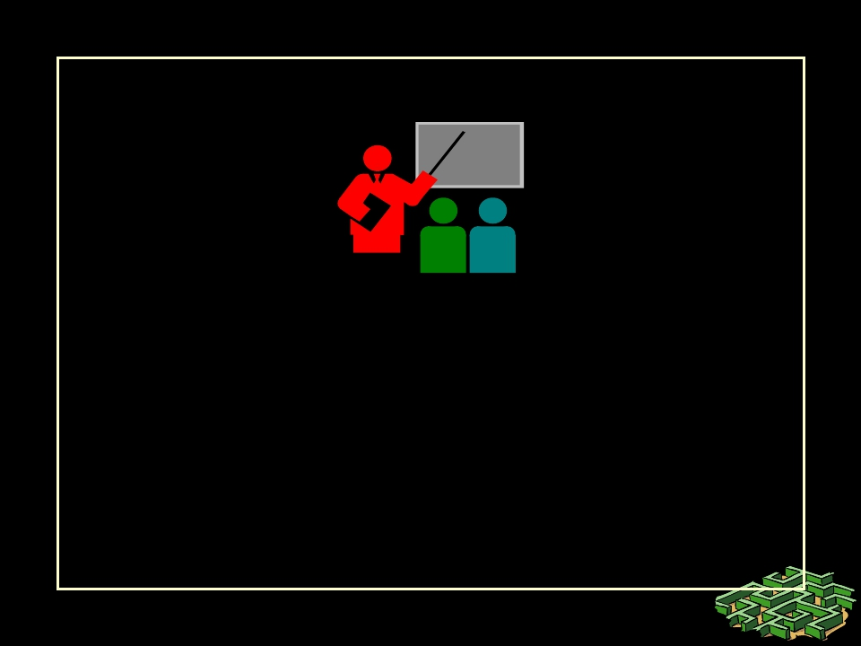
Summary
•
Networks, connectivity, topologies …
• Idea about networking layers ...
•

Slide 42
Thank U

