Slide 1
Application Layer

Slide 2

Overview
• Conceptual + implementation aspects of
network application protocols
– client server paradigm
– service models
• Specific protocols:
– http, ftp, smtp, pop, dns
• Sockets

Slide 3
Recap: Reference Models
TCP/IP Model
Application
Transport
Internetwork
Host to
Network
TCP/IP Protocols
OSI Ref Model
Application
Presentation
Session
Transport
Network
Datalink
Physical
FTP |  | Telnet |  |  | HTTP
TCP |  |  | UDP
IP
Ether net | Radio |  |  | Point-to- Point
“Top-down” approach means we will first learn the
application layer and then learn about lower layers

Slide 4
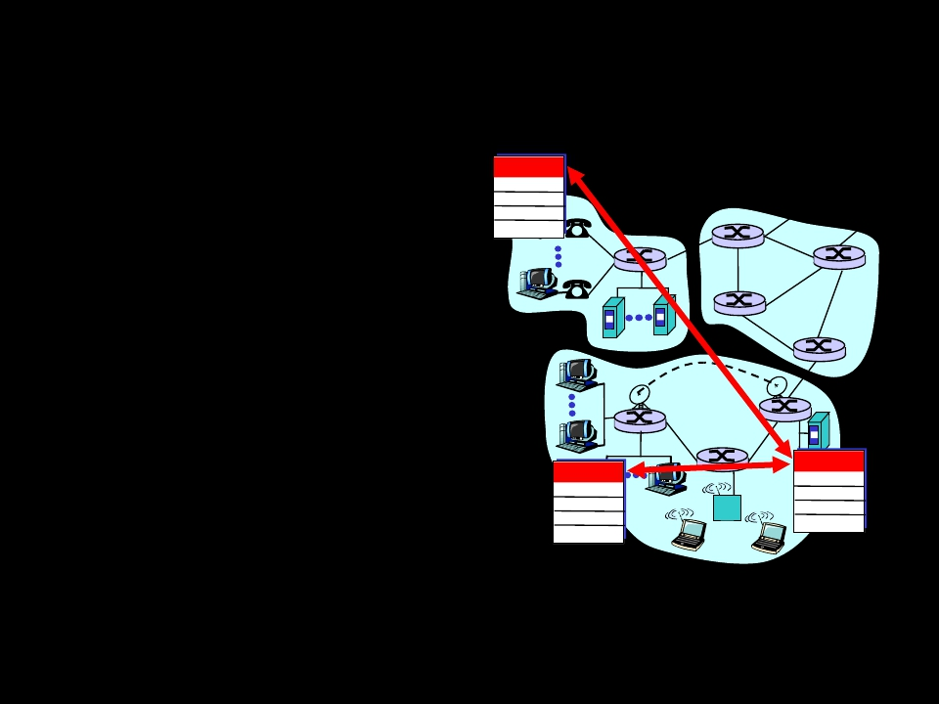
Applications and app-layer protocols
Application: communicating,
distributed processes
– running in network
hosts in “user space”
– exchange messages to
implement app
– e.g., email, file transfer,
the Web
Application-layer protocols
applicatio
n
transport
network
data link
physical
– one “piece” of an app
– define messages
exchanged by apps and
actions taken
– user services provided
by lower layer protocols
applicatio
n
transport
network
data link
physical
applicatio
n
transport
network
data link
physical

Slide 5
Network applications: some jargon
• A process is a program
that is running within a
host.
• Within the same host,
two processes
communicate with
interprocess
communication defined
by the OS.
• Processes running in
different hosts
communicate with an
application-layer
protocol
• A user agent is an
interface between
the user and the
network
application.
– Web:browser
– E-mail: mail reader
– streaming
audio/video: media
player

Slide 6
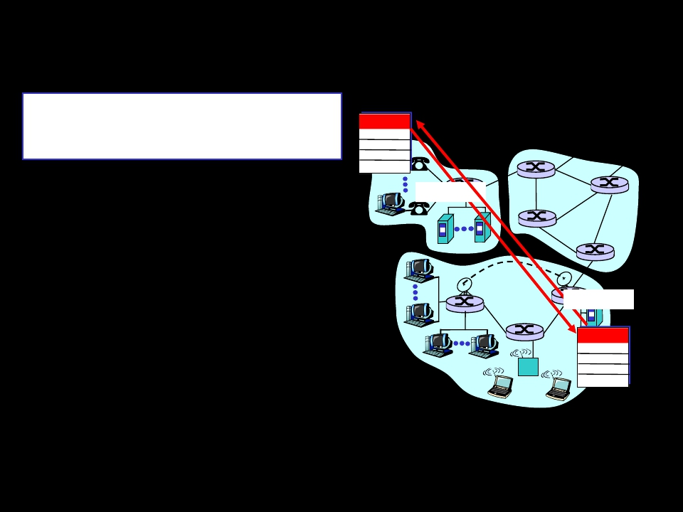
Client-server paradigm
Typical network app has two
pieces: client and server
applicatio
n
transport
network
data link
physical
Client:
• initiates contact with
server (“speaks first”)
• typically requests
service from server,
• for Web, client is
implemented in
browser; for e-mail, in
mail reader
request
reply
applicatio
n
transport
network
data link
physical

Slide 7
Client-server paradigm
Typical network app has two
pieces: client and server
applicatio
n
transport
network
Server:
• provides requested
service to client, via
replies
• e.g., Web server sends
requested Web page,
mail server delivers e-
mail
data link
physical
request
reply
applicatio
n
transport
network
data link
physical

Slide 8
Application-layer protocols
API: application
programming
interface
• defines interface
between application
and transport layer
• socket: Internet API
– two processes
communicate by
sending data into
socket, reading data
out of socket
Q: how does a process
“identify” the other
process with which it
wants to communicate?
– IP address of host
running other process
– “port number” -
allows receiving host
to determine to which
local process the
message should be
delivered

Slide 9
What Transport Service does an App need?
Data loss
• some apps (e.g., audio)
can tolerate some loss
• other apps (e.g., file
transfer, telnet) require
100% reliable data
transfer
Timing
• some apps (e.g.,
Internet telephony,
interactive games)
require low delay to
be “effective”
Bandwidth
• some apps (e.g., multimedia) require minimum
amount of bandwidth to be “effective”
• other apps (“elastic apps”) make use of whatever
bandwidth they get

Slide 10
Transport service requirements of common
apps
Application
file transfer
e-mail
Web documents
real-time audio/video
Data loss
no loss
no loss
loss-tolerant
loss-tolerant
Bandwidth
elastic
elastic
elastic
audio: 5Kb-1Mb
Time Sensitive
no
no
no
yes, 100’s msec
video:10Kb-5Mb
stored audio/video
interactive games
financial apps
loss-tolerant
loss-tolerant
no loss
same as above
few Kbps up
elastic
yes, few secs
yes, 100’s msec
yes and no

Slide 11
Services provided by Internet
transport protocols
TCP service:
required between client,
server
receiving process
sending and receiving
process
reliability, flow
overwhelm receiver
• congestion control: control, timing, or
throttle sender when bandwidth guarantee
network overloaded
• does not provide: timing,
minimum bandwidth
guarantees
Q: why bother? Why is
there a UDP?

Slide 12
Internet apps: their protocols and transport
protocols
Application
Underlying
Application
e-mail
remote terminal access
Web
file transfer
streaming multimedia
remote file server
Internet telephony
layer protocol
smtp [RFC 821]
telnet [RFC 854]
http [RFC 2068]
ftp [RFC 959]
proprietary
(e.g. RealNetworks)
NSF
proprietary
(e.g., Vocaltec)
transport protocol
TCP
TCP
TCP
TCP
TCP or UDP
TCP or UDP
typically UDP

Slide 13
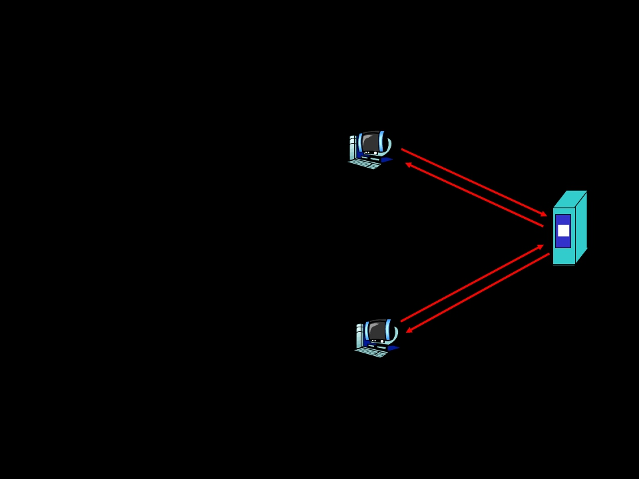
The Web: the http protocol
http: hypertext
transfer protocol
• Web’s application
layer protocol
• client/server model
– client: browser that
requests, receives,
“displays” Web
objects
– server: Web server
sends objects in
response to
requests
• http1.0: RFC 1945
• http1.1: RFC 2068
http
req
PC running htt
ue
pr
st
nse
st
e p
Explorer
Mac running
Navigator
s o
req se Server
ue
http pon
res
running
server
htt
p Apache Web

Slide 14
The http protocol: more
http is “stateless”
• server maintains
no information
about past client
requests
aside
Protocols that maintain
“state” are complex!
• past history (state) must
be maintained
• if server/client crashes,
their views of “state” may
be inconsistent, must be
reconciled
http: TCP transport service:
• client initiates TCP
connection (creates
socket) to server, port 80
• server accepts TCP
connection from client
• http messages
(application-layer
protocol messages)
exchanged between
browser (http client) and
Web server (http server)
• TCP connection closed

Slide 15
http example
Suppose user enters URL www. School.edu/
(contains text,
references to 10
jpeg images)
1a. http client initiates TCP
connection to http server
(process) at www.
School.edu. Port 80 is
default for http server.
2. http client sends http request
message (containing URL)
into TCP connection socket
1b. http server at host www.
School.edu waiting for TCP
connection at port 80. “accepts”
connection, notifying client
3. http server receives request
message, forms response
message containing requested
object (Department/home.index),
sends message into socket
time

Slide 16
http example (cont.)
4. http server closes TCP
connection.
5. http client receives
response message
containing html file,
displays html.
Parsing html file, finds
10 referenced jpeg
objects
6. Steps 1-5 repeated for
each of 10 jpeg objects
time

Slide 17
Non-persistent and persistent connections
Non-persistent
• HTTP/1.0
• server parses request,
responds, and closes
TCP connection
• Each object transfer
suffers from slow
start
But most 1.0 browsers use
parallel TCP connections.
Persistent
• default for HTTP/1.1
• on same TCP
connection: server,
parses request,
responds, parses new
request,..
• Client sends requests
for all referenced
objects as soon as it
receives base HTML.

Slide 18
http message format: request
• two types of http messages: request,
response
• http request message:
– ASCII (human-readable format)
request line
(GET, POST,
HEAD commands)
GET /somedir/page.html HTTP/1.0
User-agent: Mozilla/4.0
Accept: text/html, image/gif,image/jpeg
header Accept-language:en
lines
(extra carriage return, line feed)
Carriage return,
line feed
indicates end
of message

Slide 19
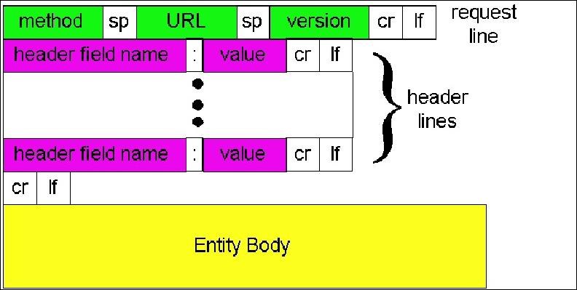
http request message: general format

Slide 20
http message format: response
status line
(protocol
status code
status phrase)
header
lines
data, e.g.,
requested
html file
HTTP/1.0 200 OK
Date: Thu, 06 Aug 1998 12:00:15 GMT
Server: Apache/1.3.0 (Unix)
Last-Modified: Mon, 22 Jun 1998 …...
Content-Length: 6821
Content-Type: text/html
data data data data data ...

Slide 21
http response status codes
In first line in server->client response message.
A few sample codes:
200 OK
– request succeeded, requested object later in
this message
301 Moved Permanently
– requested object moved, new location specified
later in this message (Location:)
400 Bad Request
– request message not understood by server
404 Not Found
– requested document not found on this server
505 HTTP Version Not Supported

Slide 22
Trying out http (client side) for
yourself
1. Telnet to your favorite Web server:
Opens TCP connection to port 80
telnet www.eurecom.fr 80 (default http server port) at www.eurecom.fr.
Anything typed in sent
to port 80 at www.eurecom.fr
2. Type in a GET http request:
GET /~ross/index.html HTTP/1.0 By typing this in (hit carriage
return twice), you send
this minimal (but complete)
GET request to http server
3. Look at response message sent by http server!

Slide 23
User-server interaction: authentication
Authentication goal: control
access to server server
usual http request
msg
req.
• authorization: typically WWW authenticate:
usual http request
– authorization: msg
usual http response
– Sends header line msg
WWW authenticate:
if unauthorized
Browser caches name & password
so
that user does not have to
repeatedly enter it.
usual http request
msg
usual http response
msg
+ Authorization:line
time

Slide 24
User-server interaction: cookies
• server sends
“cookie” to client in
response msg
Set-cookie: 1678453
• client presents
cookie in later
requests
cookie: 1678453
• server matches
presented-cookie
with server-stored
info
– authentication
– remembering user
preferences
client
usual http request
msg
+
Set-cookie: #
usual http request
msg
usual http response
msg
usual http request
msg
usual http response
msg
server
cookie-
spectific
action
cookie-
spectific
action
usual http response
cookie: #
cookie: #

Slide 25
User-server interaction: conditional
GET
• Goal: don’t send
object if client has up- client
to-date stored
http request msg
If-modified-since:
• client: specify date of <date>
cached copy in http http response
request HTTP/1.0
304 Not Modified
<date>
server
object
not
modified
(cached) version
If-modified-since:
• server: response
contains no object if
cached copy up-to-
date:
HTTP/1.0 304 Not
Modified
http request msg
If-modified-since:
<date>
http response
HTTP/1.1 200 OK
…
<data>
object
modified

Slide 26
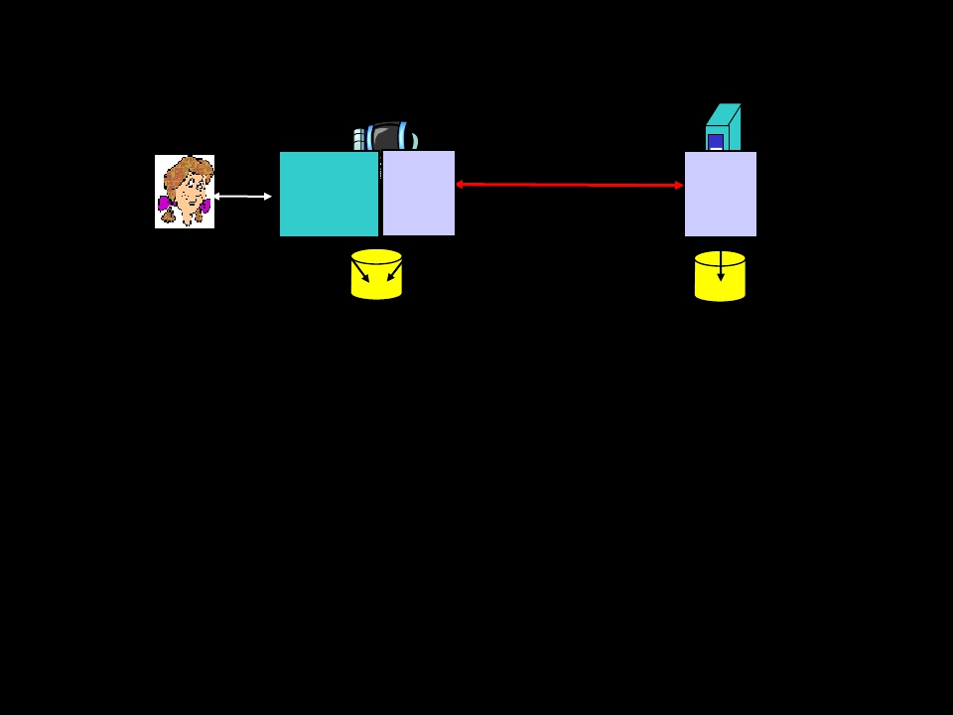
ftp: the file transfer protocol
FTP
user
interface
file transfer
FTP
server
FTP
client
local file
system
user
at host
remote file
system
• transfer file to/from remote host
• client/server model
– client: side that initiates transfer
(either to/from remote)
– server: remote host
• ftp: RFC 959
• ftp server: port 21

Slide 27
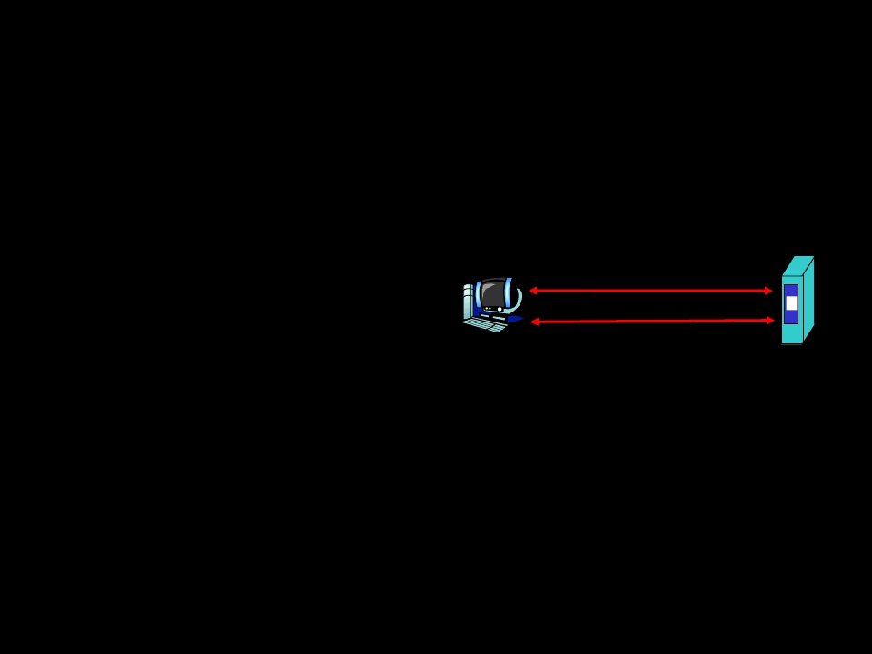
ftp: separate control, data connections
• ftp client contacts ftp
server at port 21,
specifying TCP as
transport protocol
• two parallel TCP
connections opened:
– control: exchange
commands, responses
between client, server.
“out of band control”
TCP control
connection
port 21
TCP data connection
port 20
FTP
client
FTP
server
– data: file data to/from
server
• ftp server maintains
“state”: current directory,
earlier authentication

Slide 28
ftp commands, responses
Sample commands:
• sent as ASCII text over
control channel
• USER username
• PASS password
• LIST returns list of file
in current directory
• RETR filename
retrieves (gets) file
• STOR filename stores
(puts) file onto remote
host
Sample return codes
• status code and
phrase (as in http)
• 331 Username OK,
password required
• 125 data
connection
already open;
transfer starting
• 425 Can’t open
data connection
• 452 Error writing
file

Slide 29
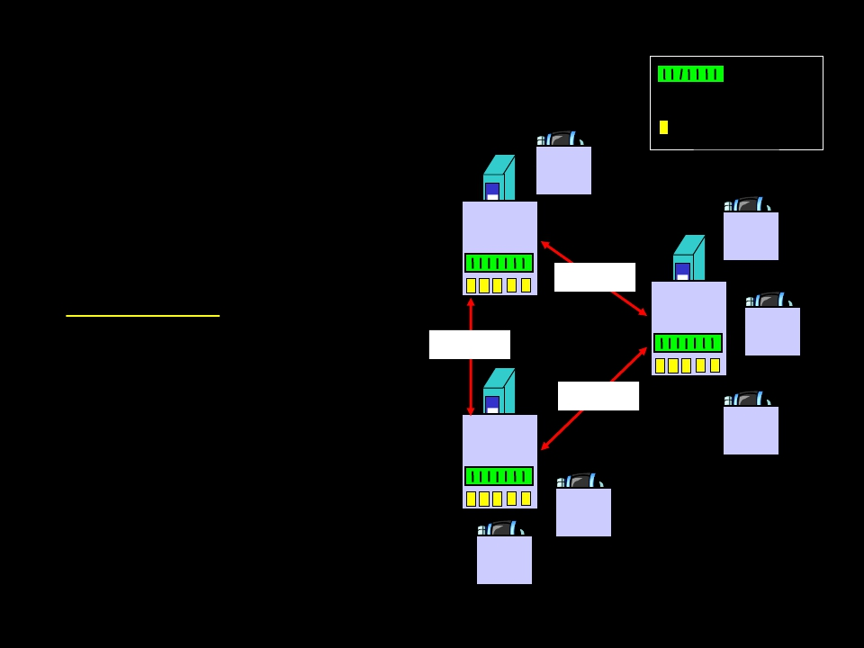
Electronic Mail
Three major components:
• user agents
outgoing
message queue
user mailbox
• mail servers
• simple mail transfer
protocol: smtp
user
agent
mail
server
user
agent
SMTP
SMTP
user
agent
mail
server
User Agent
• a.k.a. “mail reader”
• composing, editing,
reading mail messages
• e.g., Eudora, Outlook,
elm, Netscape
Messenger
• outgoing, incoming
messages stored on
server
user
agent
user
agent
SMTP
mail
server
user
agent

Slide 30
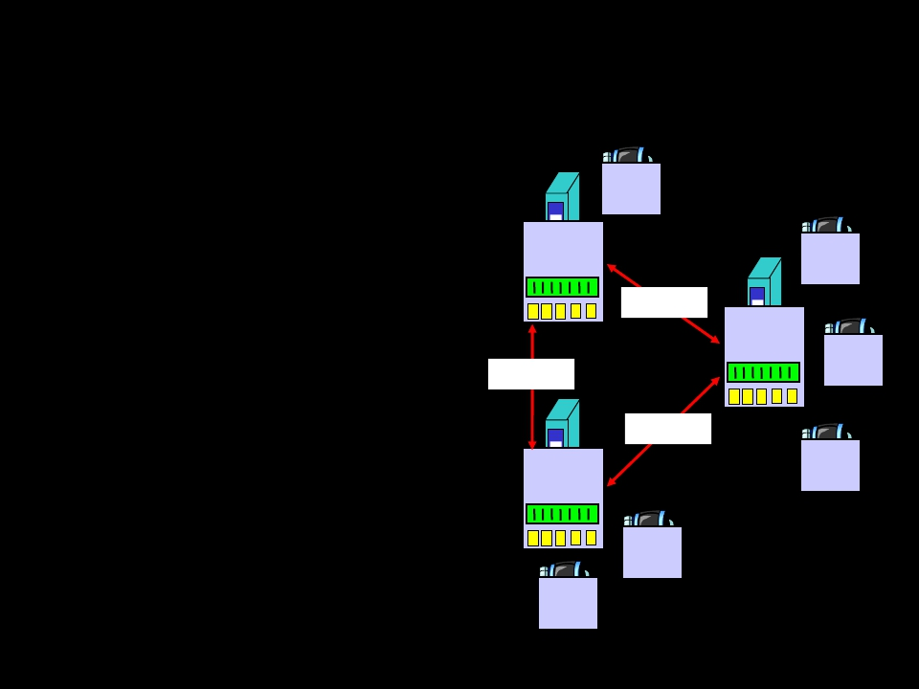
Electronic Mail: mail servers
Mail Servers
• mailbox contains
incoming messages
(yet to be read) for user
user
agent
mail
server
user
agent
• message queue of
outgoing (to be sent)
mail messages
• smtp protocol between
mail servers to send
email messages
– client: sending mail
server
– “server”: receiving
mail server
SMTP
SMTP
user
agent
mail
server
user
agent
user
agent
SMTP
mail
server
user
agent

Slide 31
Electronic Mail: smtp [RFC 821]
• uses tcp to reliably transfer email msg
from client to server, port 25
• direct transfer: sending server to
receiving server
• three phases of transfer
– handshaking (greeting)
– transfer of messages
– closure
• command/response interaction
– commands: ASCII text
– response: status code and phrase
• messages must be in 7-bit ASCII

Slide 32
Sample smtp interaction
S:
C:
S:
C:
S:
C:
S:
C:
S:
C:
C:
C:
S:
C:
S:
220 hamburger.edu
HELO crepes.fr
250 Hello crepes.fr, pleased to meet you
MAIL FROM: <alice@crepes.fr>
250 alice@crepes.fr... Sender ok
RCPT TO: <bob@hamburger.edu>
250 bob@hamburger.edu ... Recipient ok
DATA
354 Enter mail, end with "." on a line by itself
Do you like ketchup?
How about pickles?
.
250 Message accepted for delivery
QUIT
221 hamburger.edu closing connection

Slide 33
Try smtp interaction for yourself:
• telnet servername 25
• see 220 reply from server
• enter HELO, MAIL FROM, RCPT TO,
DATA, QUIT commands
above lets you to send email without
using email client (reader)

Slide 34
Mail message format
smtp: protocol for
exchanging email
msgs
RFC 822: standard for
text message format:
• header lines, e.g.,
– To:
– From:
– Subject:
different from smtp
commands!
• body
– the “message”, ASCII
characters only
header
body
blank
line

Slide 35
Message format: multimedia extensions
• MIME: multimedia mail extension, RFC
2045, 2056
• additional lines in msg header declare
MIME content type
From: alice@crepes.fr
To: bob@hamburger.edu
Subject: Picture of yummy crepe.
MIME-Version: 1.0
Content-Transfer-Encoding: base64
Content-Type: image/jpeg
base64 encoded data .....
.........................
......base64 encoded data
MIME version
method used
to encode data
multimedia data
type, subtype,
parameter declaration
encoded data

Slide 36
MIME types
Content-Type: type/subtype; parameters
Text
• example subtypes:
plain, html
Image
• example subtypes:
jpeg, gif
Audio
• exampe subtypes:
basic (8-bit mu-law
encoded), 32kadpcm
(32 kbps coding)
Video
• example subtypes:
mpeg, quicktime
Application
• other data that must
be processed by
reader before
“viewable”
• example subtypes:
msword, octet-
stream

Slide 37
Multipart Type
From: alice@crepes.fr
To: bob@hamburger.edu
Subject: Picture of yummy crepe.
MIME-Version: 1.0
Content-Type: multipart/mixed; boundary=98766789
--98766789
Content-Transfer-Encoding: quoted-printable
Content-Type: text/plain
Dear Bob,
Please find a picture of a crepe.
--98766789
Content-Transfer-Encoding: base64
Content-Type: image/jpeg
base64 encoded data .....
.........................
......base64 encoded data
--98766789--

Slide 38
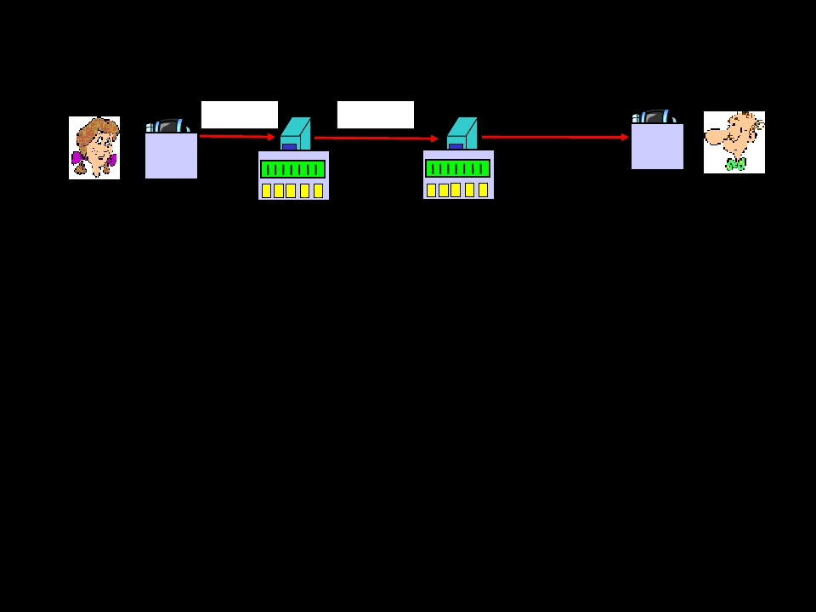
Mail access protocols
SMTP
SMTP
POP3 or
IMAP
user
agent
user
agent
sender’s mail
server
receiver’s mail
server
• SMTP: delivery/storage to receiver’s server
• Mail access protocol: retrieval from server
– POP: Post Office Protocol [RFC 1939]
• authorization (agent <-->server) and download
– IMAP: Internet Mail Access Protocol [RFC 1730]
• more features (more complex)
• manipulation of stored msgs on server
– HTTP: Hotmail , Yahoo! Mail, etc.

Slide 39
POP3 protocol
S: +OK POP3 server ready
• client commands: C: user alice
– user: declare
username
– pass: password
• server responses
– +OK
– -ERR
transaction phase, client:
• list: list message
numbers
• retr: retrieve
message by number
• dele: delete
• quit
S:
C:
S:
C:
S:
S:
S:
C:
S:
S:
C:
C:
S:
S:
C:
C:
S:
+OK
pass hungry
+OK user successfully logged
list
1 498
2 912
.
retr 1
<message 1 contents>
.
dele 1
retr 2
<message 1 contents>
.
dele 2
quit
+OK POP3 server signing off
on

Slide 40
DNS: Domain Name System
People: many identifiers:
– name, Passport #
Internet hosts, routers:
– IP address (32 bit) -
used for addressing
data / information
– “name”, e.g.,
www.google.com
used by humans
Q: map between IP
addresses and name ?
Domain Name System:
• distributed database
implemented in hierarchy
of many name servers
• application-layer protocol
host, routers, name
servers to communicate
to resolve names
(address/name
translation)
– note: core Internet
function implemented
as application-layer
protocol
– complexity at
network’s “edge”

Slide 41
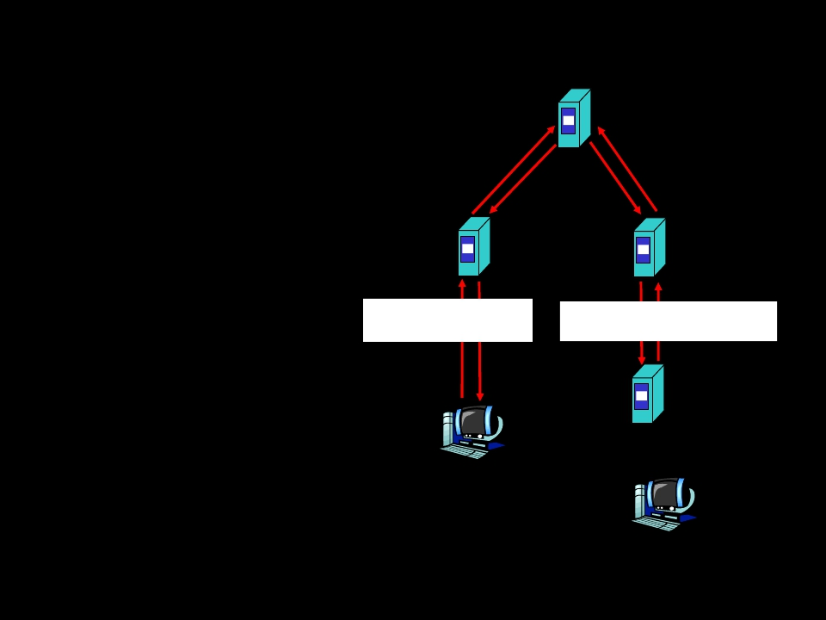
DNS example
root name
server
Root name
server:
2
6
7
3
• may not know
authoritative
name server
• may know
intermediate
name server:
who to contact
to find
authoritative
name server
local name server
dns.eurecom.fr
1 8
requesting host
surf.eurecom.fr
intermediate name server
dns.umass.edu
4 5
authoritative name server
dns.cs.umass.edu
gaia.cs.umass.edu

Slide 42
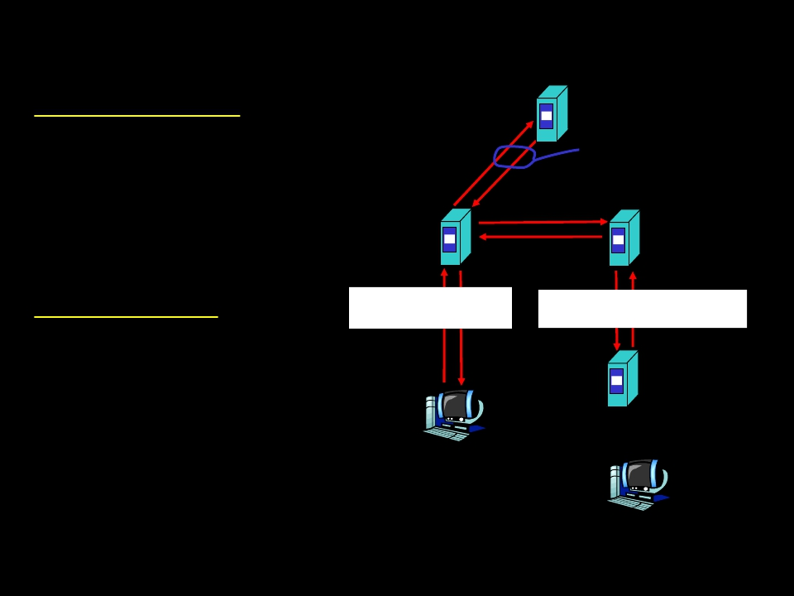
DNS: iterated queries
root name
recursive query:
server
• puts burden of name
resolution on
contacted name
server
iterated
query
2
3
4
• heavy load?
iterated query:
• contacted server
replies with name of
server to contact
• “I don’t know this
name, but ask this
server”
7
local name server intermediate name server
dns.eurecom.fr dns.umass.edu
5 6
1 8
authoritative name server
dns.cs.umass.edu
requesting host
surf.eurecom.fr
gaia.cs.umass.edu

Slide 43
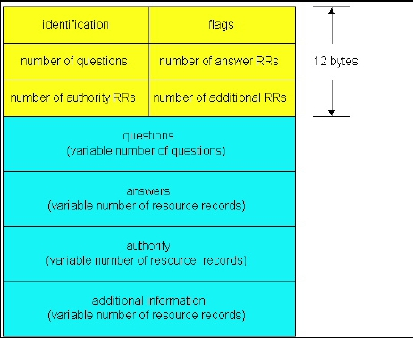
DNS protocol, messages
DNS protocol : query and reply messages,
both with same message format
msg header
• identification: 16 bit #
for query, reply to query
uses same #
• flags:
– query or reply
– recursion desired
– recursion available
– reply is authoritative

Slide 44
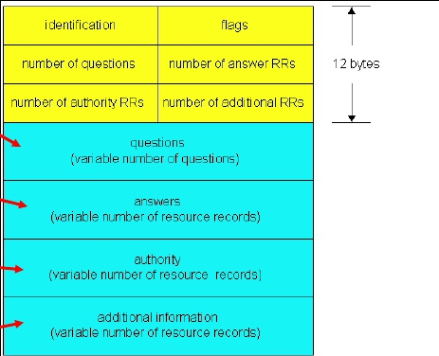
DNS protocol, messages
Name, type fields
for a query
RRs in response
to query
records for
authoritative servers
additional “helpful”
info that may be used

Slide 45
Sockets
Goal: learn models of client/server application
that communicate using sockets
Socket API
• introduced in BSD4.1
UNIX, 1981
• explicitly created, used,
released by apps
• client/server paradigm
• two types of transport
service via socket API:
– unreliable datagram
– reliable, byte
stream-oriented
a
socket host-local,
application-
created/owned,
OS-controlled interface
(a “door”) into which
application process can
both send and
receive messages
to/from another (remote
or
local) application
process

Slide 46
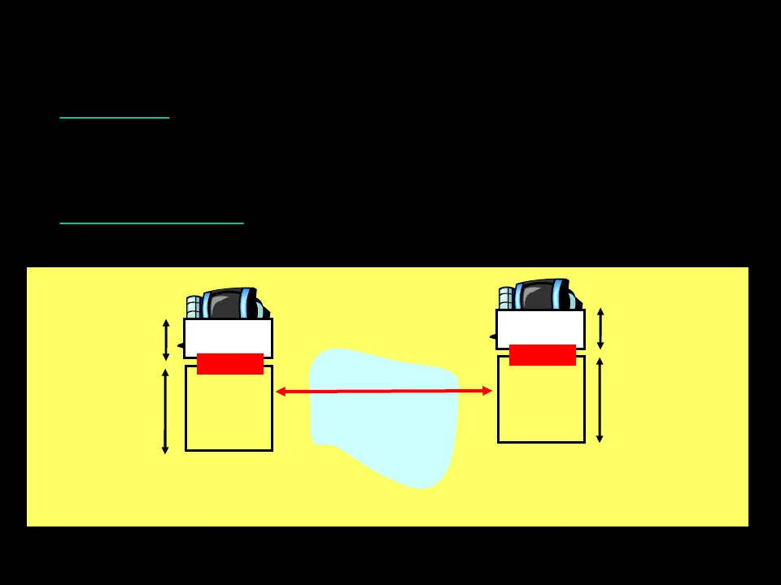
TCP sockets
Socket: a door between application process
and end-end-transport protocol (UCP or
TCP)
TCP service: reliable transfer of bytes from
one process to another
controlled by
application
developer
controlled by
operating
system
controlled by
application
developer
controlled by
operating
system
process
socket
TCP with
buffers,
variables
process
socket
TCP with
buffers,
variables
internet
host or
server
host or
server

Slide 47
TCP sockets
Client must contact server
• server process must
first be running
• server must have
created socket (door)
that welcomes client’s
contact
Client contacts server by:
• creating client-local
TCP socket
• specifying IP address,
port number of server
process
• When client creates socket:
client TCP establishes
connection to server TCP
• When contacted by client,
server TCP creates new
socket for server process
to communicate with client
– allows server to talk with
multiple clients
application viewpoint
TCP provides reliable, in-order
transfer of bytes (“pipe”)
between client and server

Slide 48
TCP Sockets
Example client-server app:
• client reads line from
standard input
(inFromUser stream) ,
sends to server via
socket (outToServer
stream)
• server reads line from
socket
• server converts line to
uppercase, sends back to
client
• client reads, prints
modified line from socket
(inFromServer stream)
Input stream: sequence
of bytes into process
Output stream:
sequence of bytes
out of process
inFromUser
client socket
outToServer
iinFromServer

Slide 49
Client/server socket interaction: TCP
Server
(running on hostid)
Client
create socket,
port=x, for
incoming request:
welcomeSocket =
ServerSocket()
TCP
connection request connection
create socket,
connect to hostid, port=x
clientSocket =
Socket()
send request using
clientSocket
read reply from
clientSocket
close
clientSocket
wait for incoming
connectionSocket =
welcomeSocket.accept()
read request from
connectionSocket
write reply to
connectionSocket
close
connectionSocket
setup

Slide 50
UDP Sockets
UDP: no “connection”
between client and
server
• no handshaking
• sender explicitly
attaches IP address
and port of
destination
• server must extract IP
address, port of
sender from received
datagram
UDP: transmitted data
may be received out
of order, or lost
application viewpoint
UDP provides unreliable transfer
of groups of bytes (“datagrams”)
between client and server

Slide 51
Client/server socket interaction: UDP
Server
(running on hostid)
Client
create socket,
port=x, for
incoming request:
serverSocket =
create socket,
clientSocket =
DatagramSocket()
DatagramSocket()
Create, address (hostid, port=x,
send datagram request
read request from
serverSocket
write reply to
serverSocket
specifying client
host address,
port umber
using clientSocket
read reply from
clientSocket
close
clientSocket

Slide 52
Application Layer: Summary
Our study of network apps now complete!
• application service
requirements:
– reliability,
bandwidth, delay
• client-server paradigm
• Internet transport
service model
– connection-
oriented, reliable:
TCP
– unreliable,
datagrams: UDP
• specific protocols:
– http
– ftp
– smtp, pop3
• sockets
– client/server
implementation
– using tcp, udp sockets

Slide 53
Thank U

