Slide 1
Transport Layer
Pranita S. Acharekar

Slide 2

Overview
•
•
•
•
•
Transport layer services
Multiplexing / demultiplexing
Connectionless transport: UDP
Principles of reliable data transfer
Connection-oriented transport: TCP

Slide 3
Transport services and
protocols
• Provide logical communication between
application processes running on different
hosts
• Transport vs. network layer services:
– network layer: data transfer between end
systems
– transport layer: data transfer between
processes
– Relies on, enhances, network layer services

Slide 4
Transport-layer protocols
Internet transport services:
• Reliable, in-order unicast delivery (TCP)
– congestion
– flow control
– connection setup
• Unreliable (“best-effort”), unordered
unicast or multicast delivery: UDP
• Services not available:
– real-time
– bandwidth guarantees
– reliable multicast

Slide 5
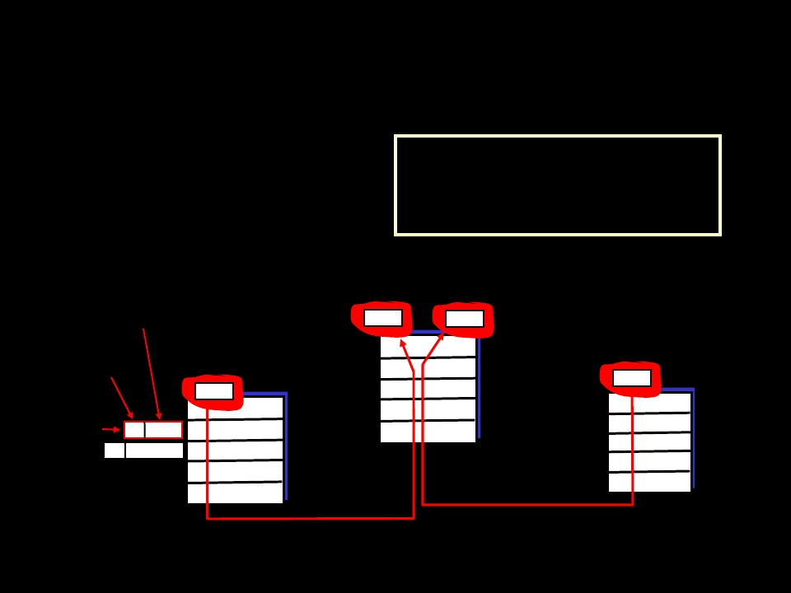
Multiplexing / demultiplexing
Recall: segment - unit of data
exchanged between
transport layer entities
– aka TPDU: transport
Demultiplexing: delivering
received segments to
correct app layer processes
protocol data unit
application-layer
data
segment
M
application
Ht M
Hnsegment network
receiver
M M
application
transport
network
P3
P4
P1
P2
header
M
application
transport
network
segment
transport

Slide 6
Multiplexing / demultiplexing
Multiplexing:
gathering data from multiple
app processes, enveloping
data with header (later used
for demultiplexing)
multiplexing/demultiplexing:
• based on sender, receiver
port numbers, IP
addresses
– source, dest port #s in
each segment
– recall: well-known port
numbers for specific
applications
32 bits
TCP/UDP segment format
sourceport# | destport#
otherheaderfields
application data (message)

Slide 7
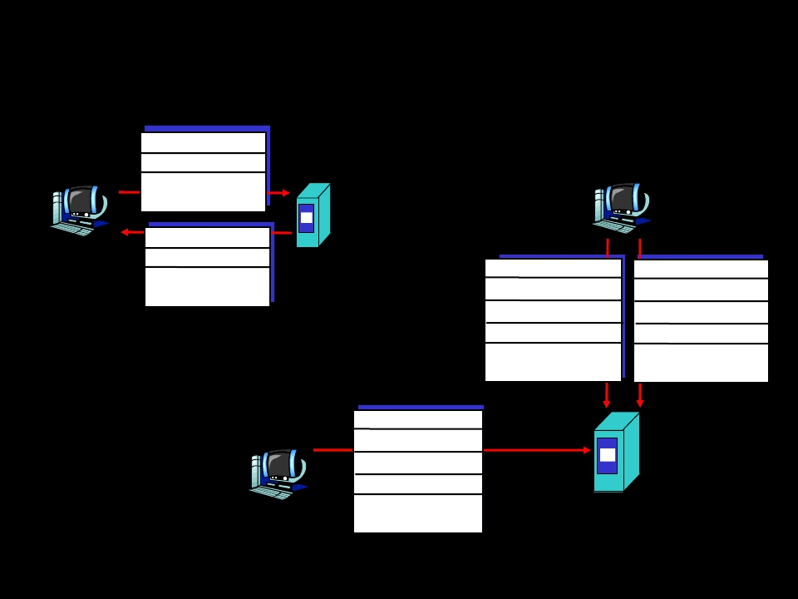
Multiplexing/demultiplexing:
examples
source port: x
dest. port: 23
Web client
host C
host A
server B
source port:23
dest. port: x
port use: simple telnet app
Web client
host A
Source IP: C
Dest IP: B
source port: y
dest. port: 80
Source IP: C
Dest IP: B
source port: x
dest. port: 80
Web
server B
Source IP: A
Dest IP: B
source port: x
dest. port: 80
port use: Web server

Slide 8
UDP

Slide 9
UDP: User Datagram Protocol
[RFC 768]
Why is there a UDP?
•
•
•
•
•
•
•
no connection establishment (which can add delay)
simple: no connection state at sender, receiver
small segment header
no congestion control: UDP can blast away as fast as desired.
– May not be a good idea, though!
Often used for streaming multimedia applications
– loss tolerant
– rate sensitive
Other UDP uses (why?):
– DNS
– SNMP
Reliable transfer over UDP: add reliability at application layer
– application-specific error recovery!

Slide 10
UDP: more
32 bits
sourceport# | destport#
length | checksum
Application data (message)
Length, in
bytes of UDP
segment,
including
header
UDP segment format

Slide 11
Error Detection and Correction
• Single bit-errors vs Burst Errors
110101 → 100101 vs 100001
• n-bit codeword = m message bits + r check bits
• Hamming Distance = # of different bits
1010101
1001010
0011111 ⇒Hamming distance = 5
• Distance d code = minimum Hamming distance
between any two code words written in the code
• To detect d-bit errors, distance d+1 code required
• To correct d-bit errors, distance 2d+1 code required

Slide 12
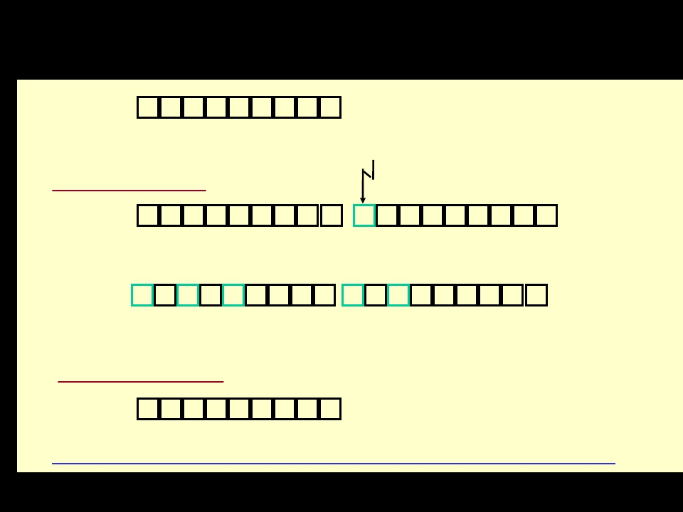
Parity Checks
10111010
1 2 3 4 5 6 7 8 9
Odd Parity
10111010 0 00111010 0
1 2 3 4 5 6 7 89 1 2 3 4 5 6 7 89
1-bit error
00010010 0 00011010 0
1 2 3 4 5 6 7 89 1 2 3 4 5 6 7 89
3-bit error 2-bit error
Even Parity
10111011 0
1 2 3 4 5 6 7 89
Parity is a distance 2 code => can detect 1-bit errors

Slide 13
UDP checksum
Goal: detect “errors” (e.g., flipped bits) in
transmitted segment
Sender:
• treat segment contents as sequence of 16-
bit integers
• checksum: addition (1’s complement sum)
of segment contents
• sender puts checksum value into UDP
checksum field
• In reality some IP header fields are
included with the UDP segment for
checksumming.

Slide 14
UDP checksum
Receiver:
• compute checksum of received segment
• check if computed checksum equals
checksum field value:
– NO - error detected
– YES - no error detected.
• But maybe errors nonetheless?
• More in chap 5 on stronger error
detection methods

Slide 15
UDP Checksum Example
• Consider three 16-bit words:
0110011001100110
0101010101010101
0000111100001111
• (1’s complement) sum of first two 16-bit words is:
1011101110111011
• Adding the third word to the above sum gives:
1100101011001010
• 1’s complement of this sum => invert 0’s and 1’s
0011010100110101 (this is the checksum field)
• If no errors, sum of all four 16-bit words (incl.
Checksum) will be all 1s, I.e., 1111111111111111

Slide 16
TCP

Slide 17
TCP: Overview
• Point-to-point:
– one sender, one receiver
• Reliable, in-order byte stream:
– no “message boundaries”
– But TCP chops it up into segments for
transmission internally
• Pipelined (window) flow control:
– Window size decided by receiver and
network
• Send & receive buffers

Slide 18
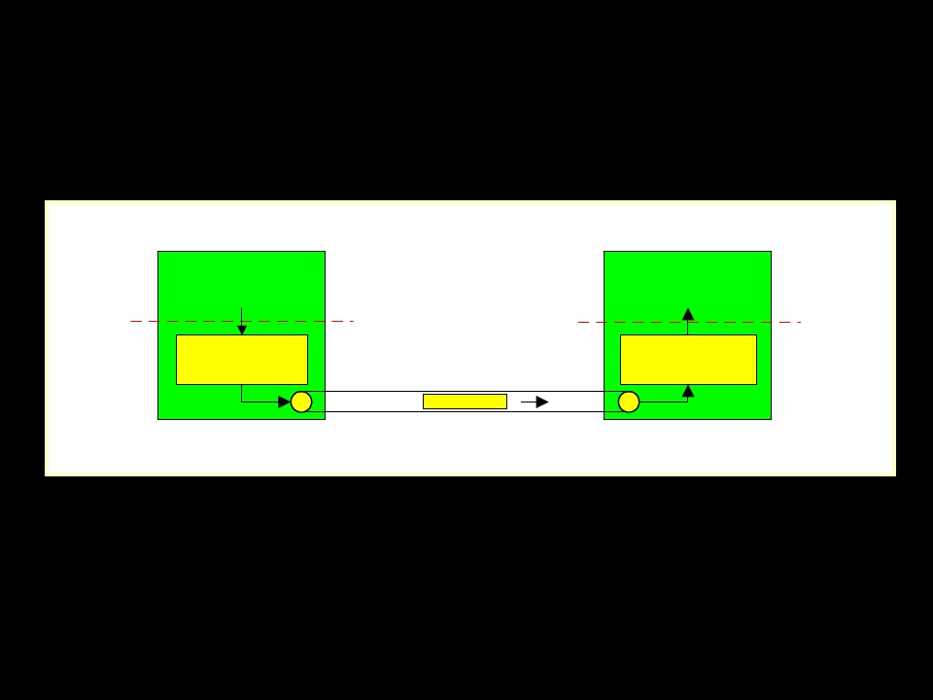
TCP: Overview
a p p lic a tio n
a p p lic a tio n
socket
door
w rite s d a ta
TCP
s e n d b u ffe r
re a d s d a ta
TC P
re c e iv e b u ffe r
socket
door
segm ent

Slide 19
TCP: Overview
• Full duplex data:
– bi-directional data flow in same connection
– MSS: maximum segment size
• Connection-oriented:
– handshaking (exchange of control msgs)
init’s sender, receiver state before data
exchange
• Flow & Congestion Control:
– sender will not overwhelm receiver or the
network

Slide 20
TCP segment structure
32 bits
URG: urgent data
(generally not used)
ACK: ACK #
valid
PSH: push data now
(generally not used)
RST, SYN, FIN:
connection estab
(setup, teardown
commands)
Internet
checksum
(as in UDP)
sourceport# |  |  |  |  |  |  |  | destport#
sequencenumber
acknowledgementnumber
head len | not used | U | A | P | R | S | F | rcvrwindowsize
checksum |  |  |  |  |  |  |  | ptrurgentdata
Options(variablelength)
application data (variablelength)
counting
by bytes
of data
(not segments!)
# bytes
rcvr willing
to accept

Slide 21
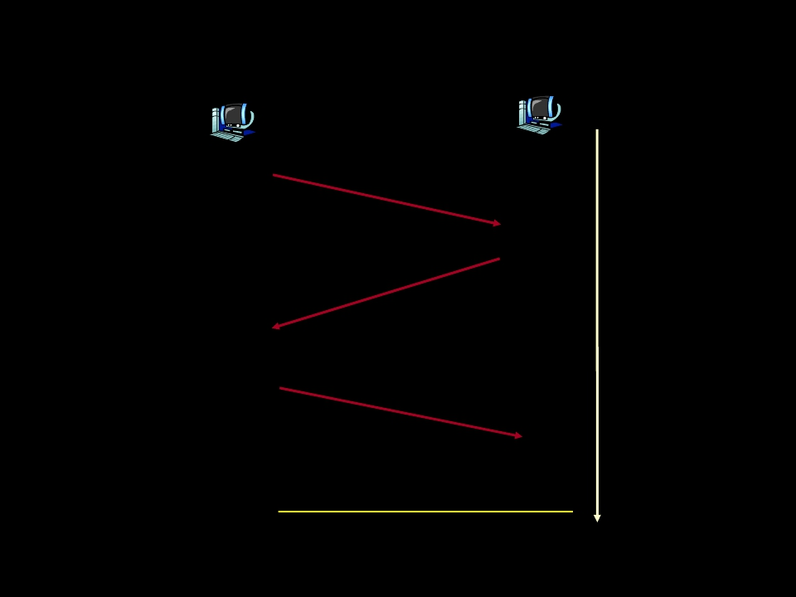
TCP Seq. #’s and ACKs (II)
Host A
Host B
User
types
‘C’
Seq=42
, ACK
=79, da
ta= ‘C
’
host ACKs
receipt of
C’ ‘C’, echoes
back ‘C’
3, da
ta = ‘
q=79, A
CK=4
Se
host ACKs
receipt
of echoed
‘C’
Seq=43
, ACK
=80
simple telnet scenario

Slide 22
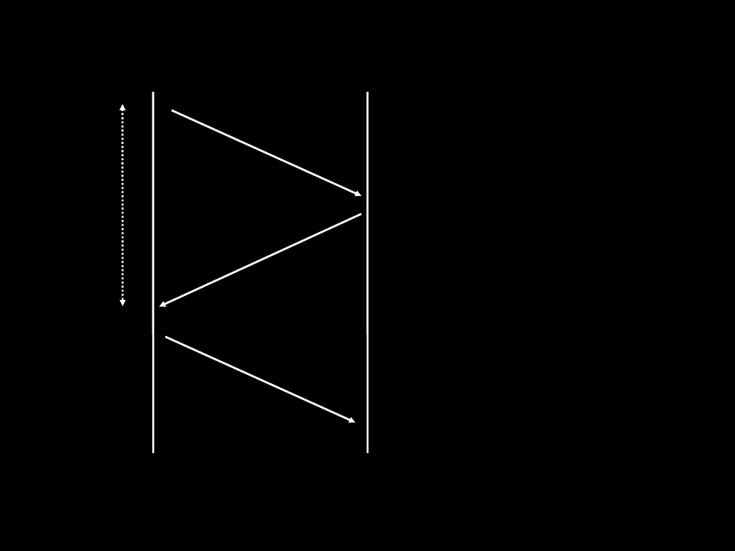
Temporal Redundancy Model
Packets
• Sequence Numbers
• CRC or Checksum
Timeout
• ACKs
• NAKs,
Status Reports
• SACKs
Retransmissions
• Packets
• FEC information

Slide 23
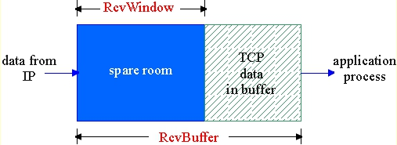
TCP Flow Control
flow control
sender won’t overrun
receiver’s buffers by
transmitting too much,
too fast
RcvBuffer = size or TCP Receive Buffer
RcvWindow = amount of spare room in Buffer
receiver buffering
receiver: explicitly
informs sender of
free buffer space
– RcvWindow
field in TCP
segment
sender: keeps the
amount of
transmitted,
unACKed data less
than most recently
received
RcvWindow

Slide 24
TCP Connection Management - 1
Recall: TCP sender, receiver establish
connection before exchanging data segments
• initialize TCP variables:
– seq. #s
– buffers, flow control info (e.g. RcvWindow)
• client: connection initiator
Socket clientSocket = new Socket("hostname","port
number");
• server: contacted by client
Socket connectionSocket = welcomeSocket.accept();

Slide 25
TCP Connection Management - 2
Three way handshake:
Step 1: client end system sends TCP SYN
control segment to server
– specifies initial seq #
Step 2: server end system receives SYN,
replies with SYNACK control segment
– ACKs received SYN
– allocates buffers
– specifies server-> receiver initial seq. #

Slide 26
TCP Connection Management - 3
Closing a connection:
client closes socket: clientSocket.close();
Step 1: client end system sends TCP
FIN control segment to server
Step 2: server receives FIN, replies with
ACK. Closes connection, sends FIN.

Slide 27
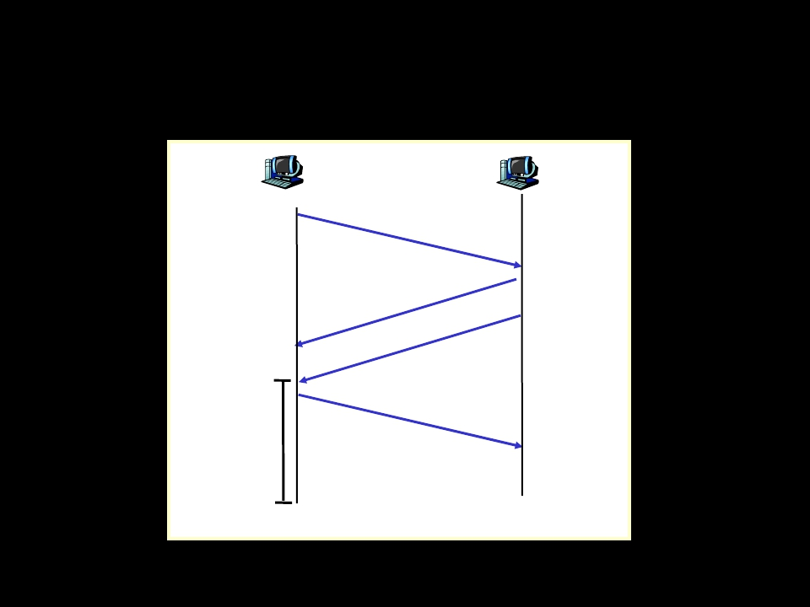
TCP Connection Management - 4
Fddfdf
close
closed
d
client
server
FIN
ACK
FIN
ACK
close
timed wait

Slide 28
TCP Connection Management - 5
Step 3: client receives FIN, replies with ACK.
– Enters “timed wait” - will respond with
ACK to received FINs
Step 4: server, receives ACK.
Connection
closed.
Note: with small modification, can handle
simultaneous FINs.

Slide 29
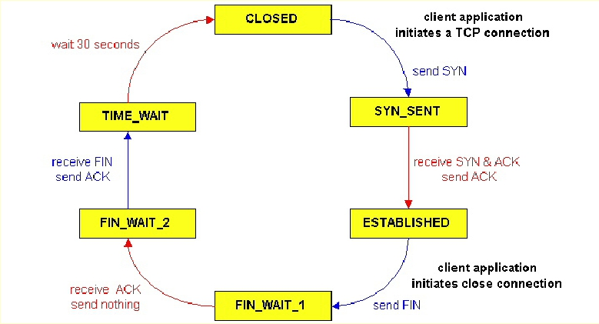
TCP Connection Management - 6
TCP client lifecycle

Slide 30
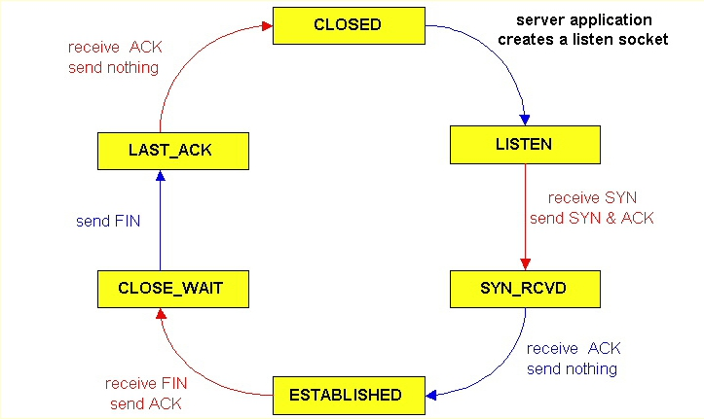
TCP Connection Management - 7
TCP server lifecycle

Slide 31
Principles of Congestion Control
Congestion:
• informally: “too many sources sending too
much data too fast for network to handle”
• different from flow control (receiver overload)!
• manifestations:
– lost packets (buffer overflow at routers)
– long delays (queuing in router buffers)
• a top-10 problem!

Slide 32
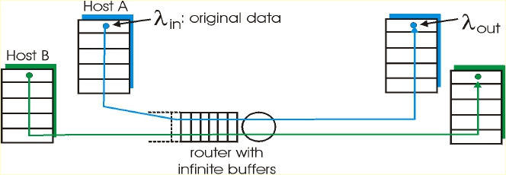
Causes/costs of congestion:
scenario 1
• two senders, two receivers
• one router, infinite buffers
• no retransmission
• large delays when congested
• maximum achievable throughput (rate at which
information is delivered) <=> bandwidth capacity

Slide 33
One more option.....
“SCTP”
• Stream Control Transmission Protocol (SCTP)
– Multi-streaming / multihoming
– Ensures reliable transmission
– in-sequence transport of messages
– Provides congestion control.
• SCTP packets have a simpler basic structure
than TCP or UDP packets. Consists of two
basic sections:
– 1. The common header, which occupies the first 12
bytes and
– 2. The data chunks, which occupy the remaining
portion of the packet.

Slide 34
SCTP.......
• Multihoming :
– A network must have its own public IP address
range and AS (Autonomous system (Internet))
number. Then a connection to two (or more)
separate ISPs is established. The routing over
these connections is normally controlled by a
BGP enabled router.
– In the case where one outgoing link from the
multihomed network fails, outgoing traffic will
automatically be routed via one of the remaining
links. More importantly, other networks will be
notified.
• Autonomous System (AS) is a collection of connected
Internet Protocol (IP) routing prefixes under the control of
one or more network operators that presents a common,
clearly defined routing policy to the Internet

Slide 35
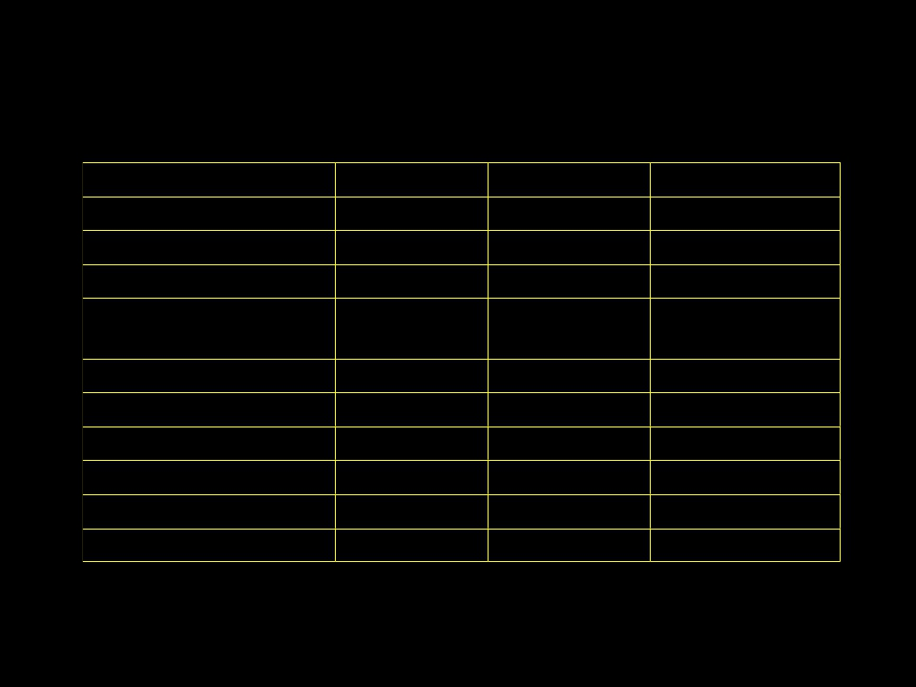
Comparison...
Feature
Connection oriented
Reliable transport
Unreliable transport
Preserve message
UDP
No
No
Yes
Yes
TCP
Yes
Yes
No
No
SCTP
Yes
Yes
Yes
Yes
boundary
Ordered delivery
Data checksum
Checksum size (bits)
Congestion Control
Multiple streams
Multihoming support
Yes
Yes
16
No
No
No
No
Yes
16
Yes
No
No
Yes
Yes
32
Yes
Yes
Yes

Slide 36
Summary
•
Principles behind transport layer services:
• multiplexing/demultiplexing
• reliable data transfer
• flow control
• congestion control
• Instantiation and implementation in the
Internet
• UDP, TCP,SCTP

Slide 37
Socket Programming

Slide 38
Network Applications -Inferences
Client 1
Client 2
Client n
Server

Slide 39
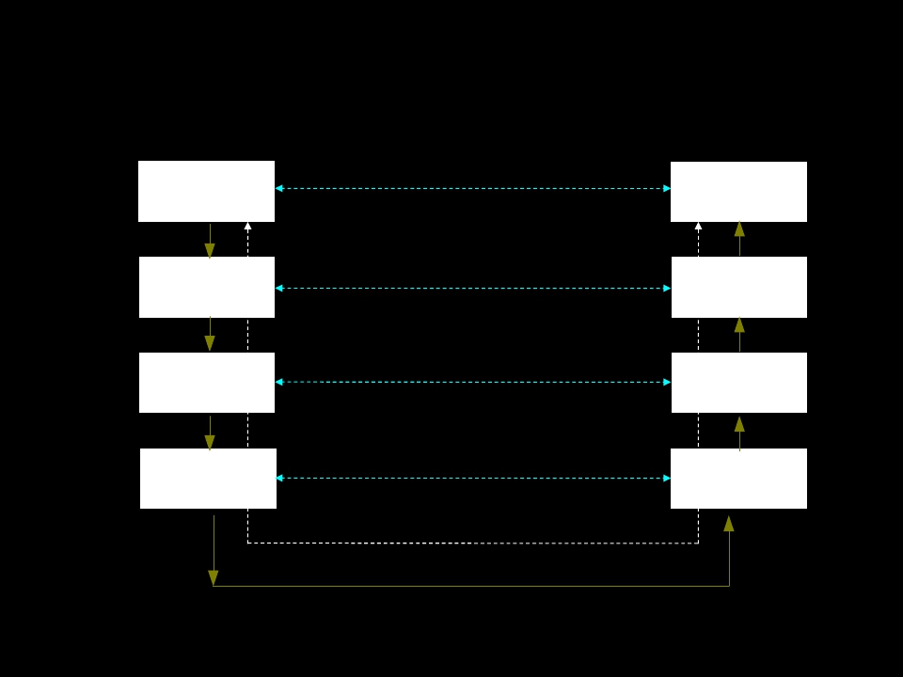
Client & Server Communications
User
Process
Web
Client
TCP
Application Protocol
TCP Protocol
Web
Server
TCP
Within
Kernel
IP Protocol
Ethernet Protocol
IP
Ethernet
Driver
IP
Ethernet
Driver
Actual Flow between Client &
Server
Ethernet

Slide 40
OSI vs TCP/IP
Application
details
Application
Presentation
Session
User
process
Application
Transport
Network
Datalink
Physical
TCP SCTP UDP
IPv4, IPv6
Device Driver &
Hardware
Socket
Kernel
Communication
Details

Slide 41
The Problem Statement???????
►
How does data reach my application
correctly??????
The Solution -Sockets

Slide 42
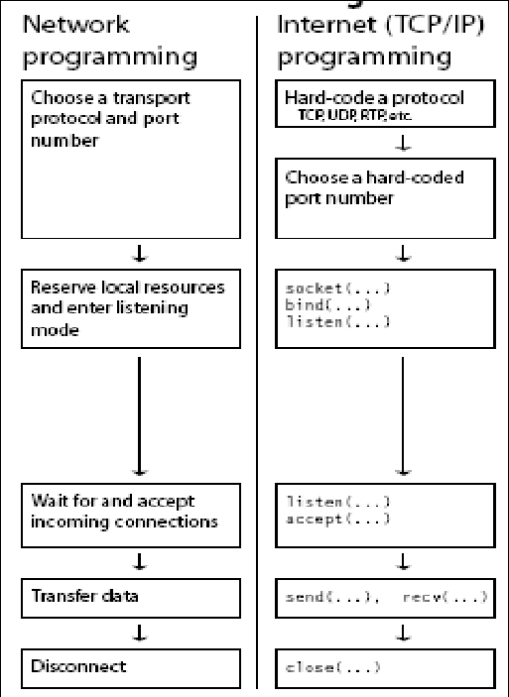
Steps
and
Commands

Slide 43
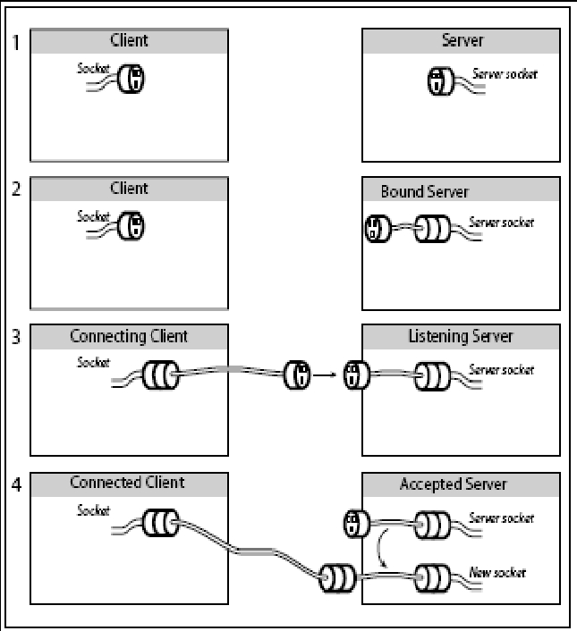
Conceptual
illustration of
steps needed to
obtain a
connected socket

Slide 44
Socket Address Structures
►
►
Most socket functions require a pointer to a socket
address structure as an argument. Each supported
protocol suite defines its own socket address
structure.
The names of these structures begin with sockaddr_
and end with a unique suffix for each protocol suite.

Slide 45
The internet IPv4 socket address
structure
struct in_addr
{
in_addr_t s_addr;
/* 32-bit IPv4 address */
/*network byte ordered */
};
struct sockaddr_in
{
uint8_t sin_len;
/* length of structure (16) */
sa_family_t sin_family; /* AF_INET */
in_port_t sin_port;
number */
/* 16-bit TCP or UDP port
/* network byte ordered */
struct in_addr sin_addr;
/* 32-bit IPv4 address */
/* network byte ordered */
char sin_zero[8];
/* unused */
};

Slide 46
Generic socket address structure
struct sockaddr
{
uint8_t sa_len;
sa_family_t sa_family; /* address family:
AF_xxx value */
char sa_data[14];
address */
/* protocol-specific
};

Slide 47
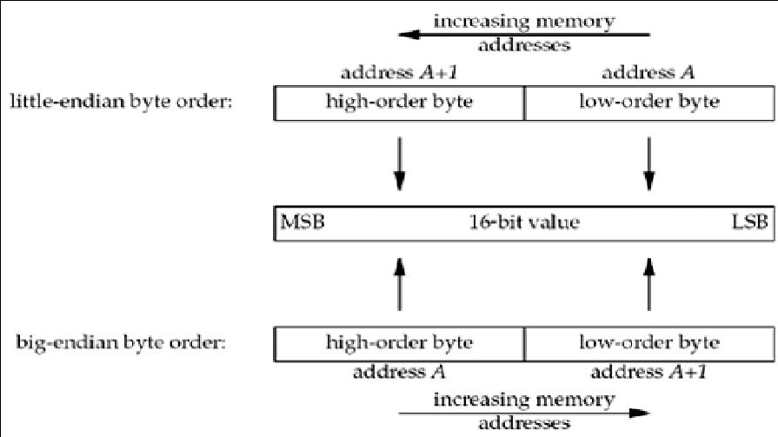
Byte Ordering Functions

Slide 48
Byte Ordering Functions
►
►
#include <netinet/in.h>
uint16_t htons(uint16_t host16bitvalue);
► uint32_t htonl(uint32_t host32bitvalue) ;
♣ Both return: value in network byte order
►
uint16_t ntohs(uint16_t net16bitvalue) ;
► uint32_t ntohl(uint32_t net32bitvalue) ;
♣ Both return: value in host byte order

Slide 49
Byte Manipulation Functions
►#include
<strings.h>
►
►
►
void bzero(void *dest, size_t nbytes);
void bcopy(const void *src, void *dest, size_t nbytes);
int bcmp(const void *ptr1, const void *ptr2, size_t
nbytes);
♣ Returns: 0 if equal, nonzero if unequal

Slide 50
Data Type Manipulations
►
#include <arpa/inet.h>
► int inet_aton(const char *strptr, struct in_addr
*addrptr);
♣ Returns: 1 if string was valid, 0 on error
► in_addr_t inet_addr(const char *strptr);
♣ Returns: 32-bit binary network byte ordered IPv4
address; INADDR_NONE if error
► char *inet_ntoa(struct in_addr inaddr);
♣ Returns: pointer to dotted-decimal string

Slide 51
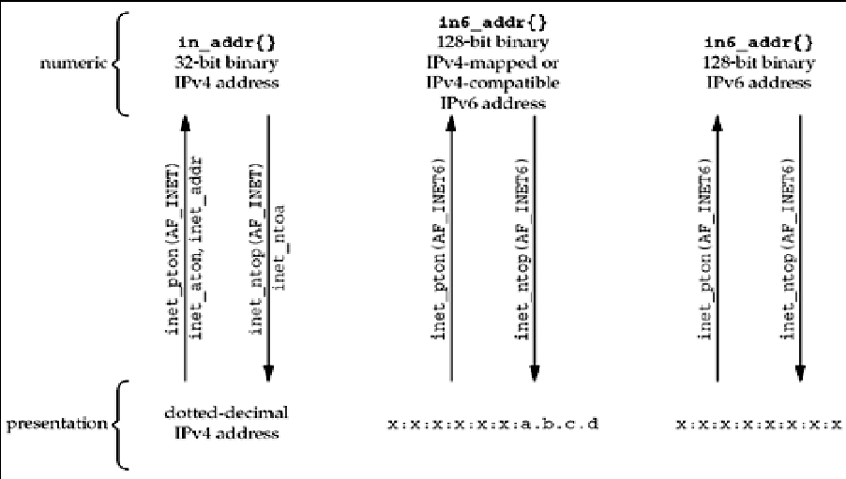
Data Type Manipulations

Slide 52
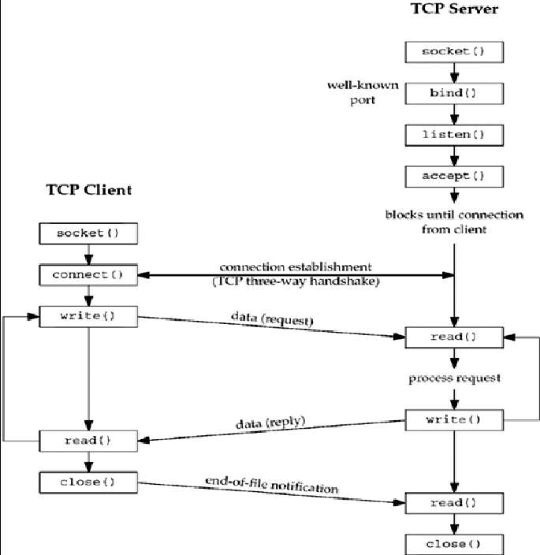
S
O
C
K
E
T
S

Slide 53
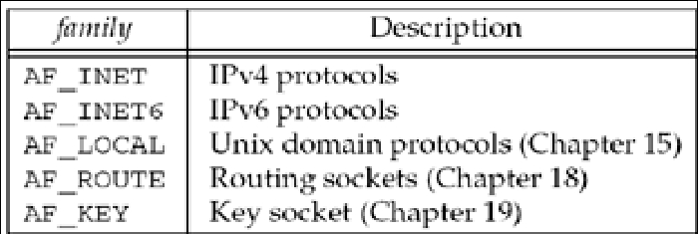
socket Function
►#include
<sys/socket.h>
►int socket (int family, int type, int
protocol);
♣ Returns: non-negative descriptor if OK, -1 on
error
family

Slide 54
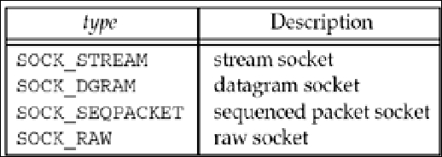
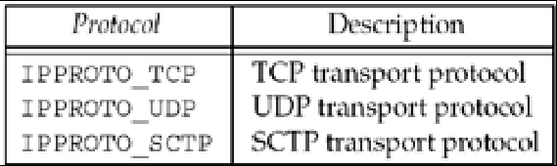
socket Function
Type field for socket
function
Protocol field for socket
function

Slide 55
connect function
►
#include <sys/socket.h>
► int connect(int sockfd, const struct sockaddr
*servaddr, socklen_t addrlen);
♣ Returns: 0 if OK, -1 on error
bind function
►#include
<sys/socket.h>
►int
bind (int sockfd, const struct sockaddr
*myaddr, socklen_t addrlen);
♣ Returns: 0 if OK,-1 on error

Slide 56
listen function
►
The listen function is called only by a TCP server and
it performs two actions:
♣ When a socket is created by the socket function, it
is assumed to be an active socket, that is, a client
socket that will issue a connect.
♣ The listen function converts an unconnected
socket into a passive socket, indicating that the
kernel should accept incoming connection
requests directed to this socket. In terms of the
TCP state transition diagram, the call to listen
moves the socket from the CLOSED state to the
LISTEN state.
► The second argument to this function specifies the
maximum number of connections the kernel should
queue for this socket.

Slide 57
listen function
►#include
<sys/socket.h>
►#int listen (int sockfd, int backlog);
♣ Returns: 0 if OK, -1 on error

Slide 58
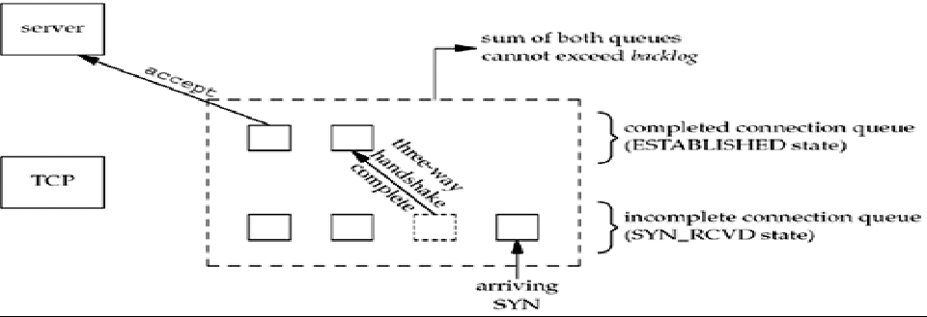
listen function
►
To understand the backlog argument, we must realize that for
a given listening socket, the kernel maintains two queues:
♣ An incomplete connection queue, which contains an entry for
each SYN that has arrived from a client for which the server is
awaiting completion of the TCP three-way handshake. These
sockets are in the SYN_RCVD state
♣ A completed connection queue, which contains an entry for each
client with whom the TCP three-way handshake has completed.
These sockets are in the ESTABLISHED state

Slide 59
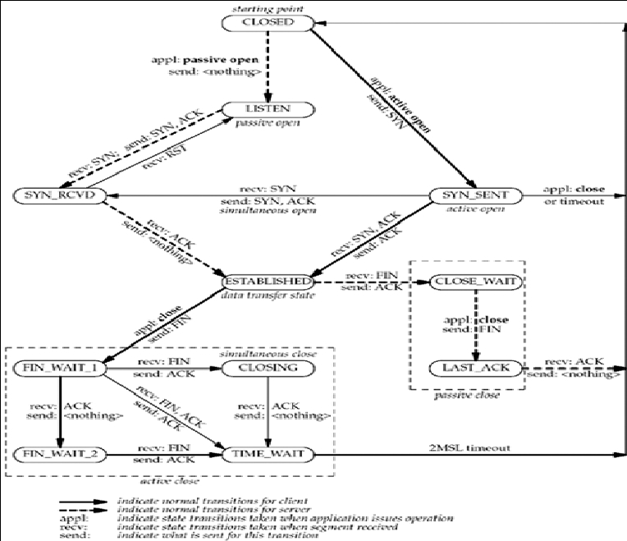
TCP State Transition Diagram

Slide 60
accept function
►
Accept is called by a TCP server to return the next
completed connection from the front of the completed
connection queue. If the completed connection queue
is empty, the process is put to sleep
►
#include <sys/socket.h>
► int accept (int sockfd, struct sockaddr *cliaddr,
socklen_t *addrlen);
Returns: non-negative descriptor if OK, -1 on
error

Slide 61
accept function
If accept is successful, its return value is a brand-new
descriptor automatically created by the kernel. This
new descriptor refers to the TCP connection with the
client.
►
► When discussing accept, we call the first argument to
accept the listening socket, and we call the return
value from accept the connected socket.
► A given server normally creates only one listening
socket, which then exists for the lifetime of the server.
The kernel creates one connected socket for each
client connection that is accepted. When the server is
finished serving a given client, the connected socket
is closed.

Slide 62
Concurrent Servers
►
►
►
►
The server discussed so far is an iterative server.
For something as simple as a daytime server, this is fine.
But when a client request can take longer to service, we
do not want to tie up a single server with one client; we
want to handle multiple clients at the same time.
The simplest way to write a concurrent server under Unix
is to fork a child process to handle each client
When a connection is established, accept returns, the
server calls fork, and the child process services the client
(on connfd, the connected socket) and the parent process
waits for another connection (on listenfd, the listening
socket). The parent closes the connected socket since
the child handles the new client.

Slide 63
Thank U

