Slide 1
Data Link Layer
&
Physical Layer
Pranita S. Acharekar

Slide 2

Overview
Link Layer services
Error detection, correction
Multiple access protocols and LANs
Link Layer Addressing, ARP
Specific link layer technologies:
Ethernet
hubs, bridges, switches
IEEE 802.11 LANs
PPP
ATM

Slide 3
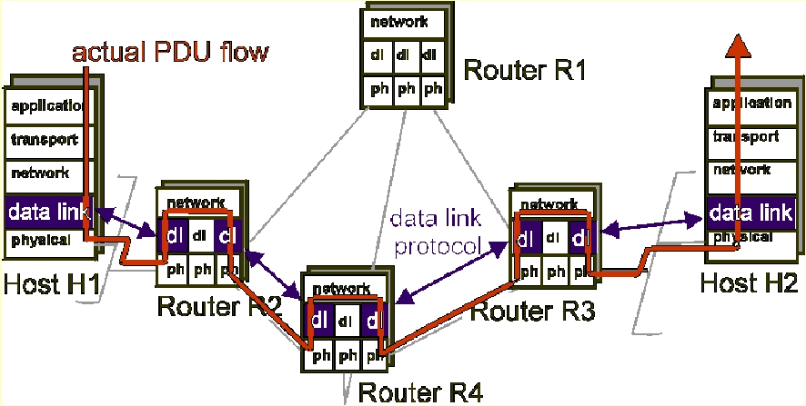
Link Layer: setting the context - 1

Slide 4
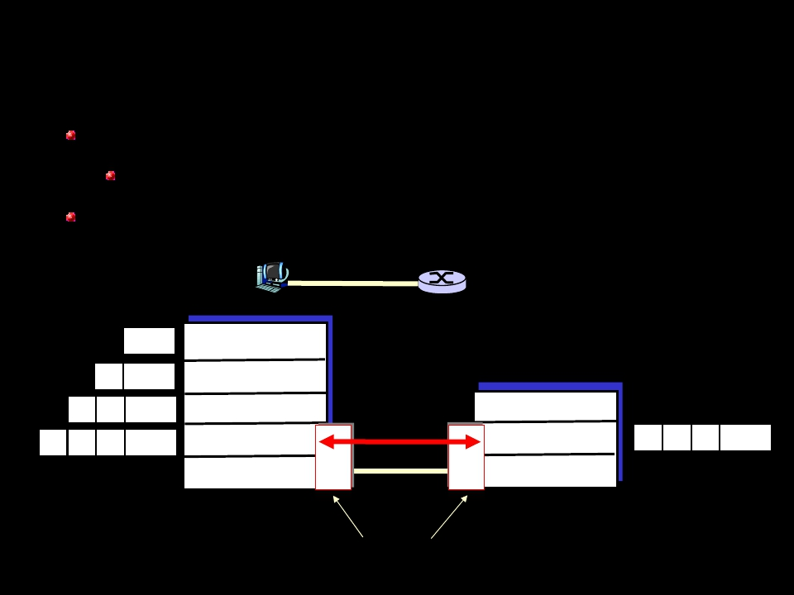
Link Layer: setting the context - 2
two physically connected devices:
host-router, router-router, host-host
unit of data: frame
M
application
Ht
HnHt
Hl HnHt
M
M
M
transport
network
link
physical
data link
protocol
network
link
physical
Hl HnHt M
frame
phys. link
adapter card

Slide 5
Link Layer Services - 1
Framing, link access:
encapsulate datagram into frame, adding
header, trailer
implement channel access if shared
medium,
‘physical addresses’ used in frame
headers to identify source, destination
different from IP address!

Slide 6
Link Layer Services - 2
Flow Control:
pacing between sender and receivers
Error Detection:
errors caused by signal attenuation,
noise.
receiver detects presence of errors:
signals sender for retransmission or
drops frame
Error Correction:
receiver identifies and corrects bit
error(s) without resorting to
retransmission

Slide 7
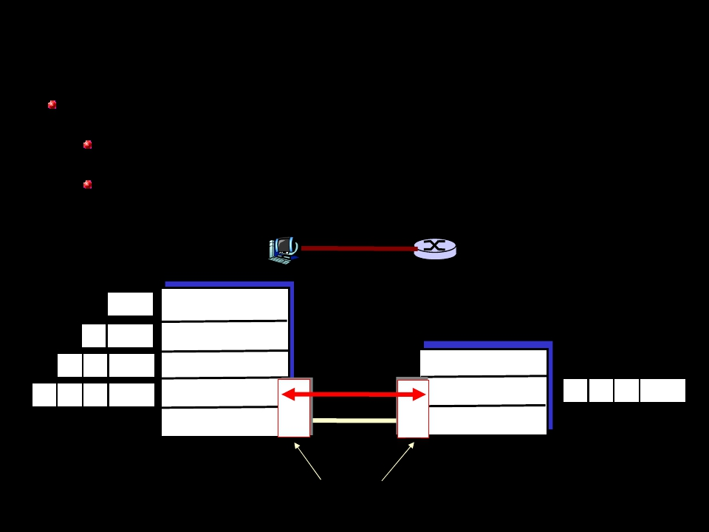
Link Layer: Implementation
Implemented in “adapter”
e.g., PCMCIA card, Ethernet card
typically includes: RAM, DSP chips,
host bus interface, and link interface
M
application
Ht
HnHt
Hl HnHt
M
M
M
transport
network
link
physical
data link
protocol
phys. link
network
link
physical
Hl HnHt M
frame
adapter card

Slide 8
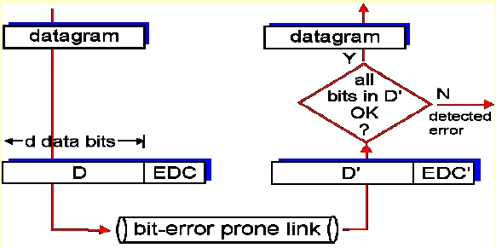
Error Detection - 1
EDC= Error Detection and Correction bits
D = Data protected by error checking, may
include header fields
•
Error detection not 100% reliable!
•
•
protocol may miss some errors, but rarely
larger EDC field yields better detection and
correction

Slide 9
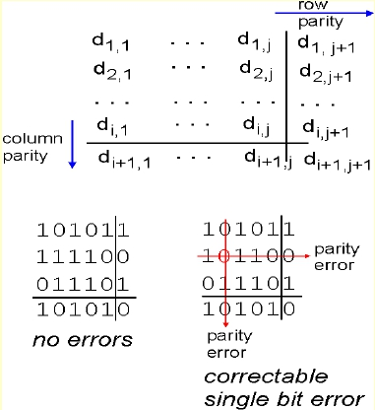

Parity Checking
Single Bit Parity:
Detect single bit
errors
Two Dimensional Bit Parity:
Detect and correct single bit errors
0
0

Slide 10
Internet checksum
Goal: detect “errors” (e.g., flipped bits) in transmitted
segment (note: used at transport layer only)
Sender:
treat segment contents
as sequence of 16-bit
integers
checksum: addition (1’s
complement sum) of
segment contents
sender puts checksum
value into UDP
checksum field
Receiver:
compute checksum of received
segment
check if computed checksum
equals checksum field value:
NO - error detected
YES - no error detected. But
maybe errors nonetheless?
More later….

Slide 11
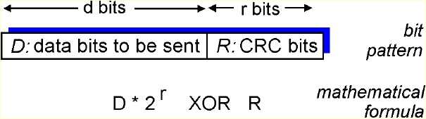
Checksumming:
Cyclic Redundancy Check
View data bits, D, as a binary number
Choose r+1 bit pattern (generator), G
Goal: choose r CRC bits, R, such that
<D,R> exactly divisible by G (modulo 2)
receiver knows G, divides <D,R> by G. If non-zero
remainder: error detected!
can detect all burst errors less than r+1 bits
Widely used in practice (ATM, HDCL)

Slide 12
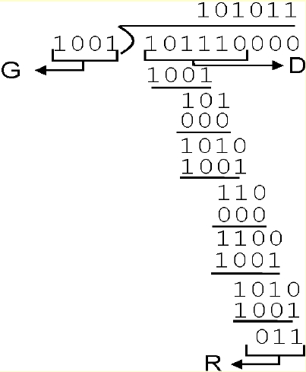
CRC Example
Want:
D.2r XOR R = nG
equivalently:
D.2r = nG XOR R
equivalently:
if we divide D.2r
by G, want
reminder R
R = remainder[
D.2r
G
]

Slide 13
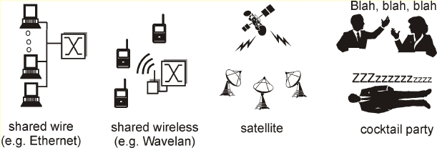
Multiple Access Links and Protocols
Three types of “links”:
Point-to-point (single wire, e.g. PPP, SLIP)
Broadcast (shared wire or medium; e.g,
Ethernet, Wavelan, etc.)
Switched (e.g., switched Ethernet, ATM etc)

Slide 14
Multiple Access protocols - 1
single shared communication channel
two or more simultaneous transmissions by nodes:
interference
only one node can send successfully at a time
multiple access protocol:
distributed algorithm that determines how stations share
channel, i.e., determine when station can transmit
communication about channel sharing must use channel
itself!
What to look for in multiple access protocols:
synchronous or asynchronous
information needed about other stations
robustness (e.g., to channel errors)
performance

Slide 15
MAC Protocols: a taxonomy
Three broad classes:
Channel Partitioning
divide channel into smaller “pieces” (time
slots, frequency)
allocate piece to node for exclusive use
Random Access
allow collisions
“recover” from collisions
“Taking turns”
tightly coordinate shared access to avoid
collisions
Goal: efficient, fair, simple, decentralized

Slide 16

Channel Partitioning
MAC protocols: TDMA - 1
TDMA: time division multiple access
Access to channel in "rounds"
Each station gets fixed length slot (length =
packet transmission time) in each round
Unused slots go idle
Example: 6-station LAN, 1,3,4 have packet,
slots 2,5,6 idle
TDM (Time Division Multiplexing): channel
divided into N time slots, one per user;
inefficient with low duty cycle users and at
light load.

Slide 17
Channel Partitioning
MAC protocols: FDMA
FDMA: frequency division multiple access
Channel spectrum divided into frequency bands
Each station assigned fixed frequency band
Unused transmission time in frequency bands go
idle
Example: 6-station LAN, 1,3,4 have packet,
frequency bands 2,5,6 idle
time
frequency bands

Slide 18
Channel Partitioning
CDMA (Code Division Multiple Access)
Unique “code” assigned to each user; ie, code set
partitioning
Used mostly in wireless broadcast channels
(cellular, satellite, etc)
All users share same frequency, but each user has
own “chipping” sequence (ie, code) to encode data
Encoded signal = (original data) X (chipping
sequence)
Decoding: inner-product of encoded signal and
chipping sequence
allows multiple users to “coexist” and transmit
simultaneously with minimal interference (if codes
are “orthogonal”)

Slide 19
Random Access Protocols
When node has packet to send
transmit at full channel data rate R.
no a priori coordination among nodes
Two or more transmitting nodes ->
“collision”,
Random access MAC protocol specifies:
how to detect collisions
how to recover from collisions (e.g., via
delayed retransmissions)
Examples of random access MAC protocols:
ALOHA
slotted ALOHA
CSMA and CSMA/CD

Slide 20
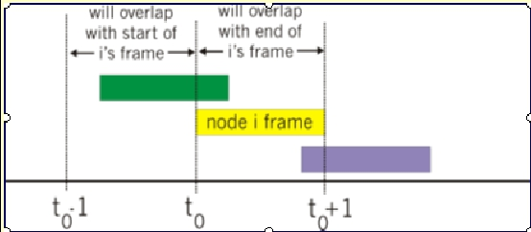
Pure (unslotted) ALOHA - 1
Unslotted Aloha: simpler, no
synchronization
packet needs transmission:
send without awaiting for beginning of
slot
Collision probability increases:
packet sent at t0 collide with other
packets sent in [t0-1, t0+1]

Slide 21
Pure (unslotted) ALOHA - 2
P(success by given node) = P(node transmits) .
P(no other node transmits in [p0-1,p0] .
P(no other node transmits in [p0-1,p0]
= p .(1-p)(N-1) .(1-p)(N-1)
P(success by any of N nodes) = N p .(1-p)(N-1) .
(1-p)(N-1)
… choosing optimum p as n -> infty ...
= 1/(2e) = .18

Slide 22
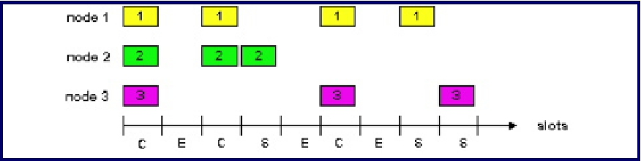
Slotted Aloha
time is divided into equal size slots (= pkt
trans. time)
node with new arriving pkt: transmit at
beginning of next slot
if collision: retransmit pkt in future slots
with probability p, until successful.
Success (S), Collision (C), Empty (E) slots

Slide 23
Slotted Aloha Efficiency
Q: What is max fraction slots successful?
A: Suppose N stations have packets to send
each transmits in slot with probability p
prob. successful transmission S is:
by single node:
by any of N nodes
S= p (1-p)(N-1)
S = Prob (only one transmits)
= N p (1-p)(N-1)
… choosing optimum p as n -> infty ...
= 1/e = .37 as N -> infty
At best:
channel
use for useful
transmissions
37% of time!

Slide 24
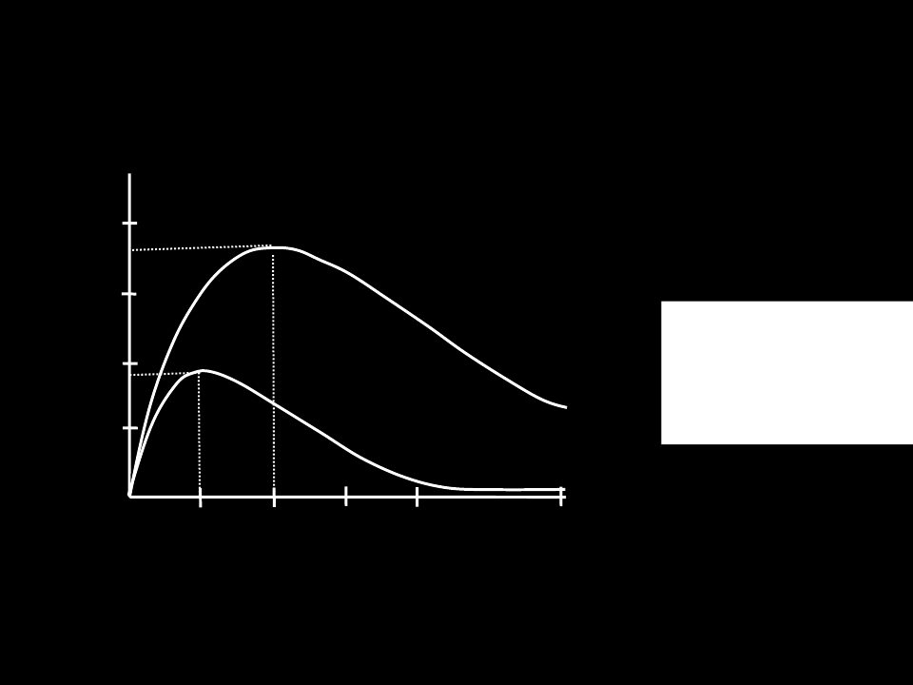
Performance Comparison
0.4
0.3
Slotted Aloha
protocol constrains
effective channel
0.2
S = throughput = “goodput”
(success rate)
throughput!
0.1
Pure Aloha
0.5
1.0
1.5
2.0
G = offered load = Np

Slide 25
Carrier Sense Multiple Access
(CSMA) - 1
In some shorter distance networks, it is
possible to listen to the channel before
transmitting
In radio networks, this is called “ sensing
the carrier”
The CSMA protocol works just like Aloha
except: If the channel is sensed busy,
then the user waits to transmit its packet,
and a collision is avoided
This really improves the performance in
short distance networks!

Slide 26
Carrier Sense Multiple Access
(CSMA) - 2
How long does a blocked user wait before trying again
to transmit its packet? Three basic variants:
1-persistent: Blocked user continuously senses
channel until its idle, then transmits
0-persistent: Blocked user waits a randomly chosen
amount of time before sensing channel again
P-persistent: Let T = end-to-end propagation delay
If channel is idle then transmit packet
If channel busy then toss coin [with P(heads) = P]
Heads: Transmit at first idle
Tails: wait until first idle plus T, sense, repeat
Human analogy: Don’t interrupt others

Slide 27
CSMA/CD (Collision Detection)
CSMA improves performance, but still it wastes
the channel during collisions
In some very short distance networks (e.g. coax
LANs), it is possible to listen while transmitting
(in addition to listening before transmitting)
If we detect a collision while transmitting, we can
abort the transmission and free up the channel
sooner
This idea was proposed by R. Metcalfe and
Boggs at Xerox PARC in the mid 1970s under the
name Ethernet.
Human analogy: the polite conversationalist

Slide 28
“Taking Turns” MAC protocols - 1
Channel partitioning MAC protocols:
share channel efficiently at high load
inefficient at low load: delay in channel
access, 1/N bandwidth allocated even if
only 1 active node!
Random access MAC protocols
efficient at low load: single node can fully
utilize channel
high load: collision overhead
“Taking turns” protocols
look for best of both worlds!

Slide 29
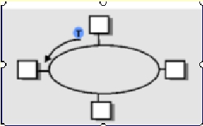
“Taking Turns” MAC protocols - 2
Polling:
Master node “invites”
slave nodes to
transmit in turn
Request to Send,
Clear to Send
messages
Concerns:
polling overhead
latency
single point of
failure (master)
Token passing:
Control token passed from one
node to next sequentially.
Token message
Concerns:
token overhead
latency
single point of failure (token)

Slide 30
Summary of MAC protocols
What do you do with a shared media?
Channel Partitioning: time, frequency or code
Time Division,Code Division, Frequency
Division
Random partitioning (dynamic),
ALOHA, S-ALOHA, CSMA, CSMA/CD
carrier sensing: easy in some technologies
(wire), hard in others (wireless)
CSMA/CD used in Ethernet
Taking Turns
polling from a central cite, token passing

Slide 31
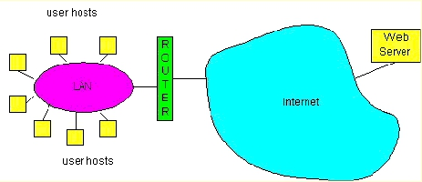
LAN technologies
Data link layer so far:
services, error detection/correction,
multiple access
Next: LAN technologies
addressing
Ethernet
hubs, bridges, switches
802.11
PPP
ATM

Slide 32
LAN Addresses and ARP - 1
32-bit IP address:
network-layer address
used to get datagram to destination
network (recall IP network definition)
LAN (or MAC or physical) address:
used to get datagram from one interface to
another physically-connected interface
(same network)
48 bit MAC address (for most LANs)
burned in the adapter ROM

Slide 33
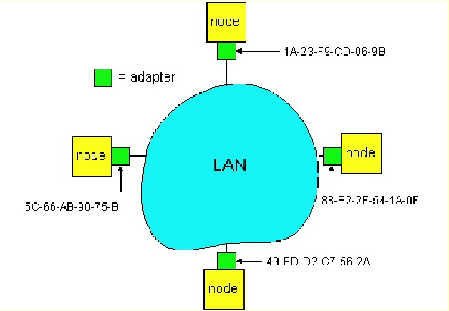
LAN Addresses and ARP - 2
Each adapter on LAN has unique LAN address

Slide 34
LAN Address (more)
MAC address allocation administered by IEEE
manufacturer buys portion of MAC address
space (to assure uniqueness)
Analogy:
(a) MAC address: like Social Security
Number
(b) IP address: like postal address
MAC flat address => portability
can move LAN card from one LAN to another
IP hierarchical address NOT portable
depends on network to which one attaches

Slide 35
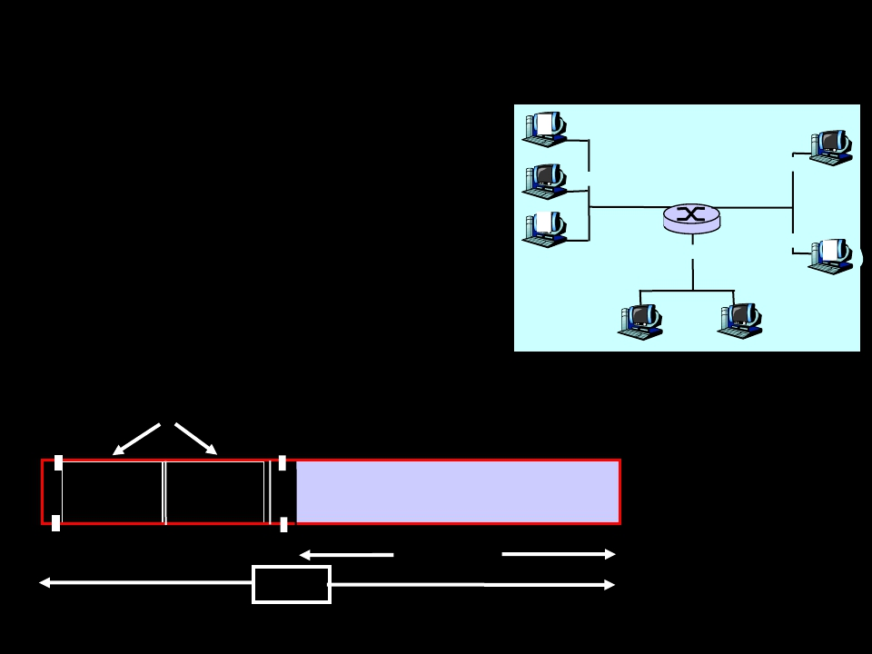
Recall earlier routing discussion
Starting at A, given IP
datagram addressed to B:
• look up net. address of B,
find B on same net. as A
A
B
223.1.1.1
223.1.2.1
223.1.1.2
223.1.1.4 223.1.2.9
223.1.2.2
223.1.1.3 223.1.3.27
E
• link layer send datagram to
B inside link-layer frame
frame source,
datagram source,
dest address
dest address
223.1.3.1
223.1.3.2
B’s MAC A’s MAC
addr addr
A’s IP
addr
B’s IP
addr
IP payload
datagram
frame

Slide 36
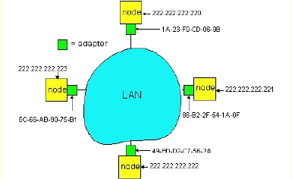
ARP: Address Resolution Protocol
Question: how to
determine
MAC address of B
given B’s IP address?
Each IP node (Host, Router)
on LAN has ARP module,
table
ARP Table: IP/MAC address
mappings for some LAN
nodes
< IP address; MAC address; TTL>
< ………………………….. >
TTL (Time To Live): time after
which address mapping will be
forgotten (typically 20 min)

Slide 37
ARP protocol
A knows B's IP address, wants to learn
physical address of B
A broadcasts ARP query pkt, containing B's
IP address
all machines on LAN receive ARP query
B receives ARP packet, replies to A with its
(B's) physical layer address
A caches (saves) IP-to-physical address
pairs until information becomes old (times
out)
soft state: information that times out
(goes away) unless refreshed

Slide 38
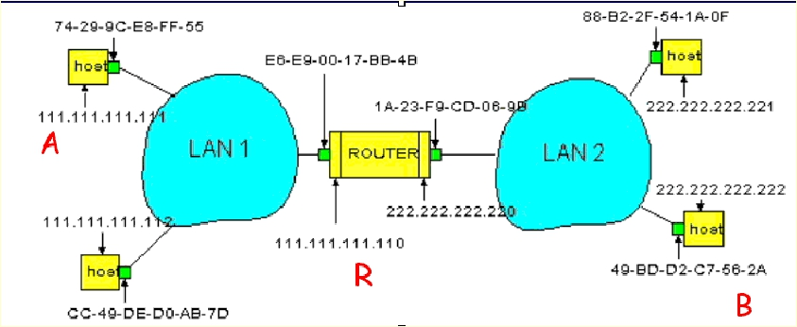
Routing to another LAN - 1
Walkthrough: routing from A to B via R

Slide 39
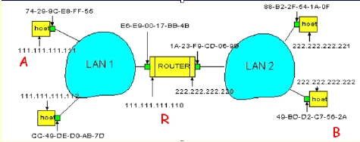
Routing to another LAN - 2
A creates IP packet with source A, destination B
A uses ARP to get R’s physical layer address for
111.111.111.110
A creates Ethernet frame with R's physical
address as dest, Ethernet frame contains A-to-B
IP datagram
A’s data link layer sends Ethernet frame

Slide 40
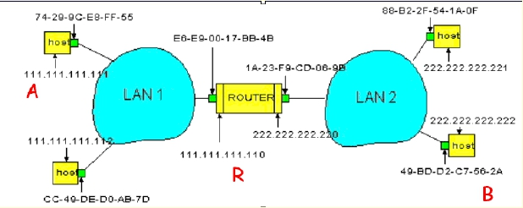
Routing to another LAN - 3
R’s data link layer receives Ethernet frame
R removes IP datagram from Ethernet frame,
sees its destined to B
R uses ARP to get B’s physical layer address
R creates frame containing A-to-B IP
datagram sends to B

Slide 41
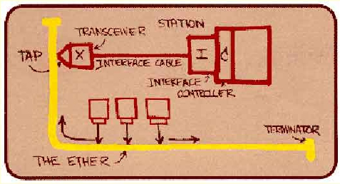
Ethernet
“Dominant” LAN technology:
Cheap $20 for 100Mbs!
First widely used LAN technology
Simpler, cheaper than token LANs and ATM
Kept up with speed race: 10, 100, 1000 Mbps
Metcalfe’s Ethernet
sketch

Slide 42
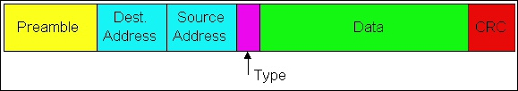
Ethernet Frame Structure - 1
Sending adapter encapsulates IP datagram
(or other network layer protocol packet) in
Ethernet frame
Preamble:
7 bytes with pattern 10101010 followed by
one byte with pattern 10101011
Used to synchronize receiver, sender
clock rates

Slide 43
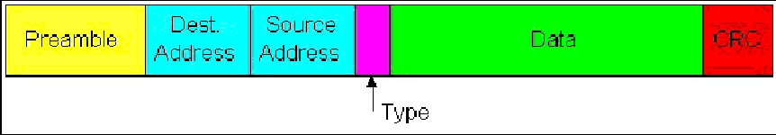
Ethernet Frame Structure - 2
Addresses: 6 bytes, frame is received by
all adapters on a LAN and dropped if
address does not match
Type: indicates the higher layer protocol,
mostly IP but others may be supported
such as Novell IPX and AppleTalk)
CRC: checked at receiver, if error is
detected, the frame is simply dropped

Slide 44
Ethernet
Ethernet uses 1-persistent CSMA/CD on
coaxial cable at 10 Mbps (802.3 allows other
speeds & media)
The maximum cable length allowed: 500m
Longer distances covered using repeaters to
connect multiple “segments” of cable
No two stations can be separated by more than
2500 meters and 4 repeaters
Including the propagation delay for 2500m and
the store and forward delay in 4 repeaters, the
maximum time for a bit to travel between any
two stations is τ max=25.6∝ se (one way)

Slide 45
Ethernet: uses CSMA/CD
A: sense channel, if idle
then {
transmit and monitor the channel;
If detect another transmission
then {
abort and send jam signal;
update # collisions;
delay as required by exponential backoff
algorithm;
goto A
}
else {done with the frame; set collisions to
zero}
}
else {wait until ongoing transmission is over and
goto A}

Slide 46
Ethernet’s CSMA/CD
In order to ensure that every collision i s
“heard" by all stations, when a station detects
a collision , it jams the channel for
Example
Two stations, A and B, are close together
A third station, C, is far away
A and B will detect each other’s
transmission very quickly and shut off
This will only cause a short blip which may
not be detected by C but will still cause
enough errors to destroy C’s packet

Slide 47
Ethernet’s CSMA/CD
When collisions occur, Ethernet uses a random
retransmission scheme called exponential
backoff:
If your packet is in a collision, set K=2
Pick a number k at random from {0, 1,..,K-1}
After τ max seconds, sense channel, transmit if
idle
If collision occurs, let K=2 x K, go to step 2
After 10 repeats, stop doubling K
After 16, give up and tell layer above “I give up”
“Fixes” random access stability problem by
passing it to the layer above!

Slide 48
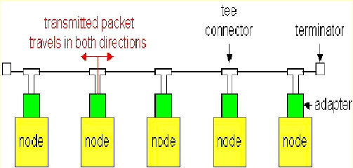
Ethernet Technologies: 10Base2
10: 10Mbps; 2: under 200 meters max cable
length
Thin coaxial cable in a bus topology
Repeaters used to connect up to multiple
segments
Repeater repeats bits it hears on one interface
to its other interfaces: physical layer device!

Slide 49
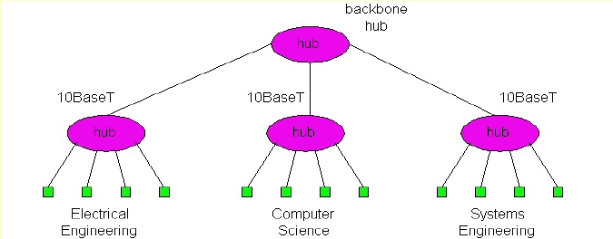
10BaseT and 100BaseT - 1
10/100 Mbps rate; latter called “fast ethernet”
T stands for Twisted Pair
Hub to which nodes are connected by
twisted pair, thus “star topology”
CSMA/CD implemented at hub

Slide 50


10BaseT and 100BaseT - 1
Max distance from node to Hub is
100 meters
Hub can disconnect “jabbering
adapter
Hub can gather monitoring
information, statistics for display to
LAN administrators

Slide 51

Gbit Ethernet
Use standard Ethernet frame format
Allows for point-to-point links and shared
broadcast channels
In shared mode, CSMA/CD is used; short
distances between nodes to be efficient
Uses hubs, called here “Buffered
Distributors”
Full-Duplex at 1 Gbps for point-to-point
links

Slide 52
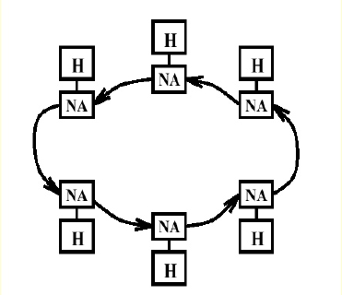
Token Rings (IEEE 802.5)
A ring topology is a single unidirectional
loop connecting a series of stations in
sequence
Each bit is stored and forwarded by each
station’s network interface

Slide 53
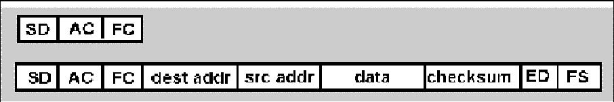
Token Rings: IEEE 802.5 -1
Versions that operate at 1, 4, and 16 Mbps
over shielded twisted pair copper wire
Max token holding time: 10 ms, limiting frame
length
• SD, ED mark start, end of packet

Slide 54
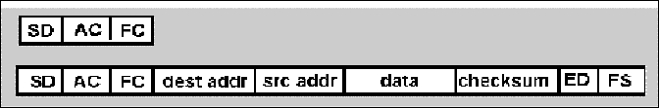
Token Ring: IEEE 802.5 - 2
AC: access control byte:
Token bit: value 0 means token can be
seized, value 1 means data follows FC
Priority bits: priority of packet
Reservation bits: station can write these
bits to prevent stations with lower
priority packet from seizing token after
token becomes free

Slide 55
Token Ring: IEEE 802.5 - 3
• FC: frame control used for monitoring and
maintenance
• Source, destination address: 48 bit physical
address, as in Ethernet
• Data: packet from network layer
• Checksum: CRC
• FS: frame status: set by dest., read by
sender
• set to indicate destination up, frame
copied OK from ring
• DLC-level ACKing

Slide 56
Token Ring: IEEE 802.5 - 4
After transmitting one or more packets
(depending on the rules of the protocol),
the node transmits a new token to the next
node in one of 3 ways:
1.Single Packet Mode: Token is
transmitted after receiving the last bit of
transmitted packet(s)
2.Multiple Token Mode: Token is
transmitted immediately after the last bit
of the packet(s) is transmitted
In small rings, the last two are the same

Slide 57
Interconnecting LANs
Q: Why not just one big LAN?
Limited amount of supportable traffic: on
single LAN, all stations must share
bandwidth
Limited length: 802.3 specifies maximum
cable length
Large “collision domain” (can collide with
many stations)
Limited number of stations: 802.5 have
token passing delays at each station

Slide 58
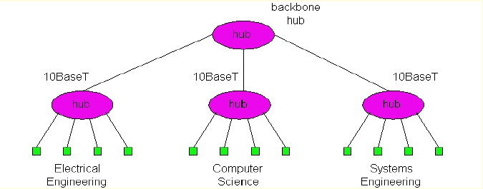
Hubs - 1
Physical Layer devices: essentially
repeaters operating at bit levels: repeat
received bits on one interface to all other
interfaces
Hubs can be arranged in a hierarchy (or
multi-tier design), with backbone hub at its
top

Slide 59
Hubs - 2
Hub Advantages:
simple, inexpensive device
Multi-tier provides graceful degradation: portions of the
LAN continue to operate if one hub malfunctions
extends maximum distance between node pairs (100m
per Hub)
Hub Limitations:
Single collision domain results in no increase in max
throughput
multi-tier throughput same as single segment
throughput
Individual LAN restrictions pose limits on number of
nodes in same collision domain and on total allowed
geographical coverage
Cannot connect different Ethernet types (e.g., 10BaseT
and 100baseT)

Slide 60
Bridges - 1
Link Layer devices: operate on Ethernet
frames, examining frame header and
selectively forwarding frame based on its
destination
Bridge isolates collision domains since it
buffers frames
When frame is to be forwarded on
segment, bridge uses CSMA/CD to access
segment and transmit

Slide 61
Bridges - 2
Bridge advantages:
Isolates collision domains resulting in higher total
max throughput, and does not limit the number of
nodes nor geographical coverage
Can connect different type Ethernet since it is a store
and forward device
Transparent: no need for any change to hosts LAN
adapters
Bridges filter packets
Same-LAN -segment frames not forwarded onto
other LAN segments
Forwarding:
How to know which LAN segment on which to
forward frame?

Slide 62
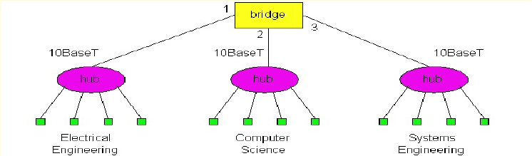
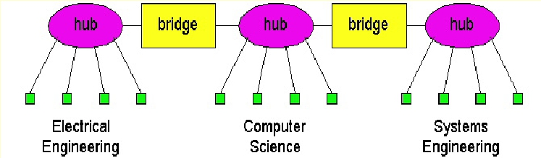
Backbone Bridge
Interconnection Without Backbone

Slide 63
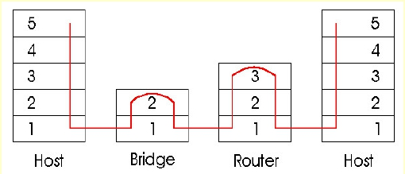
Bridges vs. Routers
Both store-and-forward devices
routers: network layer devices (examine
network layer headers)
bridges are Link Layer devices
Routers maintain routing tables, implement
routing algorithms
Bridges maintain filtering tables, implement
filtering, learning and spanning tree
algorithms

Slide 64
Routers vs. Bridges - 1
Bridges + and -
+ Bridge operation is simpler requiring less
processing bandwidth
- Topologies are restricted with bridges: a
spanning tree must be built to avoid
cycles
- Bridges do not offer protection from
broadcast storms (endless broadcasting
by a host will be forwarded by a bridge)

Slide 65
Routers vs. Bridges - 2
Routers + and -
+ arbitrary topologies can be supported, cycling
is limited by TTL counters (and good routing
protocols)
+ provide firewall protection against broadcast
storms
- require IP address configuration (not plug and
play)
- require higher processing bandwidth
Bridges do well in small (few hundred hosts)
while routers used in large networks
(thousands of hosts)

Slide 66
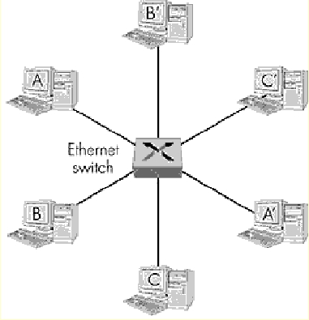
Ethernet Switches - 1
layer 2 (frame)
forwarding, filtering
using LAN addresses
Switching: A-to-B and A’-
to-B’ simultaneously, no
collisions
large number of
interfaces
often: individual hosts,
star-connected into
switch
Ethernet, but no
collisions!

Slide 67
Ethernet Switches - 2
cut-through switching: frame forwarded
from input to output port without awaiting
for assembly of entire frame
slight reduction in latency
combinations of shared/dedicated,
10/100/1000 Mbps interfaces

Slide 68
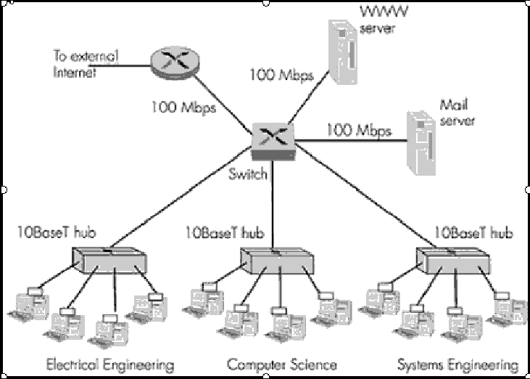
Ethernet Switches - 3

Slide 69
Gateway
A gateway may contain devices such as
protocol translators,
impedance matching devices,
rate converters,
fault isolators, or
signal translators
as necessary to provide system interoperability.
Gateways work on all seven OSI layers .
A router by itself transfers, accepts and relays packets only
across networks using similar protocols. A gateway on the
other hand can accept a packet formatted for one protocol
(e.g. AppleTalk) and convert it to a packet formatted for
another protocol (e.g. TCP/IP) before forwarding it.
A gateway can be implemented in hardware, software or
both, but they are usually implemented by software installed
within a router

Slide 70
Thank U

