Slide 3

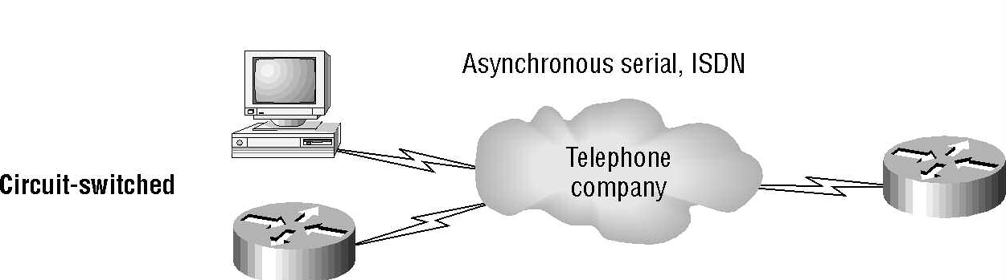
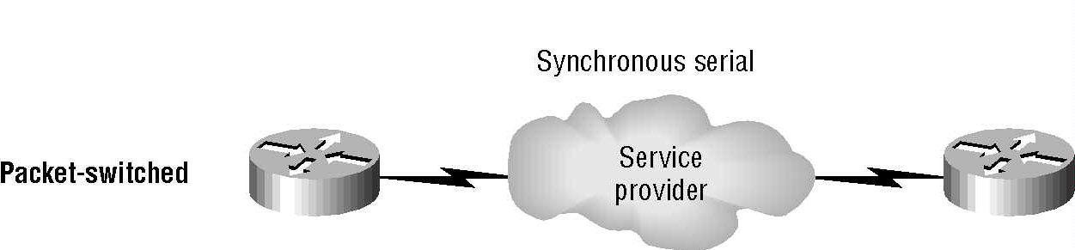
WAN Connection Types
Point-to-Point connection
No setup before transmission
Up to 45Mbs
Setup before transmission
Dial-up modems or ISDN
Low bandwidth
Share bandwidth
Frame Relay and X.25
56Kbps to 2.048Mps

Slide 4
High-Level Data-Link Control Protocol
HDLC specifies an encapsulation method for data on synchronous serial data links using frame characters and checksums.
Default encapsulation used by CISCO.
Everyone has its own proprietary HDLC.
If your are connecting a CISCO router with another type router, you must specify an encapsulation type (protocol).
WAN Networking Protocols

Slide 5
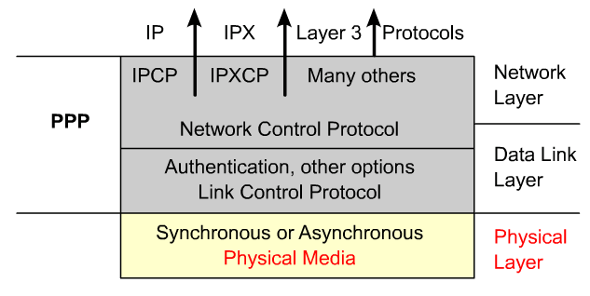
PPP layered architecture
PPP contains two sub-protocols:
  Link Control Protocol – Used for establishing the point-to-point link.
    Negotiate and setup control options on the WAN data link.
  Network Control Protocol – Used for configuring the various network layer protocols.
    Encapsulate and negotiate options for multiple network layer protocols.
    The LCP sits on top of the physical layer and is used to establish, configure, and test the data-link connection.

Slide 6
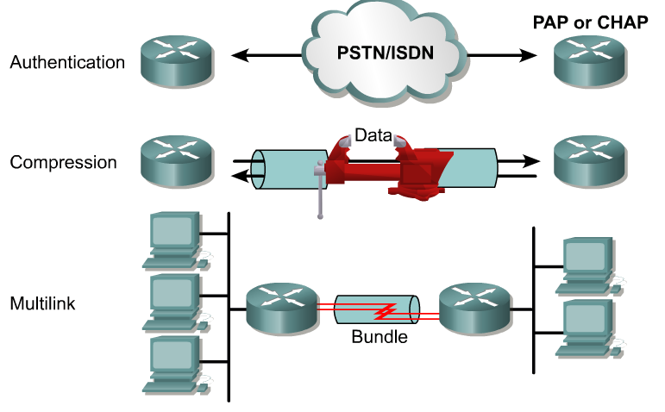
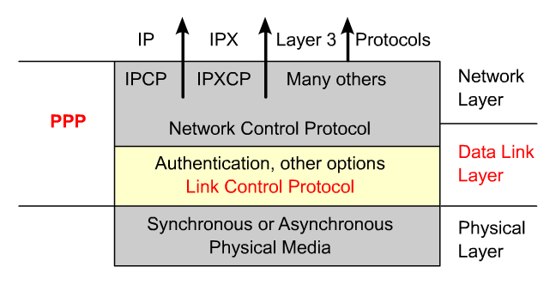
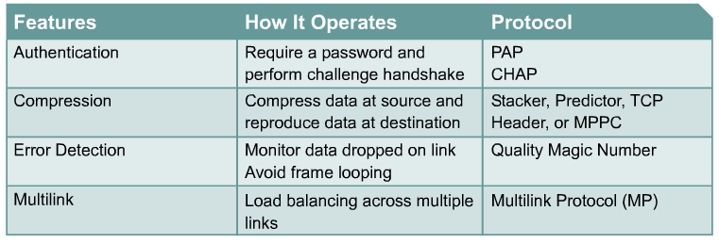
LCP
Also: PPP callback
LCP is used to automatically agree upon encapsulation format options.

Slide 7
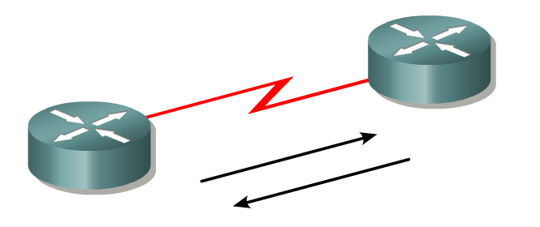
Link-establishment phase
In this phase each PPP device sends LCP frames to configure and test the data link.
LCP frames contain a configuration option field that allows devices to negotiate the use of options such as the maximum transmission unit (MTU), compression of certain PPP fields, and the link-authentication protocol.
If a configuration option is not included in an LCP packet, the default value for that configuration option is assumed.
Before any network layer packets can be exchanged, LCP must first open the connection and negotiate the configuration parameters.
This phase is complete when a configuration acknowledgment frame has been sent and received.

Slide 8
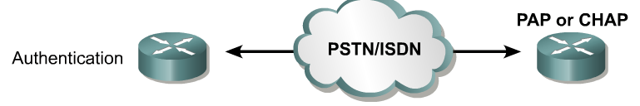
Authentication Phase (Optional)
After the link has been established and the authentication protocol decided on, the peer may be authenticated.
Authentication, if used, takes place before the network layer protocol phase is entered.
As part of this phase, LCP also allows for an optional link-quality determination test.
  The link is tested to determine whether the link quality is good enough to bring up network layer protocols

Slide 9
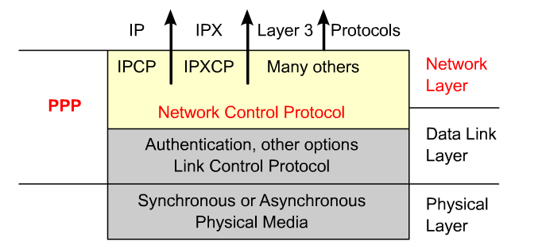
Network Layer Protocol Phase
In this phase the PPP devices send NCP packets to choose and configure one or more network layer protocols, such as IP.
Once each of the chosen network layer protocols has been configured, packets from each network layer protocol can be sent over the link.
If LCP closes the link, it informs the network layer protocols so that they can take appropriate action.
The show interfaces command reveals the LCP and NCP states under PPP configuration.
The PPP link remains configured for communications until LCP or NCP frames close the link or until an inactivity timer expires or a user intervenes.

Slide 10
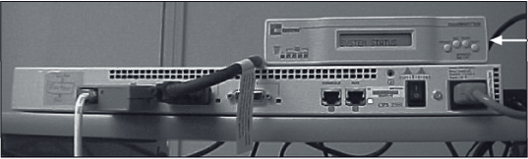
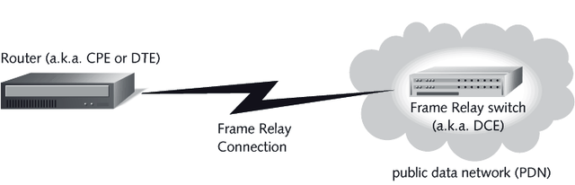
Frame Relay
WAN Networking Protocols
CSU/DSU (channel service unit/
digital service unit)
Frame Relay provides connection-oriented, Data Link layer communication via virtual circuits.
ANSI defines Frame Relay as a connection between the data terminal equipment (DTE) and the data communication equipment (DCE) over high speed digital medium.
CSU/DSU is located at customer location and used for encoding, filtering, and translating communication to and from the digital line.

Slide 11
Frame Relay
Supports many protocols, IP, Novell IPX, Decnet, AppleTalk, ....
Efficient and fast (56Kps to 44.736Mbps) since it does not perform error checking.
Uses both permanent virtual circuits (PVC) and switched virtual circuits (SPC).
Virtual circuits are maintained by a software and multiplexed on onto physical channels.
WAN Networking Protocols

Slide 12
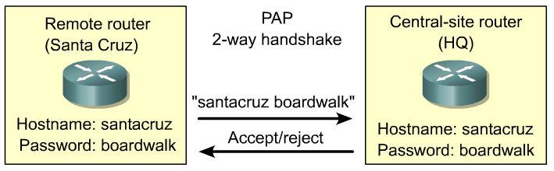

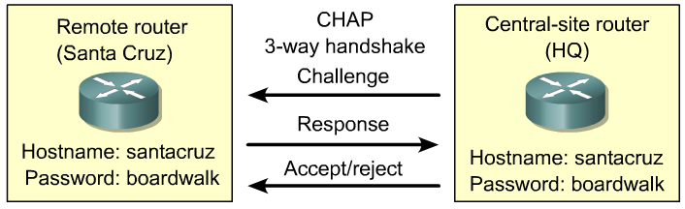
PPP authentication protocols
Encrypted password Repeated challenges
1. Link establishment - (LCPs)
2. Authentication - Optional (LCPs)
3. Link quality determination - Optional (LCPs)
4. Network layer protocol configuration (NCPs)
5. Link termination (LCPs)

Slide 13
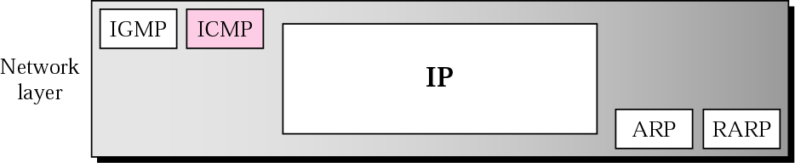
Position of ICMP in the network layer

Slide 14
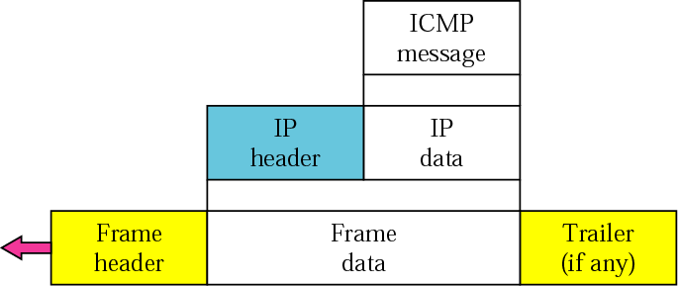
ICMP encapsulation

Slide 15
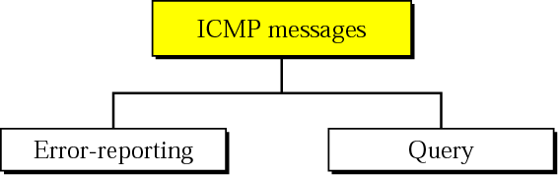
TYPES OF MESSAGES
ICMP messages are divided into error-reporting messages and query messages. The error-reporting messages report problems that a router or a host (destination) may encounter. The query messages get specific information from a router or another host.

Slide 16
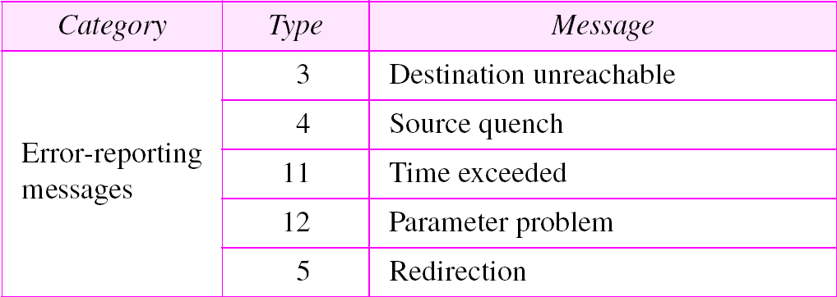
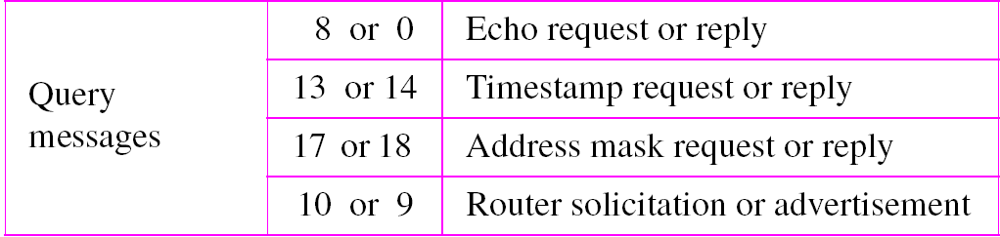
ICMP messages

Slide 17
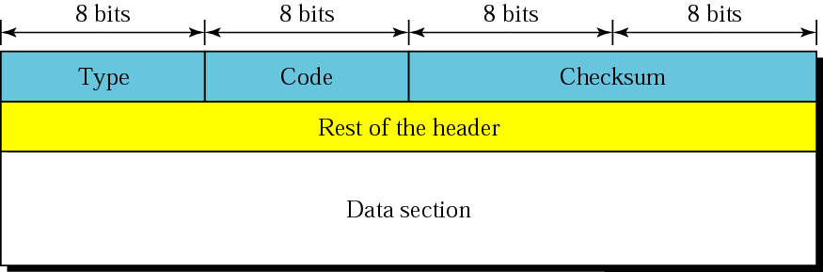
General format of ICMP messages

Slide 18
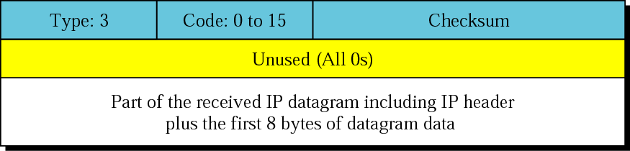
Query Message
Destination-unreachable format

Slide 19
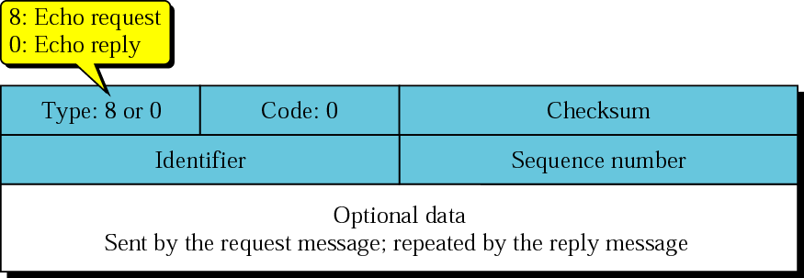
Error Reporting Message
Echo-request and echo-reply messages

