Slide 1

Linux Architecture
& System Calls

Slide 2

Design Principles
  Linux is a multiuser, multitasking system with a full set of UNIX-compatible tools
  Its file system adheres to traditional UNIX semantics, and it fully implements the standard UNIX networking model
  Main design goals are speed, efficiency, and standardization
  Linux is designed to be compliant with the relevant POSIX documents; at least two Linux distributions have achieved official POSIX certification
  The Linux programming interface adheres to the SVR4 UNIX semantics, rather than to BSD behavior
LinuxArchitecture_SysCalls
L3.2

Slide 3
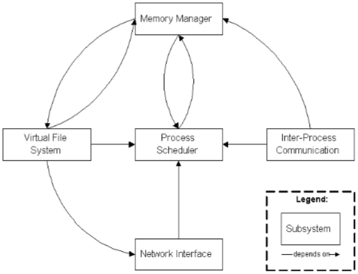
Linux Architecture
  Linux Operating System
    User Applications -- word-processing, web-browser, etc
    O/S Services -- command shell, API’s to kernel, compiler, etc
    Linux Kernel -- presents a virtual machine interface to user processes;
    Hardware -- CPU, memory, controllers, disks, network i/f, etc
LinuxArchitecture_SysCalls
L3.3

Slide 4
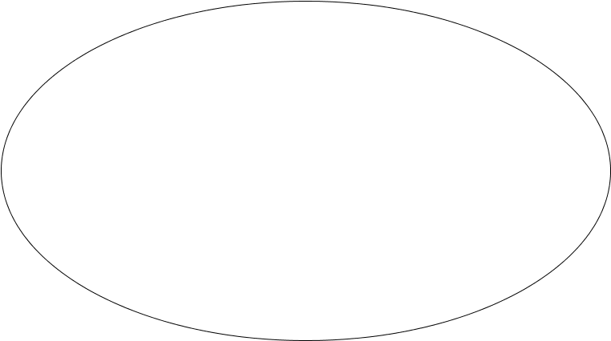

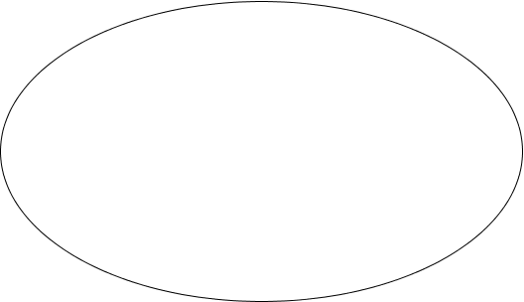


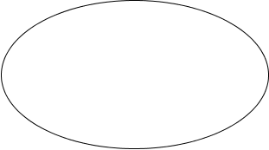




Linux Operating System
X window
csh
vi
du
who
kernel
Network
Admin.
Package
wc
telnet
Hardware
grep
ps
a.out
sort
cscope
gcc
RDBMS
LinuxArchitecture_SysCalls
L3.4

Slide 5





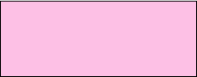





Linux Operating System
User Programs
User Programs
Trap
User level
Libraries
Kernel level
System Call Interface
File System Management
Process
Management
IPC
Buffer Cache
Context
Device Drivers
Memory Management
Hardware Control (Interrupts handling, etc)‏
HW level
Hardware
LinuxArchitecture_SysCalls
L3.5

Slide 6
Linux Kernel Structure
  The Linux kernel is composed of five main subsystems:
    Process Scheduler (SCHED) – manages processes and controls their access to the CPU.
    Memory Manager (MM) – permits multiple process to securely share the machine's main memory system and supports virtual memory
    Virtual File System (VFS) – presents a common file i/f to hardware devices and supports the file system format
    Network Interface (NET) – provides access to several networking standards and a variety of network hardware.
    Inter-Process Communication (IPC) – supports several mechanisms for process-to-process synchronization and communication
LinuxArchitecture_SysCalls
L3.6

Slide 7
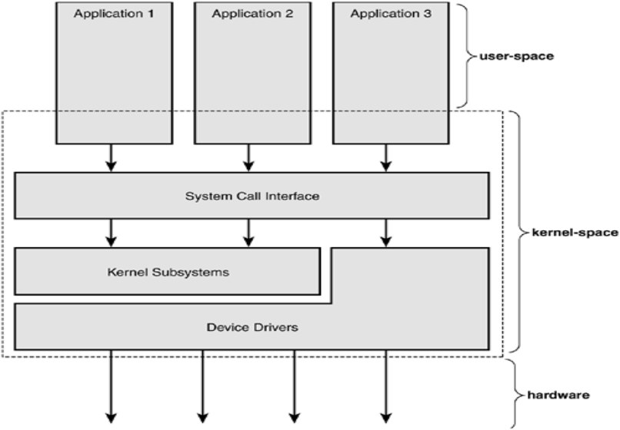
Process and Kernel Space
LinuxArchitecture_SysCalls
L3.7

Slide 8
Kernel Modules
  Sections of kernel code that can be compiled, loaded, and unloaded independent of the rest of the kernel
  A kernel module may typically implement a device driver, a file system, or a networking protocol
  The module interface allows third parties to write and distribute, on their own terms, device drivers or file systems that could not be distributed under the GPL
  Kernel modules allow a Linux system to be set up with a standard, minimal kernel, without any extra device drivers built in
  Three components to Linux module support:
    module management
    driver registration
    conflict resolution
LinuxArchitecture_SysCalls
L3.8

Slide 9
Module Management
  Supports loading modules into memory and letting them talk to the rest of the kernel
  Module loading is split into two separate sections:
    Managing sections of module code in kernel memory
    Handling symbols that modules are allowed to reference
  The module requestor manages loading requested, but currently unloaded, modules; it also regularly queries the kernel to see whether a dynamically loaded module is still in use, and will unload it when it is no longer actively needed
LinuxArchitecture_SysCalls
L3.9

Slide 10
Driver Registration
  Allows modules to tell the rest of the kernel that a new driver has become available
  The kernel maintains dynamic tables of all known drivers, and provides a set of routines to allow drivers to be added to or removed from these tables at any time
  Registration tables include the following items:
    Device drivers
    File systems
    Network protocols
    Binary format
LinuxArchitecture_SysCalls
L3.10

Slide 11
Interrupts and Interrupt Handlers
  The kernel needs to service the asynchronous interrupt requests (IRQ)‏
  Exceptions (synchronous interrupts) are raised by the processor on I/O completion and error conditions and need kernel attention
  The kernel’s device drivers that manage the devices handle these interrupts through interrupt service routines (ISR)‏
  The interrupt handler must execute quickly yet do a much work for the device because they have preempted some tasks and switched off interrupts
  They are split into two parts known as Top Halves and Bottom Halves
  The top half (interrupt handler), runs immediately on receipt of the interrupt and performs only time critical work (acknowledging interrupt or resetting the hardware)‏
  The bottom half runs subsequently, with all interrupts enabled
LinuxArchitecture_SysCalls
L3.11

Slide 12
Interrupts and Interrupt Handlers
  Top Half tasks
    Run with all interrupts on the current processor disabled
    acknowledges the hardware interrupt
    copies the new networking packets into main memory
    readies the device for more I/O
    These jobs are the important, time-critical, and hardware-specific work
    Interrupt context is time critical because the interrupt handler interrupts other code
  Bottom Half Tasks
    The job of bottom halves is to perform any interrupt-related work not performed by the interrupt handler itself
    Multiple methods for bottom half processing
      Softirqs, tasklets and work queues by kernel threads
LinuxArchitecture_SysCalls
L3.12

Slide 13
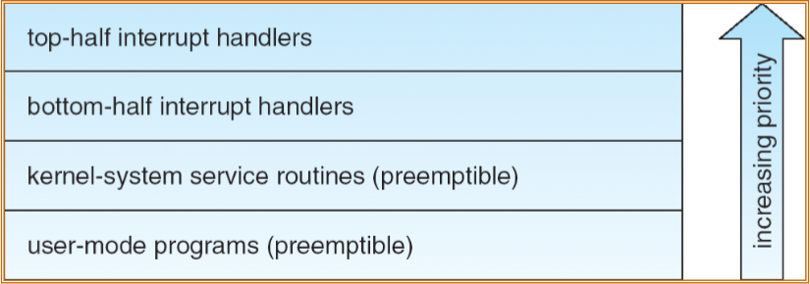
Interrupt Protection Levels
  Each level may be interrupted by code running at a higher level, but will never be interrupted by code running at the same or a lower level
  User processes can always be preempted by another process when a time-sharing scheduling interrupt occurs
LinuxArchitecture_SysCalls
L3.13

Slide 14
Timers & Time Management
  The system timer is a programmable piece of hardware that issues an interrupt at a fixed frequency. The interrupt handler for this timercalled the timer interrupt updates the system time and performs periodic work.
  The system timer goes off at a preprogrammed frequency, called the tick rate
  Some of the work executed periodically by the timer interrupt includes:
    Updating the system uptime
    Updating the time of day
    On an SMP system, ensuring that the scheduler runqueues are balanced, and if not, balancing them
    Checking whether the current process has exhausted its timeslice and, if so, causing a reschedule
    Running any dynamic timers that have expired
    Updating resource usage and processor time statistics
LinuxArchitecture_SysCalls
L3.14

Slide 15
Timers & Time Management
  The Tick Rate: HZ - in include/asm-i386/param.h , the i386 architecture defines: #define HZ 1000
  Jiffies
    The global variable jiffies holds the number of ticks that have occurred since the system booted
    The jiffies variable has always been an unsigned long; (overflow in about 497 days)‏
    A second variable is also defined in <linux/jiffies.h> : extern u64 jiffies_64;
LinuxArchitecture_SysCalls
L3.15

Slide 16
Timers & Time Management
  Hardware Clocks and Timers
  Architectures provide two hardware devices to help with time keeping: the system timer, which we have been discussing, and the real-time clock.
  Real-Time Clock
  The real-time clock (RTC) provides a nonvolatile device for storing the system time. The RTC continues to keep track of time even when the system is off by way of a small battery
  System Timer
  provide a mechanism for driving an interrupt at a periodic rate
  On x86, the primary system timer is the programmable interrupt timer (PIT).
LinuxArchitecture_SysCalls
L3.16

Slide 17
Timers & Time Management
  The Timer Interrupt Handler
  The timer interrupt is broken into two pieces: an architecture-dependent and an architecture-independent routine
  Architecture-dependent routine is registered as the interrupt handler for the system timer
    Obtain the xtime_lock lock, which protects access to jiffies_64 and the wall time value, xtime
    Acknowledge or reset the system timer as required
    Periodically save the updated wall time to the real time clock
    Call the architecture-independent timer routine, do_timer()‏
  Architecture-independent routine, do_timer()‏
    Increment the jiffies_64 count by one
    Update resource usages, such as consumed system and user time, for the currently running process
    Run any dynamic timers that have expired (discussed in the following section)‏
    Execute scheduler_tick()‏
    Update the wall time, which is stored in xtime
LinuxArchitecture_SysCalls
L3.17

Slide 18



Licensing
remove restrictions on distributing copies and modified versions
Copyright
Copyleft
gives the author exclusive right for a certain time period
BSD
LGPL
GNU GPL
any copies and derivatives of the source code created under permissive licences may be made available on any restrictive terms
copyleft restrictions on the program but not to other s/w linking with it
requires derived works to be available under the same copyleft
LinuxArchitecture_SysCalls
L3.18

Slide 19
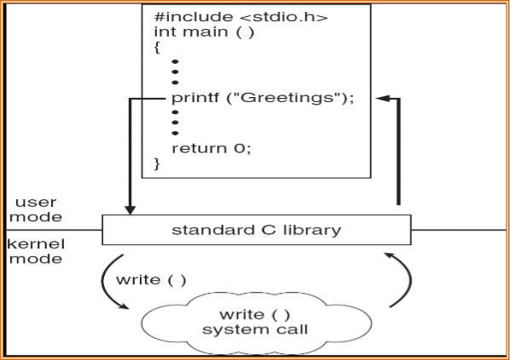
System Calls
  Programming interface to the services provided by the OS
  Typically written in a high-level language (C or C++)‏
  Mostly accessed by programs via a high-level Application Program Interface (API) rather than direct system call use
  C program invoking printf() library call, which calls write() system call
LinuxArchitecture_SysCalls
L3.19

Slide 20
System Calls
  Typically, a number associated with each system call
    System-call interface maintains a table indexed according to these numbers
  The system call interface invokes intended system call in OS kernel and returns status of the system call and any return values
  The caller need know nothing about how the system call is implemented
    Just needs to obey API and understand what OS will do as a result call
    Most details of OS interface hidden from programmer by API
      Managed by run-time support library (set of functions built into libraries included with compiler)‏
LinuxArchitecture_SysCalls
L3.20

Slide 21
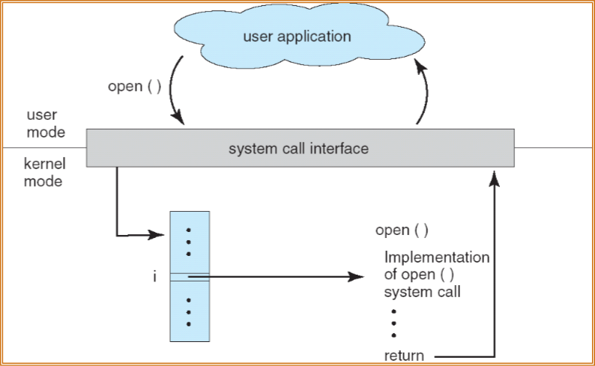
API – System Call – OS Relationship
LinuxArchitecture_SysCalls
L3.21

Slide 22
System Call Parameter Passing
  Often, more information is required than simply identity of desired system call
    Exact type and amount of information vary according to OS and call
  Three general methods used to pass parameters to the OS
    Simplest: pass the parameters in registers
      In some cases, may be more parameters than registers
    Parameters stored in a block, or table, in memory, and address of block passed as a parameter in a register
      This approach taken by Linux and Solaris
    Parameters placed, or pushed, onto the stack by the program and popped off the stack by the operating system
    Block and stack methods do not limit the number or length of parameters being passed
LinuxArchitecture_SysCalls
L3.22

Slide 23
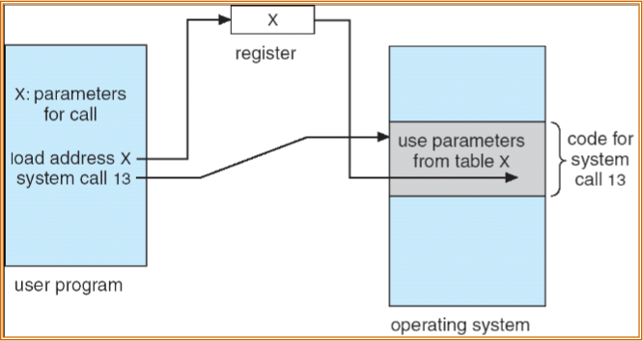
Parameter Passing via Table
LinuxArchitecture_SysCalls
L3.23

Slide 24
Types of System Calls
  Process control
    Create, terminate process
    Load, execute, end, wait event / time, signal
  File management
    Create. delete, open, close
    Read, write,
  Device management
    Request / release device
    Device operation
  Information maintenance
    Get/set system attributes
    Get/set attributes of files, processes
  Communications
    Create/delete connection, attach/detach remote devices
    Send/receive messages
LinuxArchitecture_SysCalls
L3.24

Slide 25
Kernel Module Programming
Introduction to Device Drivers

Slide 26
References
  The Linux Kernel Module Programming Guide
    Peter Jay Salzman, Michael Burian, Ori Pomerantz
    Linux Documentation Project (LDP).
    http://opensource.org/licenses/osl.php
  Writing device drivers in Linux: A brief tutorial
    Xavier Calbet
    http://www.freesoftwaremagazine.com
KrnlModPrg_DevDrvr
L4.2

Slide 27


User space and kernel space
  User space
    End-user programs, like the UNIX shell or other GUI based applications
    These applications need to interact with the system’s hardware
    They don’t do so directly, but through the kernel supported functions
  Kernel space
    The Linux kernel manages the machine’s hardware in a simple and efficient manner
    The kernel offers the user a simple and uniform programming interface to perform the low level interactions directly with the hardware
User Space
Kernel Space
Hardware
KrnlModPrg_DevDrvr
L4.3

Slide 28
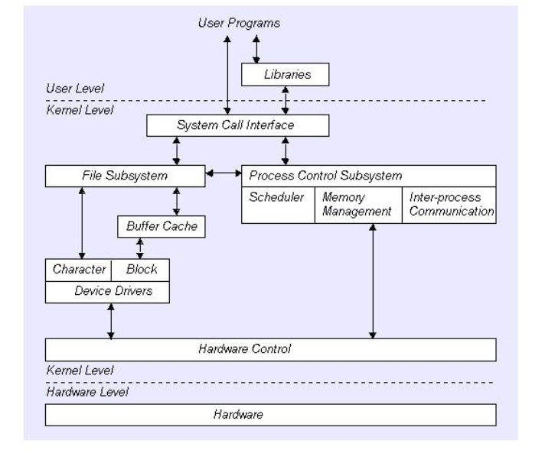
User program & Kernel interface
KrnlModPrg_DevDrvr
L4.4

Slide 29
Kernel Modules
  Loadable Kernel Module (LKM) are pieces of code that can be loaded and unloaded into the kernel upon demand. They extend the functionality of the kernel without the need to rebuild the kernel or reboot the system.
    eg Device drivers
  Kernel modules live in /proc/modules
    lsmod
  Modules are loaded and unloaded by
    insmod ./mymodule.ko
    {kernel modules have a .ko extension}
    rmmod mymodule
  Kernel modules must have at least two functions:
    a "start" (initialization) function called init_module() which is called when the module is insmoded into the kernel
    an "end" (cleanup) function called cleanup_module() which is called just before it is rmmoded
KrnlModPrg_DevDrvr
L4.5

Slide 30
Types of LKM
  Device drivers
  Filesystem driver (one for ext2, MSDOS FAT16, 32, NFS)‏
  System calls
  Network Drivers
  TTY line disciplines. special terminal devices.
  Executable interpreters.
KrnlModPrg_DevDrvr
L4.6

Slide 31
LKM Utilities Commands
  Insmod, rmmod
    Insert an LKM into the kernel, Remove an LKM from the kernel.
  depmod
    Determine interdependencies between LKMs.
  kerneld
    Kerneld daemon program
  ksyms
    Display symbols that are exported by the kernel for use by new LKMs.
  lsmod Or % more /proc/modules
    List currently loaded LKMs.
  modinfo
    Display contents of .modinfo section in an LKM object file.
  modprobe
    Insert or remove an LKM or set of LKMs intelligently. For example, if you must load A before loading B, Modprobe will automatically load A when you tell it to load B.
KrnlModPrg_DevDrvr
L4.7

Slide 32
Kernel Modules – hello-1.c
/* hello−1.c − The simplest kernel module */
#include <linux/module.h> /* Needed by all modules */
#include <linux/kernel.h> /* Needed for KERN_INFO */
int init_module(void)‏
{
  printk(KERN_INFO "Hello world 1.\n");
  /* A non 0 return means init_module failed; module can't be loaded */
  return 0;
}
void cleanup_module(void)‏
{
printk(KERN_INFO "Goodbye world 1.\n");
}
  The print function is – printk() will be directed to a logfile, which can be viewed by dmesg. There are 8 levels, KERN_ALERT will be directed to console. This is preferrable to <1> <2> etc
KrnlModPrg_DevDrvr
L4.8

Slide 33
Kernel Modules
  To compile the kernel modules we need the kernel header in /usr/src
  The books suggest to make the file – Makefile – NOT recommended
obj−m := hello−1.o
all:
make −C /lib/modules/$(shell uname −r)/build M=$(PWD) modules
clean:
make −C /lib/modules/$(shell uname −r)/build M=$(PWD) clean
  uname –r will give the version of the kernel: linux-headers-2.6.27-7-generic/
  M instructs where the modules should be built ie in current directory (PWD)‏
  $ sudo make will look for the Makefile and build the kernel module
KrnlModPrg_DevDrvr
L4.9

Slide 34
Kernel Modules - recommended
  makefile
obj-m := hello-1.o
{Note: tab character before and after := }
$ sudo make –C /usr/src/linux-headers-2.6.27-7-generic/ M=$PWD modules
  sudo password: {sudo attempts to use superuser privilege without changing the user. For this the user should be registered as sudoer}
  There will be messages, “Entering directory /usr/src/…, building modules, Leaving directory /usr/src/..
  $ ls will show many files like hello-1.mod.c, hello-1.o, hello-1.ko etc
  Kernel modules can be listed by $ lsmod {hello-1.ko will not be there}
  $ sudo insmod hello-1.ko {sudo password will not be asked again}
  $ dmesg will show at bottom Hello world 1.
  $ lsmod {hello-1.ko will be there}
  $ sudo rmmod hello-1.ko
  $ dmesg will show at bottom Goodbye world 1.
  $ lsmod {hello-1.ko will not be there}
KrnlModPrg_DevDrvr
L4.10

Slide 35
Kernel Modules – hello-2.c
  As of Linux 2.4, you can rename the init and cleanup functions of your modules; they no longer have to be called init_module() and cleanup_module() respectively. This is done with the module_init() and module_exit() macros.
    /* hello−2.c − Demonstrating the module_init() and module_exit() macros. */
    #include <linux/module.h> #include <linux/kernel.h>
    #include <linux/init.h> /* Needed for the macros */
    int cdac_init () {
    printk ("Init...\n");
    return 0;
    }
    int cdac_exit () {
    printk ("Exit...\n");
    }
    module_init (cdac_init);
    module_exit (cdac_exit);
KrnlModPrg_DevDrvr
L4.11

Slide 36
Kernel Modules
  For kernel 2.4 or later, we get a warning on loading modules:
    $ insmod xxxxxx.ko
    Warning: loading xxxxxx.ko will taint the kernel: no license
    Module xxxxxx loaded, with warnings
  Get rid of taint message by declaring code as GPL
    MODULE_LICENSE("GPL");
  Optionally you can also add:
    MODULE_AUTHOR(“Shem Chandran”); /* Who wrote this module? */
    MODULE_DESCRIPTION(“Sample module”); /* What this module does */
KrnlModPrg_DevDrvr
L4.12

Slide 37
What is a device driver?
  A programming module with interfaces
    Communication Medium between application/user and hardware
  In Unix,
    Kernel module
    device driver interface = file interface
    What are normal operations?
    Block vs. character
KrnlModPrg_DevDrvr
L4.13

Slide 38
Linux Device Drivers
  A set of API subroutines (typically system calls) interface to hardware
  Hide implementation and hardware-specific details from a user program
  Typically use a file interface metaphor
  Device is a special file
  Manage data flow between a user program and devices
  A self-contained component (add/remove from kernel)‏
  A user can access the device via file name in /dev , e.g. /dev/lp0
KrnlModPrg_DevDrvr
L4.14

Slide 39
Interfacing functions between user space and kernel space
Events
User functions
Kernel functions
Load module
Open device
Read device
Write device
Close device
Remove module
Table of device driver events and their associated interfacing functions
  In Unix & Linux, the user sees the devices as files and so I/O is done through open(), read(), write(), close(), etc
  In kernel space Linux also offers several functions to perform the low level interactions directly with the hardware, and allow the transfer of information from kernel to user space
  For each function in user space there exists an equivalent in kernel space
KrnlModPrg_DevDrvr
L4.15

Slide 40
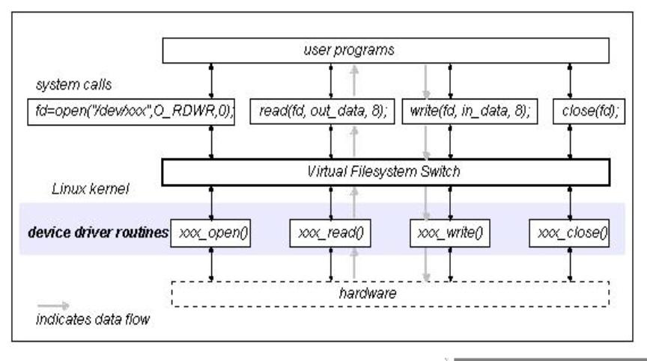
Device Driver interface
KrnlModPrg_DevDrvr
L4.16

Slide 41
device driver: memory.c
  This device will allow a character to be read from or written into a memory location – illustrative of a device driver (doesn’t need hardware)‏
  Several #include statements required
    <memory initial> =
    #include <linux/init.h>
    #include <linux/module.h>
    #include <linux/kernel.h> /* printk() */
    #include <linux/slab.h> /* kmalloc() */
    #include <linux/fs.h> /* everything... */
    #include <linux/errno.h> /* error codes */
    #include <linux/types.h> /* size_t */
    #include <linux/proc_fs.h>
    #include <linux/fcntl.h> /* O_ACCMODE */
    #include <asm/system.h> /* cli(), *_flags */
    #include <asm/uaccess.h> /* copy_from/to_user */
KrnlModPrg_DevDrvr
L4.17

Slide 42
device driver: memory.c
MODULE_LICENSE ("Dual BSD/GPL");
/* Declaration of memory.c fns */
int memory_open (struct inode *inode, struct file *filp);
int memory_release(struct inode *inode, struct file *filp);
ssize_t memory_read(struct file *filp, char *buf, size_t count, loff_t *f_pos);
ssize_t memory_write(struct file *filp, char *buf, size_t count, loff_t *f_pos);
void memory_exit(void);
int memory_init(void);
/* Structure for the file access fns */
struct file_operations memory_fops = {
read: memory_read,
write: memory_write,
open: memory_open,
release: memory_release
};
module_init(memory_init);
module_exit(memory_exit);
/* Global variables of the driver */
int memory_major = 60;
char *memory_buffer; /* to store data */
The common functions which are typically used to manipulate files are declared in the definition of the file_operations structure. the global variables of the driver are declared: one of them is the major number of the driver, the other is a pointer to a region in memory, memory_buffer, to store the driver data.
KrnlModPrg_DevDrvr
L4.18

Slide 43
device driver: memory.c
  In UNIX and Linux, devices are accessed from user space in exactly the same way as files are accessed. These device files are normally subdirectories of the /dev directory.
  To link normal files with a kernel module two numbers are used: major number and minor number. The major number is the one the kernel uses to link a file with its driver. The minor number is for internal use and not covered here.
  To achieve this, a file (which will be used to access the device driver) must be created, by typing the following command as root:
$ mknod /dev/memory c 60 0
  In the above, c means that a char device is to be created, 60 is the major number and 0 is the minor number.
  Within the driver, in order to link it with its corresponding /dev file in kernel space, the register_chrdev function is used. It is called with three arguments: major number, a string of characters showing the module name, and a file_operations structure which links the call with the file functions it defines. It is invoked, when installing the module.
KrnlModPrg_DevDrvr
L4.19

Slide 44
device driver: memory.c
  Installing the module
<memory init module> =
int memory_init(void) {
  int result; /* Registering device */
  result = register_chrdev(memory_major, "memory", &memory_fops);
  if (result < 0) {
  printk(KERN_INFO Cannot obtain major # %d\n", memory_major); return result; }
  /* Allocating memory for the buffer */
  memory_buffer = kmalloc(1, GFP_KERNEL);
  if (!memory_buffer) {
  result = -ENOMEM; goto fail; }
  memset(memory_buffer, 0, 1);
  printk("KERN_INFO Inserting memory module\n");
  return 0;
  fail: memory_exit(); return result;
}
KrnlModPrg_DevDrvr
L4.20

Slide 45
device driver: memory.c
  To remove the module inside the memory_exit function, the function unregsiter_chrdev is called, which will free the major number for the kernel.
    <memory exit module> =
    void memory_exit(void) {
      /* Freeing the major number */
      unregister_chrdev(memory_major, "memory");
      /* Freeing buffer memory */
      if (memory_buffer) {
      kfree(memory_buffer);
      }
      printk("KERN_INFO Removing memory module\n");
    }
  The buffer memory is also freed in this function, in order to leave a clean kernel when removing the device driver.
KrnlModPrg_DevDrvr
L4.21

Slide 46
Interfacing functions between user space and kernel space
Events
User functions
Kernel functions
Load module
insmod
module_init()‏
Table of device driver events and their associated interfacing functions
Open device
Read device
Write device
Close device
Remove module
rmmod
module_exit()‏
KrnlModPrg_DevDrvr
L4.22

Slide 47
device driver: memory.c
  The common functions which are typically used to manipulate files are declared in the definition of the file_operations structure.
  The “memory” driver: opening the device as a file
  The kernel space function, which corresponds to opening a file in user space (fopen), is the member open. It takes as arguments: an inode structure, which sends information to the kernel regarding the major number and minor number; and a file structure with information relative to the different operations that can be performed on a file.
    <memory open> =
    int memory_open(struct inode *inode, struct file *filp) {
    return 0; /* Success */ }
  The “memory” driver: closing the device as a file
  The corresponding function for closing a file in user space (fclose) is the release. When a file is closed, it’s usually necessary to free the used memory and any variables related to the opening of the device.
    <memory release> =
    int memory_release(struct inode *inode, struct file *filp) {
    return 0; /* Success */ }
KrnlModPrg_DevDrvr
L4.23

Slide 48
Interfacing functions between user space and kernel space
Events
User functions
Kernel functions
Load module
insmod
module_init()‏
Table of device driver events and their associated interfacing functions
Open device
fopen
file_operations: open
Read device
Write device
Close device
fclose
file_operations: release
Remove module
rmmod
module_exit()‏
KrnlModPrg_DevDrvr
L4.24

Slide 49
device driver: memory.c
  The “memory” driver: reading the device
  The member to read a device is memory_read of the file_operations structure. Its arguments are: a type file structure, a buffer (buf), counter with the number of bytes to transfer (count), and the position of where to start reading the file (f_pos).
      <memory read> =
      ssize_t memory_read(struct file *filp, char *buf, size_t count,
      loff_t *f_pos) {
      /* Transfering data to user space */
      copy_to_user(buf,memory_buffer,1);
      if (*f_pos == 0) {
      *f_pos+=1;
      return 1;
      } else { return 0; } }
  In this simple case, the memory_read function transfers a single byte from the driver buffer (memory_buffer) to user space with the function copy_to_user.
  The reading position in the file (f_pos) is increased by 1 and the number of bytes read is given as a return value, 1. If not at beginning of file, returns 0.
KrnlModPrg_DevDrvr
L4.25

Slide 50
device driver: memory.c
  The “memory” driver: writing to a device
  To write to a device the function is memory_write of the file_operations structure. Its arguments are a type file structure, buf, a buffer in which the user space function (fwrite) will write, count, a counter with the number of bytes to transfer and f_pos, the position of where to start writing in the file.
    <memory write> =
    ssize_t memory_write( struct file *filp, char *buf, size_t count,
    loff_t *f_pos) {
      char *tmp;
      tmp=buf+count-1;
      copy_from_user(memory_buffer,tmp,1);
      return 1; }
  In this case, the function copy_from_user transfers the data from user space to kernel space.
KrnlModPrg_DevDrvr
L4.26

Slide 51
Interfacing functions between user space and kernel space
Events
User functions
Kernel functions
Load module
insmod
module_init()‏
Table of device driver events and their associated interfacing functions
Open device
fopen
file_operations: open
Read device
fread
file_operations: read()‏
Write device
fwrite
file_operations: write()‏
Close device
fclose
file_operations: release
Remove module
rmmod
module_exit()‏
KrnlModPrg_DevDrvr
L4.27

Slide 52
The complete “memory” driver
  The complete driver is made of all the above modules:
<memory.c> =
<memory initial>
<memory init module>
<memory exit module>
<memory open>
<memory release>
<memory read>
<memory write>
  Compile and load the module with $ sudo insmod memory.ko
  Create the device file $ sudo mknod /dev/memory c 60 0
  Unprotect the device $ sudo chmod 666 /dev/memory
  Check the device $ ls –l /dev/memory
  $ echo -n abcdef >/dev/memory {only the last char will be stored}
  $ cat /dev/memory {should output f}
  This will remain till the module is removed
  $ dmesg, $ lsmod {memory.ko will be there}
KrnlModPrg_DevDrvr
L4.28

Slide 53

“parlelport” driver
  The parallel port is a device that allows the input and output of digital information
  It has a D-25 connector with 25 pins
  In a PC, base address is 0x378
  To output 25 bits 3 bytes are needed and bit-25 set to ground
  The driver will use only one byte
  The driver will be called parlelport
Bit#
7
6
5
4
3
2
1
0
Pin#
9
8
7
6
5
4
3
2
25
D – 25 connector
KrnlModPrg_DevDrvr
L4.29

Slide 54
“parlelport” driver
Init module changes
  The previous memory_init function needs modification—changing the RAM memory allocation for the reservation of the memory address of the parallel port (0x378)‏
  To achieve this, use the function for checking the availability of a memory region (check_region), and the function to reserve the memory region for this device (request_region)‏
  Both have base address of the memory region as arguments and its length
  The request_region function also accepts a string which defines the module
    <parlelport modified init module> =
    /* Registering port */
    port = check_region(0x378, 1);
    if (port) {
    printk(“KERN_INFO parlelport: cannot reserve 0x378\n");
    result = port;
    goto fail;
    }
    request_region(0x378, 1, "parlelport");
KrnlModPrg_DevDrvr
L4.30

Slide 55
“parlelport” driver
Exit module changes
  The memory_exit module will be modified by substituting the freeing of memory with the removal of the reserved memory of the parallel port
  This is done by the release_region function, which has the same arguments as check_region.
    <parlelport modified exit module> =
    /* Make port free! */
    if (!port) {
    release_region(0x378,1);
    }
KrnlModPrg_DevDrvr
L4.31

Slide 56
“parlelport” driver
  Read module changes
  In this case, a real device reading action needs to be added to allow the transfer of this information to user space
  The inb function achieves this; its arguments are the address of the parallel port and it returns the content of the port.
    <parlelport inport> =
    /* Reading port */
    parlelport_buffer = inb(0x378);
    Write module changes
  You have to add the “writing to the device” function to be able to transfer this data to user space
  The function outb accomplishes this; it takes as arguments the content to write in the port and its address
    <parlelport outport> =
    /* Writing to the port */
    outb(parlelport_buffer,0x378);
KrnlModPrg_DevDrvr
L4.32

Slide 57
The complete “parlelport” driver
  <parlelport.c> =
  <parlelport initial>
  <parlelport init module>
  <parlelport exit module>
  <parlelport open>
  <parlelport release>
  <parlelport read>
  <parlelport write>
  Initial section
  In the initial section of the driver a different major number is used (61).
  Also, the global variable memory_buffer is changed to port and two more #include lines are added: ioport.h and io.h.
KrnlModPrg_DevDrvr
L4.33

Slide 58
The complete “parlelport” driver
<parlelport initial> =
#include <linux/init.h>
/* #include <linux/config.h> */
#include <linux/module.h>
#include <linux/kernel.h> /* printk() */
#include <linux/slab.h> /* kmalloc() */
#include <linux/fs.h> /* everything... */
#include <linux/errno.h> /*err codes */
#include <linux/types.h> /* size_t */
#include <linux/proc_fs.h>
#include <linux/fcntl.h> /*O_ACCMODE*/
#include <linux/ioport.h>
#include <asm/system.h> /*cli(),flags*/
#include <asm/uaccess.h> /*copy usr*/
#include <asm/io.h> /* inb, outb */
MODULE_LICENSE("Dual BSD/GPL");
int parlelport_open(struct inode *inode, struct file *filp);
int parlelport_release(struct inode *inode, struct file *filp);
ssize_t parlelport_read(struct file *filp, char *buf, size_t count, loff_t *f_pos);
ssize_t parlelport_write(struct file *filp, char *buf, size_t count, loff_t *f_pos);
void parlelport_exit(void);
int parlelport_init(void);
/* file access functions */
struct file_operations parlelport_fops = {
read: parlelport_read,
write: parlelport_write,
open: parlelport_open,
release: parlelport_release
};
KrnlModPrg_DevDrvr
L4.34

Slide 59
The complete “parlelport” driver
/* Driver global variables */
/* Major number */
int parlelport_major = 61;
/* reservation of the parallel port*/
int port;
module_init(parlelport_init);
module_exit(parlelport_exit);
<parlelport init module> =
int parlelport_init(void) {
int result;
result = register_chrdev(parlelport_major, "parlelport", &parlelport_fops);
if (result < 0) {
printk(KERN_INFO "parlelport: cannot obtain major number %d\n",
parlelport_major);
return result; }
/* Registering port */
port = check_region(0x378, 1);
if (port) {
printk(KERN_INFO "parlelport: cannot reserve 0x378\n");
result = port;
goto fail;
}
request_region(0x378, 1, "parlelport");
printk( KERN_INFO "Inserting parlelport module\n");
return 0;
fail:
parlelport_exit();
return result;
}
KrnlModPrg_DevDrvr
L4.35

Slide 60
The complete “parlelport” driver
<parlelport exit module> =
void parlelport_exit(void) {
/* Make major number free! */
unregister_chrdev(parlelport_major, "parlelport");
/* Make port free! */
if (!port) {
release_region(0x378,1); }
printk(KERN_INFO "Removing parlelport module\n"); }
<parlelport open> =
int parlelport_open(struct inode *inode, struct file *filp) {
/* Success */
return 0; }
<parlelport release> =
int parlelport_release(struct inode *inode, struct file *filp) {
/* Success */
return 0; }
<parlelport read> =
ssize_t parlelport_read(struct file *filp, char *buf, size_t count, loff_t *f_pos) {
/* Buffer to read the device */
char parlelport_buffer;
/* <parlelport inport> */
parlelport_buffer = inb(0x378);
copy_to_user(buf,&parlelport_buffer,1);
if (*f_pos == 0) {
*f_pos+=1; return 1; }
else { return 0; } }
KrnlModPrg_DevDrvr
L4.36

Slide 61
The complete “parlelport” driver
<parlelport write> =
ssize_t parlelport_write( struct file *filp, char *buf, size_t count, loff_t *f_pos) {
char *tmp;
/* Buffer writing to the device */
char parlelport_buffer;
tmp=buf+count-1;
copy_from_user(&parlelport_buffer,tmp,1);
/* Writing to the port */
outb(parlelport_buffer,0x378);
return 1;
}
  To test the Parlelport driver
  If the file /dev/parlelport does not exist, it must be created as root with the command:
$ mknod /dev/parlelport c 61 0
  It needs to be made readable and writable by anybody with:
$ chmod 666 /dev/parlelport
  The module parlelport can now be installed
  Check it is reserving the input/output port addresses 0x378 with the command:
$ cat /proc/ioports
  $ dmesg, $ lsmod {parlelport.ko will be there}
KrnlModPrg_DevDrvr
L4.37

Slide 62
Thanks & Questions

