Slide 1

Introduction to OS

Slide 2

Topics
  Overview of RTOS course
  Introduction to Operating Systems
    Computer-System Organization
    Computer-System Operation
  Operating-System Services
    User Interface
    Process Management
    Memory Management
    Storage Management
    Protection and Security
  Types of Operating Systems
    Distributed Systems
    Special-Purpose Systems
    Computing Environments
Operating System Concepts
C1.2

Slide 3
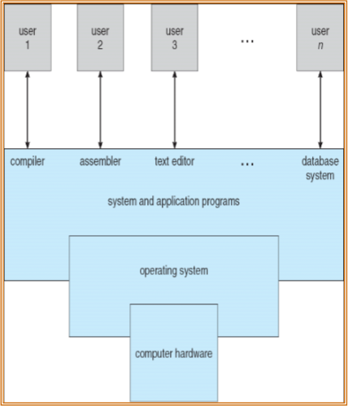
Components of a Computer System
  Computer system can be divided into four components
    Hardware – provides basic computing resources
      CPU, memory, I/O devices
    Operating system
      Controls and coordinates use of hardware among various applications and users
    Application programs – define the ways in which the system resources are used to solve the computing problems of the users
      Word processors, compilers, web browsers, database systems, video games
    Users
      People, machines, other computers
Operating System Concepts
C1.3

Slide 4
What is an Operating System?
  User perspective: A program that acts as an intermediary between a user of a computer and the computer hardware. It Provides an environment in which the user can execute programs in a convenient and efficient manner. (Virtual Machine)‏
  System Perspective: A software that manages the computer hardware to ensure correct and efficient operation
    OS is a resource allocator
      Manages all resources
    Decides between conflicting requests for efficient and fair resource use
    OS is a control program
      Controls execution of programs to prevent errors and improper use of the computer
Convenience of use – Pcs
Efficiency of resource usage – Mainframes, Servers, etc
Operating System Concepts
C1.4

Slide 5
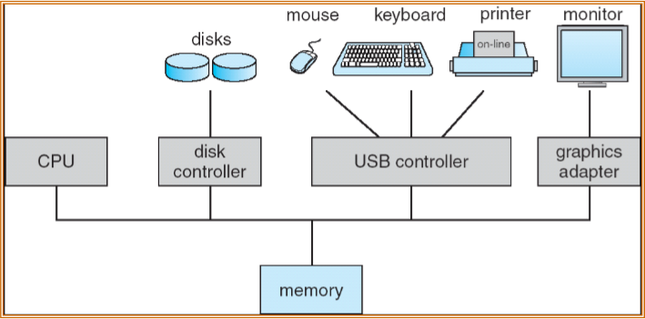
Computer System Organization
  All peripheral devices have device controllers, which permit concurrent execution of CPUs and devices
  A common bus provides access to 1 or more CPUs and device controllers to a shared memory
Operating System Concepts
C1.5

Slide 6
Computer Startup
  In Embedded Systems, the OS (& code) is resident on ROM or EPROM, generally known as firmware
  bootstrap program is loaded at power-up or reboot
    Typically stored in ROM or EPROM
    Initializes all aspects of system
    Loads operating system kernel and starts execution
  “The one program running at all times on the computer” is the kernel. Everything else is either a system program (ships with the operating system) or an application program
Operating System Concepts
C1.6

Slide 7


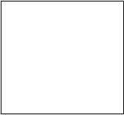

Device Controllers
  Programs in the OS, known as device drivers communicate with the device controllers
  Each device controller (Small computer-system interface - SCSI) is in charge of a particular device type
  Device controllers have local buffers
  Data moves from/to CPU to/from local buffers and similarly from/to local buffers to/from devices
  Device controller informs CPU on operation completion or error by causing an interrupt.
command
i/o request
driver
controller
status
device
interrupt
data
data
Local buffers
Operating System Concepts
C1.7

Slide 8
Interrupt handling
  The operating system preserves the state of the CPU by storing registers and the program counter (context) .
  Determines which type of interrupt has occurred:
    polling
    vectored interrupt system which contains the addresses of all the service routines.
  Interrupt transfers control to the interrupt service routine (ISR)‏
  Incoming interrupts are disabled while another interrupt is being processed. They may be queued to prevent a lost interrupt.
  A trap is a software-generated interrupt caused either by an error or a user request
Operating System Concepts
C1.8

Slide 9
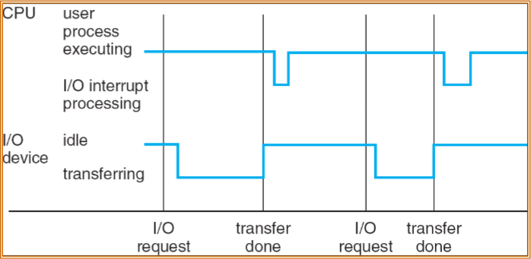
Interrupt Timeline
Operating System Concepts
C1.9

Slide 10
I/O methods
  Synchronous I/O: After I/O starts, control returns to user program only upon I/O completion.
    Wait instruction idles the CPU until the next interrupt
    At most one I/O request is outstanding at a time, no simultaneous I/O processing.
  Asynchronous I/O: After I/O starts, control returns to user program without waiting for I/O completion.
    System call – request to the operating system to allow user to wait for I/O completion.
    Device-status table contains entry for each I/O device indicating its type, address, and state.
  Dual buffers can be used to interleave I/O and processing
Operating System Concepts
C1.10

Slide 11








Direct Memory Access
  In character oriented I/O, each character/byte transfer is initiated by CPU, and CPU is interrupted on completion
  For high-speed I/O devices, able to transmit information at close to memory speeds, Direct Memory Access (DMA) is used.
  Device controller transfers blocks of data from buffer storage directly to main memory without CPU intervention.
  Only one interrupt is generated per block, rather than the one interrupt per byte.
CPU
cash
local
buffer
mem_addr
I/O
mem
word_count
Operating System Concepts
C1.11

Slide 12
Storage Structure
  Main memory – only large storage media that the CPU can access directly.
  Secondary storage – extension of main memory that provides large nonvolatile storage capacity.
  Magnetic disks – rigid metal or glass platters covered with magnetic recording material
    Disk surface is logically divided into tracks, which are subdivided into sectors.
    The disk controller determines the logical interaction between the device and the computer.
Operating System Concepts
C1.12

Slide 13
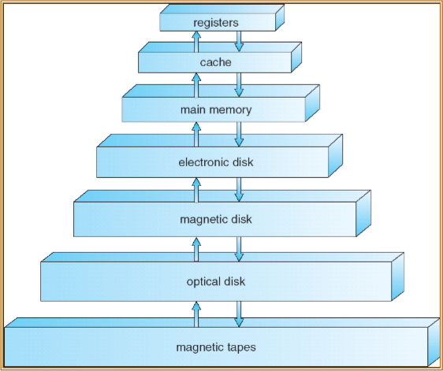
Storage-Device Hierarchy
Speed
Volatile
Size
Cost
Operating System Concepts
C1.13

Slide 14
Caching
  Information (code, data) in use copied from slower to faster storage temporarily
  Faster storage (cache) checked first to determine if information is there
    If it is, information used directly from the cache (fast)‏
    If not, data copied to cache and used there
  Cache smaller than storage
    Cache management important design problem
    Cache size and replacement policy
    Caches are often made in levels
    L1 – A small fast on chip cache (few KB)‏
    L2 – Larger cache on an additional chip (100's Kbs)‏
    L3 – Much larger (few MBs)‏
Operating System Concepts
C1.14

Slide 15
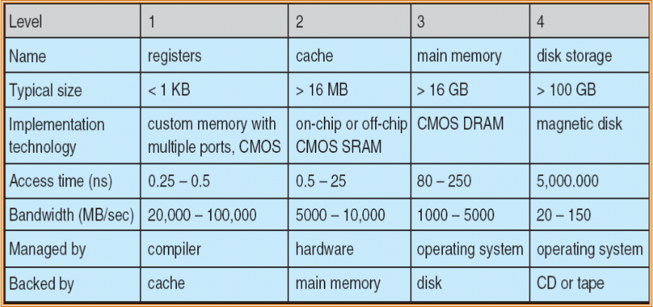
Performance of Various Levels of Storage
  Movement between levels of storage hierarchy can be explicit or implicit
Operating System Concepts
C1.15

Slide 16
Operating System Structure
  Multiprogramming needed for efficiency
    Single user cannot keep CPU and I/O devices busy at all times
    Multiprogramming organizes jobs (code and data) so CPU always has one to execute
    A subset of total jobs in system is kept in memory
    One job selected and run via job scheduling
    When it has to wait (for I/O for example), OS switches to another job
  Timesharing (multitasking) is logical extension in which CPU switches jobs so frequently that users can interact with each job while it is running, creating interactive computing
    Response time should be < 1 second
    Each user has at least one program executing in memory process
    If several jobs ready to run at the same time  CPU scheduling
    If processes don’t fit in memory, swapping moves them in and out to run
    Virtual memory allows execution of processes not completely in memory
Operating System Concepts
C1.16

Slide 17
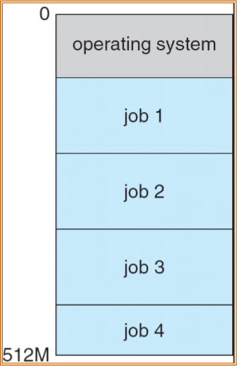
Memory Layout for Multiprogrammed System
Operating System Concepts
C1.17

Slide 18
Operating System Services
  User oriented operating-system services:
    User interface - Almost all operating systems have a user interface (UI)‏
      Batch (Job language), Command-Line (CLI),
      Graphics User Interface (GUI)‏
    Program execution
    I/O operations
    File-system
    Communications
Operating System Concepts
C1.18

Slide 19
Operating System Services (Cont.)‏
  System oriented operating-system services:
    Resource allocation - When multiple users or multiple jobs running concurrently, resources must be allocated to each of them
      CPU cycles, main memory, file storage, communication etc
    Accounting - To keep track of which users use how much and what kinds of computer resources
    Protection and security
      Protection involves ensuring that all access to system resources is controlled
      Security of the system from outsiders requires user authentication, extends to defending external I/O devices from invalid access attempts
Operating System Concepts
C1.19

Slide 20
User Operating System Interface - CLI
Command Line Interface (CLI) allows direct command entry
    Sometimes implemented in kernel, sometimes by systems program
    Sometimes multiple flavors implemented – shells
    Primarily fetches a command from user and executes it
      Sometimes commands built-in, sometimes just names of programs
        If the latter, adding new features doesn’t require shell modification
Operating System Concepts
C1.20

Slide 21
User Operating System Interface - GUI
  Graphical User Interface
    Usually mouse, keyboard, and monitor
    Touch Screen, Light Pens, Front Panel
    Icons represent files, programs, actions, etc
    Various mouse buttons actions over objects in the interface cause various functions (click, double click, drag & drop)‏
    Menus – pull down, popup
    Invented at Xerox PARC
  Many systems now include both CLI and GUI interfaces
    Microsoft Windows is GUI with CLI “command” shell
    Apple Mac OS X as “Aqua” GUI interface with UNIX kernel underneath and shells available
    Solaris is CLI with optional GUI interfaces (Java Desktop, KDE)‏
Operating System Concepts
C1.21

Slide 22
Process Management
  A process is a program in execution. It is a unit of work within the system. Program is a passive entity, process is an active entity.
  Process needs resources to accomplish its task
    CPU, memory, I/O, files
    Initialization data
  Process termination requires reclaim of any reusable resources
  The program counter specifies location of next instruction to execute
  The program counter of a suspended process must be saved in the process context
  Typically system has many processes, some user, some operating system running concurrently on one or more CPUs
Operating System Concepts
C1.22

Slide 23
Process Management Activities
The operating system is responsible for the following activities in connection with process management:
  Creating and deleting both user and system processes
  Suspending and resuming processes
  Providing mechanisms for process synchronization
  Providing mechanisms for process communication
  Providing mechanisms for deadlock handling
Operating System Concepts
C1.23

Slide 24
Memory Management
  All data and instructions in memory in order to execute
  Memory management determines what is in memory to optimize CPU utilization and computer response to users
  Memory management activities
    Keeping track of which parts of memory are currently being used and by whom
    Deciding which processes (or parts thereof) and data to move into and out of memory
    Allocating and deallocating memory space as needed
Operating System Concepts
C1.24

Slide 25
Storage Management
  OS provides uniform, logical view of information storage
    Abstracts physical properties to logical storage unit - file
    Each medium is controlled by device (i.e., disk drive, tape drive)‏
      Varying properties include access speed, capacity, data-transfer rate, access method (sequential or random)‏
  File-System management
    Files usually organized into directories
    Access control determines who can access what
    OS activities include
      Creating and deleting files and directories
      Access control
      Mapping files onto secondary storage
      Backup files onto stable (non-volatile) storage media
Operating System Concepts
C1.25

Slide 26
I/O Subsystem
  One purpose of OS is to hide peculiarities of hardware devices from the user
  I/O subsystem responsible for
    Memory management of I/O including buffering (storing data temporarily while it is being transferred), caching (storing parts of data in faster storage for performance), spooling (the overlapping of output of one job with input of other jobs)‏
    General device-driver interface
    Drivers for specific hardware devices
Operating System Concepts
C1.26

Slide 27
Protection and Security
  Protection – any mechanism for controlling access of processes or users to resources defined by the OS
  Security – defense of the system against internal and external attacks
    Huge range, including denial-of-service, worms, viruses, identity theft, theft of service
  Systems generally first distinguish among users, to determine who can do what
    User identities (user IDs) include name and associated number, one per user
    User ID then associated with all files, processes of that user to determine access control
    Group identifier (group ID) allows set of users to be defined and controls managed, then also associated with each process, file
Operating System Concepts
C1.27

Slide 28
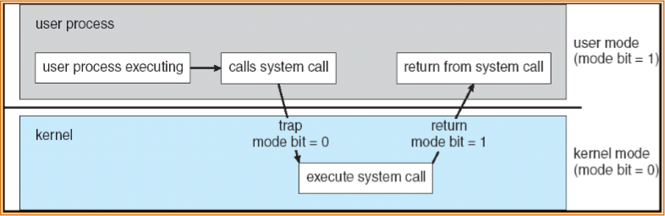
Protection through User and Kernel Modes
Dual-mode operation allows OS to protect itself and other system components
  User mode and kernel mode
  Mode bit provided by hardware
    Provides ability to distinguish when system is running user code or kernel code
    Some instructions designated as privileged, only executable in kernel mode
    System call changes mode to kernel, return from call resets it to user
Operating System Concepts
C1.28

Slide 29
System Calls
  Programming interface to the services provided by the OS
  Typically written in a high-level language (C or C++)‏
  Mostly accessed by programs via a high-level Application Program Interface (API) rather than direct system call use
  System Call Implementation
    Typically, a number associated with each system call
      System-call interface maintains a table indexed according to these numbers
    The system call interface invokes intended system call in OS kernel and returns status of the system call and any return values
Operating System Concepts
C1.29

Slide 30
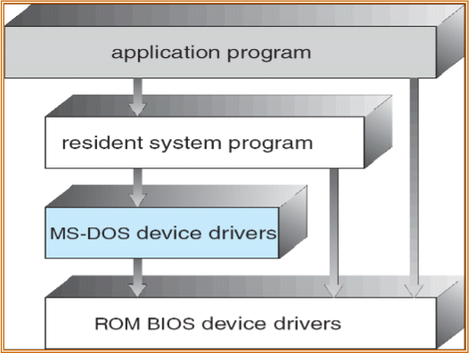
Operating System Structure
  MS-DOS – written to provide the most functionality in the least space
    Not divided into modules
    Although MS-DOS has some structure, its interfaces and levels of functionality are not well separated
Operating System Concepts
C1.30

Slide 31
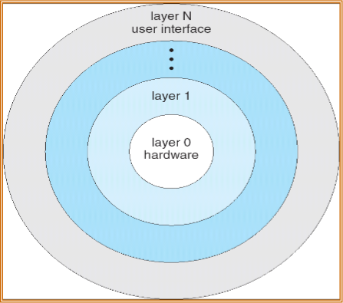
Layered Approach
  The operating system is divided into a number of layers (levels), each built on top of lower layers. The bottom layer (layer 0), is the hardware; the highest (layer N) is the user interface.
  With modularity, layers are selected such that each uses functions (operations) and services of only lower-level layers
Operating System Concepts
C1.31

Slide 32
UNIX
  UNIX – limited by hardware functionality, the original UNIX operating system had limited structuring. The UNIX OS consists of two separable parts
    Systems programs
    The kernel
      Consists of everything below the system-call interface and above the physical hardware
      Provides the file system, CPU scheduling, memory management, and other operating-system functions; a large number of functions for one level
Operating System Concepts
C1.32

Slide 33
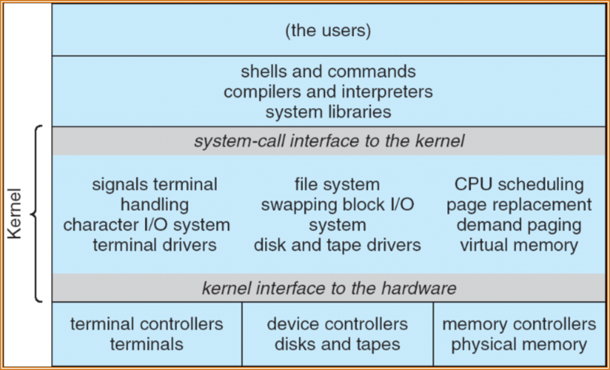
UNIX System Structure
Operating System Concepts
C1.33

Slide 34
Microkernel System Structure
  Moves as much from the kernel into “user” space
  Communication takes place between user modules using message passing
  Benefits:
    Easier to extend a microkernel
    Easier to port the operating system to new architectures
    More reliable (less code is running in kernel mode)‏
    More secure
  Detriments:
    Performance overhead of user space to kernel space communication (Windows NT First release)‏
  Mach (CMU), QNX
Operating System Concepts
C1.34

Slide 35
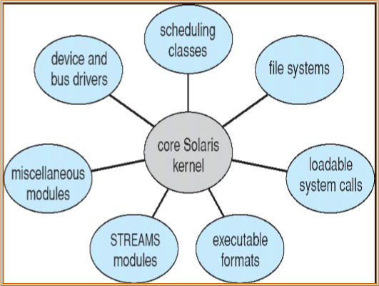
Modules
  Most modern operating systems implement kernel modules
    Uses object-oriented approach
    Each core component is separate
    Each talks to the others over known interfaces
    Each is loadable as needed within the kernel (dynamic loading)‏
  Overall, similar to layers but with more flexible (Solaris)‏
Operating System Concepts
C1.35

Slide 36
Virtual Machines
  A virtual machine takes the layered approach to its logical conclusion. It treats hardware and the operating system kernel as though they were all hardware
  A virtual machine provides an interface identical to the underlying bare hardware (with limitations eg. mini disks)‏
  The operating system creates the illusion of multiple processes, each executing on its own processor with its own (virtual) memory and environment
  The resources of the physical computer are shared to create the virtual machines
    CPU scheduling can create the appearance that users have their own processor
    Spooling and a file system can provide virtual card readers and virtual line printers
    A normal user time-sharing terminal serves as the virtual machine operator’s console
Operating System Concepts
C1.36

Slide 37
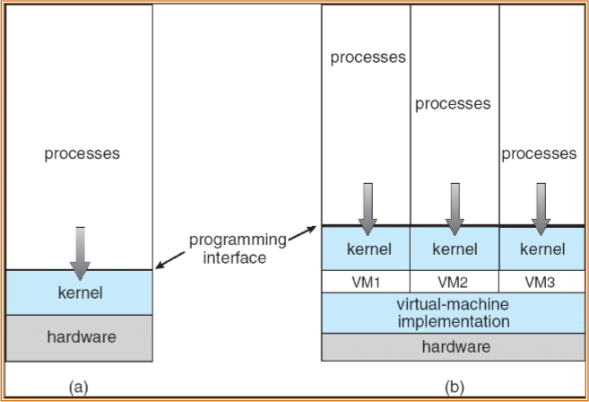
Virtual Machines (Cont.)‏
(a) Nonvirtual machine (b) Virtual machine
Non-virtual Machine
Virtual Machine
Operating System Concepts
C1.37

Slide 38
Virtual Machines (Cont.)‏
  The virtual-machine concept (pioneered by IBM) provides complete protection of system resources since each virtual machine is isolated from all other virtual machines. This isolation, however, permits no direct sharing of resources.
  A virtual-machine system is a perfect vehicle for operating-systems research and development. System development is done on the virtual machine, instead of on a physical machine and so does not disrupt normal system operation.
  Simulate a network of virtual machines
  The virtual machine concept is difficult to implement due to the effort required to provide an exact duplicate to the underlying machine
Operating System Concepts
C1.38

Slide 39
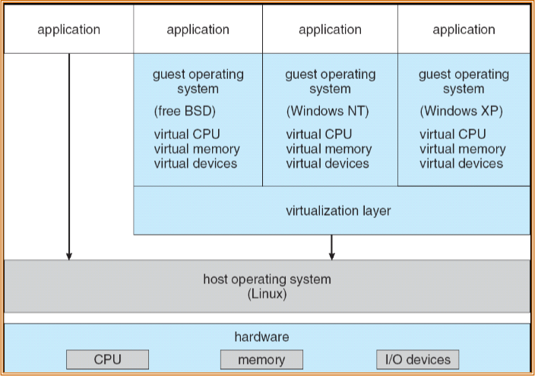
VMware Architecture
Operating System Concepts
C1.39

Slide 40
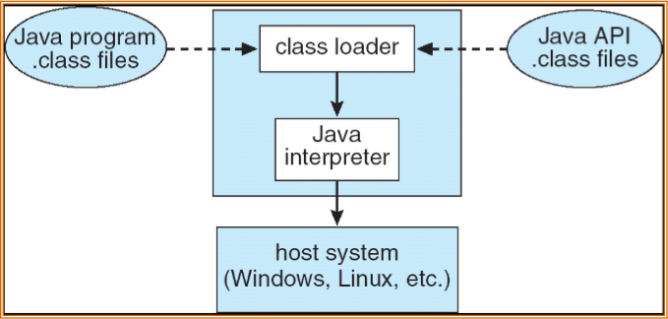
The Java Virtual Machine
  The class loader loads the compiled .class files from both the Java program and the Java API
  A verifier checks the validity of the bytecode, overflows of stack etc
  The Java interpreter executes the bytecode, does garbage collection etc
  Performance can be improved using a just-in-time (JIT) compiler or JVM is run in hardware on a special Java chip that executes bytecode as native code
Operating System Concepts
C1.40

Slide 41
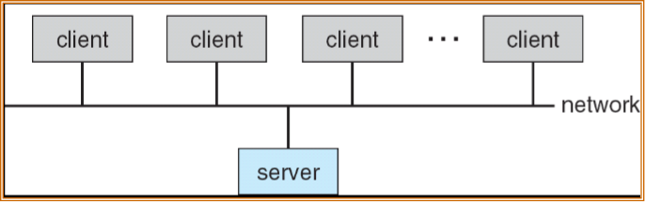
Computing Environments
  Client-Server Computing
    Dumb terminals supplanted by smart PCs
    Many systems now servers, responding to requests generated by clients
      Compute-server provides an interface to client to request services (i.e. database)‏
      File-server provides interface for clients to store and retrieve files
Operating System Concepts
C1.41

Slide 42
Web-Based Computing
  Web has become ubiquitous
  PCs most prevalent devices
  More devices becoming networked to allow web access
  Cloud Computing
  Use of operating systems like Windows 95, client-side, have evolved into Linux and Windows XP, which can be clients (Thin and Thick) and servers
Operating System Concepts
C1.42

Slide 43
Thanks and Question

