Slide 1

Process Management

Slide 2

Processes
  Process Concept
  Process Scheduling
  Operations on Processes
  Cooperating Processes
  Interprocess Communication
  Communication in Client-Server Systems
  Synchronization
  Sockets & Remote Procedure Calls
  Threads
  Process Scheduling
Process Management
C3.2

Slide 3
Process Concept
  An operating system executes a variety of programs:
    Batch system – jobs
    Time-shared systems – user programs or tasks
  The terms job, task and process almost interchangeably
  Process – a program in execution; process execution must progress in sequential fashion
  A process includes:
    program counter
    stack
    data section
  A process needs resources to execute
    CPU, memory, files, I/O devices,etc
  A thread is a light-weight process
Process Management
C3.3

Slide 4
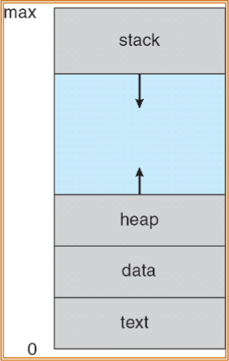
Process in Memory
Process Management
C3.4

Slide 5
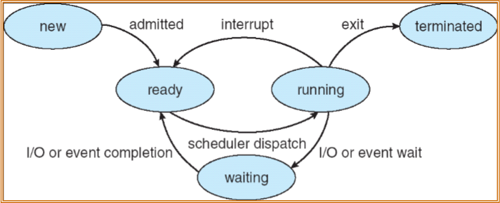
Process State
  As a process executes, it changes state
    new: The process is being created
    running: Instructions are being executed
    waiting: The process is waiting for some event to occur
    ready: The process is waiting to be assigned to a processor
    terminated: The process has finished execution
Process Management
C3.5

Slide 6
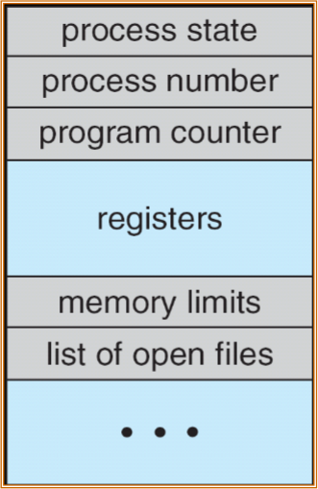
Process Control Block (PCB)‏
Information associated with each process
  Process state
  Program counter
  CPU registers
  CPU scheduling information
  Memory-management information
  Accounting information
  I/O status information
Process Management
C3.6

Slide 7
Context Switch
  When CPU switches to another process, the system must save the state of the old process and load the saved state for the new process
  Context-switch time is overhead; the system does no useful work while switching
  Time dependent on hardware support
Process Management
C3.7

Slide 8
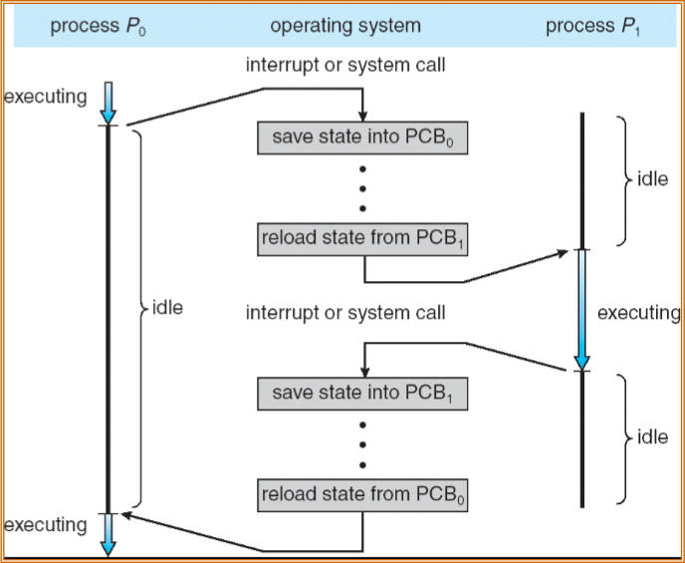
CPU Switch From Process to Process
Process Management
C3.8

Slide 9
Process Scheduling Queues
  Job queue – set of all processes in the system
  Ready queue – set of all processes residing in main memory, ready and waiting to execute
  Event queues – set of processes waiting for an event
  Device queues – set of processes waiting for an I/O device
  Processes migrate among the various queues
Process Management
C3.9

Slide 10
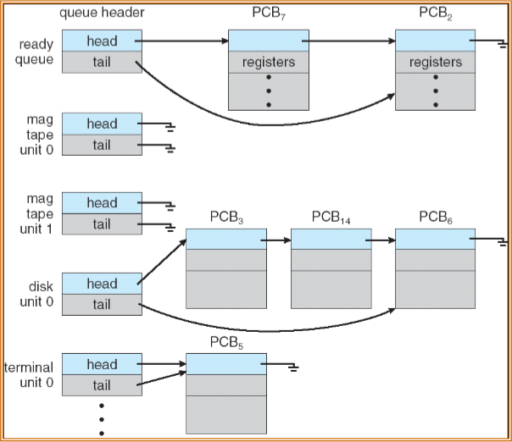
Ready Queue And Various I/O Device Queues
Process Management
C3.10

Slide 11
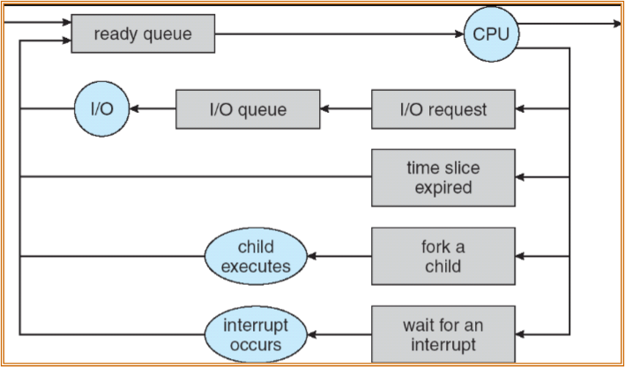
Representation of Process Scheduling
Process Management
C3.11

Slide 12
Schedulers
  Short-term scheduler (or CPU scheduler) – selects which process should be executed next and allocates CPU
    invoked very frequently (milliseconds)‏
  Long-term scheduler (or job scheduler) – selects which processes should be brought into the ready queue
    invoked very infrequently (seconds, minutes)‏
    Mix of I/O bound and CPU bound processes
    I/O-bound process – spends more time doing I/O than computations, many short CPU bursts
    CPU-bound process – spends more time doing computations; few very long CPU bursts
  Medium-term scheduler – swaps in and out jobs from the ready queue to disk to tune the degree of multiprogramming to optimize performance (virtual memory issues like thrashing)‏
Process Management
C3.12

Slide 13
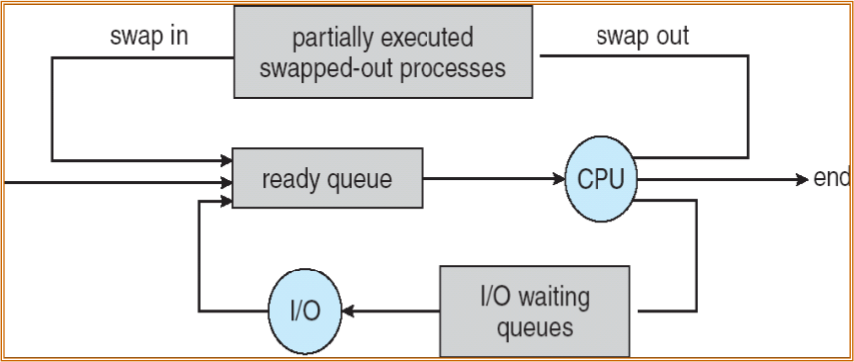
Addition of Medium Term Scheduling
Process Management
C3.13

Slide 14
Process Creation
  Parent processes create children processes, which, in turn create other processes, forming a tree of processes
    init process (pid=1) is the first created after booting.
  Resource sharing
    Parent and children share all resources
    Children share subset of parent’s resources
    Parent and child share no resources
  Execution
    Parent and children execute concurrently
    Parent waits until children terminate
  Address space
    Child duplicate of parent
    Child has a program loaded into it
  UNIX examples
    fork system call creates new process as a copy of parent
    exec system call used after a fork to replace the process’ memory space with a new program
Process Management
C3.14

Slide 15
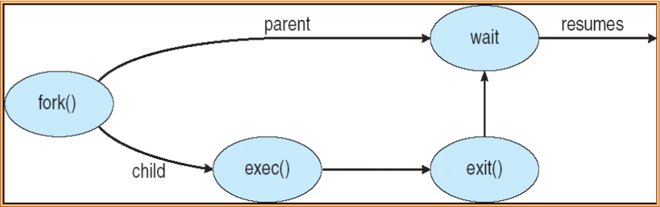
Process Creation contd
  UNIX examples
    fork system call creates new process as a copy of parent
    exec system call used after a fork to replace the process’ memory space with a new program
Process Management
C3.15

Slide 16









C Program Forking Separate Process
int main()‏
{
pid_t pid;
/* fork another process */
pid = fork();
if (pid < 0) { /* error occurred */
fprintf(stderr, "Fork Failed");
exit(-1);
}
else if (pid == 0) { /* child process */
execlp("/bin/ls", "ls", NULL);
}
else { /* parent process */
/* parent will wait for the child to complete */
wait (NULL);
printf ("Child Complete");
exit(0);
}
}
main
fork()‏
child
main
exec
wait
exit
continue
Process Management
C3.16

Slide 17
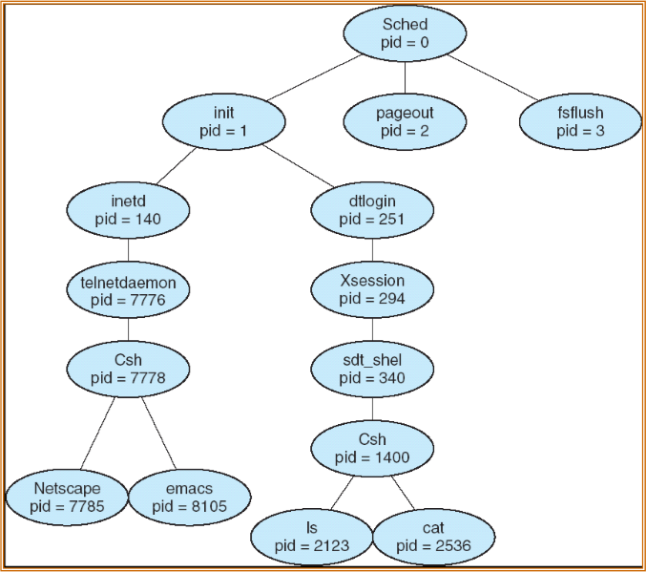
A tree of processes on a typical Solaris
Process Management
C3.17

Slide 18
Process Termination
  Process executes last statement and asks the operating system to delete it (exit 0 for successful exit, exit 1, or >0 for exit with error condition)‏
    Output data from child to parent (via wait)‏
    Process’ resources are deallocated by operating system
  Parent may terminate execution of children processes (abort)‏
    Child has exceeded allocated resources
    Task assigned to child is no longer required
    If parent is exiting
      Some operating system do not allow child to continue if its parent terminates
        All children terminated - cascading termination
      In Linux, if a parent terminates before a child, the child is re-parented to another process in the group or to the init process
Process Management
C3.18

Slide 19
Cooperating Processes
  Independent process cannot affect or be affected by the execution of another process
  Cooperating process can affect or be affected by the execution of another process
  Advantages of process cooperation
    Synchronization and Information sharing
    Computation speed-up
    Modularity
  Interprocess Process Communication mechanisms
    Shared Memory
    Message Passing
Process Management
C3.19

Slide 20
Producer-Consumer Problem
  Paradigm for cooperating processes, producer process produces information that is consumed by a consumer process
    unbounded-buffer places no practical limit on the size of the buffer
    bounded-buffer assumes that there is a fixed buffer size
    dual-buffer for many applications like communication
  Buffers are created in shared memory, where both the processes can access the data
Process Management
C3.20

Slide 21





Bounded-Buffer
Insert () method
while (true) {
/* Produce an item */
while (((in = (in + 1) % BUFSIZE) == out)‏
; /* do nothing -- no free buffers */
buffer[in] = item;
}
in
Buf 0
Buf 1
Buf 2
Buf 3
Remove () method
while (true) {
while (in == out)‏
; // do nothing -- nothing to consume
// remove an item from the buffer
item = buffer[out];
out = (out + 1) % BUFSIZE;
return item;
}
Buf 4
Buf 5
Buf n-1
out
Process Management
C3.21

Slide 22
Interprocess Communication (IPC)‏
  Mechanism for processes to communicate and to synchronize their actions
  Message passing – processes communicate with each other without resorting to shared variables
    IPC facility provides two operations:
      send(message) – message size fixed or variable
      receive(message)‏
    Direct Communication
      Between Processes
    Indirect Communication
      Through mailboxes
  Shared memory for interprocess communication
  Client-Server Communication
    Sockets
    Remote Procedure Calls
    Remote Method Invocation (Java)‏
Process Management
C3.22

Slide 23
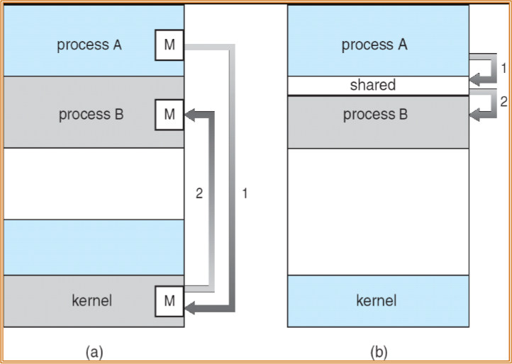
Communication Models
(a) Message Passing
(b) Shared Memory
Process Management
C3.23

Slide 24
Synchronization
  Message passing may be either blocking or non-blocking
  Blocking is considered synchronous
    Blocking send has the sender block until the message is received
    Blocking receive has the receiver block until a message is available
  Non-blocking is considered asynchronous
    Non-blocking send has the sender send the message and continue
    Non-blocking receive has the receiver receive a valid message or null
Process Management
C3.24

Slide 25
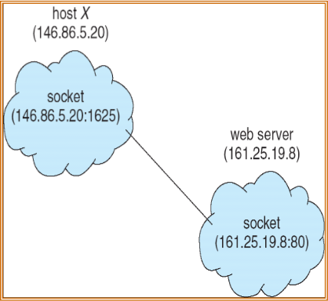
Sockets
  A socket is defined as an endpoint for communication
  Communication consists between a pair of sockets
  Socket Identifier: Concatenation of IP address and port
  The socket 161.25.19.8:80
(port 80 on host 161.25.19.8)‏
  Server waits for client requests on specific ports
  Ports < 1024 are well known
  (21: ftp, 23: telnet, 80: http)‏
  Host computer assigns a client requesting a connection
Client Server Model
Process Management
C3.25

Slide 26












Processes & Threads
  Process
    Address space
    Single thread of control
    Global Variables,
    Resources: files, timers, signals, etc
  Threads within a process
    Lightweight process
    Same address space
    Thread Id, priority, Program counter, stack, state
  Kernel threads
    Most of kernel functions
process
thread
pc

Slide 27
Threads
  Advantages
    Less overheads
    Same address space
      Better throughput
      eg: data base or file server
    Low context switching
    Parallel execution with multiple processors
  Issues
    Re-entrant code
    Managing global variables
  Threaded Applications
    Overlapping CPU work with I/O: For example, While one thread is waiting for an I/O system call to complete, CPU intensive work can be performed by other threads.
    Priority/real-time scheduling: tasks which are more important can be scheduled to supersede or interrupt lower priority tasks.
    Asynchronous event handling: tasks which service events of indeterminate frequency and duration can be interleaved.

Slide 28
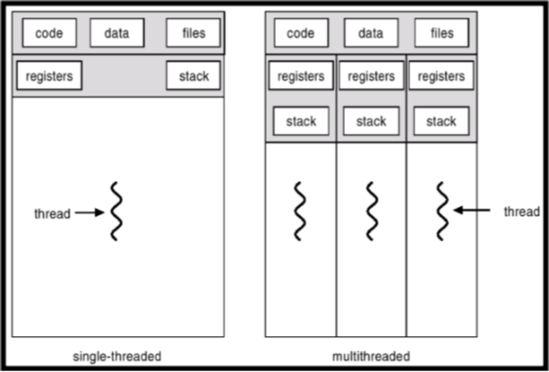
Threaded Applications
  Overlapping CPU work with I/O: For example, While one thread is waiting for an I/O system call to complete, CPU intensive work can be performed by other threads.
  Priority/real-time scheduling: tasks which are more important can be scheduled to supersede or interrupt lower priority tasks.
  Asynchronous event handling: tasks which service events of indeterminate frequency and duration can be interleaved.

Slide 29
Models of Thread Programming
  Master/slave model – one thread (the master) receives each request and creates slave threads to handle the request.
  Worker model – a number of worker threads are created to service clients; client requests are placed on a queue, and removed by worker threads when as they finish earlier requests.
  Pipelining model – tasks are broken into smaller components, each component providing the input to the next component.

Slide 30
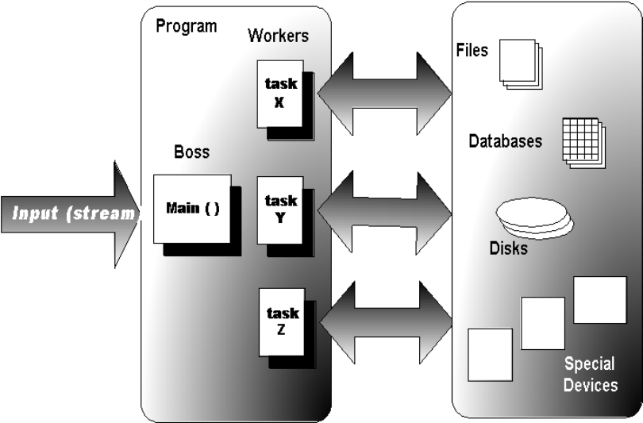
Master/Slave Model

Slide 31
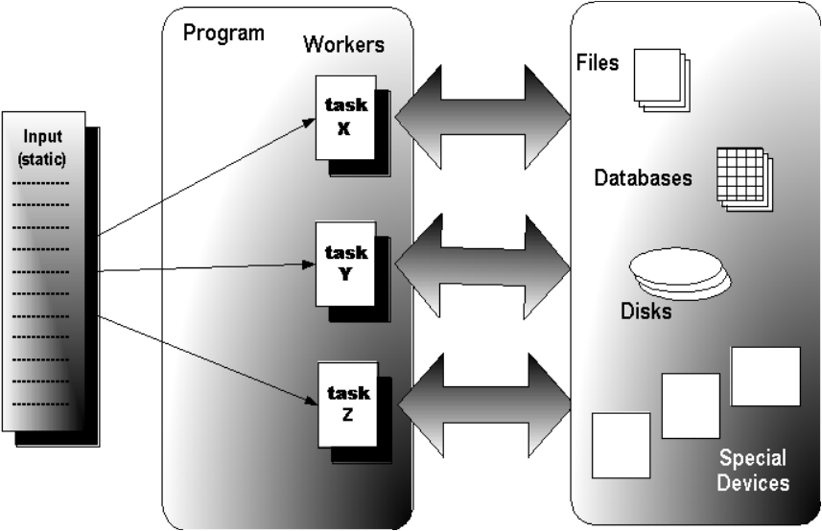
Worker Model

Slide 32
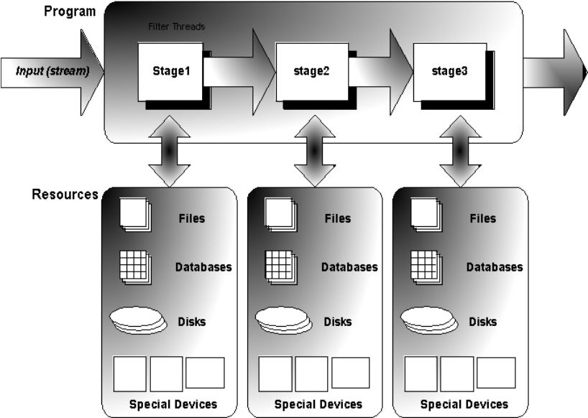
Pipeline Model

Slide 33
CPU Scheduling
  Basic Concepts
  Scheduling Criteria
  Scheduling Algorithms
  Multiple-Processor Scheduling
  Real-Time Scheduling
  Thread Scheduling
Process Management
C3.35

Slide 34
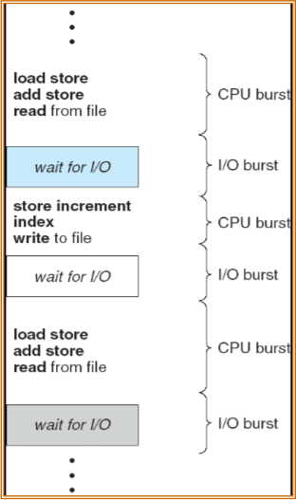
Basic Concepts
  Maximum CPU utilization obtained with multiprogramming
  Process execution consists of a cycle of CPU execution and I/O wait - CPU–I/O Burst Cycle
  CPU burst distribution
Process Management
C3.36

Slide 35
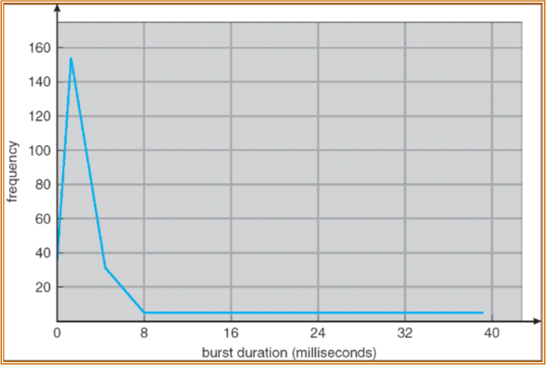
Histogram of CPU-burst Times
Process Management
C3.37

Slide 36
CPU Scheduler
  Selects a process from the ready queue, and allocates the CPU to one of them
  CPU scheduling decisions may take place when a process:
    1. Switches from running to waiting state (I/O, messages)‏
    2. Switches from running to ready state (interrupt, timeout)‏
    3. Switches from waiting to ready (I/O completion, message)‏
    4. Terminates
  Scheduling under 1 and 4 is nonpreemptive (Once CPU is assigned to a process, it is released only by the process)‏
  All other scheduling is preemptive (OS withdraws CPU from a running process)‏
Process Management
C3.38

Slide 37
Dispatcher
  Dispatcher module gives control of the CPU to the process selected by the short-term scheduler; this involves:
    switching context
    switching to user mode
    jumping to the proper location in the user program to restart that program
  Dispatch latency – time it takes for the dispatcher to stop one process and start another running
Process Management
C3.39

Slide 38
Scheduling Criteria
  CPU utilization – keep the CPU as busy as possible
  Throughput – maximize # of processes that complete their execution per time unit
  Turnaround time – minimize amount of time to execute a particular process
  Waiting time – minimize amount of time a process has been waiting in the ready queue
  Response time – minimize amount of time it takes from when a request was submitted until the first response is produced (for time-sharing environment)‏
Process Management
C3.40

Slide 39

First-Come, First-Served (FCFS) Scheduling
Process Burst Time
P1 24
P2 3
P3 3
  Suppose that the processes arrive at time 0, in the order: P1 , P2 , P3
  The Gantt Chart for the schedule is:
  Waiting time for P1 = 0; P2 = 24; P3 = 27
  Average waiting time: (0 + 24 + 27)/3 = 17
P1
P2
P3
0
24
27
30
Process Management
C3.41

Slide 40

FCFS Scheduling (Cont.)‏
Suppose that the processes arrive in the order
P2 , P3 , P1 at time 0
  The Gantt chart for the schedule is:
  Waiting time for P1 = 6; P2 = 0; P3 = 3
  Average waiting time: (6 + 0 + 3)/3 = 3
  Much better than previous case
  Convoy effect - short process behind long process
P2
P3
P1
0
3
6
30
Process Management
C3.42

Slide 41
Shortest-Job-First (SJF) Scheduling
  Associate with each process the length of its next CPU burst. Use these lengths to schedule the process with the shortest time
  Two schemes:
    nonpreemptive – once CPU given to the process it cannot be preempted until completes its CPU burst
    preemptive – if a new process arrives with CPU burst length less than remaining time of current executing process, preempt.
    This scheme is know as the Shortest-Remaining-Time-First (SRTF)‏
  SJF is optimal – gives minimum average waiting time for a given set of processes
Process Management
C3.43

Slide 42

Example of Non-Preemptive SJF
Process Arrival Time Burst Time
P1 0.0 7
P2 2.0 4
P3 4.0 1
P4 5.0 4
  SJF (non-preemptive)‏
  Average waiting time = (0 + 6 + 3 + 7)/4 = 4
P1
P3
P2
P4
0
3
7
8
12
16
Process Management
C3.44

Slide 43

Example of Preemptive SJF
Process Arrival Time Burst Time
P1 0.0 7
P2 2.0 4
P3 4.0 1
P4 5.0 4
  Preemptive SJF (preempt if a new process arrives with CPU burst length less than remaining time of current executing process)‏
  Average waiting time = (9 + 1 + 0 +2)/4 = 3
P1
P2
P3
P2
P4
P1
0
2
4
5
7
11
16
Process Management
C3.45

Slide 44
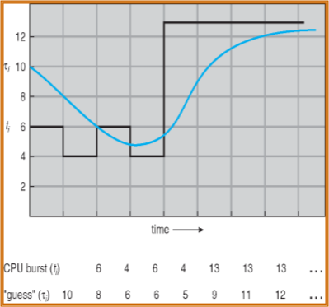
Determining Length of Next CPU Burst
  Can only estimate the length
  Can be done by using the length of previous CPU bursts, using exponential averaging
1. tn = actual length of nth CPU burst
2. ζn = predicted value for nth CPU burst
3. α, 0 ≤ α ≤ 1
4. Define: ζn+1 = α tn + (1- α) ζn
Process Management
C3.46

Slide 45
Priority Scheduling
  A priority number (integer) is associated with each process
  The CPU is allocated to the process with the highest priority (smallest integer  highest priority)‏
    Preemptive
    nonpreemptive
  SJF is a priority scheduling where priority is the inverse of the predicted next CPU burst time
  Problem  Starvation – low priority processes may never execute
  Solution  Aging – as time progresses increase the priority of the process
Process Management
C3.47

Slide 46
Round Robin (RR)‏
  Each process gets a small unit of CPU time (time quantum), usually 10-100 milliseconds. After this time has elapsed, the process is preempted and added to the end of the ready queue.
  If there are n processes in the ready queue and the time quantum is q, then each process gets 1/n of the CPU time in chunks of at most q time units at once. No process waits more than (n-1)q time units.
  Performance
    q large  FIFO
    q small  q must be large with respect to context switch, otherwise overhead is too high
    (context switch time is less than 10 microseconds)
Process Management
C3.48

Slide 47
Multilevel Queue
  Ready queue is partitioned into separate queues:
  foreground (interactive)
  background (batch)‏
  Each queue has its own scheduling algorithm
    foreground – RR
    background – FCFS
  Scheduling must be done between the queues
    Fixed priority scheduling; (i.e., serve all from foreground then from background). Possibility of starvation.
    Time slice – each queue gets a certain amount of CPU time which it can schedule amongst its processes; i.e., 80% to foreground in RR
    20% to background in FCFS
Process Management
C3.49

Slide 48
Multiple-Processor Scheduling
  CPU scheduling is more complex when multiple CPUs are available
  Asymmetric Multiprocessing, where one CPU (master) handles scheduling decisions, I/O processing, system activities (alleviating the need for data sharing)‏
  Symmetric Multiprocessing, where each processor is self-scheduling. All processes are in common queues.
    Processor affinity to improve cache performance
    Load Balancing by Push and Pull migration
Real-Time Scheduling
  Hard real-time systems – required to complete a critical task within a guaranteed amount of time
  Soft real-time computing – requires that critical processes receive priority over normal processes
Process Management
C3.50

Slide 49
Linux Scheduling
  Preemptive, priority-based scheduling
  Two algorithms: time-sharing and real-time
  Time-sharing (nice values range from 100 to 140)‏
    Dynamic priorities
      I/O bound jobs have higher priorities
      Aging adds priority
  Real-time (Real-time priorities vary from 0 to 99)‏
    Soft real-time
    Posix.1b compliant – (static priorities)‏
      FCFS and RR
      Highest priority process always runs first
Process Management
C3.51

Slide 50
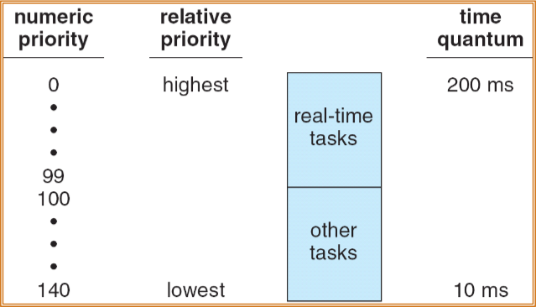
The Relationship Between Priorities and Time-slice length
Process Management
C3.52

Slide 51
Thanks & questions

