Slide 1

Process Synchronization & Deadlocks

Slide 2

Background
  Concurrent access to shared data may result in data inconsistency
  Maintaining data consistency requires mechanisms to ensure the orderly execution of cooperating processes
  Some mechanisms may result in a situation where processes are waiting indefinitely. This situation is known as deadlock. OS need to prevent and deal with deadlocks if they occur
Process Synchronization & Deadlocks
C4.2

Slide 3
Race Condition
  count++ could be implemented as
  register1 = count
  register1 = register1 + 1
  count = register1
  count-- could be implemented as
  register2 = count
  register2 = register2 - 1
  count = register2
  Consider this execution interleaving with “count = 5” initially:
    S0: producer execute register1 = count {register1 = 5}
    S1: producer execute register1 = register1 + 1 {register1 = 6}
    S2: consumer execute register2 = count {register2 = 5}
    S3: consumer execute register2 = register2 - 1 {register2 = 4}
    S4: producer execute count = register1 {count = 6 }
    S5: consumer execute count = register2 {count = 4}
Process Synchronization & Deadlocks
C4.4

Slide 4
Critical-Section Problem
  We declare a portion of code that should be allowed to complete without interrupting as a critical section
  If process Pi is executing in its critical section, then no other processes can be executing in their critical section - Mutual Exclusion
  Kernels have large number of data whose integrity should be maintained.
  Hence most kernels are not preemptive (turn off interrupts during kernel routine execution).
  But a real time process, ready to run, will have to wait for a lower priority process which may be in kernel mode.
  Linux 2.6 onwards have preemptive kernels.
  The kernel operation which is needed to accomplish a major function, instead of being implemented as one non-preemptive module, is broken up into many smaller sections and only the critical sections, which modify kernel data structures, are made non-preemptive, and the kernel during the remaining operations is preemptive.
Process Synchronization & Deadlocks
C4.5

Slide 5
Semaphore
  Synchronization tool that does not require busy waiting
  Semaphore S – integer variable
  Two standard operations modify S: wait() and signal()‏
    Originally called P() and V()‏
  The semaphores can only be accessed only via two indivisible (atomic) operations, apart from its creation which initializes its value
    wait (S) {
    while S <= 0
    ; // no-op
    S--;
    }
    signal (S) {
    S++;
    }
    The operations which change the value of S will be atomic, and the test of S and its possible modification in wait will also be atomic
Process Synchronization & Deadlocks
C4.8

Slide 6
Semaphore as General Synchronization Tool
  Counting semaphore – integer value can range over a number indicating available resources
  Binary semaphore – integer value can range only between 0
  and 1; can be simpler to implement
    Also known as mutex locks
  Semaphore Implementation
    Busy wait – not efficient use of CPU
  Using Scheduler
    With each semaphore there is an associated variable value and a waiting queue
    When a process executes wait on a semaphore not positive, it will block – suspend and place itself on the appropriate waiting queue. The scheduler will select another process in ready queue to execute
    When a process executes signal on a semaphore, it will wakeup one of the processes in the waiting queue – remove from the waiting queue and place it in the ready queue
Process Synchronization & Deadlocks
C4.9

Slide 7
Solution using semaphore
  Implementation of wait:
wait (S) {
value--;
if (value < 0) {
add this process to waiting queue
block(); }
}
  Implementation of signal:
signal (S){
value++;
if (value <= 0) {
remove a process P from the waiting queue
wakeup(P); }
}
Process Synchronization & Deadlocks
C4.10

Slide 8
Deadlock and Starvation
  Deadlock – two or more processes are waiting indefinitely for an event that can be caused by only one of the waiting processes
  Let S and Q be two semaphores initialized to 1
P0 P1
wait (S); wait (Q);
wait (Q); wait (S);
. .
signal (S); signal (Q);
signal (Q); signal (S);
  Starvation – indefinite blocking. A process may never be removed from the semaphore queue in which it is suspended.
  Classical Problems of Synchronization
    Bounded-Buffer Problem
    Readers and Writers Problem
    Dining-Philosophers Problem
Process Synchronization & Deadlocks
C4.11

Slide 9
Bounded-Buffer Problem
  N buffers, each can hold one item
  Semaphore mutex, provides mutual exclusion access to the buffer pool; initialized to the value 1
  Semaphore full (initialized to 0) and empty (initialized to N) count the number of full and empty buffer
  The producer process
while (true) {
// produce an item
wait (empty);
wait (mutex);
// add the item to the buffer
signal (mutex);
signal (full);
}
  The consumer process
while (true) {
wait (full);
wait (mutex);
// remove an item from buffer
signal (mutex);
signal (empty);
// consume the removed item
}
Process Synchronization & Deadlocks
C4.12

Slide 10
Readers-Writers Problem
  A data set is shared among a number of concurrent processes
    Readers – only read the data set; they do not perform any updates
    Writers – can both read and write.
  Problem – allow multiple readers and only one writer to access the data at the same time. No reader should wait, unless writer is accessing the data
  Shared Data
    Semaphore mutex initialized to 1
    Integer readcount initialized to 0
    Semaphore wrt initialized to 1
  The reader process
while (true) {
wait (mutex) ;
readcount ++ ;
if (readcount == 1) wait (wrt) ;
signal (mutex) ;
// reading is performed
wait (mutex) ;
readcount - - ;
if (readcount == 0) signal (wrt) ;
signal (mutex) ;
}
  The writer process
while (true) {
wait (wrt) ;
// writing is done
signal (wrt) ;
}
Process Synchronization & Deadlocks
C4.13

Slide 11

Dining-Philosophers Problem
  Classical problem
    5 philosophers thinking and eating
    One can eat only when he can get both neighboring chopsticks, which he has to pickup one by one
  Issues
    What if all pick at same time the left chopstick – deadlock
    How ensure no philosopher starves
Process Synchronization & Deadlocks
C4.14

Slide 12
Problems with Semaphores
  Incorrect use of semaphore operations can lead to deadlocks or data corruption
    signal (mutex) …. wait (mutex)‏
    wait (mutex) … wait (mutex)‏
    Omitting of wait (mutex) or signal (mutex) (or both)‏
  Semaphores are low level constructs and there is potential to misuse
  C.A.R. Hoare and Per Brinch Hansen proposed a high level construct called Monitors
  A monitor is an object with methods, which can be used by threads. At any time, at most one thread may be execute any of its methods
Process Synchronization & Deadlocks
C4.15

Slide 13
Linux Synchronization
  Linux:
    disables interrupts (on single-processor systems) to implement short critical sections
  Linux provides:
    Semaphores (process state changed to wait)‏
    spin locks (busy wait to avoid context switching)‏
  Pthreads Synchronization
(Pthreads API is OS-independent)‏
  It provides:
    mutex locks
    condition variables (as in monitors)‏
  Non-portable extensions include:
    read-write locks (specifying mode of the lock – read or write)‏
    spin locks
Process Synchronization & Deadlocks
C4.19

Slide 14
The Deadlock Problem
  A set of blocked processes each holding a resource and waiting to acquire a resource held by another process in the set.
  Example
    System has 2 disk drives.
    P1 and P2 each hold one disk drive and each needs another one.
  Example
    semaphores A and B, initialized to 1
        P0 P1
        wait (A); wait(B)‏
        wait (B); wait(A)‏
Process Synchronization & Deadlocks
C4.20

Slide 15
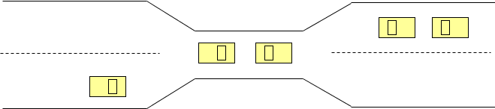
Bridge Crossing Example
  Traffic only in one direction.
  Each section of a bridge can be viewed as a resource.
  If a deadlock occurs, it can be resolved if one car backs up (preempt resources and rollback).
  Several cars may have to be backed up if a deadlock occurs.
  Starvation is possible.
Process Synchronization & Deadlocks
C4.21

Slide 16
System Model
  Resource types R1, R2, . . ., Rm
      CPU cycles, memory space, I/O devices, files
  Each resource type Ri has Wi instances.
  Each process utilizes a resource as follows:
    request
    use
    release
Process Synchronization & Deadlocks
C4.22

Slide 17
Deadlock Characterization
Deadlock can arise if four conditions hold simultaneously.
  Mutual exclusion: only one process at a time can use a resource.
  Hold and wait: a process holding at least one resource is waiting to acquire additional resources held by other processes.
  No preemption: a resource can be released only voluntarily by the process holding it, after that process has completed its task.
  Circular wait: there exists a set {P0, P1, …, P0} of waiting processes such that P0 is waiting for a resource that is held by P1, P1 is waiting for a resource that is held by P2, …, Pn–1 is waiting for a resource that is held by Pn, and P0 is waiting for a resource that is held by P0.
Process Synchronization & Deadlocks
C4.23

Slide 18


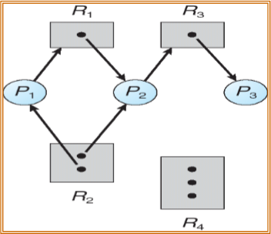



Resource-Allocation Graph
A set of vertices V and a set of edges E.
  V is divided into 2 partitions:
    P = {P1, P2, …, Pn}, the set consisting of all the processes in the system.
    R = {R1, R2, …, Rm}, the set consisting of all resource types in the system.
  request edge – directed edge P1  Rj
  assignment edge – directed edge Rj  Pi
Process
Resource Type with 4 instances
Pi
Rj
Pi requests instance of Rj
Pi
Rj
Pi is holding an instance of Rj
Process Synchronization & Deadlocks
C4.24

Slide 19
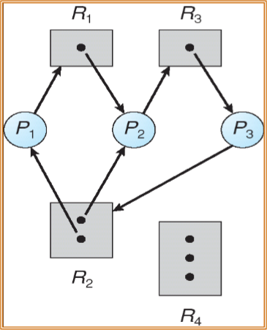
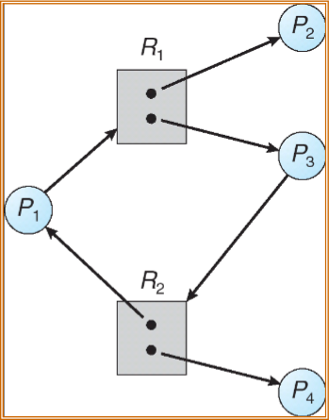
Resource Allocation Graph With A Deadlock
Graph With A Cycle But No Deadlock
Process Synchronization & Deadlocks
C4.25

Slide 20
Methods for Handling Deadlocks
  Ensure that the system will never enter a deadlock state.
  Allow the system to enter a deadlock state and then recover.
  Ignore the problem and pretend that deadlocks never occur in the system; used by most operating systems, including UNIX.
Process Synchronization & Deadlocks
C4.26

Slide 21
Deadlock Prevention
Restrain the ways request can be made.
  Mutual Exclusion – not required for sharable resources (eg read-only file); must hold for nonsharable resources (eg printer)‏
  Hold and Wait – must guarantee that whenever a process requests a resource, it does not hold any other resources.
    Require process to request and be allocated all its resources before it begins execution, or allow process to request resources only when the process has none.
    Low resource utilization; starvation possible.
Process Synchronization & Deadlocks
C4.27

Slide 22
Deadlock Prevention (Cont.)‏
  No Preemption –
    If a process that is holding some resources requests another resource that cannot be immediately allocated to it, then all resources currently being held are released.
    Preempted resources are added to the list of resources for which the process is waiting.
    Process will be restarted only when it can regain its old resources, as well as the new ones that it is requesting.
  Circular Wait – impose a total ordering of all resource types, and require that each process requests resources in an increasing order of enumeration.
Process Synchronization & Deadlocks
C4.28

Slide 23
Deadlock Detection
  Allow system to enter deadlock state
  Detection algorithm
  Recovery scheme
Process Synchronization & Deadlocks
C4.29

Slide 24
Recovery from Deadlock: Process Termination
  Abort all deadlocked processes.
  Abort one process at a time until the deadlock cycle is eliminated.
  In which order should we choose to abort?
    Priority of the process.
    How long process has computed, and how much longer to completion.
    Resources the process has used.
    Resources process needs to complete.
    How many processes will need to be terminated.
    Is process interactive or batch?
Process Synchronization & Deadlocks
C4.30

Slide 25
Thanks & Questions

