Slide 1

Memory Management

Slide 2

Memory Management
  Background
  Swapping
  Contiguous Memory Allocation
  Paging
  Structure of the Page Table
  Segmentation
  Example: The Intel Pentium
Memory Management
C5.2

Slide 3
Background
  Program must be brought (from disk) into memory and placed within a process for it to be run
  Main memory and registers are only storage CPU can access directly
  Register access in one CPU clock (or less)‏
  Main memory can take many cycles
  Cache sits between main memory and CPU registers
  Multi processing improves system performance
    Multiple processes need to be in memory at the same time
  Protection of memory required to ensure correct operation
    A process may access memory only in a range of addresses
Memory Management
C5.3

Slide 4
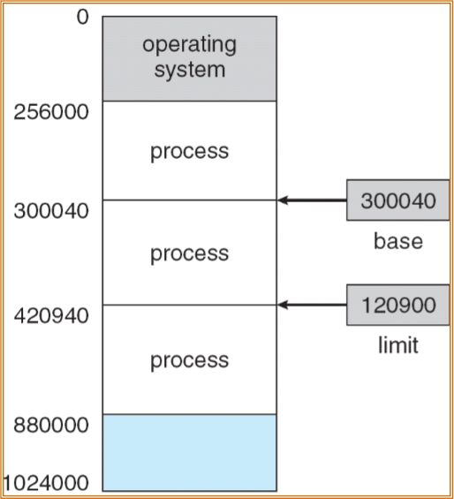
Base and Limit Registers
  A pair of base and limit registers define the logical address space for a process
  This allows a process to be relocated after swapping out and swapping in
Memory Management
C5.4

Slide 5
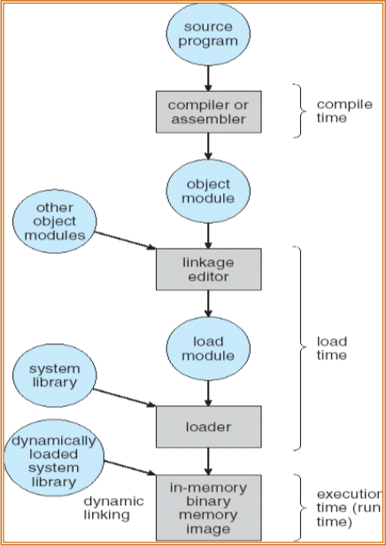
Binding of Instructions and Data to Memory
  Address binding of instructions and data to memory addresses can happen at different stages
    Compile time: If memory location known a priori, absolute code can be generated; must recompile code if starting location changes
    Load time: Must generate relocatable code if memory location is not known at compile time
    Execution time: Binding delayed until run time if the process can be moved during its execution from one memory segment to another. Need hardware support for address maps (e.g., base and limit registers)‏
Memory Management
C5.5

Slide 6
Logical vs. Physical Address Space
  The concept of a logical address space that is bound to a separate physical address space is central to proper memory management
    Logical address – generated by the CPU; also referred to as virtual address (The set of all logical addresses for a process is known as its address space)‏
    Physical address – address seen by the memory unit
  Logical and physical addresses are the same in compile-time and load-time address-binding schemes; logical (virtual) and physical addresses differ in execution-time address-binding scheme
  Memory-Management Unit (MMU)‏
    Hardware device that maps virtual to physical address
    In MMU scheme, the value in the relocation register is added to every address generated by a user process at the time it is sent to memory
    The user program deals with logical addresses (0 to max); it never sees the real physical addresses (R + 0 to R + max)‏
Memory Management
C5.6

Slide 7
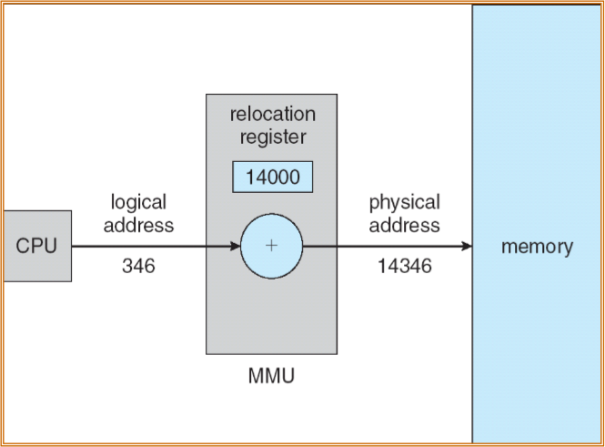
Dynamic relocation using a relocation register
Memory Management
C5.7

Slide 8
Dynamic Loading
  Routine is not loaded until it is called
  Better memory-space utilization; unused routine is never loaded
  Useful when large amounts of code are needed to handle infrequently occurring cases
  All programs are in disk in a relocatable load format
  No special support from the operating system is required. This is implemented through program design
Memory Management
C5.8

Slide 9
Dynamic Linking
  Linking postponed until execution time
  Small piece of code, stub, used to locate the appropriate memory-resident library routine
  Stub replaces itself with the address of the routine, and executes the routine
  Operating system needed to check if routine is in processes’ memory address
  Dynamic linking is particularly useful for libraries, known as shared libraries
Memory Management
C5.9

Slide 10
Swapping
  A process can be swapped temporarily out of memory to a backing store, and then brought back into memory for continued execution
  Backing store – fast disk large enough to accommodate copies of all memory images for all users; must provide direct access to these memory images
  Roll out, roll in – swapping variant used for priority-based scheduling algorithms; lower-priority process is swapped out so higher-priority process can be loaded and executed
  Major part of swap time is transfer time; total transfer time is directly proportional to the amount of memory swapped
  If binding is done during compile or load time then the process must be swapped in in the same location. For execution time binding the process can be relocated
  System maintains a ready queue of ready-to-run processes which have memory images on disk
Memory Management
C5.10

Slide 11
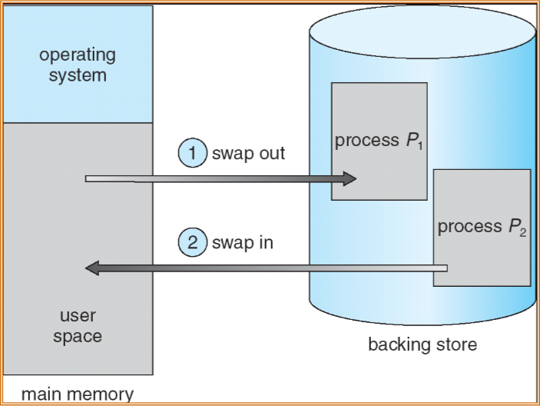
Schematic View of Swapping
Memory Management
C5.11

Slide 12
Contiguous Allocation
  Main memory usually into two partitions:
    Resident operating system, usually held in low memory with interrupt vector
    User processes then held in high memory
  Relocation registers used to protect user processes from each other, and from changing operating-system code and data
    Base register contains value of smallest physical address
    Limit register contains range of logical addresses – each logical address must be less than the limit register
    MMU maps logical address dynamically
Memory Management
C5.12

Slide 13
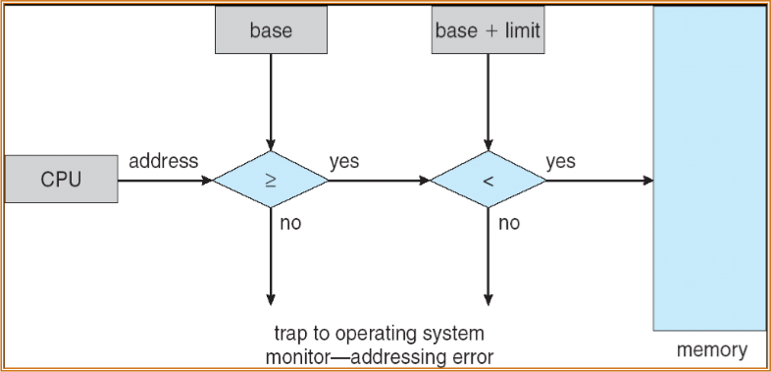
HW address protection with base and limit registers
Memory Management
C5.13

Slide 14

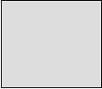


Memory Allocation
  Fixed-sized partitions (MFT)‏
    Each partition can contain only one process (IBM OS/360, no longer used)‏
  Variable-partition allocation (MVT)‏
    Hole – block of available memory; holes of various size are scattered throughout memory
    When a process arrives, it is put in a queue (ordered)‏
    A process is allocated memory from a large enough hole
    Operating System maintains information about:
    a) input queue (with memory requirement), b) allocated partitions, c) free partitions (holes)‏
OS
OS
OS
OS
process 5
process 5
process 5
process 5
process 9
process 9
process 8
process 10
process 2
process 2
process 2
process 2
Memory Management
C5.14

Slide 15
Dynamic Storage-Allocation Problem
How to satisfy a request of size n from a list of free holes
  First-fit: Allocate the first hole that is big enough
  Best-fit: Allocate the smallest hole that is big enough; must search entire list, unless ordered by size
    Produces the smallest leftover hole
  Worst-fit: Allocate the largest hole; must also search entire list
    Produces the largest leftover hole
First-fit and best-fit better than worst-fit in terms of speed and storage utilization
Memory Management
C5.15

Slide 16
Fragmentation
  External Fragmentation – total memory space exists to satisfy a request, but it is not contiguous
  Internal Fragmentation – allocated memory may be slightly larger than requested memory; this size difference is memory internal to a partition, but not being used
  Reduce external fragmentation by compaction
    Shuffle memory contents to place all free memory together in one large block (evaluate cost in time)‏
    Compaction is possible only if relocation is dynamic, and is done at execution time
  Fragmentation is also a problem in backing store
Memory Management
C5.16

Slide 17
Paging
  Logical address space of a process can be noncontiguous; process is allocated physical memory whenever the latter is available
  Divide physical memory into fixed-sized blocks called frames (size is power of 2, between 512 bytes and 8,192 bytes, these days between 4KB and 8KB, and for large systems 4MB)‏
  Divide logical memory into blocks of same size called pages
  Keep track of all free frames
  To run a program of size n pages, need to find n free frames and load pages into those frames
  Set up a page table to translate logical to physical addresses
  No external fragmentation, but internal fragmentation
  Large page size will have more internal fragmentation, while smaller page size has more overheads
Memory Management
C5.17

Slide 18

Address Translation Scheme
  Address generated by CPU (Logical address) is divided into:
    Page number (p) – used as an index into a page table which contains base address of each page in physical memory
    Page offset (d) – combined with base address to define the physical memory address that is sent to the memory unit
    For given logical address space 2^m and page size 2^n
page number
page offset
p
d
m - n
n
Memory Management
C5.18

Slide 19
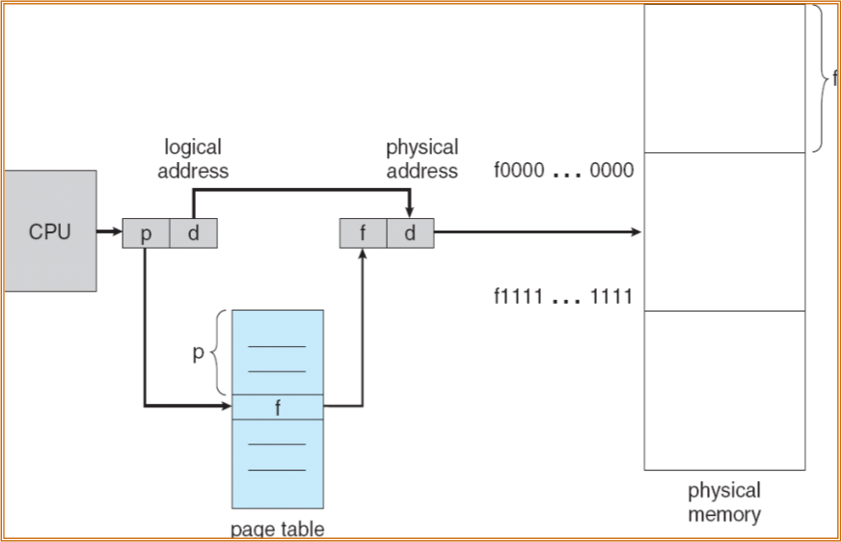
Paging Hardware
Memory Management
C5.19

Slide 20
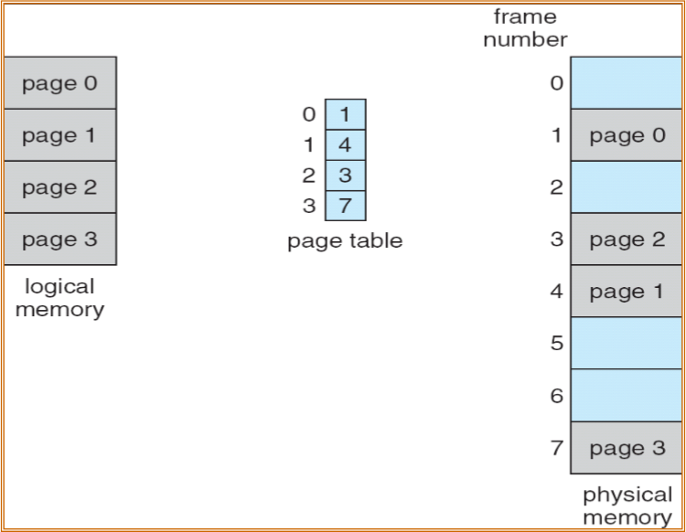
Paging Model of Logical and Physical Memory
32-byte memory and 4-byte pages
Memory Management
C5.20

Slide 21
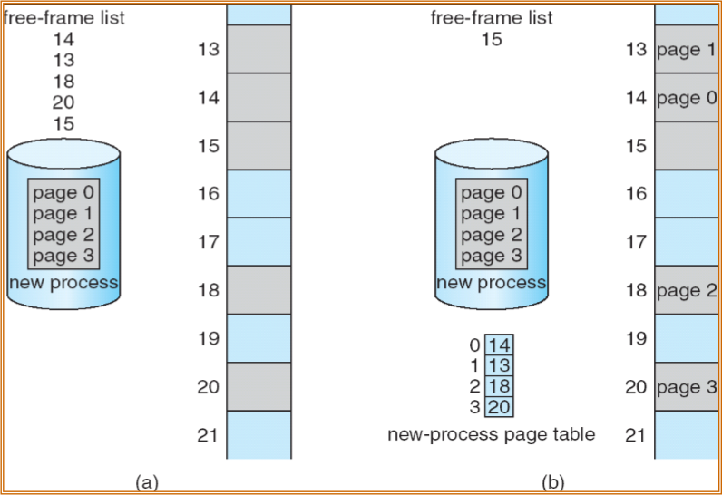
Free Frames
Before allocation
After allocation
Memory Management
C5.21

Slide 22
Implementation of Page Table
  Page table is kept in main memory
  A Page Table Base Register (PTBR) points to the page table
  In this scheme every data/instruction access requires two memory accesses: one for the page table and one for the data/instruction
  Memory access is improved by the use of a special fast-lookup hardware cache called associative memory or translation look-aside buffer (TLB)‏
  The TLB contains only a few of the pages of a process
  For a logical address generated by the CPU, its page number is presented to the TLB to search if that page number is available. If found, the frame number is used to access memory.
  If not found, a memory reference to the page table is made and its address is stored in TLB
  Percentage of times the page is found is known as hit ratio
  If the page table is full, a page is selected for replacement
  Replacement policies range from random to least recently used (LRU)‏
  An address-space identifiers (ASIDs) in each TLB entry can be used to point to the process, to implement protection.
Memory Management
C5.22

Slide 23

Page Table
  Associative Cache
Page #
Frame #
  Address translation (p, d)‏
    Search in parallel if p is in page #
    Cache hit: get frame # out
    Cache miss: replace a page and find page in memory and load frame address in TLB
  Effective access time
    Search time in TLB=20 ns; memory access time = 100 ns;
    For hit ratio = 80%
      effective access time = 0.8 * 120 + 0.2 * 220 = 140 ns
    For hit ratio = 98%
      effective access time = 0.98 *120 +0.02 * 220 = 122 ns
Memory Management
C5.23

Slide 24
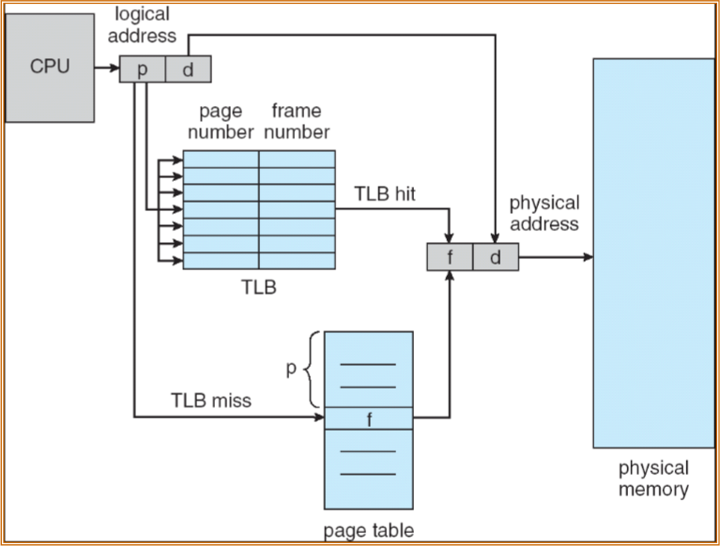
Paging Hardware With TLB
Memory Management
C5.24

Slide 25
Memory Protection
  Memory protection implemented by associating protection bit with each frame
  Valid-invalid bit attached to each entry in the page table:
    “valid” indicates that the associated page is in the process’ logical address space, and is thus a legal page
    “invalid” indicates that the page is not in the process’ logical address space
  Additional protection bits may be provided to indicate:
    Read-write or read-only
Memory Management
C5.25

Slide 26
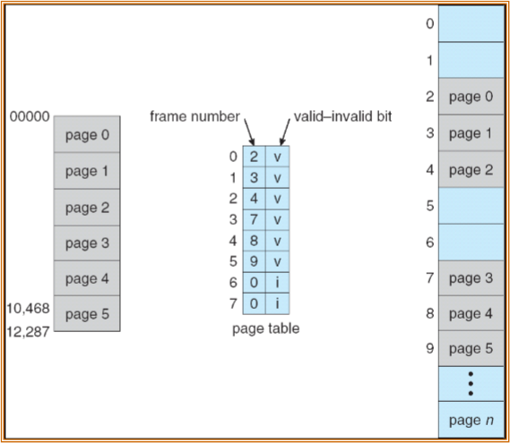
Valid (v) or Invalid (i) Bit In A Page Table
Memory Management
C5.26

Slide 27
Shared Pages
  Shared code
    One copy of read-only (reentrant) code shared among processes (i.e., text editors, compilers, window systems).
    Shared code must appear in same location in the logical address space of all processes
    Shared memory is used for Inter Process Communication. OS supports shared memory by using shared pages
  Private code and data
    Each process keeps a separate copy of the code and data
    The pages for the private code and data can appear anywhere in the logical address space
Memory Management
C5.27

Slide 28
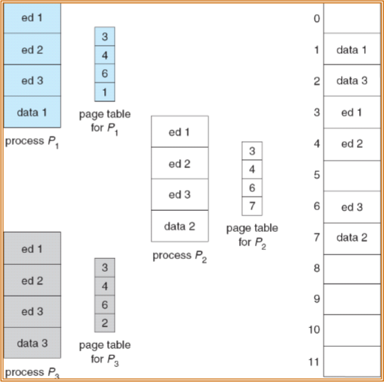
Shared Pages Example
Memory Management
C5.28

Slide 29
Structure of the Page Table
  Modern systems support large logical address space (2^32 to 2^64), The page table itself can become very large. (for a 32 logical addr space, with 4 KB (212) pages, page table size would be 1 million).
  Hierarchical Paging
    The page table itself is paged by splitting into a hierarchy of pages
  Hashed Page Tables
    Using a hashed page table, where each entry is a linked list
  Inverted Page Tables
    Each frame in the physical memory has an entry in the inverted page table which has info about the process and logical page number
Memory Management
C5.29

Slide 30
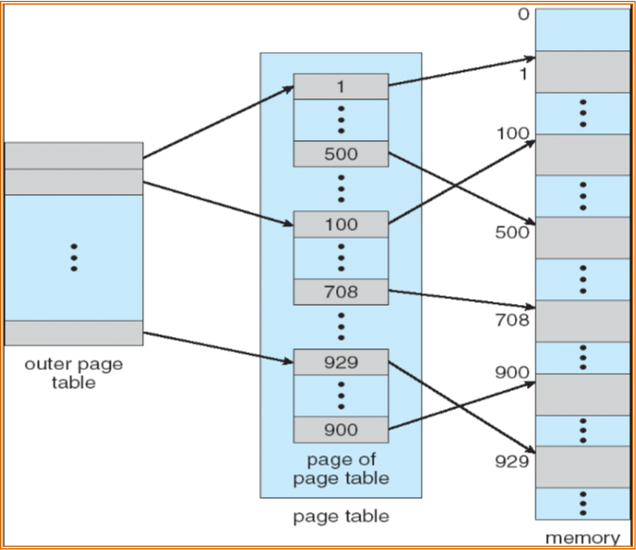
Hierarchical Two-Level Page-Table Scheme
Memory Management
C5.30

Slide 31
Two-Level Paging Example
  A logical address (on 32-bit machine with 1K page size) is divided into:
  a page number consisting of 22 bits
    a page offset consisting of 10 bits
  Since the page table is paged, the page number is further divided into:
    a 12-bit page number
    a 10-bit page offset
  Thus, a logical address is as follows:
  where p1 is an index into the outer page table, and p2 is the displacement within the page of the outer page table
page number
page offset
p1
p2
d
12
10
10
Memory Management
C5.31

Slide 32
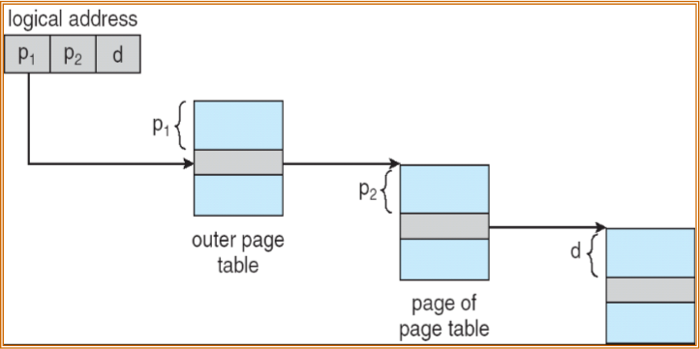
Address-Translation Scheme
Memory Management
C5.32

Slide 33
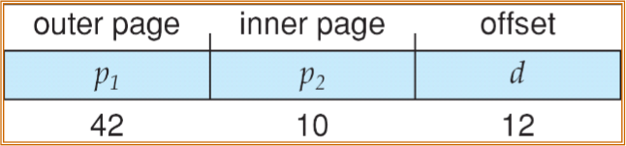
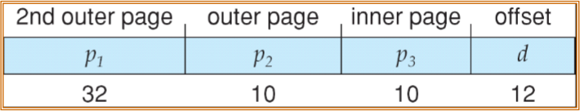
Higher-level Paging Scheme
For a 64 bit address size the number of outer pages in a two-level (VAX) page table can become very high. The outer pages can in turn be divided into three-level (X86, SPARC) or four-level hierarchical (Motorola 68030) pages.
Memory Management
C5.33

Slide 34
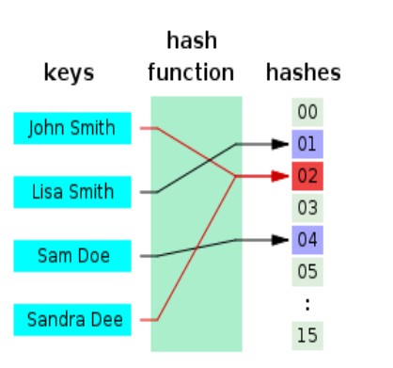
Hashed Page Tables
  Common in address spaces > 32 bits
  A hash function is a well-defined procedure which converts a large, possibly variable-sized amount of data into a small set of values. Multiple keys can hash to same value (collision). Collisions are resolved by linked lists.
  The virtual page number is hashed into a page table. This page table contains a chain of elements hashing to the same location.
  Virtual page numbers are compared in this chain searching for a match. If a match is found, the corresponding physical frame is extracted.
Memory Management
C5.34

Slide 35
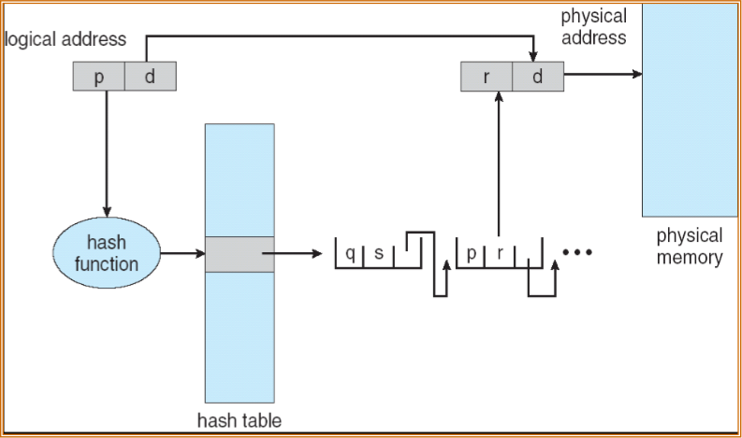
Hashed Page Table
Memory Management
C5.35

Slide 36
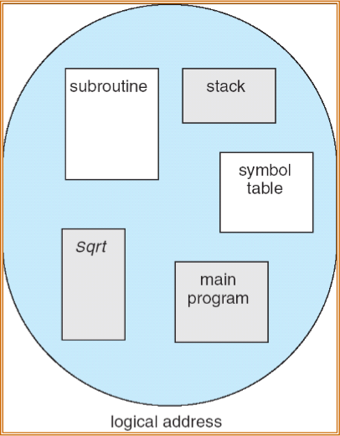
Segmentation
  Memory-management scheme that supports user view of memory
  A program is a collection of segments. A segment is a logical unit such as:
- main program
- procedure
- function
- method
- object
- local variables
- global variables
- common block
- stack
- symbol table
- arrays
Memory Management
C5.38

Slide 37






Logical View of Segmentation
1
4
1
2
3
2
4
3
user space
physical memory space
Memory Management
C5.37

Slide 38
Segmentation Architecture
  Logical address consists of a two tuple:
<segment-number, offset>,
  Segment table – maps two-dimensional physical addresses; each table entry has:
    base – contains the starting physical address where the segments reside in memory
    limit – specifies the length of the segment
  Segment-table base register (STBR) points to the segment table’s location in memory
  Segment-table length register (STLR) indicates number of segments used by a program;
    segment number s is legal if s < STLR
Memory Management
C5.38

Slide 39
Segmentation Architecture (Cont.)‏
  Protection
    With each entry in segment table associate:
      validation bit = 0  illegal segment
      read/write/execute privileges
  Protection bits associated with segments; code sharing occurs at segment level
  Since segments vary in length, memory allocation is a dynamic storage-allocation problem
  A segmentation example is shown in the following diagram
Memory Management
C5.39

Slide 40
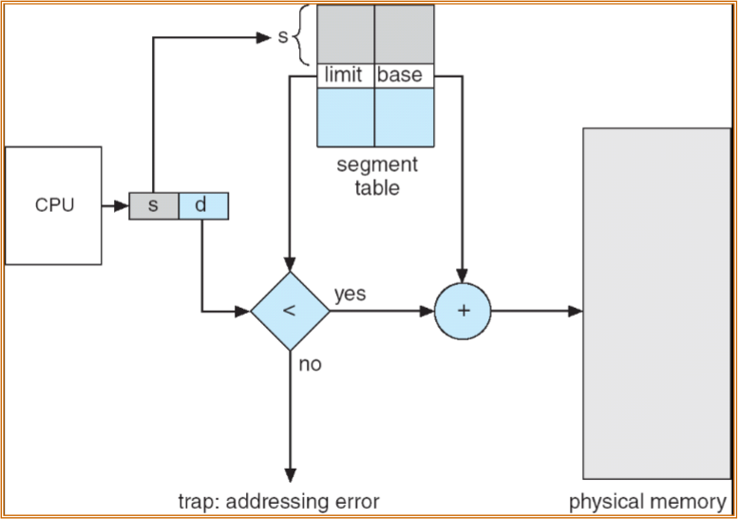
Segmentation Hardware
Memory Management
C5.40

Slide 41
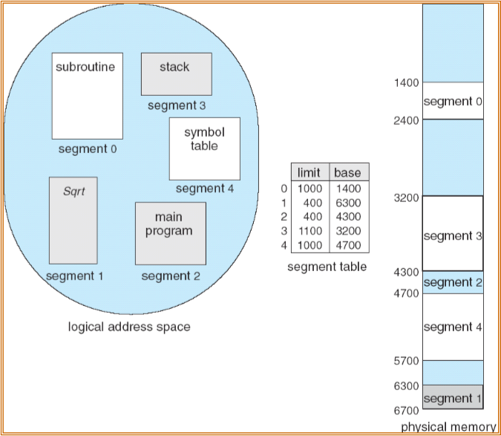
Example of Segmentation
Memory Management
C5.41

Slide 42
Thanks & Questions

