Slide 1

Virtual Memory

Slide 2

Virtual Memory
  Background
  Demand Paging
  Copy-on-Write
  Page Replacement
  Allocation of Frames
  Thrashing
  Memory-Mapped Files
  Allocating Kernel Memory
  Other Considerations
  Operating-System Examples
Virtual Memory
C6.2

Slide 3
Background
  Virtual memory – separation of user logical memory from physical memory.
    Only part of the program needs to be in memory for execution
    Logical address space can therefore be much larger than physical address space
    Allows address spaces to be shared by several processes
    Allows for more efficient process creation
  Virtual memory can be implemented via:
    Demand paging
    Demand segmentation
Virtual Memory
C6.3

Slide 4
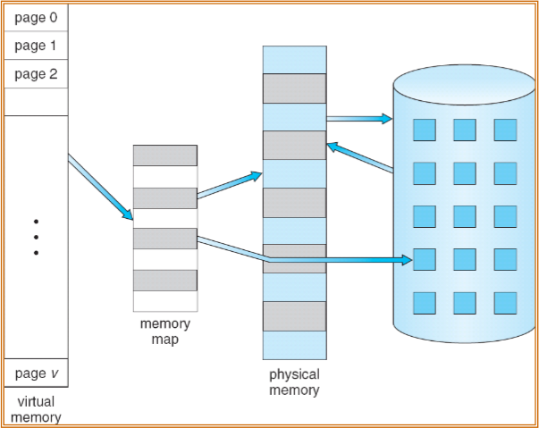
Virtual Memory That is Larger Than Physical Memory
⇒
Virtual Memory
C6.4

Slide 5
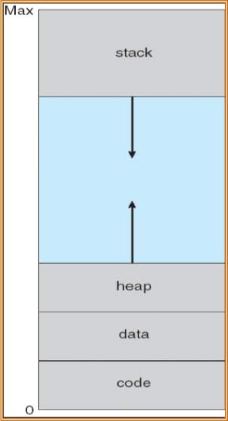
Virtual-address Space
  Virtual Address Space
    Logical view of how a process is stored in memory
    Starts with a logical address (0) and exists in contiguous memory
  The OS creates a huge area of memory, known as heap, from which it allocates memory to processes dynamically
  The memory allotted to the process (heap) can grow as needed (typically allotted at low address and grows upwards)‏
  Stacks are data structures used to hold program status during subroutine calls and these also grow (typically allotted at high address and grows downwards)‏
Virtual Memory
C6.5

Slide 6
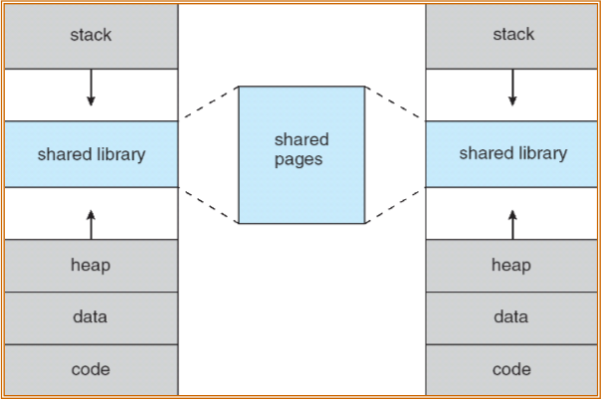
Shared Library Using Virtual Memory
  Virtual memory allows memory to be shared by multiple processes
    Shared memory for interprocess communication
    System libraries
    Parent pages to be shared by child during process creation – fork()‏
Virtual Memory
C6.6

Slide 7
Demand Paging
  Bring a page into memory only when it is needed
    Less I/O needed
    Less memory needed
    Faster response
    More users
  Page is needed  reference to it
    invalid reference  abort
    not-in-memory  bring to memory
  Lazy swapper – never swaps a page into memory till it is needed
  Two major issues in Demand paging:
    Page Replacement Algorithm
    Allocation of Frames
Virtual Memory
C6.7

Slide 8
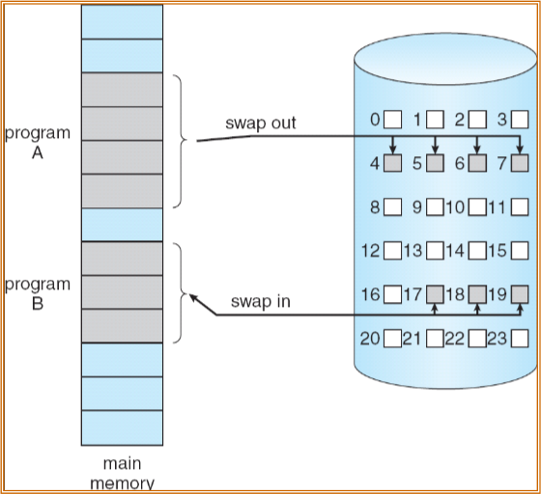
Transfer of a Paged Memory to Contiguous Disk Space
Virtual Memory
C6.8

Slide 9

Valid-Invalid Bit
  With each page table entry a valid–invalid bit is associated
  (v  in-memory, i  not-in-memory)‏
  Initially valid–invalid bit is set to i on all entries
  Example of a page table snapshot:
  During address translation, if valid–invalid bit in page table entry
is i  page fault
Frame #
valid-invalid bit
v
v
v
v
i
….
i
i
page table
Virtual Memory
C6.9

Slide 10
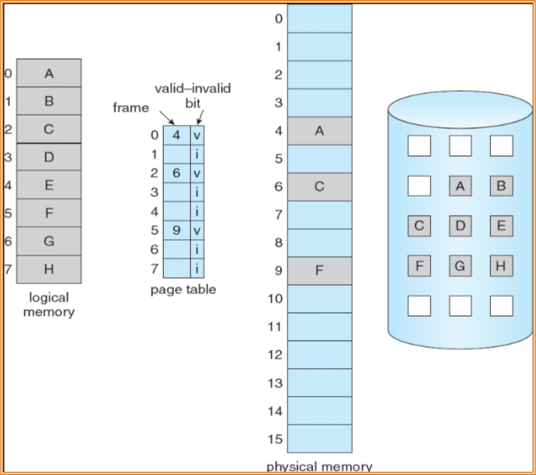
Page Table When Some Pages Are Not in Main Memory
Virtual Memory
C6.10

Slide 11
Page Fault
  If there is a reference to a page, first reference to that page will trap to operating system: page fault
    Operating system looks at another table to decide:
      Invalid reference  abort
      Just not in memory
    Get an empty frame
    Swap page into frame
    Reset tables
    Set validation bit = v
    Restart the instruction that caused the page fault
  The hardware to support demand paging is the same as the hardware for paging and swapping (refer non Virtual Memory Management)‏
    Page table with a valid-invalid bit
    Secondary memory, usually a high speed disk, with a section allotted for swap space
Virtual Memory
C6.11

Slide 12
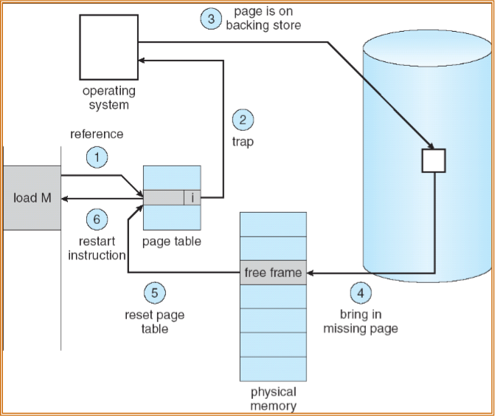
Steps in Handling a Page Fault
Virtual Memory
C6.12

Slide 13
Performance of Demand Paging
  Page Fault Rate 0  p  1.0
    if p = 0 no page faults, if p = 1, every reference is a fault
  Effective Access Time (EAT)‏
EAT = (1 – p) x memory access
+ p (page fault overhead + swap page out + swap page in + restart overhead)‏
  Example
    Memory access time = 200 nanoseconds
    Average page-fault service time = 8 milliseconds (ms)‏
(head seek time ~ 5 ms, disk latency ~ 3 ms, data transfer ~ 0.05 ms)‏
  EAT = (1 – p) x 200 ns + p (8 milliseconds)
  = (1 – p x 200 + p x 8,000,000 ns = 200 + p x 7,999,800 ns
  If one access out of 1,000 causes a page fault, then
  EAT = 8.2 microseconds. This is a slowdown by a factor of 40!!
  If we want performance degradation to be less than 10%
    220 > 200 + 7,999,800 X p
    p < 0.0000025 ie less than 1 page fault for 400,000 memory accesses
Virtual Memory
C6.13

Slide 14
Copy-on-Write
  Virtual memory allows other benefits during process creation:
- Copy-on-Write
- Memory-Mapped Files (later)‏
  Copy-on-Write (COW) allows both parent and child processes to initially share the same pages in memory
  If either process modifies a shared page, only then is the page copied
  COW allows more efficient process creation as only modified pages are copied
Virtual Memory
C6.14

Slide 15
Page Replacement
  When we bring in a new page, if there are no free frames, we need to find some page in memory, which are not really in use, and swap it out (Page replacement)‏
  Page replacement completes separation between logical memory and physical memory – large virtual memory can be provided on a smaller physical memory
  Prevent over-allocation of memory by modifying page-fault service routine to include page replacement
  Page replacement policy should result in minimum number of future page faults to avoid same page brought into memory several times
  Since the replaced page needs to be written back to disk, we use modify (dirty) bit to reduce overhead of page transfers – only not modified pages are written to disk
Virtual Memory
C6.15

Slide 16
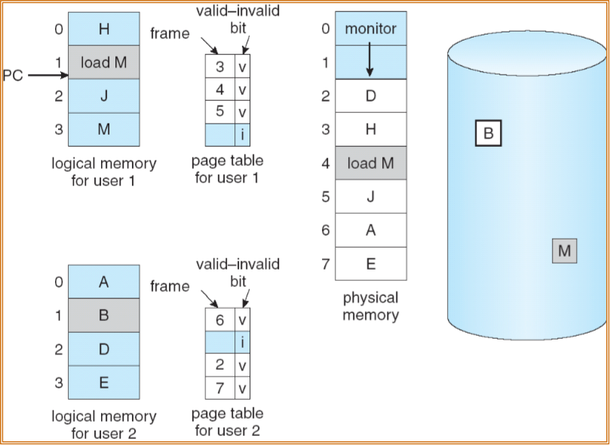
Need For Page Replacement
Virtual Memory
C6.16

Slide 17
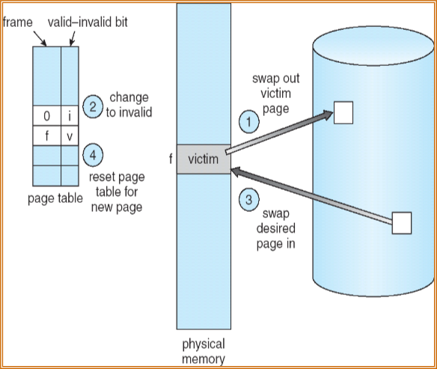
Basic Page Replacement
  Find the location of the desired page on disk
  Find a free frame:
  - If there is a free frame, use it
  - If there is no free frame, use a page replacement algorithm to select a victim frame
  Bring the desired page into the (newly) free frame; update the page and frame tables
  Restart the process
Virtual Memory
C6.17

Slide 18
Page Replacement Algorithms
  Want lowest page-fault rate
  Page replacement policy should result in minimum number of future page faults to avoid same page brought into memory several times
  Since the replaced page needs to be written back to disk, we use modify (dirty) bit to reduce overhead of page transfers – only not modified pages are written to disk
  Evaluate algorithm by running it on a particular string of memory references (reference string of logical pages) and computing the number of page faults on that string
  In following examples, the reference string is
7, 0, 1, 2, 0, 3, 0, 4, 2, 3, 0, 3, 2, 1, 2, 0, 1, 7, 0, 1
Virtual Memory
C6.18

Slide 19
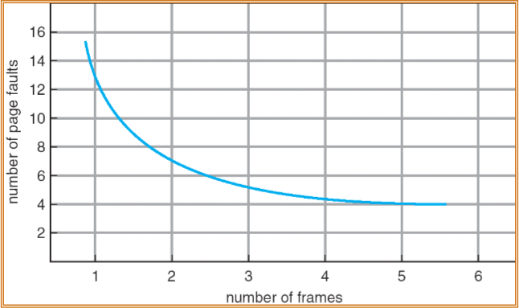
Graph of Page Faults Versus The Number of Frames
  The number of page faults depends on the number of frames available for that process
  In general we expect a curve for number of page faults against available number of frames as in figure
Virtual Memory
C6.19

Slide 20
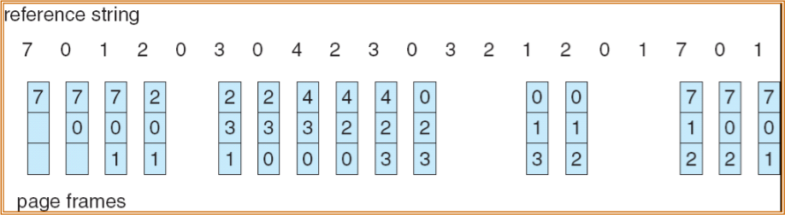
FIFO Page Replacement
  The simplest page replacement algorithm is the first-in first-out (FIFO)‏
  It associates with each page the time when that was brought into memory
  When a page needs to be replaced, the oldest page is chosen
  It is not necessary to record the time when a page is brought in. A circular FIFO queue is maintained; a new page brought in is entered at the tail of the queue; the page at the head of the queue is replaced.
  For the reference string with 3 frames, FIFO gives 15 page faults
Virtual Memory
C6.20

Slide 21
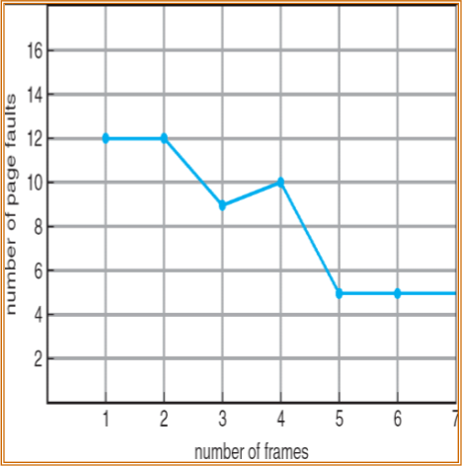



Belady’s Anomaly
  Reference string:
1, 2, 3, 4, 1, 2, 5, 1, 2, 3, 4, 5
  3 frames (3 pages can be in memory at a time per process)‏
  4 frames
  Belady’s Anomaly: more frames  more page faults
1
1
4
5
2
2
1
3
9 page faults
3
3
2
4
1
1
5
4
2
2
1
5
10 page faults
3
3
2
4
4
3
Virtual Memory
C6.21

Slide 22
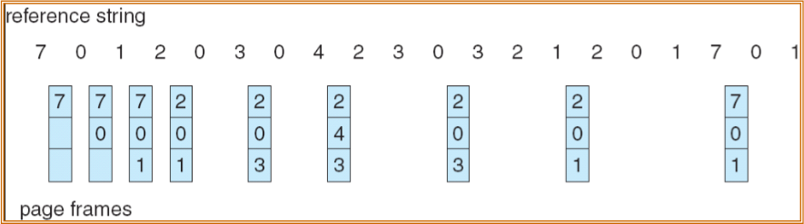
Optimal Page Replacement
  Replace page that will not be used for longest period of time
  4 frames example
1, 2, 3, 4, 1, 2, 5, 1, 2, 3, 4, 5
How do you see ahead what pages are needed?
  Used for measuring how well your algorithm performs
  For the reference string with 3 frames, Optimal policy gives 9 page faults
1
4
2
6 page faults
3
4
5
Virtual Memory
C6.22

Slide 23



Least Recently Used (LRU) Algorithm
  Reference string: 1, 2, 3, 4, 1, 2, 5, 1, 2, 3, 4, 5
  Counter implementation
    Every page entry has a counter; every time the page is referenced the counter is incremented
    When a page needs to be replaced, find the page with the smallest counter value
  Other solutions include use of stack, etc
1
1
1
1
5
2
2
2
2
2
3
5
5
4
4
4
4
3
3
3
Virtual Memory
C6.23

Slide 24
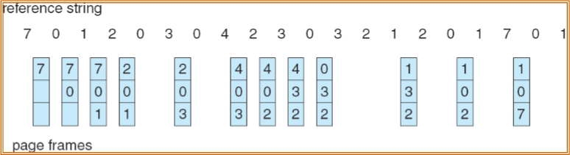
LRU Page Replacement
  For the reference string with 3 frames the LRU gives 12 page faults
Virtual Memory
C6.24

Slide 25
LRU Approximation Algorithms
  Reference bit
    With each page associate a bit, initially = 0
    When page is referenced set bit to 1
    Replace the one which is 0 (if one exists)‏
      We do not know the order, however
  Additional reference bits
    8-bit byte for each page. Periodically (100 ms) a timer interrupt triggers an OS routine to shift the bits right. The lowest number in the 8-bit byte will point to the LRU page.
  Second chance (clock algorithm)‏
    The reference bits form a circular queue with a pointer to page for next replacement
    The pointer advances till it finds a 0 reference bit to find the LRU page
    As it advances it clears any reference bit set
    Effectively a page is given a second chance before being replaced
Virtual Memory
C6.25

Slide 26
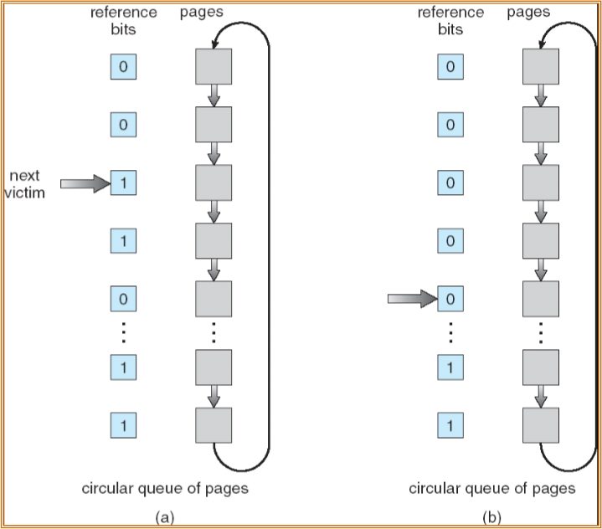
Second-Chance (clock) Page-Replacement Algorithm
Virtual Memory
C6.26

Slide 27
Allocation of Frames
  Each process needs minimum number of pages
  Example: IBM 370 – 6 pages to handle SS MOVE instruction:
    instruction is 6 bytes, might span 2 pages
    2 pages to handle from operand
    2 pages to handle to operand
  Two major allocation schemes
    fixed allocation
    priority allocation
Virtual Memory
C6.27

Slide 28
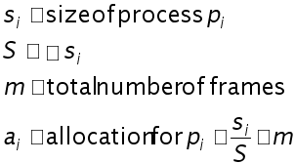
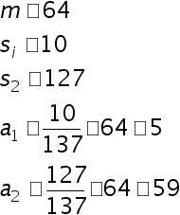
Fixed Allocation
  Equal allocation – For example, if there are 100 frames and 5 processes, give each process 20 frames.
    Some processes may never use all their frames
  Proportional allocation – Allocate according to the size of process
Virtual Memory
C6.28

Slide 29
Priority Allocation
  Use a proportional allocation scheme using priorities rather than size
  If process Pi generates a page fault,
    select for replacement one of its frames
    select for replacement a frame from a process with lower priority number
Global vs. Local Allocation
  Global replacement – process selects a replacement frame from the set of all frames; one process can take a frame from another
  Local replacement – each process selects from only its own set of allocated frames
Virtual Memory
C6.29

Slide 30
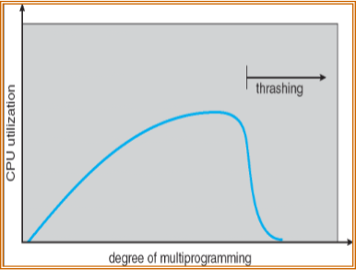
Thrashing
  If a process does not have “enough” pages, the page-fault rate is very high. This leads to:
    low CPU utilization
    operating system thinks that it needs to increase the degree of multiprogramming
    another process added to the system
  Thrashing  a process is busy swapping pages in and out
Virtual Memory
C6.30

Slide 31
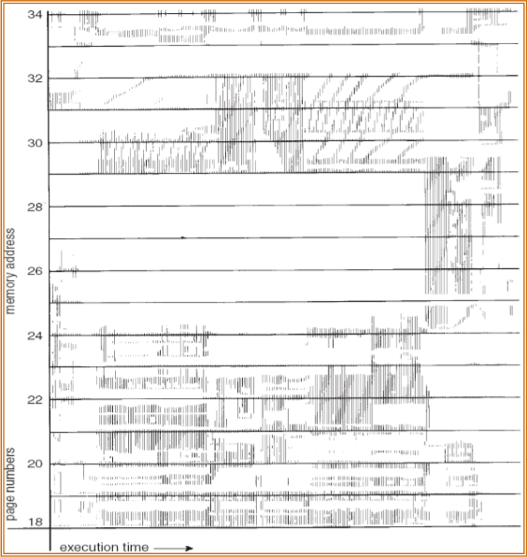
Locality in a Memory Reference Pattern
  Why does demand paging work?
  Locality model
    Process migrates from one locality to another
    Localities may overlap
  Why does thrashing occur?
   size of locality > total memory size
Virtual Memory
C6.31

Slide 32
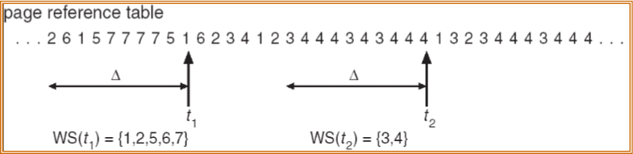
Working-Set Model
    working-set window  a fixed number of page references
  Example: 10,000 instruction
  WSSi (working set of Process Pi) =
  total number of pages referenced in the most recent  (varies in time)‏
    if  too small will not encompass entire locality
    if  too large will encompass several localities
    if  =   will encompass entire program
  D =  WSSi  total demand frames for all processes
  if D > m (total memory size)  Thrashing
  Policy if D > m, then suspend one of the processes
Virtual Memory
C6.32

Slide 33
Keeping Track of the Working Set
  Approximate with interval timer + a reference bit
  Example:  = 10,000
    Timer interrupts after every 5000 time units
    Keep in memory 2 bits for each page
    Whenever a timer interrupts copy and set the values of all reference bits to 0
    If one of the bits in memory = 1  page in working set, since it has been used sometime in the last 10,000 instructions
  Why is this not completely accurate?
  Improvement = 10 bits and interrupt every 1000 time units
Virtual Memory
C6.33

Slide 34
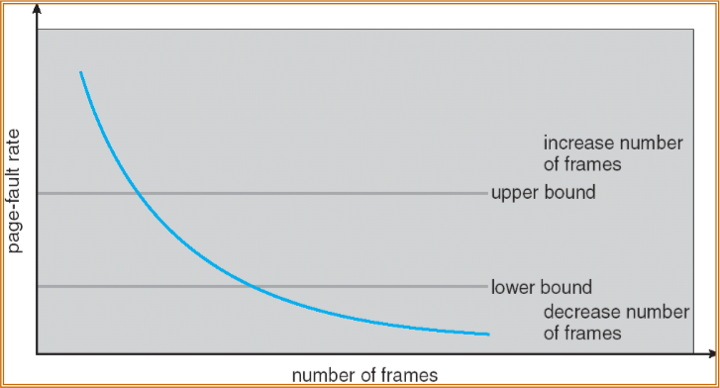
Page-Fault Frequency Scheme
  Establish “acceptable” page-fault rate
    If actual rate too low, process loses frame
    If actual rate too high, process gains frame
  If page-fault increases, and no free frames are available, some process must be selected and suspended
Virtual Memory
C6.34

Slide 35
Memory-Mapped Files
  Memory-mapped file I/O allows file I/O to be treated as routine memory access by mapping a disk block to a page in memory
  A file is initially read using demand paging. A page-sized portion of the file is read from the file system into a physical page. Subsequent reads/writes to/from the file are treated as ordinary memory accesses.
  Simplifies file access by treating file I/O through memory rather than read() write() system calls
  Also allows several processes to map the same file allowing the pages in memory to be shared
Virtual Memory
C6.35

Slide 36
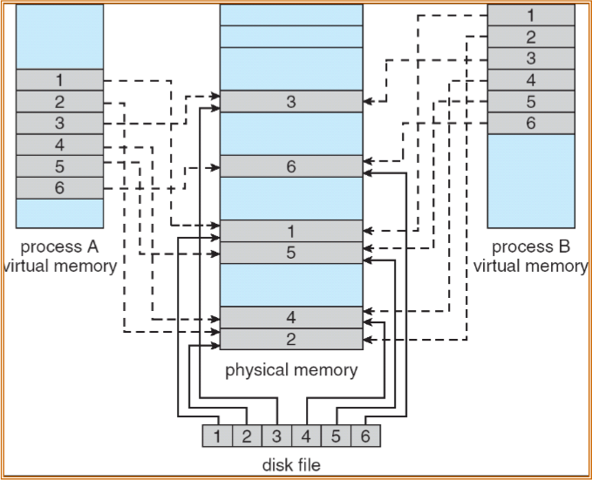
Memory Mapped Files
Virtual Memory
C6.36

Slide 37
Allocating Kernel Memory
  Treated differently from user memory
  Often allocated from a free-memory pool
    Kernel requests memory for structures of varying sizes
    Some kernel memory needs to be contiguous
Virtual Memory
C6.37

Slide 38
Buddy System
  Allocates memory from fixed-size segment consisting of physically-contiguous pages
  Memory allocated using power-of-2 allocator
    Satisfies requests in units sized as power of 2
    Request rounded up to next highest power of 2
    When smaller allocation needed than is available, current chunk split into two buddies of next-lower power of 2
      Continue until appropriate sized chunk available
Virtual Memory
C6.38

Slide 39
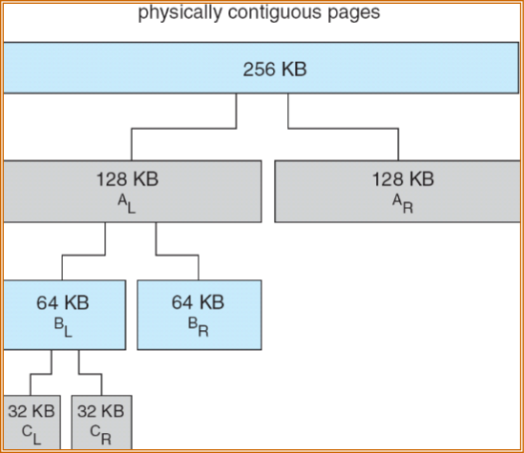
Buddy System Allocator
Virtual Memory
C6.39

Slide 40
Slab Allocator
  Alternate strategy
  Slab is one or more physically contiguous pages
  Cache consists of one or more slabs
  Single cache for each unique kernel data structure
    Each cache filled with objects – instantiations of the data structure
  When cache created, filled with objects marked as free
  When structures stored, objects marked as used
  If slab is full of used objects, next object allocated from empty slab
    If no empty slabs, new slab allocated
  Benefits include no fragmentation, fast memory request satisfaction
Virtual Memory
C6.40

Slide 41
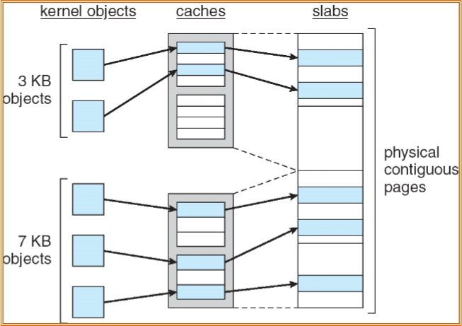
Slab Allocation
Virtual Memory
C6.41

Slide 42
Thanks & Questions

