Slide 1


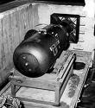








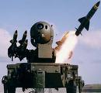






Real Time Systems &
Real Time OS Concepts
Santosh Sam Koshy
Member Technical Staff
NUCRC, C-DAC, Hyderabad

Slide 2
Agenda
What are Real Time Systems
RTOS Introduction
RTOS Services
RTOS Architecture
RTOS – Important Concepts
RT Scheduling, Algorithms
Priority Inversion
Overview of popular RTOS’s
RT Systems & RTOS
R0.2

Slide 3
Real Time Systems - Definitions
A Real-Time System (RTS) is one that reacts to events in the environment by performing predefined actions within specified time
A result produced after the deadline, even if correct, is considered wrong
Real Time Systems are characterized by consequences that result if logical as well as timing correctness properties of the system are not met. A real-time deadline must be met, regardless of system load
In a Real-Time System the correctness of the system behaviour depends not only on the logical results of the computations, but also on the physical instant at which these results are produced.
A real time system is a system that must satisfy explicit (bounded) response-time constraints or risk severe consequences, including failure

Slide 4
A bit more....
Often RT Systems are embedded computers in a plant. They acquire data from the environment and the plant through sensors, and control the plant through actuators
Examples of Real Time and Embedded systems vary from household appliances (Dish washer, etc) to Industrial Control, Aircraft and Missile Control systems, etc
Some RT Systems are identified as Safety-Critical systems. In a Safety-Critical system an incorrect operation, usually due to a missed deadline, may result in a catastrophe. Examples of Safety-Critical systems include Weapon Systems, Flight Control Systems, Life Support Systems, etc

Slide 5
Real Time Systems - Classifications
  Real Time Systems are classified as
    Hard RTS, which have stringent deadline requirements
      Missing a deadline is considered failure of the system
      In Firm, RTS missing a deadline is a catastrophe
    Soft RTS, where the deadlines are less restrictive
      Missing deadlines result in drop in performance of the system
  RT Systems are also classified as:
    Periodic (Time driven) – task activity occurs repeatedly
    Aperiodic (Event driven) – task activities are asynchronous
    Combination of both – Some tasks are periodic others, aperiodic
  Hard real time systems
    Aircraft Control Systems
    Nuclear Power Stations
    Chemical Plants
    Life support systems
  Soft real time systems
    Mutlimedia
    Online Transaction Systems
    Interactive video games
RT Systems & RTOS
santoshk@cdac.in

Slide 6
Characteristics of RT Systems
  The following characteristics are typical of Real Time Systems, especially Embedded Systems
  Specific timing specifications
  Dedicated Application
  Small Size
    Owing to size and power restrictions
    Low CPU Power (8/16 bit processors)
    Less Memory (Max 10 MB)
    No peripherals, disks
    Dedicated UI like buttons, keypad, switches, LEDs, LCDs, etc
  Inexpensively mass produced, especially for home appliances, consumer devices, etc
  System-on-chip (SOC) architecture, rather than bus architecture
RT Systems & RTOS
R0.5

Slide 7
Real Time Operating Systems - Services
Multi-tasking and threads
Task & Thread Management
Creation and scheduling of tasks. Since some tasks may have more stringent deadlines than others, they would be need to declared with high priority and the OS should ensure, if such tasks are ready to be run, they will be scheduled
Priority based pre-emptive scheduling
Vectored Interrupt Service Routines (avoid polling)
Inter Task Synchronization including mutual exclusion, signals, etc
Inter Task Communications through messages, shared memory, etc
Usually no Memory Management
Provision to lock in memory code/data for high priority tasks (In disk-less systems, the full OS and application Program will be in ROM, and some RAM for the data)
Memory-mapped files in flash memory
Timer Services such as periodic and aperiodic interrupts (watchdog timers)
Device drivers to service the needed special devices
Communication Protocol software (networking through ethernet, wireless, etc)
Application Programming Interface (APIs) to access kernel services
RT Systems & RTOS
R0.6

Slide 8
RTOS vs GPOS
Determinism
Load-Independent Timing
Task Scheduling
Dynamic Memory Allocations
Interrupts
Intertask Communication
OS Scalability

Slide 9
RTOS Architecture
Two tier & Three tier Architecture
An RTOS consists of
  Kernel (micro-kernel)
  Device Manager
  Networking protocol sw
  Libraries
  File sys (optional)
Application s/w
comm sw
Operating system
libraries
kernel
file sys
device mgr
Application Programming i/f

Slide 10
Kernel Types – Non Preemptive Kernel
low priority task
1
2
ISR
3
ISR makes the high priority task ready
4
5
6
high priority task

Slide 11
Kernel Types – Preemptive Kernel
low priority task
1
2
ISR
3
high priority task
4

Slide 12
Kernel Objects
Kernel objects
  Scheduler
  Tasks
  Interrupt Service Routines
  Semaphores
  Mutexes
  Mail boxes
  Message queues
  Pipes
  Event registers
  Signals
  Timers
Message
queues
Signals
Event
Registers
Mailboxes
Semaphores
Scheduler
Pipes
ISRs
Tasks
Mutexes
Timers

Slide 13
Real Time Tasks
TASK #1
TASK #2
TASK #3
Task Control Block
Task Control Block
Task Control Block
Memory
CPU
CPU Registers
Real Time application involves splitting the work to be done in Tasks.
A real time task, also called a thread, is a simple program that thinks it has the CPU all to itself. It is generally implemented as an infinite loop
Each Task is assigned its own set of CPU Registers, Stack Area and a Priority.

Slide 14
Task States
Waiting
Dormant
Ready
Running
ISR

Slide 15
Task Priority & Characteristics
A priority is assigned to each task. The more important the task the more the priority
Tasks can be created at compile time or at run-time
Two types of priority assigning
  Static (Assigned at Compile Time)‏
  Dynamic (Assigned at Execution Time)‏
Categories of Tasks
  Periodic Tasks
    Time-driven. Characteristics are known a priori
    E.g.: Task monitoring temperature of a patient in an ICU.
  Aperiodic Tasks
    Event driven. Characteristics are not known a-priori
    Eg: Task detected on change in patient's condition
  Sporadic Tasks
    A task with a minimum known interval
    Eg: Administer glucose once every hour but not later than 1.5 hours

Slide 16
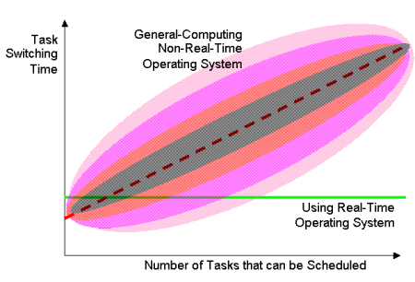
Task Switching

Slide 17
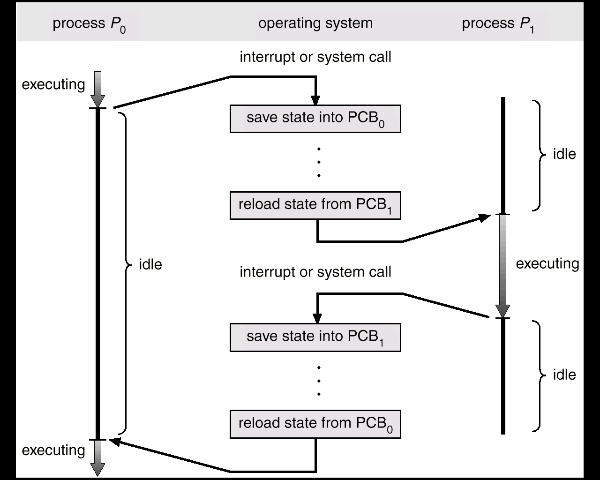
RTOS Context Switch

Slide 18
Real Time Scheduling
Real Time Scheduling
Static Scheduling
Dynamic Scheduling
Table Driven
Priority Driven
Planning Based
Best Effort

Slide 19
RTOS Scheduling
RTOS Scheduling involves the allocation of resources (mainly CPU) and time to tasks to meet the performance requirements. Hence metrics are defined to evaluate the scheduling algorithms, depending upon the applications
Tasks can be associated with computation times, resource requirements, priorities, and timing constraints.
A periodic task has a period, and an aperiodic task has a deadline.
Scheduling algorithms are of following types:
  Static priority-driven preemptive approaches
  Static table-driven approaches
  Dynamic planning-based approaches
  Dynamic best-effort approaches

Slide 20
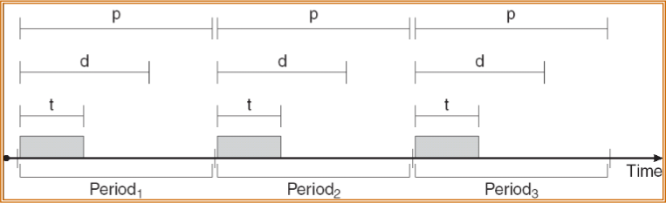
Real-Time CPU Scheduling
Periodic tasks require the CPU at specified intervals (periods)
  p is the duration of the period
  d is the deadline by when the process must be serviced
  t is the processing time
  0 ≤ t ≤ d ≤ p, must hold or the task is not scheduled
Schedulers can assign priorities according to the rate or deadline requirements
When a new periodic task arrives (dynamically), an admission control algorithm can schedule it guaranteeing performance or reject it

Slide 21
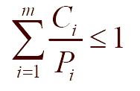
Scheduling conditions in Real time systems
Consider periodic systems
Schedulable real-time system
Given
  m periodic events
  Task 'i' occurs within period Pi and requires Ci seconds, Then the load can only be handled if

Slide 22
Real Time Scheduling administer algorithms
Rate Monotonic Scheduling
  Static priority-driven scheduling.
  Priorities are assigned based on the period of each task. The shorter the period, the higher the priority
Earliest Deadline first
  The task with the earliest deadline is chosen next
  It is a dynamic preemptive algorithm with dynamic priorities
Least Laxity First (LLF)‏
  Laxity = Absolute Deadline – Worst case computation time
  Priority assignment based on laxity of jobs. Job with minimum laxity assigned highest priority
  Schedulable utilization = 1
Deadline Monotonic Scheduling
  Each task is assigned a priority. Tasks with smaller deadlines will have higher priorities.
  Tasks with higher priority interrupt tasks with lower priority.

Slide 23
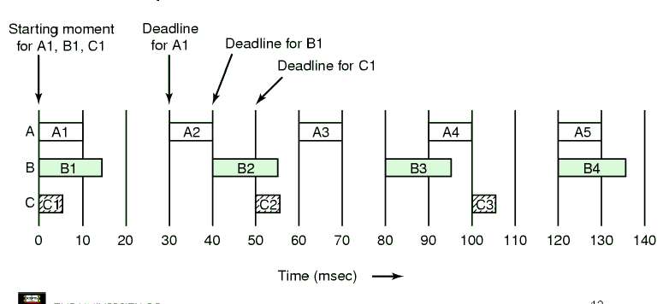
Example

Slide 24
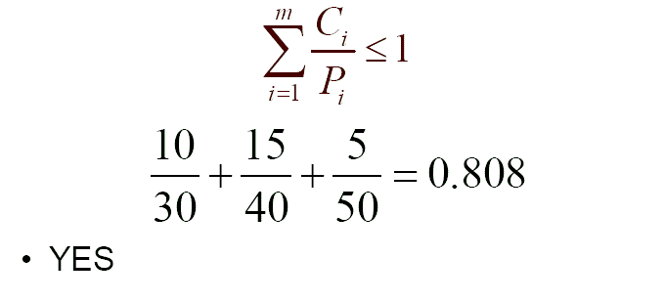
Success Example

Slide 25
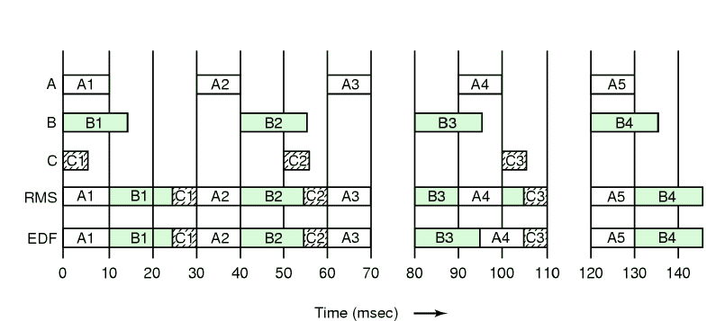
RMS vs EDF

Slide 26
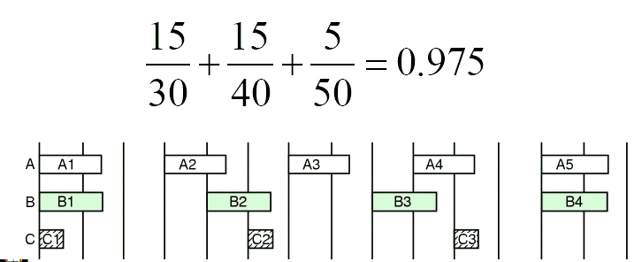
Modify Example

Slide 27
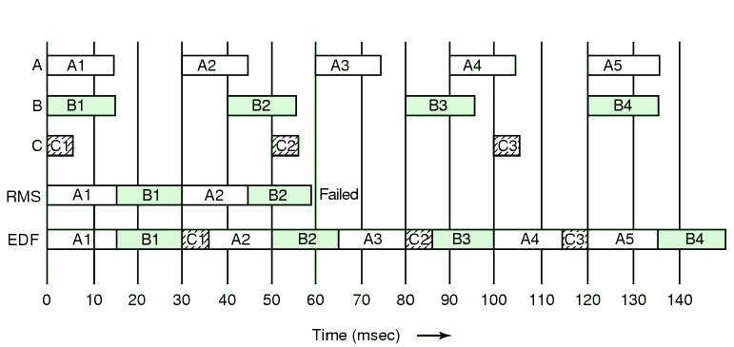
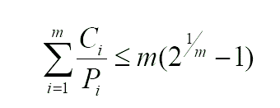
RMS Fails

Slide 28
Interrupts
Interrupts are Interrupt is a h/w signal that needs CPU attention
When an interrupt occurs,
  CPU saves its context on the stack
  Jumps to the Interrupt Servicing Routine (ISR) {minimal registers saved by ISR}
  Executes ISR and Returns
After ISR processes the event, in a non-preemptive kernel, CPU returns to the task interrupted. In a preemptive kernel, highest priority task executes
Interrupt Latency
  max time interrupts are disabled + time to start execution of 1st instruction in ISR
Interrupt Response Time
  Interrupt Latency + time to start of code to handle the event
Interrupt Recovery Time
  time for CPU to return to interrupted code / highest priority task

Slide 29
Important Note
A systems’s worst case response is its only response
Your system may respond to Interrupts in 50us 99% of the time, but if it responds to Interrupts in 250us the other 1% you must assume 250us Interrupt Response Time,

Slide 30
Interrupts in Non Preemptive Kernels
Interrupt
Request
CS
ISR
IL
IRec
IR
Time ->
Background Process
CPU Context Saved
User Code ISR

Slide 31
Interrupts in a preemptive kernel
Interrupt
Request
IRec1
CS
Entry
Exit
ISR
IL
ISR
IR
IRec2
Time ->
Background Process
CPU Context Saved
Preemptive Kernel
User Code ISR

Slide 32
Priority Inversion, Inheritance and Ceiling
Task HP
Task MP
Task LP
Shared Resource

Slide 33
Priority Inversion Notes
In preemptive priority scheduling, priority inversion is the scenario where a lower priority task runs even when a higher priority task is ready to run. This happens when a low priority task holds a shared resource that is required by a high priority task. This causes the execution of the high priority task to be blocked until the low priority task has released the resource, effectively "inverting" the relative priorities of the two tasks. If some other medium priority task, one that does not depend on the shared resource, attempts to run in the interim, it will take precedence over both the low priority task and the high priority task, which can be blocked indefinitely
The trouble experienced by the Mars lander "Mars Pathfinder" is a classic example of problems caused by priority inversion in real-time systems
One of the solutions is Priority inheritance
  Under priority inheritance, whenever a high priority task has to wait for some resource shared with an executing low priority task, the low priority task is assigned the priority of the highest waiting priority task for the duration of its own use of the shared resource, thus keeping medium priority tasks from pre-empting the (originally) low priority task, and thereby effectively the waiting high priority task as well
Priority Ceiling
  Assign the resource with a priority greater than the priority of the highest task contending for the resource. All tasks alter their priorities when they take the resource

Slide 34
Overview of available RTOS’s
  Three categories of real-time operating systems:
    Small, proprietary kernels.
e.g. VRTX32,pSOS, VxWorks, Windows CE, MicroC-OS/II*
    Real-time extensions to commercial timesharing operating systems.
      RT-Linux, RT-NT, RTAI
    Research kernels
      MARS, ARTS, Spring, Polis, MicroC-OS/II
Vx Works, Lynx, QNX
Intime, HyperKernel, RTX
Hard
Real Time Operating System
Windows CE
General Purpose Operating System
Linux, NT
Soft
RT Systems & RTOS

Slide 35
Small Fast Proprietary Kernels
  Stripped down and optimized versions of timesharing operating systems.
  Intended to be fast
    a fast context switch
    external interrupts recognized quickly
    the ability to lock code and data in memory
    special sequential files that can accumulate data at a fast rate
  To deal with timing requirements
    a real-time clock with special alarms and timeouts
    bounded execution time for most primitives
    real-time queuing disciplines such as earliest deadline first
    primitives to delay/suspend/resume execution
    priority-driven best-effort scheduling mechanism or a table-driven mechanism
  Communication and synchronization via mailboxes, events, signals, and semaphores
RT Systems & RTOS
R0.22

Slide 36
QNX Neutrino
  Developed by Gordon Bell and the students at the University of Waterloo in 1980
  Supported on ARM, MIPS, Power PC, x86 and Pentium
  Excellent IDE
  Micro-kernel based, and most of the OS is run in the form of a number of small tasks, known as servers
  Configurable and can be made small (64 K kernel ROM, 32 K kernel RAM)
  Neutrino supports Symmetric multiprocessing and strict priority-preemptive scheduling
RT Systems & RTOS

Slide 37
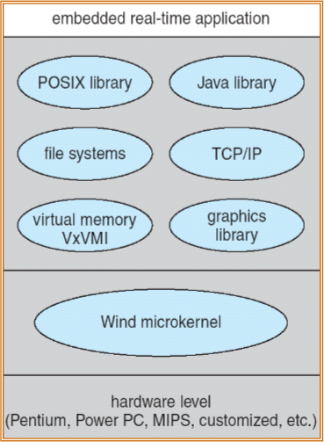
Vx Works
  VxWorks is a real time operating system developed by Wind River Systems of California, based on VRTX. Intel acquired Wind River Systems on July 17, 2009
  Used in automobiles, consumer devices, networking devices (routers, switches), Mars Pathfinder
  Micro-kernel based
  Processes and threads
  Preemptive and non-preemptive scheduling
  Manages interrupts (with bounded interrupt and dispatch latency times)
  Shared memory and message passing interprocess communication facilities.
RT Systems & RTOS

Slide 38
Microsoft Windows CE
  Supported on x86, MIPS, ARM processors for embedded systems
  Large parts of it are offered in source code form
  Windows Mobile, Pocket PC, SmartPhone are platforms based on CE
  Supports threads, priority inheritance and priority inversion
  Applications can be developed on Visual Studio
Lynx
  Lynx is a Unix like real time operating system
  Mostly used in embedded systems in avionics, aerospace, communications
  Developed for Motorola 68010, ported to x86, ARM, Power PC
  Support hard real time applications, due to extremely fast interrupt routines known as Multiple Priority Light Weight kernel Task-based Interrupt Handling
RT Systems & RTOS
R0.25

Slide 39
Thanks and Questions

