Slide 1


Linux Device Drivers
(Character Devices)

Slide 2

Contents
ν
ν
ν
ν
ν
Major and Minor number
Important Structures
Open and Release
Read and Write
Device Filesystem
2

Slide 3


Major and Minor numbers
ν
ν
ν
Special files under /dev “c” for char & “b” for
block
Major number identifies driver use at open time
Minor number is used only by driver to control
several devices
crw-rw-rw- 1 root
root
1,
3
Feb 23 1999
null
crw-------
1 root
root
10,
1
Feb 23 1999
psaux
crw-------
1 rubini tty
4,
1
Aug 16 22:22
tty1
crw-rw-rw- 1 root dialout
crw-rw-rw- 1 root dialout
4,
4,
64
65
Jun 30 11:19
Aug 16 00:00
ttyS0
ttyS1
crw-------
crw-------
1 root sys
1 root sys
7,
7,
1
129
Feb 23 1999
Feb 23 1999
vcs1
vcsa1
crw-rw-rw- 1 root root
1,
5
Feb 23 1999
zero
3

Slide 4
Register a new driver
ν
int register_chrdev (unsigned int
major,
const
char *name, struct file_operations
*fops);
♦Tells
the kernel to remember the major
number and the name of the device
driver associated with it.
♦fops point to a global structure which
kernel finds
4

Slide 5
Create device node
ν
mknod /dev/name c major minor
♦The
name should be the same
♦Now users can access the device
5

Slide 6
Dynamic major number
ν
register_chrdev (major, “name”,
*fops)
♦when
major = 0, it returns a dynamically
allocated major number
Disadvantage
ν
♦You
can’t create the device nodes
because the major number assigned to
your module can’t be guaranteed to
always be the same.
6

Slide 7

Dynamic major number
ν
Use /proc/devices
Character devices:
1 mem
2 pty
3 ttyp
4 ttyS
6 lp
7 vcs
10 misc
13 input
major=‘awk
"\\$2==\"$module\" {print \\$1}" /proc/devices‘
14 sound
21 sg
180 usb
Block devices:
2 fd
8 sd
11 sr
65 sd
66 sd
7

Slide 8
Dynamic major number
result = register_chrdev(major, “scull”, &scull_fops);
if (result < 0)
{
printk(w_level “scull: cannot get a major %d\n”
major);
return result;
}
if (major == 0) //dynamic major allocation
major = result;
8

Slide 9
Remove a driver
ν
int unregister_chrdev(unsigned int
major, const char *name);
9

Slide 10
Minor number
ν
ν
Every time the kernel calls a device driver,
it tells the driver which device is being
acted upon.
The major and minor numbers are paired
in a single data type that the driver uses
to identify a particular device.
♦ It
resides in the field i_rdev of the inode
structure.
10

Slide 11
dev_t
ν
Historically, Unix declared dev_t to
hold the device numbers.
ν It used to be a 16-bit integer value.
ν Nowadays, more than 256 minor
numbers are needed at times,
♦Changing
dev_t is difficult
11

Slide 12
kdev_t
ν
Within the Linux kernel, a different
type, kdev_t, is used.
12

Slide 13
kdev_t macros
ν
ν
MAJOR(kdev_t dev);
♦ Extract the major number from a kdev_t
structure.
MINOR(kdev_t dev);
♦ Extract
the minor number.
ν
ν
MKDEV(int ma, int mi);
♦ Create a kdev_t built from major and minor
numbers.
kdev_t_to_nr(kdev_t dev);
♦ Convert a
kdev_t type to a number (a dev_t).
ν
to_kdev_t(int dev);
♦ Convert a
number to kdev_t.
13

Slide 14

Contents
ν
ν
ν
ν
ν
Major and Minor number
Important Structures
Open and Release
Read and Write
Device Filesystem
14

Slide 15
file_operations structure
ν
An open device is identified internally
by a file structure.
ν The kernel uses the file_operations
structure to access the driver’s
functions.
ν The structure, defined in
<linux/fs.h>.
ν It is an array of function pointers.
15

Slide 16
file_operations structure
struct file_operations
{
loff_t (*llseek) (struct file *, loff_t, int)
ssize_t (*read) (struct file *, char *, size_t, loff_t *)
ssize_t (*write) (struct file *, const char *, size_t, loff_t *);
int (*readdir) (struct file *, void *, filldir_t);
unsigned int (*poll) (struct file *, struct poll_table_struct *);
int (*open) (struct inode *, struct file *);
int (*release) (struct inode *, struct file *);
int (*flush) (struct file *);
16

Slide 17
file_operations structure
int (*ioctl) (struct inode *, struct file *, unsigned int, unsigned long);
int (*mmap) (struct file *, struct vm_area_struct *);
int (*fsync) (struct inode *, struct dentry *, int);
int (*fasync) (int, struct file *, int);
int (*lock) (struct file *, int, struct file_lock *);
ssize_t (*readv) (struct file *, const struct iovec *, unsigned long, loff_t *);
ssize_t (*writev) (struct file *, const struct iovec *, unsigned long, loff_t *);
struct module *owner;
};
16

Slide 18
file_operations functions
ν
llseek
♦It
is used to change the current
read/write position in a file.
read
ν
♦Used
to retrieve data from the device.
ν
write
♦Sends
data to the device.
17

Slide 19
file_operations functions
ν
ν
ν
readdir
♦ This field should be NULL for device files; it is
used for reading directories, and is only useful
to filesystems.
poll
♦ Used to inquire if a device is readable or
writable or in some special state.
ioctl
♦ It offers a way to issue device-specific
commands (like formatting a track of a floppy
disk, which is neither reading nor writing).
18

Slide 20
file_operations functions
ν
mmap
♦ It
is used to request a mapping of device
memory to a process’s address space.
open
ν
♦ This
is always the first operation performed on
the device file.
release
ν
♦ This
operation is invoked when the file structure
is being released.
19

Slide 21
file_operations functions
ν
flush
♦ The
flush operation is invoked when a process
closes its copy of a file descriptor fora device.
fsync
ν
♦ When
user calls to flush any pending data.
ν
fasync
♦ This
operation is used to notify the device of a
change in its FASYNC flag.
20

Slide 22
file_operations functions
ν
lock
♦ It
is used to implement file locking.
ν
readv and writev
♦ These
system calls allow them to do read or
write operation involving multiple memory areas
without forcing extra copy operations on the
data.
owner
ν
♦ It
is a pointer to themodule that “owns” this
structure.
21

Slide 23
file_operations sample
struct file_operations scull_fops = {
read: scull_read,
write: scull_write,
open: scull_open,
release: scull_release,
owner: THIS_MODULE
};
22

Slide 24
file structure
ν
The file structure represents an open
file.
ν It is created by the kernel on open
and is passed to any function that
operates on the file, until the last
close.
ν It is defined in <linux/fs.h>.
23

Slide 25
file structure
ν
An open file is different from a disk
file, represented by struct inode.
ν A struct file has nothing to do with
the FILEs of user-space programs.
♦A
FILE is defined in the C library and
never appears in kernel code.
♦A struct file is a kernel structure that
never appears in user programs.
24

Slide 26
file structure
struct file
{
mode_t f_mode;
loff_t f_pos;
unsigned int f_flags;
struct file_operations *f_op;
void *private_data;
…
};
25

Slide 27
file structure fields
ν
ν
mode_t f_mode
♦The file mode identifies the file as either
readable or writable (or both).
loff_t f_pos
♦The
current reading or writing position.
ν
unsigned int f_flags
♦These are the file flags, such as
O_RDONLY, O_NONBLOCK, and O_SYNC.
26

Slide 28
file structure fields
ν
struct file_operations *f_op
♦The
operations associated with the file.
ν
void *private_data
♦The
driver can use this field to point to
allocated data.
27

Slide 29

Contents
ν
ν
ν
ν
ν
Major and Minor number
Important Structures
Open and Release
Read and Write
Device Filesystem
28

Slide 30
The open method
ν
Increment the usage count.
ν Check for device-specific errors.
ν Initialize the device, if it is being
opened for the first time.
ν Identify the minor number and
update the f_op pointer.
ν Allocate and fill any data structure to
be put in filp->private_data.
29

Slide 31
The open method
ν
int open(struct inode *inode, struct
file *file);
30

Slide 32
The release method
ν
Deallocate anything that open
allocated in filp->private_data.
ν Shut down the device on last close.
ν Decrement the usage count.
31

Slide 33
The release method
ν
int release(struct inode *inode, struct
file *filp);
32

Slide 34

Contents
ν
ν
ν
ν
ν
Major and Minor number
Important Structures
Open and Release
Read and Write
Device Filesystem
33

Slide 35
Read and Write
ν
The read and write methods perform
a similar task, that is, copying data
from and to application code.
34

Slide 36
Read and Write
ν
ν
ν
ν
ssize_t read(struct file *filp, char *buff,
size_t count, loff_t *offp);
ssize_t write(struct file *filp, const char
*buff, size_t count, loff_t *offp);
The buff argument points to the user
buffer holding the data.
offp is a pointer to a “long offset type”
object that indicates the file position the
user is accessing.
35

Slide 37
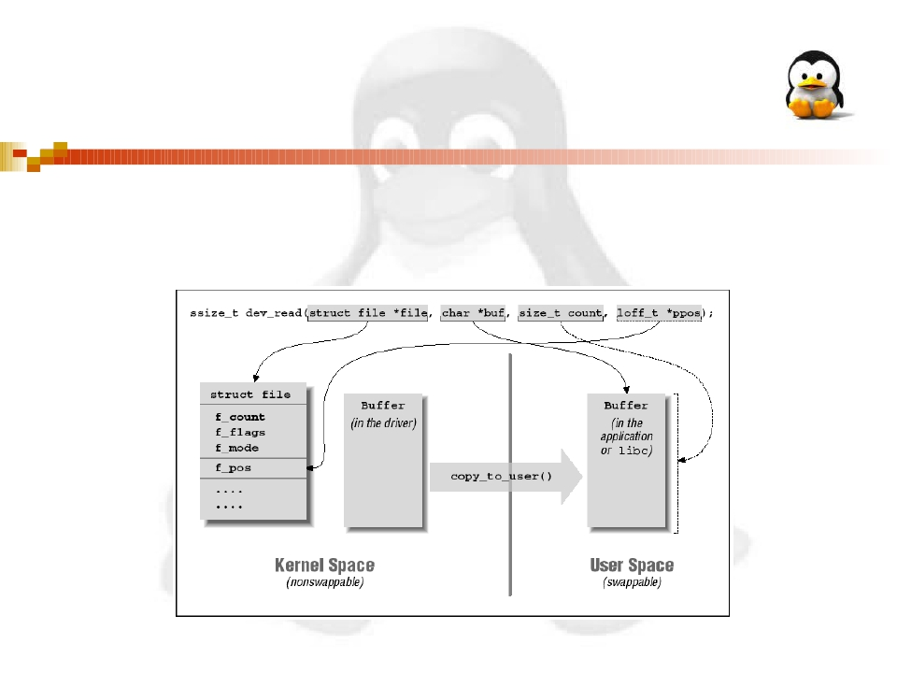
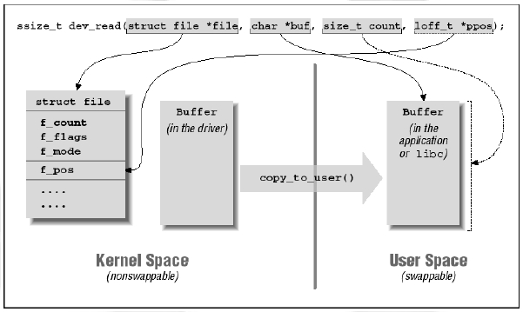
Kernel space to User space
ν
unsigned long copy_to_user(void *to,
const void *from, unsigned long
count);
36

Slide 38
User space to Kernel space
ν
unsigned long copy_from_user(void
*to, const void *from, unsigned long
count);
37

Slide 39

Contents
ν
ν
ν
ν
ν
Major and Minor number
Important Structures
Open and Release
Read and Write
Device Filesystem
38

Slide 40
Device filesystem
ν
Version 2.4 of the kernel
♦introduced
a new (optional) feature, the
device file system or devfs.
If this file system is used,
management of device files is
simplified and quite different;
ν
39

Slide 41
Advantage of devfs
ν
Device entry points in /dev are
created at device initialization and
removed at device removal.
ν There is no need to allocate a major
number for the device driver and
deal with minor numbers.
40

Slide 42
Devfs functions
ν
ν
ν
devfs_handle_t devfs_mk_dir
(devfs_handle_t dir, const char *name,
void *info);
devfs_handle_t devfs_register
(devfs_handle_t dir, const char *name,
unsigned int flags, unsigned int major,
unsigned int minor, umode_t mode, void
*ops, void *info);
void devfs_unregister (devfs_handle_t de);
41

Slide 43
Thank You!
42

