Slide 1


Linux Device Driver
(Block Devices)

Slide 2

Contents
ν
ν
ν
ν
ν
ν
Registering the Driver
blk.h
Handling request
Mount and umount
Ioctl
Removable devices
2

Slide 3


Block device
ν
ν
ν
Like char devices, block devices are
accessed by filesystem nodes in the /dev
directory.
A block device is something that can host
a filesystem, such as a disk.
A block device can be accessed only as
multiples of a block,
♦ A block is usually one kilobyte of data or
another power of 2.
3

Slide 4
Registering the driver
ν
Like char drivers, block drivers in the
kernel are identified by major
numbers.
ν Block major numbers are entirely
distinct from char major numbers.
♦A
block device with major number 32
can coexist with a char device using the
same major number since the two
ranges are separate.
4

Slide 5
Registering the driver
νint
register_blkdev(unsigned int
major, const char *name, struct
block_device_operations *bdops);
νint unregister_blkdev(unsigned int
major, const char *name);
νThey are defined in <linux/fs.h>.
5

Slide 6
block_device_operations
struct block_device_operations
{
int (*open) (struct inode *inode, struct file *filp);
int (*release) (struct inode *inode, struct file *filp);
int (*ioctl) (struct inode *inode, struct file
*filp,unsigned command, unsigned long
argument);
int (*check_media_change) (kdev_t dev);
int (*revalidate) (kdev_t dev);
};
6

Slide 7
Block device read/write
ν
ν
ν
There are no read or write operations
provided in the block_device_operations
structure.
All I/O to block devices is normally
buffered by the system.
User processes do not perform direct I/O to
these devices.
♦ User-mode access to block devices usually is
implicit in filesystem operations they perform
(those operations clearly benefit fromI/O
buffering).
♦ However, even ‘‘direct’’ I/O to a block device,
such as when a filesystem is created, goes
through the Linux buffer cache.
7

Slide 8
Block device read/write
ν
The kernel provides a single set of
read and write functions for block
devices, and drivers do not need to
worry about them.
ν In Linux, the method used for these
I/O operations is called request.
ν The request method handles both
read and write operations and can be
somewhat complex.
8

Slide 9
Request method
ν
ν
ν
ν
For the purposes of block device
registration, however, we must tell
the kernel where our request method
is.
blk_init_queue(request_queue_t *queue,
request_fn_proc *request);
blk_cleanup_queue(request_queue_t
*queue);
They are defined in <linux/blkdev.h>
9

Slide 10
Device request queue
ν
Each device has a request queue
that it uses by default.
ν BLK_DEFAULT_QUEUE(major)
♦It
is used to indicate that queue when
needed.
♦This macro looks into a global array of
blk_dev_struct structures.
10

Slide 11
Sample
ν
blk_init_queue(BLK_DEFAULT_QUEUE
(major), sbull_request);
11

Slide 12
blk_dev_struct
struct blk_dev_struct
{
request_queue_t request_queue;
queue_proc *queue;
void *data;
};
ν
ν
The request_queue member contains the I/O
request queue.
The data field may be used by the driver for its
own data.
12

Slide 13
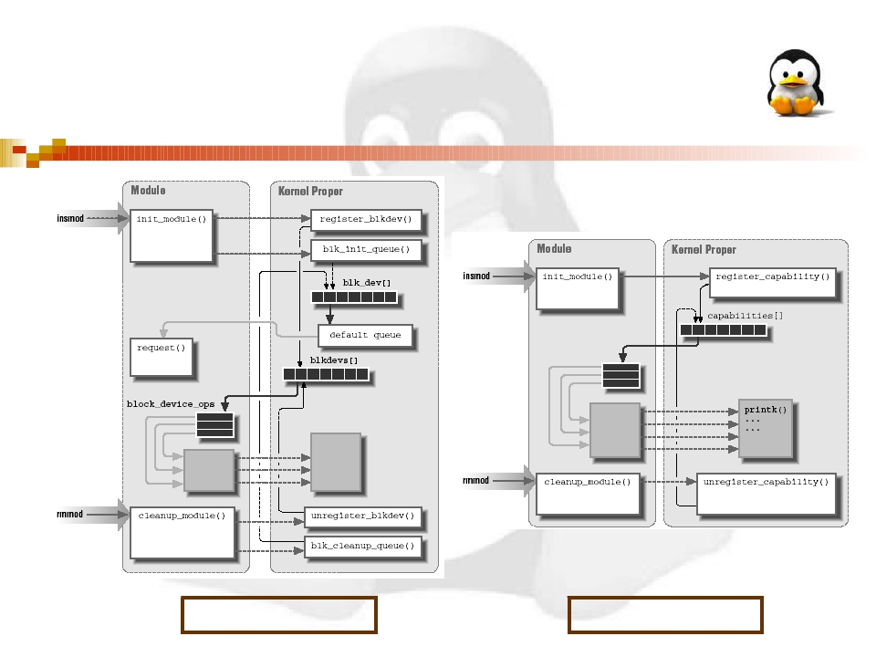
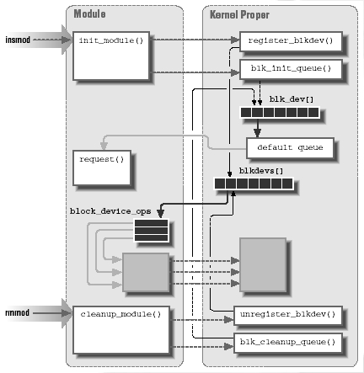
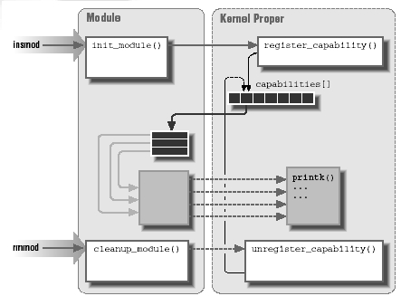
Block vs Character
Block Device
Char Device
13

Slide 14
Block device global arrays
ν
ν
struct blk_dev_struct blk_dev[]
int blk_size[][]
♦ It
describes the size of each device, in kilobytes.
ν
int blksize_size[][]
♦ The
size of the block used by each device, in
bytes.
int hardsect_size[][]
ν
♦ The
size of the hardware sector used by each
device, in bytes.
14

Slide 15
Block device global arrays
ν
int read_ahead[] and int
max_readahead[][]
♦ These
read.
arrays define the number of sectors to be
ν
int max_sectors[][]
♦ This
array limits the maximumsize of a single
request.
int max_segments[]
ν
♦ This
array controlled the number of individual
segments that could appear in a clustered
request.
15

Slide 16
Sample
read_ahead[major] = sbull_rahead;
sbull_sizes = kmalloc(sbull_devs * sizeof(int), GFP_KERNEL);
for (i=0; i < sbull_devs; i++)
sbull_sizes[i] = sbull_size;
blk_size[major]=sbull_sizes;
sbull_blksizes = kmalloc(sbull_devs * sizeof(int), GFP_KERNEL);
for (i=0; i < sbull_devs; i++)
sbull_blksizes[i] = sbull_blksize;
blksize_size[major]=sbull_blksizes;
sbull_hardsects = kmalloc(sbull_devs * sizeof(int),
GFP_KERNEL);
for (i=0; i < sbull_devs; i++)
sbull_hardsects[i] = sbull_hardsect;
hardsect_size[major]=sbull_hardsects;
16

Slide 17
Register disk
ν
ν
ν
One last thing that must be done is to
register every ‘‘disk’’ device provided by
the driver.
register_disk(struct gendisk *gd, int drive,
unsigned minors, struct
block_device_operations *ops, long size);
A block driver without partitions will work
without this call in 2.4.0, but it is safer to
include it.
17

Slide 18
Sample
for (i = 0; i < sbull_devs; i++)
register_disk(NULL,
MKDEV(major, i), 1, &sbull_bdops,
sbull_size << 1);
18

Slide 19
Cleanup block device
νThe
call to fsync_dev is
needed to free all
references to the device
that the kernel keeps in
various caches.
19

Slide 20
Sample
for (i=0; i<sbull_devs; i++)
fsync_dev(MKDEV(sbull_major, i));
unregister_blkdev(major, "sbull");
blk_cleanup_queue(BLK_DEFAULT_QUEUE(major));
read_ahead[major] = 0;
kfree(blk_size[major]);
blk_size[major] = NULL;
kfree(blksize_size[major]);
blksize_size[major] = NULL;
kfree(hardsect_size[major]);
hardsect_size[major] = NULL;
20

Slide 21

Contents
ν
ν
ν
ν
ν
ν
Registering the Driver
blk.h
Handling request
Mount and umount
Ioctl
Removable devices
21

Slide 22
The Header File blk.h
ν
All block drivers should include the
header file <linux/blk.h>.
ν This file defines much of the common
code that is used in block drivers.
ν It provides functions for dealing with
the I/O request queue.
22

Slide 23
Module compile notes
νthe
blk.h header is quite unusual.
νIt defines several symbols based
on the symbol MAJOR_NR.
♦It
must be declared by the driver
before it includes the header.
23

Slide 24
blk.h symbols
ν
MAJOR_NR
♦
This symbol is used to access a few arrays.
ν
DEVICE_NAME
♦
The name of the device being created.
ν
DEVICE_NR(kdev_t device)
♦
♦
This symbol is used to extract the ordinal number of the
physical device from the kdev_t device number.
The value of this macro can be MINOR(device).
ν
DEVICE_INTR
♦
This symbol is used to declare a pointer variable that
refers to the current bottom-half handler.
24

Slide 25
blk.h symbols
ν
DEVICE_ON(kdev_t device) & DEVICE_OFF(kdev_t device)
♦
These macros are intended to help devices that need to perform
processing before or after a set of transfers is performed.
♦ for example, they could be used by a floppy driver to start the
drive motor before I/O and to stop it afterward.
DEVICE_NO_RANDOM
ν
♦
By default, the function end_request contributes to system
entropy, which is used by /dev/random.
♦ If the device isn’t able to contribute significant entropy to the
random device, DEVICE_NO_RANDOM should be defined.
DEVICE_REQUEST
ν
♦
Used to specify the name of the request function used by the
driver.
25

Slide 26
Sample
#define MAJOR_NR sbull_major
static int sbull_major;
#define DEVICE_NR(device) MINOR(device)
#define DEVICE_NAME "sbull"
#define DEVICE_INTR sbull_intrptr
#define DEVICE_NO_RANDOM
#define DEVICE_REQUEST sbull_request
#define DEVICE_OFF(d)
#include <linux/blk.h>
26

Slide 27

Contents
ν
ν
ν
ν
ν
ν
Registering the Driver
blk.h
Handling request
Mount and umount
Ioctl
Removable devices
27

Slide 28
Request function
ν
The most important function in a
block driver is the request function.
ν It performs the low-level operations
related to reading and writing data.
28

Slide 29
Request queue
ν
When the kernel schedules a data
transfer, it queues the request in a
list, ordered in such a way that it
maximizes system performance.
ν The queue of requests is passed to
the driver’s request function.
ν void request_fn(request_queue_t
*queue);
29

Slide 30
Request function tasks
ν
ν
ν
Check the validity of the request. This test is
performed by the macro INIT_REQUEST.
Perform the actual data transfer.
♦ The CURRENT variable (a macro, actually) can be
used to retrieve the details of the current request.
Clean up the request just processed.
♦ This
operation is performed by end_request.
ν
Loop back to the beginning, to consume the
next request.
30

Slide 31
Sample
void sbull_request(request_queue_t *q)
{
while(1)
{
INIT_REQUEST;
printk("<1>request %p: cmd %i sec %li (nr. %li)\n",
CURRENT,
CURRENT->cmd,
CURRENT->sector,
CURRENT->current_nr_sectors);
end_request(1);
}
}
31

Slide 32
CURRENT
ν
ν
CURRENT is a pointer to struct request.
kdev_t rq_dev;
♦ The
device accessed by the request.
ν
ν
int cmd;
♦ This field describes the operation to be
performed; it is either READ or WRITE.
unsigned long sector;
♦ The number of the first sector to be transferred
in this request.
32

Slide 33
CURRENT
ν
ν
ν
unsigned long current_nr_sectors &
unsigned long nr_sectors;
♦ The number of sectors to transfer for the
current request.
char *buffer;
♦ The area in the buffer cache to which data
should be written or read.
struct buffer_head *bh;
♦ The structure describing the first buffer in the
list for this request.
33

Slide 34
Sample
void sbull_request(request_queue_t *q)
{
while(1)
{
INIT_REQUEST; /* returns when queue is empty */
status = sbull_transfer(device, CURRENT);
end_request(status);
}
}
//----------------------------------------------------------------------
static int sbull_transfer(Sbull_Dev *dev, const struct request *req)
{
ptr = device->data + req->sector * sbull_hardsect;
size = req->current_nr_sectors * sbull_hardsect;
switch(req->cmd)
{
case READ:
memcpy(req->buffer, ptr, size); /* from sbull to buffer */
return 1;
case WRITE:
memcpy(ptr, req->buffer, size); /* from buffer to sbull */
return 1;
}
}
34

Slide 35

Contents
ν
ν
ν
ν
ν
ν
Registering the Driver
blk.h
Handling request
Mount and umount
Ioctl
Removable devices
35

Slide 36
Mount
ν
ν
ν
When the kernel mounts a device in the
filesystem, it invokes the normal open methodto
access the driver.
in this case both the filp and inode arguments to
open are dummy variables.
In the file structure, only the f_mode and f_flags
fields hold anything meaningful.
♦
The value of f_mode tells the driver whether the device
is to be mounted read-only (f_mode == FMODE_READ)
or read/write (f_mode == (FMODE_READ|
FMODE_WRITE)).
ν
In the inode structure only i_rdev may be used.
36

Slide 37
Umount
νAs
far as umount is concerned, it
just flushes the buffer cache and
calls the release driver method.
νThere is no meaningful filp to
pass to the release method.
37

Slide 38

Contents
ν
ν
ν
ν
ν
ν
Registering the Driver
blk.h
Handling request
Mount and umount
Ioctl
Removable devices
38

Slide 39
The ioctl method
ν
The only relevant difference between
block and char ioctl implementations
is that block drivers share a number
of common ioctl commands that
most drivers are expected to
support.
39

Slide 40
Common commands
ν
ν
BLKGETSIZE
♦ Retrieve the size of the current device,
expressed as the number of sectors.
BLKFLSBUF
♦ Literally,
‘‘flush buffers.’’
ν
BLKRRPART
♦ Reread
the partition table.
ν
BLKRAGET & BLKRASET
♦ Used to get and change the current block-level
read-aheadvalue for the device.
40

Slide 41
Common commands
ν
ν
ν
ν
BLKFRAGET & BLKFRASET
♦ Get and set the filesystem-level read-ahead
value.
BLKROSET & BLKROGET
♦ used to change and check the read-only flag for
the device.
BLKSECTGET & BLKSECTSET
♦ retrieve and set the maximum number of sectors
per request.
BLKSSZGET
♦ Returns
the sector size of this block device.
41

Slide 42
Common commands
ν
ν
ν
BLKPG
♦Allows user-mode programs to add and
delete partitions.
BLKELVGET & BLKELVSET
♦These commands allow some control over
how the elevator request sorting
algorithm works.
HDIO_GETGEO
♦Used
to retrieve the disk geometry.
42

Slide 43
Sample
int sbull_ioctl (struct inode *inode, struct file *filp, unsigned int cmd, unsigned long arg)
{
struct hd_geometry geo;
switch(cmd)
{
case BLKGETSIZE:
size = blksize*sbull_sizes[MINOR(inode->i_rdev)]/sbull_hardsects[MINOR(inode-
>i_rdev)];
copy_to_user((long *) arg, &size, sizeof (long));
return 0;
case BLKRRPART:
return -ENOTTY;
case HDIO_GETGEO:
size = sbull_size * blksize / sbull_hardsect;
geo.cylinders = (size & ˜0x3f) >> 6;
geo.heads = 4;
geo.sectors = 16;
geo.start = 4;
copy_to_user((void *) arg, &geo, sizeof(geo));
return 0;
}
}
43

Slide 44

Contents
ν
ν
ν
ν
ν
ν
Registering the Driver
blk.h
Handling request
Mount and umount
Ioctl
Removable devices
44

Slide 45
check_media_change
ν
The checking function receives kdev_t
as a single argument that identifies
the device.
ν The return value is 1 if the medium
has been changed and 0 otherwise.
45

Slide 46
Sample
int sbull_check_change(kdev_t i_rdev)
{
int minor = MINOR(i_rdev);
Sbull_Dev *dev = sbull_devices + minor;
if (dev->data)
return 0; /* still valid */
return 1; /* expired */
}
46

Slide 47
Revalidation
ν
The validation function is called when
a disk change is detected.
47

Slide 48
Sample
int sbull_revalidate(kdev_t i_rdev)
{
Sbull_Dev *dev = sbull_devices + MINOR(i_rdev);
if (dev->data)
return 0;
dev->data = vmalloc(dev->size);
if (!dev->data)
return -ENOMEM;
return 0;
}
48

Slide 49
Thank You!
49

