Slide 1
Introduction to Linux Network
劉德懿
danny@cmlab.csie.ntu.edu.tw

Slide 2
Outline
OSI and TCP/IP Overview
Linux Networking Layers
BSD Socket Interface
INET Socket Interface
An Example of Socket Programming

Slide 3
OSI Overview
OSI (Open Systems Interconnection)
See Figures…

Slide 4
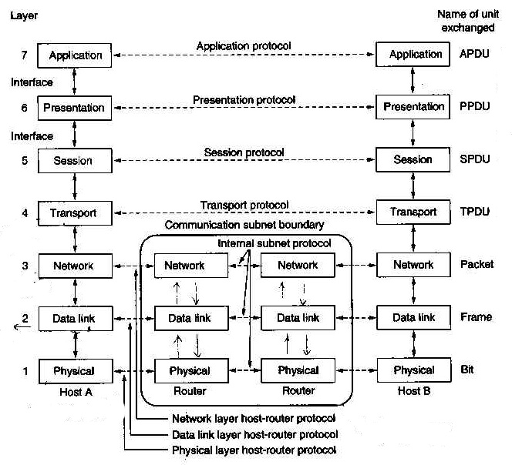

Slide 5
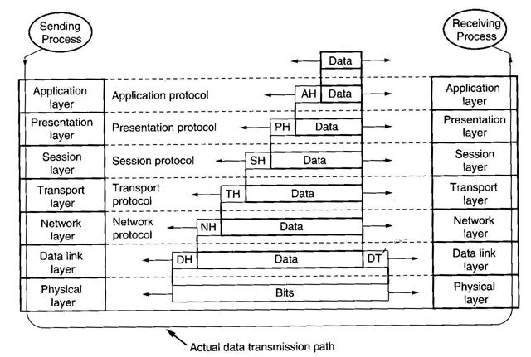

Slide 6
TCP/IP Model
OSI TCP/IP
7
6
5
4
3
2
1
Application
Presentation
Session
Transport
Network
Data Link
Physical
Application
Transport
Internet
Host-to-Network
Not present
TCP
IP

Slide 7
TCP Overview
TCP (Transmission Control Protocol)
  Connection-Oriented
  Reliable Protocol
UDP (User Datagram Protocol)
  Connectionless
  Unreliable Protocol

Slide 8
IP Overview
32-bit Unique IP Address
  Network Address
  Subnet Address
  Host Address
Gateway
(Router)
140.112.28.XX
140.112.30.XX

Slide 9
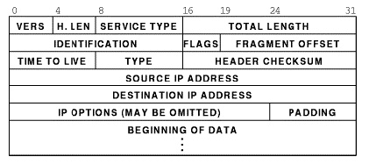
IP Overview (cont.)
IP Header

Slide 10
Ethernet Layer
48-bit Unique Device Address
ARP (Address Resolution Protocol)
multicast
multicast
multicast
multicast

Slide 11
Linux Networking Layers
Support Mechanism
  Various Networking
  Inter-Process Communication
A Special Kind of Pipe
Support Several Address Family…
Support Several Socket Type…

Slide 12
Addr Family | Description
UNIX | Unix domain sockets
INET | Internet address family support TCP(UDP)/IP
AX25 | Amateur radio X25
IPX | Novell IPX
APPLETALK | Appletalk DDP
X25 | X25

Slide 13
Socket Type | Description
Stream | Reliable, Sequenced, Like TCP
Datagram | Unreliable, Not sequenced, Like UDP
Reliable Delivered Messages | Like datagram but reliable
Sequenced Packet | Like Stream but fixed size packet

Slide 14
Network Applications
User
Kernel
BSD Sockets
Socket Interface
INET Sockets
TCP
UDP
Protocol Layers
IP
ARP
Network Devices
PPP
SLIP
Ethernet

Slide 15
Client/Server Communication
Client
Server
Connect
4. Create a socket
1. Create a socket
Accept
2. Bind an addr
3. Listen the client
Send
Recv

Slide 16
BSD Socket API
See An Example

Slide 17
BSD Initialization
void __init proto_init(void)

Slide 18
The INET Layer
BSD Socket
  A part of VFS inode
  A socket can be operated just the same as a file by system call read(), write(), lseek()…
INET Layer use sock data structure to handle BSD socket

Slide 19
Creating a BSD Socket
For both client and server
int socket(int family, int type, int protocol)
  Ex. fd=Socket(AF_INET, SOCK_STREAM,0);

Slide 20
files_struct
count
close_on_exec
open_fs
fd[0]
fd[1]
fd[255]
file
BSD Socket
File Operations
f_mode
f_pos
f_flags
f_count
f_owner
f_op
f_inode
f_version
lseek
read
write
select
ioctl
close
fasync
inode
socket
type
protocol
data (sk)
SOCK_STREAM
Address Family
socket operations
SOCK_STREAM
sock
type
protocol
socket
Linux BSD Socket Data Structure

Slide 21
Binding an Address
Only for Server
Int bind(int sockfd, const struct sockaddr *address, size_t add_len)
Port Number is optional for binding
socket.socket_state = TCP_CLOSE;
The bound socket can’t be used for other communication

Slide 22
Binding an Address (cont.)
The bound addr was saved in sock.rcv_saddr
UDP maintains a hash table udp_hash to allocate UDP port
TCP doesn’t add the binding sock to hash table during binding operation

Slide 23
Listening
Only for server
int listen(int sockfd, int queue_size)
socket.socket_state = TCP_LISTEN;
Add the sock to tcp_bound_hash and tcp_listening_hash

Slide 24
Listening (cont.)
After receiving client’s request
  Server build a new sock
  Clones the incoming sk_buff and queues it to the listening sock.receive_queue

Slide 25
Connecting
Only for client
Before connecting,
socket.socket_state = SS_UNCONNECTED;
Int connect(int csockfd, const struct sockaddr *address, size_t add_len)
Add the sock to tcp_listening_hash waiting for server’s response

Slide 26
Accepting
Only for server
int accept(int sockfd, struct sockaddr *address, size_t *add_len)
A new socket was cloned from the listening socket

Slide 27
Accepting (cont.)
If there are no incoming connection to accept
  Non-Blocking—accept operation failed and throw away the new socket
  Blocking—accept operation was added to the wait queue

Slide 28
next
prev
dev
head
data
tail
end
Packet to be transmitted
sk_buffer structure
Push
Pull
Put
Trim
len
truesize

Slide 29
References
The Linux Kernel, chapter 10
Linux Kernel Internals, chapter 8
Unix System Programming, chapter 10
Computer Networks, chapter 1, 5, 6

