Slide 1
CLASSCUE · EXPERIENCE CONCEPT
A calmer way to keep every child’s classes moving
Phone-first user journeys for schedules, attendance, punctuality, fees and reminders.
SCHEDULES ATTENDANCE FEES PARENT CONTROL
17 JULY 2026
CLASSCUE · USER JOURNEY 01

Slide 2
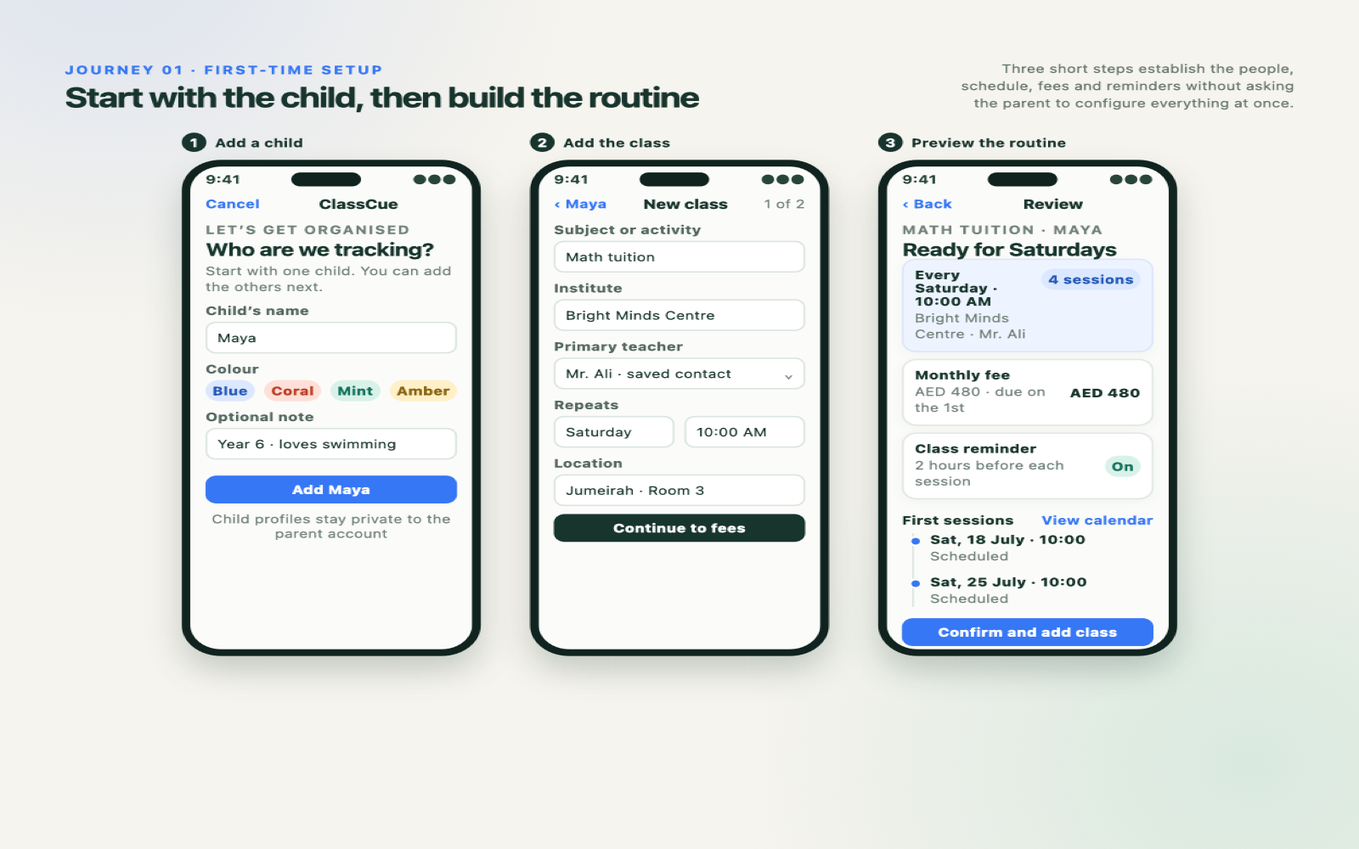
CLASSCUE · USER JOURNEY 02

Slide 3
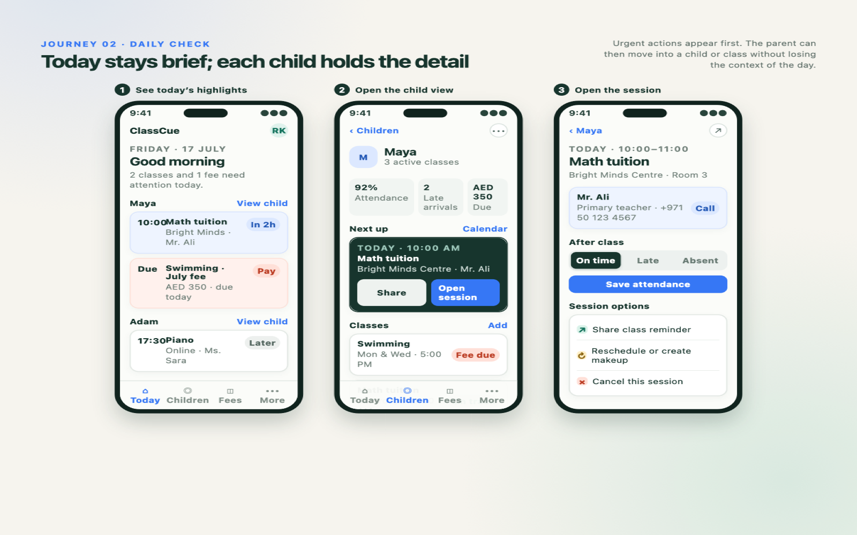
CLASSCUE · USER JOURNEY 03

Slide 4
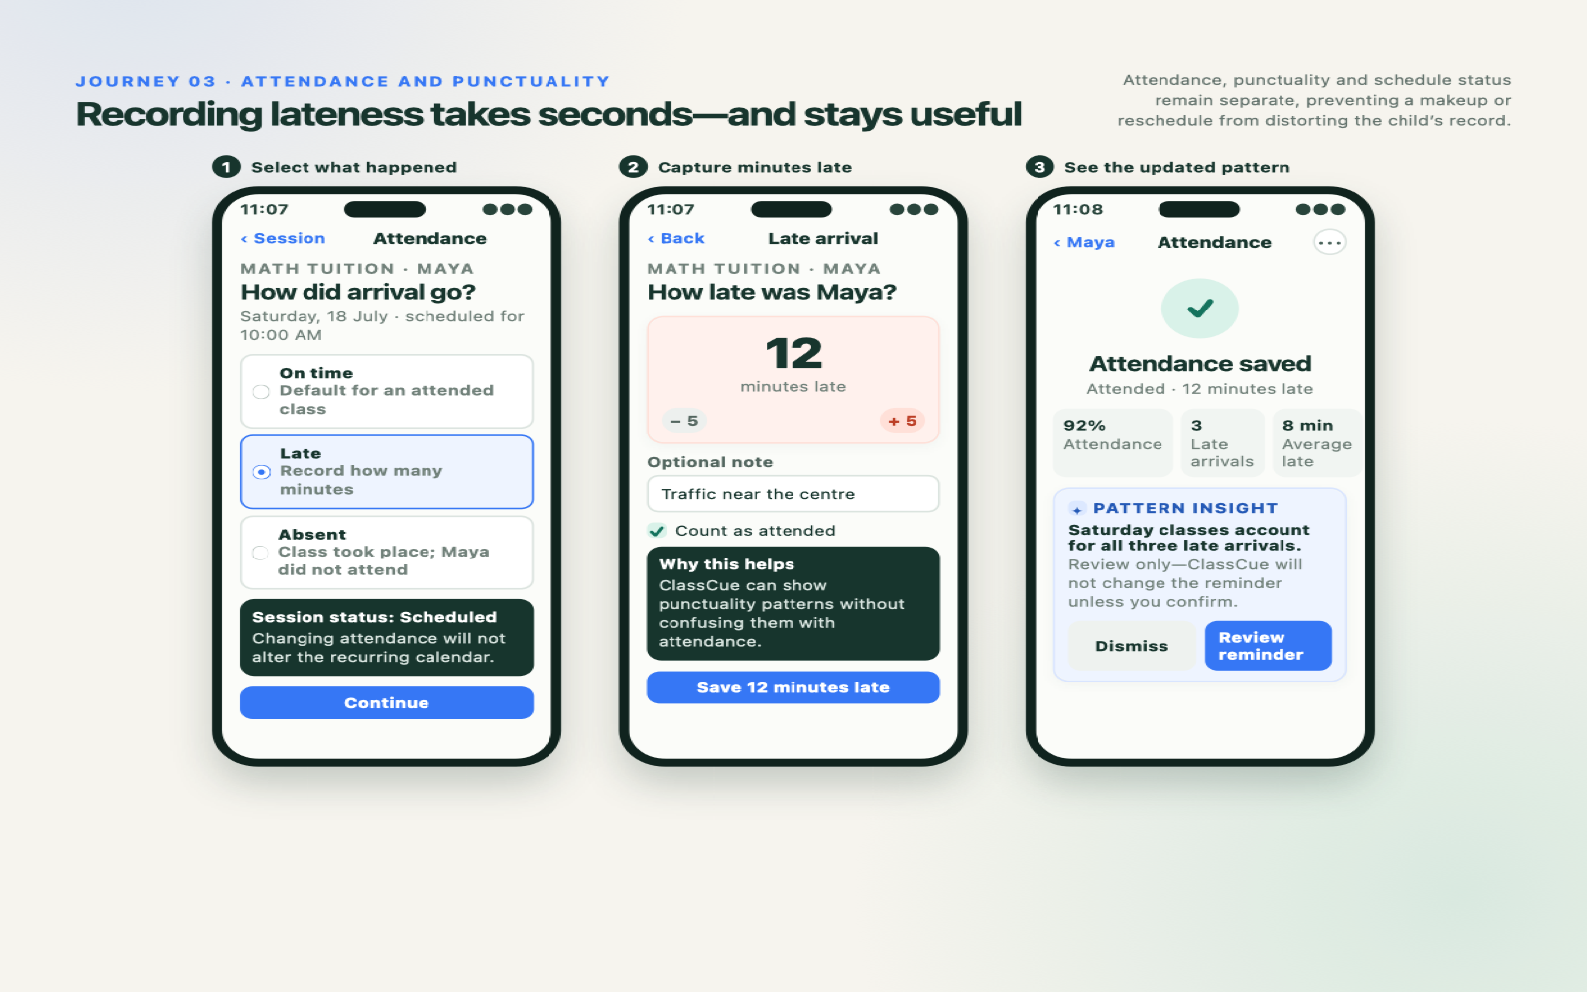
CLASSCUE · USER JOURNEY 04

Slide 5
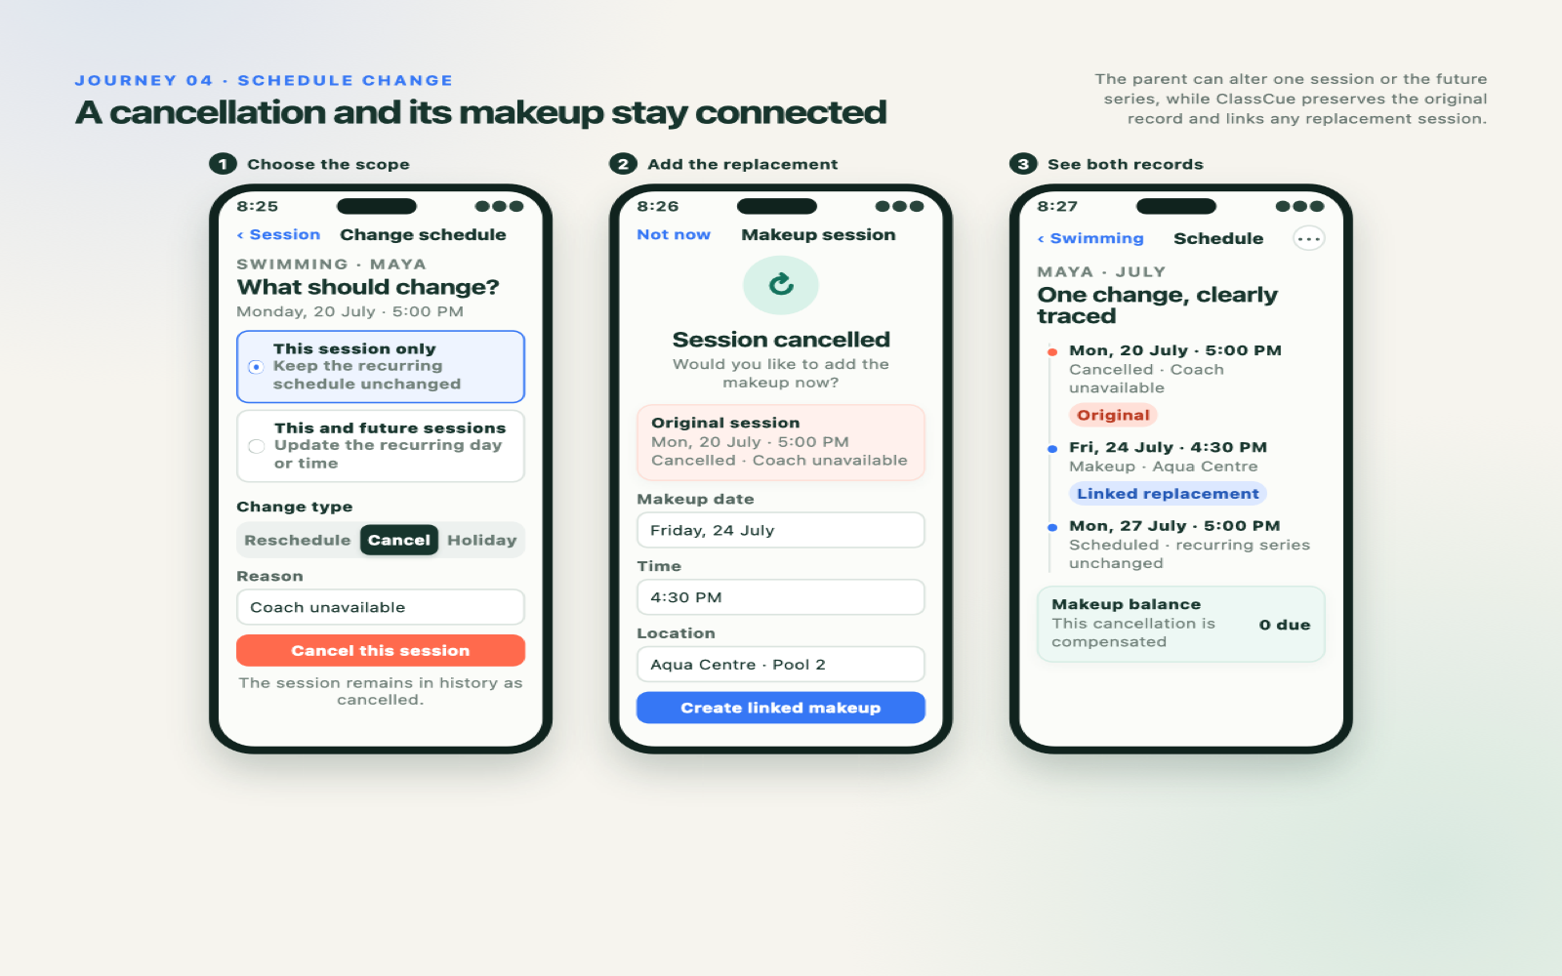
CLASSCUE · USER JOURNEY 05

Slide 6
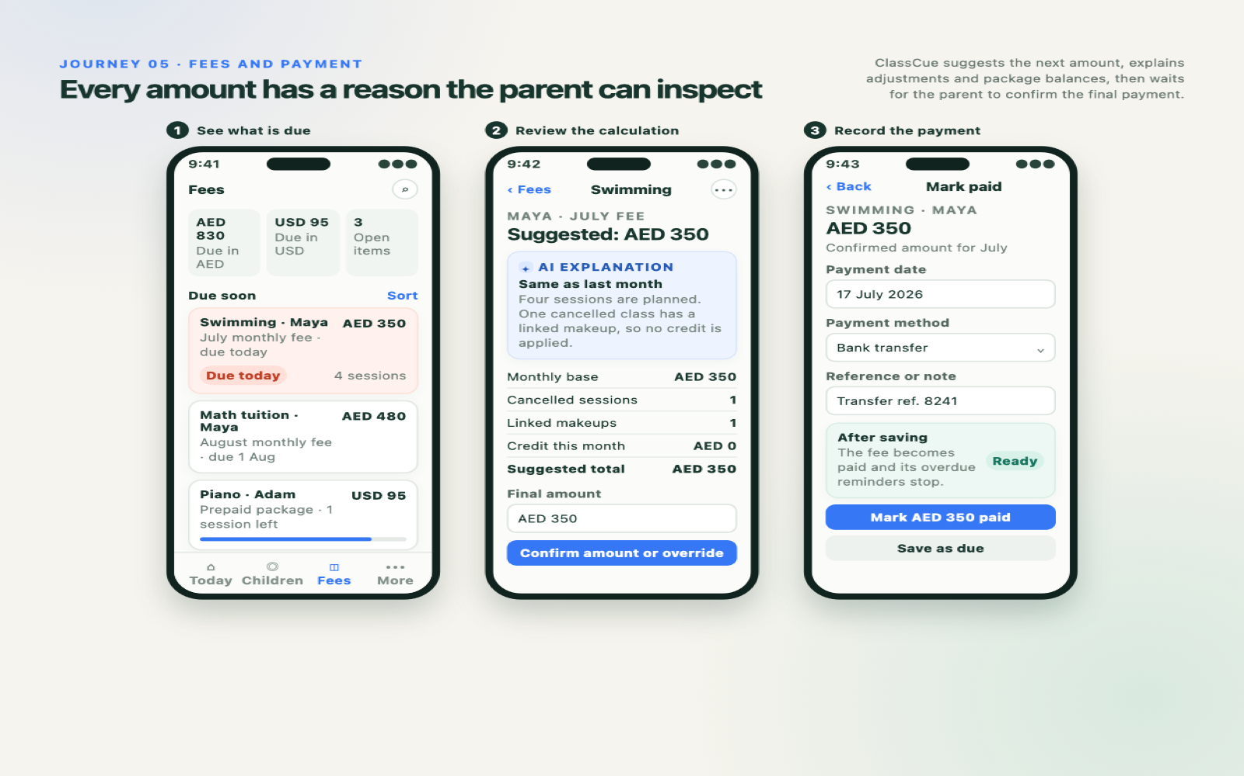
CLASSCUE · USER JOURNEY 06

Slide 7
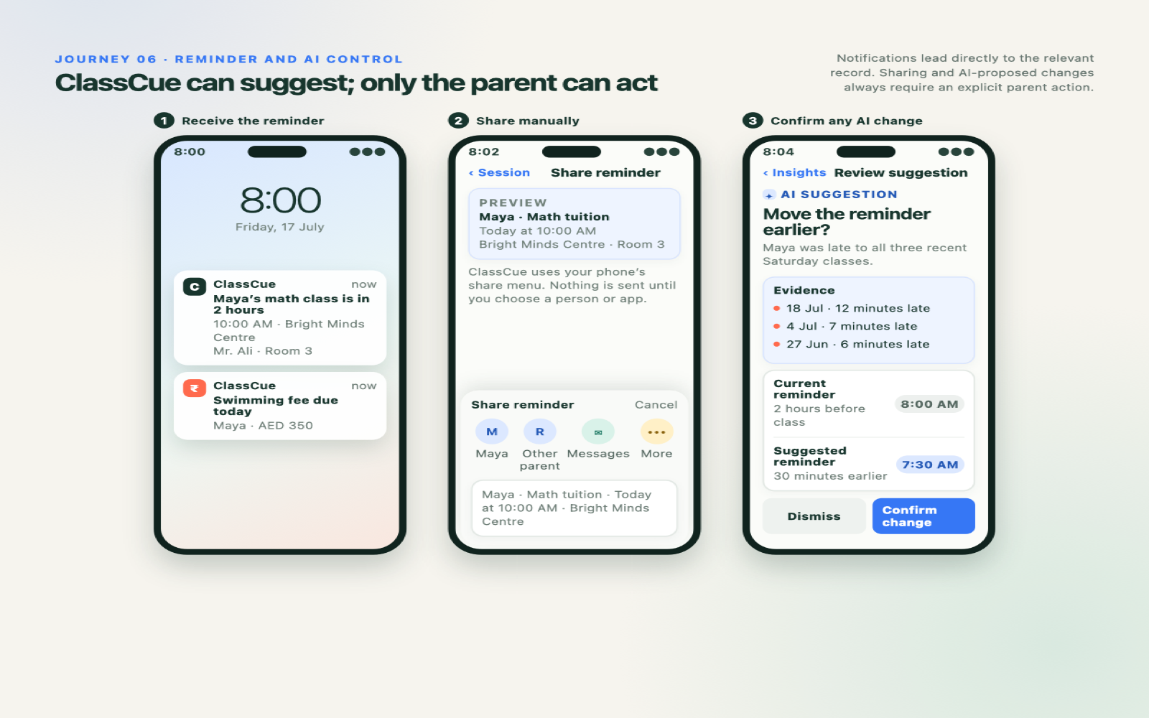
CLASSCUE · USER JOURNEY 07

Slide 8
THE BUILD SHOULD PROTECT THREE IDEAS
Simple daily actions. Trustworthy history. Parent control.
01
Today shows only what needs attention now; detailed history lives with each child.
02
Session status, attendance and punctuality remain separate—and explainable.
03
AI may suggest and explain; only the parent can change records or share information.
NEXT · Convert these journeys into the architecture, data model and MVP build plan.
CLASSCUE · USER JOURNEY 08

